Slide 1
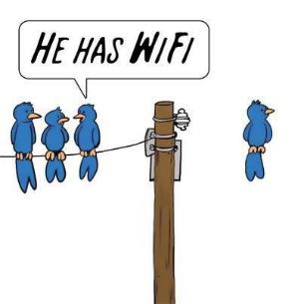

Campus WiFi Project
A Data Science for Social Good-Atlanta Project by Daniel García, Daniel Sedra, and Richard Zheng
Advised by Dr. Russ Clark, Matt Sanders

Slide 2


Campus WiFi
Objective
Analyze WiFi data to estimate:
Space utilization
People’s behavior
Clustering pattern
Migration pattern
Data Sources
WiFi authentication logs
Access Point location
Username and Device ID
Timestamps
Observation
External data sources

Slide 3
Preliminary Analysis
Challenge
Choice of access point
Inconsistent connection
Limitation of observation result
What we did
A heuristic estimation of population
A cluster of access points – the “Field”
Scenario based analysis
Pilot analysis in CULC Starbucks

Slide 4
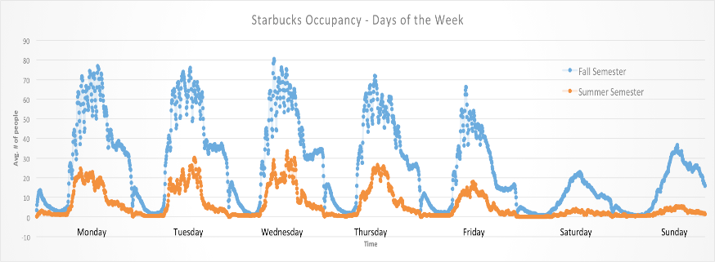
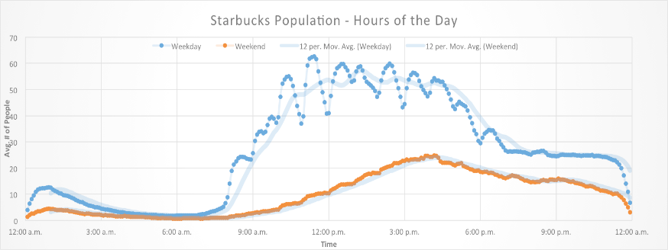

Slide 5
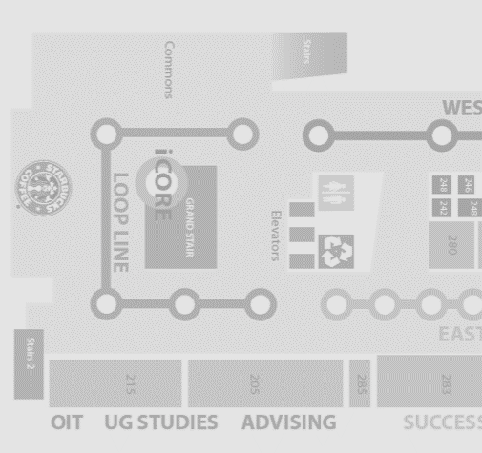
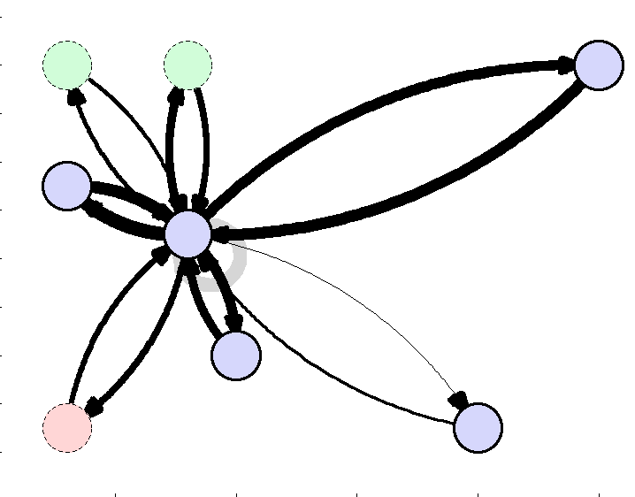
AP in 3rd floor
AP in 2nd floor
AP in 1st floor

Slide 6
What’s next ?
Estimation Model improvement
Sequence clustering analysis on pathway
Logistic regression on ‘Field’ selection
Population & space utilization prediction
Time series regression based forecasting
Analysis with more datasets
Migration patterns
Campus space utilization
More generalized applications

Slide 7


