Slide 1
NEBIUS × VOXEL51 · MUNICH · 23 SEPTEMBER 2026
From raw robot logs
to a trained detector
A hands-on Physical AI workshop: real DROID recordings, open-source FiftyOne, GPUs on Nebius.
Daniel Gural — Partnership Engineering, Voxel51 · Impact Hub Munich
Nebius × Voxel51 · Physical AI Workshop
1
Notes:
Start on time. Repo QR is on the next slide; people will still be installing. Say the Nebius Builder Program early: it comes back at the end with a city-specific QR.

Slide 2
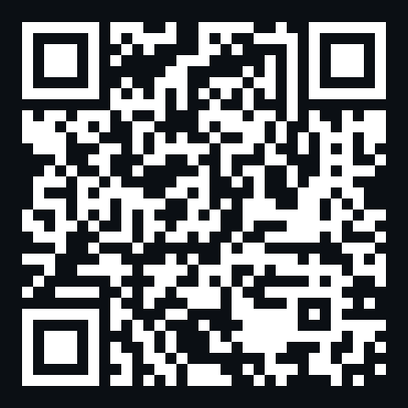
FOLLOW ALONG
Everything you need is one repo away
git clone https://github.com/danielgural/physical-ai-workshop
cd physical-ai-workshop
python -m venv .venv && source .venv/bin/activate
pip install -r requirements.txt
python notebooks/download_data.py # 1.1 GB, once
jupyter lab notebooks/
• Laptop CPU is enough. Every GPU step's output is already in the datasets you download.
• Slow wifi? USB sticks at the front: python notebooks/download_data.py --from-usb /Volumes/WORKSHOP
github.com/danielgural/physical-ai-workshop
Nebius × Voxel51 · Physical AI Workshop
2
Notes:
Leave this up during the whole setup chatter. The download is 1.1 GB; anyone who did not pre-download should start now and can watch the first two segments. USB sticks are at the front.

Slide 3
WHY WE ARE HERE
Physical AI has a data problem. It is not collection.
• Every demonstration is expensive — human teleop time; you cannot just collect more.
• Quality lives at the episode level — failed grasps, occluded cameras, teleop glitches, degenerate 2-second 'successes'.
• Nobody looks — a recording is a 60 MB binary blob; without tooling it never gets opened.
• The model is rarely the bottleneck — whether anyone has looked at the data is.
Nebius × Voxel51 · Physical AI Workshop
3
Notes:
Land the question: when did you last watch 20 random episodes from your training set? Most robotics teams cannot answer. That is the whole workshop.

Slide 4
TODAY
The loop every serious robotics team runs
see
›
curate
›
embed
›
label
›
train
›
evaluate
100 DROID robot-arm episodes. Two hours. Open-source FiftyOne on your laptop for the interactive steps; Nebius Serverless AI Jobs for the GPU steps. The same loop, pointed at millions of episodes, is what production teams run.
you explore · curate · browse embeddings · review labels · evaluate · tag
Nebius embeddings at scale · YOLO11n fine-tune · (Token Factory: auto-label VLMs)
Nebius × Voxel51 · Physical AI Workshop
4
Notes:
Anchor diagram. Each segment lights one step. Say the split now: I run the GPU steps on Nebius; you run everything else on your laptop with the GPU outputs baked in.

Slide 5
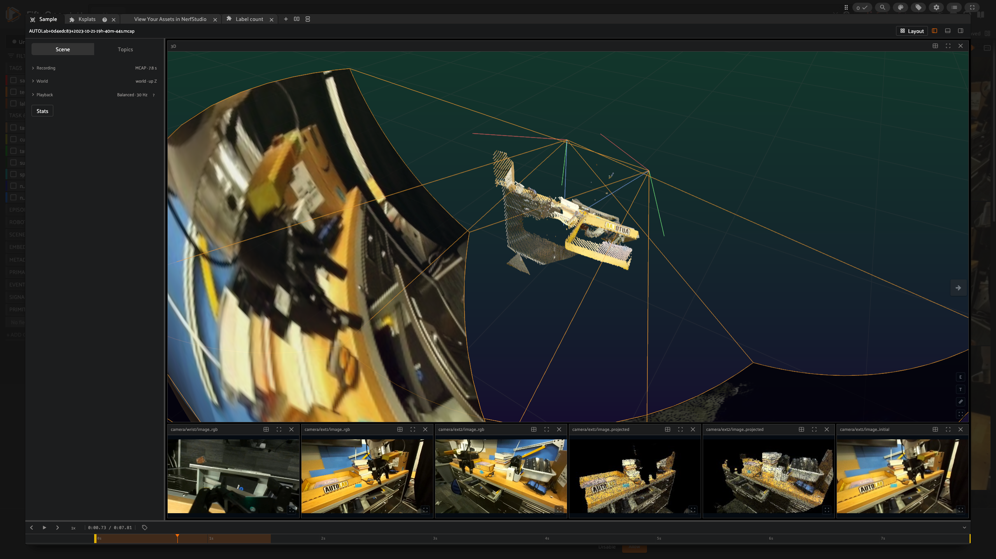
THE DATA
A robot demonstration is not an image
• 3 cameras — wrist + two externals, H.264, synchronized
• Depth + fused point clouds — the scene in 3D
• Joint state, gripper state, end-effector speed — what the arm actually did
• 3D cuboid tracks — labels over time
• One .mcap file — one of 76,000 in DROID, 13 labs
Nebius × Voxel51 · Physical AI Workshop
5
Notes:
DEMO: drag a raw .mcap into the MCAP Explorer panel BEFORE clicking to this slide. 'Nothing was uploaded or converted — the browser is reading the file.'

Slide 6
THE WHOLE TRICK
An episode is a sample
import fiftyone as fo
dataset = fo.Dataset("droid")
dataset.add_samples([fo.Sample("episode-0001.mcap"), ...])
dataset.media_type # "multimodal" — no conversion, no ROS install
Cameras, point clouds, transforms and cuboids are discovered from the file. Fields you add — task, lab, success, joint statistics — make episodes queryable. Temporal tags label a time range, not a frame.
Nebius × Voxel51 · Physical AI Workshop
6
Notes:
The only code slide before the notebooks. FiftyOne ≥ 1.21: multimodal media type. The file is the sample.

Slide 7
see
›
curate
›
embed
›
label
›
train
›
evaluate
10–25 min
Explore a recording
Three cameras and 3D on one clock. Filter episodes like rows. Tag an interval.
you 01_explore_mcap.ipynb
presenter demo.fiftyone.ai · Droid demo (100 episodes)
Nebius × Voxel51 · Physical AI Workshop
7
Notes:
Grid previews → open the hero episode (19h-40m-44s) → arrange wrist / ext / 3D → scrub → click a cuboid → sidebar filter task_type, success → sort duration_s asc → open the 1.4 s and 2.8 s episodes → expand timeline: grasp/release tags → Shift+T, tag arm-stall → match_temporal_tags in the notebook.

Slide 8
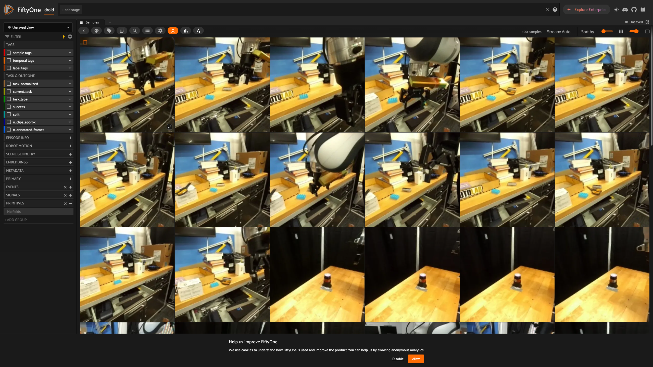
SEE
What is in the ten episodes you downloaded
• A 1.4 s 'multi-step task' — gripper never closed (gripper_open_frac = 1.0). Marked failed. Correctly.
• A 2.8 s 'success' — put brick in drawer and close it, in under three seconds? Look at it.
• grasp / release intervals — 31 temporal tags already on the timeline; queryable with match_temporal_tags().
• Five task families — brick-in-drawer, fold cloth, unhang cloth, clump/unclump, multi-step.
Nebius × Voxel51 · Physical AI Workshop
8
Notes:
What the room should find in the 10 episodes they have. Do not reveal until they have looked.

Slide 9
see
›
curate
›
embed
›
label
›
train
›
evaluate
25–40 min
Curate: frames out of the recording
Decode the camera streams at 1 fps. Filter with robot state. Drop near-duplicates. Save the view.
you 02_curate_frames.ipynb
presenter demo.fiftyone.ai · Droid workshop frames (5,172 frames)
Nebius × Voxel51 · Physical AI Workshop
9
Notes:
Show extract_frames.py briefly: H.264 NAL units → ffmpeg → JPEG, each frame keeps episode_id, camera, timestamp_ns, gripper_open, joint_speed_norm. Then in the App: match gripper_open == False, sort by uniqueness both ways, show the near-duplicate tag, build + save curated_train.

Slide 10
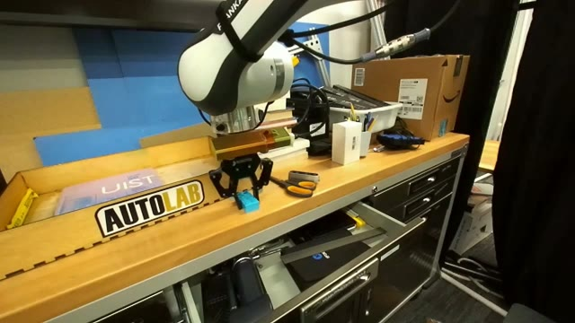
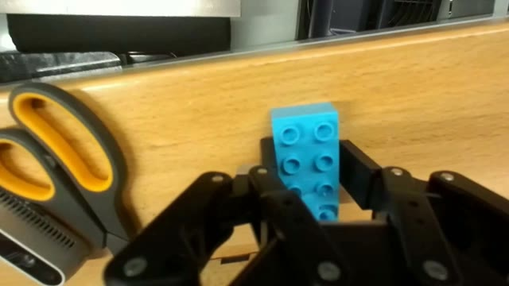
CURATE
Every frame remembers its recording
# build/extract_frames.py
for _, ch, msg, proto in reader.iter_decoded_messages(
topics=["/camera/ext1/image_rgb"]):
ffmpeg.stdin.write(proto.data) # H.264 → fps=1 → 640px JPEG
sample = fo.Sample(filepath=jpg)
sample["episode_id"] = episode.episode_id
sample["camera"] = "ext1"
sample["timestamp_ns"] = t
sample["gripper_open"] = nearest(gripper_state, t)
5,172 frames · 75 episodes · 3 cameras · gripper state and joint speed per frame
Nebius × Voxel51 · Physical AI Workshop
10
Notes:
The frame remembers where it came from. That link is the payoff in segment 6.

Slide 11
see
›
curate
›
embed
›
label
›
train
›
evaluate
40–55 min
Embeddings, similarity, visualization
CLIP on every frame. UMAP to see structure. A similarity index for 'more like this' — and text prompts.
you 03_embeddings.ipynb (runs precomputed)
presenter Nebius Serverless AI Jobs · embeddings at scale
Nebius × Voxel51 · Physical AI Workshop
11
Notes:
Embeddings panel: color by camera (3 worlds), task_type, gripper_open. Lasso an island. Similarity from the most-unique frame. Text prompt 'a robot gripper holding a blue brick'. Say clearly: on the deployment this compute is a Nebius Serverless job; the interactive part is what humans do.

Slide 12
EMBED
Batch on the GPU, interactive on the laptop
• compute_embeddings — one call, any model: CLIP today, Qwen3-VL-Embedding or SigLIP2 tomorrow
• As a Nebius Serverless AI Job — a container reads frames from object storage, writes vectors back; no cluster to keep warm
• Then the brain runs — compute_similarity, compute_visualization, compute_uniqueness, find_duplicates
• The room never waits on a GPU — every run ships in the dataset; you lasso, sort, tag
frames.compute_embeddings(model, embeddings_field="clip"); fob.compute_visualization(frames, embeddings="clip", brain_key="frames_viz")
Nebius × Voxel51 · Physical AI Workshop
12
Notes:
One slide on the split: batch compute lives in a GPU job, humans get the interactive part. If the stretch embeddings job landed, show its console entry here.

Slide 13
see
›
curate
›
embed
›
label
›
train
›
evaluate
55–75 min
Auto-label with open vocabulary
Grounding DINO, prompted with words. 7 labels on 5,172 frames. Humans review the queue, not the corpus.
you 04_autolabel.ipynb
presenter Grounding DINO on the presenter GPU · Token Factory VLMs next
Nebius × Voxel51 · Physical AI Workshop
13
Notes:
Show the prompt string. Count values. Sort gripper boxes by low confidence → this is the review queue. Sanity check: % of wrist frames with a gripper box. Then the split-by-episode rule. Mention Token Factory VLMs as the natural next labeler (Nebius closes on that).

Slide 14
LABEL
Models draft. Humans verify the 5% that matters.
• Prompt, do not annotate — 'robot gripper . robot arm . blue brick . scissors . drawer . cloth . cardboard box'
• Confidence is a field — sort by it; the bottom of the list is your review queue
• Check labels against state — the gripper is in every wrist frame; if boxes are missing, the labeler is wrong, not the data
• Split by episode, never by frame — 1 fps neighbours are near-identical; a frame split leaks
• Curation chose what to label — curated_train, minus near-duplicates, is the training set
Nebius × Voxel51 · Physical AI Workshop
14
Notes:
The 'models draft, humans verify' slide.

Slide 15
PART ONE DONE
Lightning talks. Then we train.
• Right now on Nebius — YOLO11n is fine-tuning on the frames we just labeled (L40S, 15 epochs, ~10 min)
• Part two — pull the weights, evaluate, put detections back on the recording, then Nebius
• Catch up — notebooks 01–04 are what we did; 05–06 are next
github.com/danielgural/physical-ai-workshop
Nebius × Voxel51 · Physical AI Workshop
15
Notes:
END OF PART ONE. The Nebius job was submitted during the embeddings segment; say so: 'a GPU in Finland is training while we listen to the talks.' Repo QR stays up through the break.

Slide 16
see
›
curate
›
embed
›
label
›
train
›
evaluate
75–95 min
Fine-tune YOLO11n on Nebius
Export to YOLO format. Stage on Nebius Object Storage. Submit a Serverless AI Job from a notebook. Pull best.pt.
you 05_train_eval.ipynb (predictions + eval baked in)
presenter Nebius Serverless AI Jobs · L40S · yolo11n.pt · 15 epochs
Nebius × Voxel51 · Physical AI Workshop
16
Notes:
SUBMIT THE JOB before this slide (during segment 4 Q&A). Show presenter/train_on_nebius.ipynb: export cell, upload, submit → job id → Nebius console AI Jobs page → poll states. While it trains: the job spec slide. If late, weights/best-dryrun.pt is the fallback and you say so.

Slide 17
TRAIN
A training job is a container, a bucket and one API call
from presenter.nebius_job import NebiusJob
job = NebiusJob() # IAM token + Object Storage key
job.upload_dir("build/yolo_export", "runs/stuttgart/input")
job_id = job.submit("stuttgart", "runs/stuttgart",
model="yolo11n.pt", epochs=15, imgsz=640,
platform="gpu-l40s-a", preset="1gpu-8vcpu-32gb")
job.wait(job_id) # PROVISIONING → RUNNING → COMPLETED
job.download("runs/stuttgart/output/best.pt", "weights/best.pt")
• Serverless — no cluster; a GPU appears for the job and goes away
• Image — ghcr.io/danielgural/fiftyone-yolo-train, public
• Contract — INPUT_S3_URI · OUTPUT_S3_URI · MODEL · HYPERPARAMS_JSON
• Data — stays in Nebius Object Storage, eu-north1
Nebius × Voxel51 · Physical AI Workshop
17
Notes:
This is the whole job. No orchestrator, no plugin: SDK call, container, bucket.

Slide 18
EVALUATE
Evaluate against the auto-labels — every cell is a view
• evaluate_detections — mAP, per-class P/R, confusion matrix; results live on the samples as eval_yolo_tp / fp / fn
• Click a confusion cell — the grid shows exactly those frames
• Worst-first — sort validation by false positives; open the episodes
• Missed grippers — false negatives grouped by episode tell you what to collect next
results = val.evaluate_detections(
"yolo11n_preds",
gt_field="auto_labels",
eval_key="eval_yolo",
compute_mAP=True)
results.print_report()
Nebius × Voxel51 · Physical AI Workshop
18
Notes:
Model Evaluation panel: click the confusion-matrix cells. Then sort val by eval_yolo_fp. Then the missed grippers — what does the model not see, and which episodes.

Slide 19
see
›
curate
›
embed
›
label
›
train
›
evaluate
95–105 min
Close the loop on the timeline
Detections on frames become temporal tags on the recording. Query the episodes by what the model saw.
you 06_close_the_loop.ipynb
presenter demo.fiftyone.ai · predictions back on Droid demo
Nebius × Voxel51 · Physical AI Workshop
19
Notes:
06 notebook: intervals_from_predictions → brick-visible tags → open an episode: grasp / release / brick-visible rows on the timeline. Rank episodes by mean gripper confidence. Then the flywheel sentence.

Slide 20
WRAP
see
›
curate
›
embed
›
label
›
train
›
evaluate
Same loop. Bigger plumbing.
today, your laptop | → | a production robotics team
10 episodes, 5k frames | → | millions of episodes in a data lake
you scrubbing an episode | → | triage teams on every collection run
CLIP baked into the dataset | → | embedding jobs on Nebius on every ingest
Grounding DINO labels | → | VLM labelers on Token Factory, human verify queues
one YOLO11n on an L40S | → | scheduled fine-tunes gated by curation queries
brick-visible on ten timelines | → | model output as a first-class field on every recording
Nebius × Voxel51 · Physical AI Workshop
20
Notes:
Payoff. Every step mapped to what a production team does. Flywheel: the next collection run gets curated with the views and tags saved today.

Slide 21
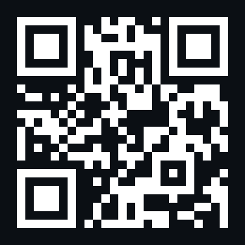
YOUR DATA
Do this on your recordings this week
• pip install fiftyone — drop one of your own .mcap files into the MCAP Explorer. Watch 20 episodes. You will find something.
• Hosted FiftyOne — app.voxel51.com: same App, no install, datasets and brain runs in the cloud
• Take the repo home — extract_frames.py, the notebooks, the Nebius job helper are all yours
app.voxel51.com
Nebius × Voxel51 · Physical AI Workshop
21
Notes:
Two CTAs, in this order: FiftyOne on your own recordings (self-serve QR), then Nebius hands over.

Slide 22
NEBIUS
What else runs on Nebius
The GPU you just watched train a detector is one of three surfaces built for the Physical AI loop.
Nebius × Voxel51 · Physical AI Workshop
22
Notes:
Hand over to Nebius. If Nebius has no speaker at this stop, present 22–25 yourself; content is theirs.

Slide 23
NEBIUS
Three surfaces for the Physical AI loop
Workbench CLI
Serverless AI Jobs
Token Factory
Build, train and deploy Physical AI systems from one open-source CLI — containerized tools, SkyPilot workflows, SDK entry points.
Provision in under three minutes for simulation, synthetic data and policy training. Pay for the job, not a cluster. What you saw today.
Open-weight chat and vision models behind one API — Qwen, GLM, Kimi — for labeling, review and augmentation of real-world data.
Nebius × Voxel51 · Physical AI Workshop
23
Notes:
From the Nebius H2 plan. Serverless is what we used. Token Factory is where the labeler VLMs live.

Slide 24
NEBIUS
Where Token Factory plugs into today's loop
• Label — a vision-language model reads the frame and the task string: 'is the brick in the drawer?' becomes a field
• Review — the low-confidence queue goes to a VLM first, humans second
• Describe — per-episode natural-language summaries for search: 'episodes where the cloth slipped'
• OpenAI-compatible API — api.tokenfactory.nebius.com/v1; the same code you already write
• Credits for builders — through the Builder Program, next slide
Nebius × Voxel51 · Physical AI Workshop
24
Notes:
Concrete: where Token Factory plugs into the loop we just ran.

Slide 25
NEBIUS
Keep going: Physical AI Office Hours
• Biweekly online sessions — raw robotics data to a working model in one sitting
• Voxel51 workshop series — this format, 15 cities, September–November 2026
• Builders & Brews — casual monthly builds; Berlin, Amsterdam, Paris, London, Warsaw…
Nebius × Voxel51 · Physical AI Workshop
25
Notes:
Nebius's recurring format. If they announced dates, add them here.

Slide 26
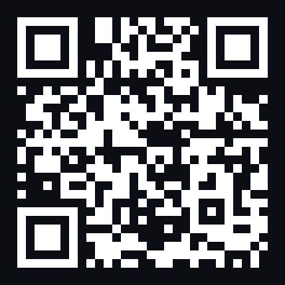
NEBIUS BUILDER PROGRAM
GPU credits for what you build next
• Scan now — the form is prefilled with this workshop; it takes a minute
• Credits + onboarding — from sign-up to first job with a human, not a doc dump
• Serverless, Workbench, Token Factory — everything you saw today
• Bring your recordings — the repo's job helper works on your bucket unchanged
link.voxel51.com/nebius-munich
Nebius × Voxel51 · Physical AI Workshop
26
Notes:
THE CTA. QR goes to link.voxel51.com/nebius-munich which prefills the form with this event. Ask everyone to scan now, not later; it takes name, email, company, GitHub. Goal is 500 sign-ups across the roadshow.

Slide 27
Look at your data.
repo github.com/danielgural/physical-ai-workshop
datasets huggingface.co/datasets/dgural/droid-mcap-workshop
huggingface.co/datasets/dgural/droid-frames-workshop
fiftyone github.com/voxel51/fiftyone · app.voxel51.com
nebius link.voxel51.com/nebius-munich
repo
nebius
DROID: Khazatsky et al. 2024, CC-BY-4.0 · droid-dataset.github.io
Nebius × Voxel51 · Physical AI Workshop
27
Notes:
Q&A. Leave this up.

