Slide 1
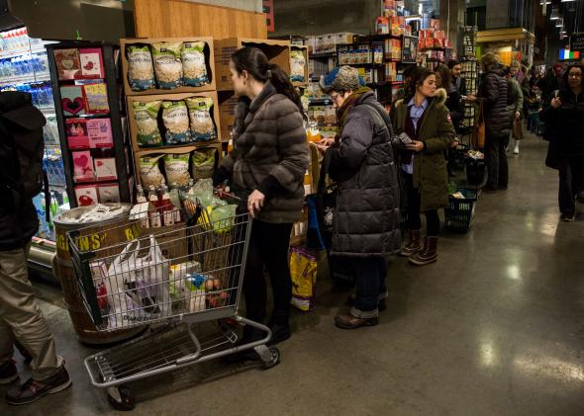
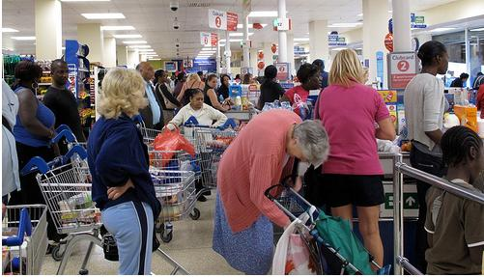
Do you like waiting in the lines?
Do your customers leave because of a big line ?

Slide 2
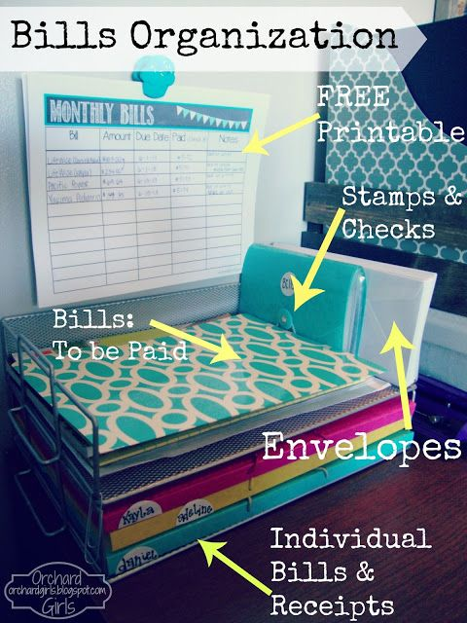
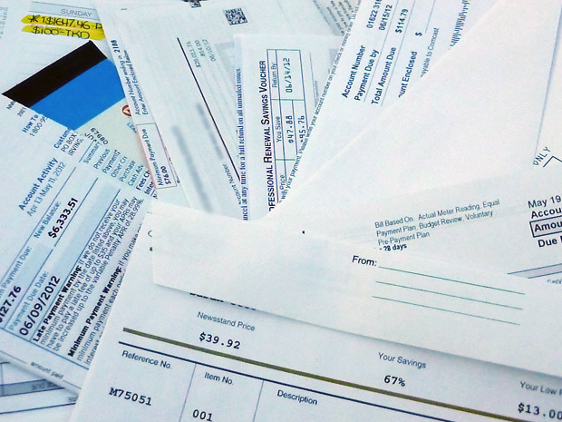
Are your paper bills pilling up?
Can you actually find a particular one?

Slide 3
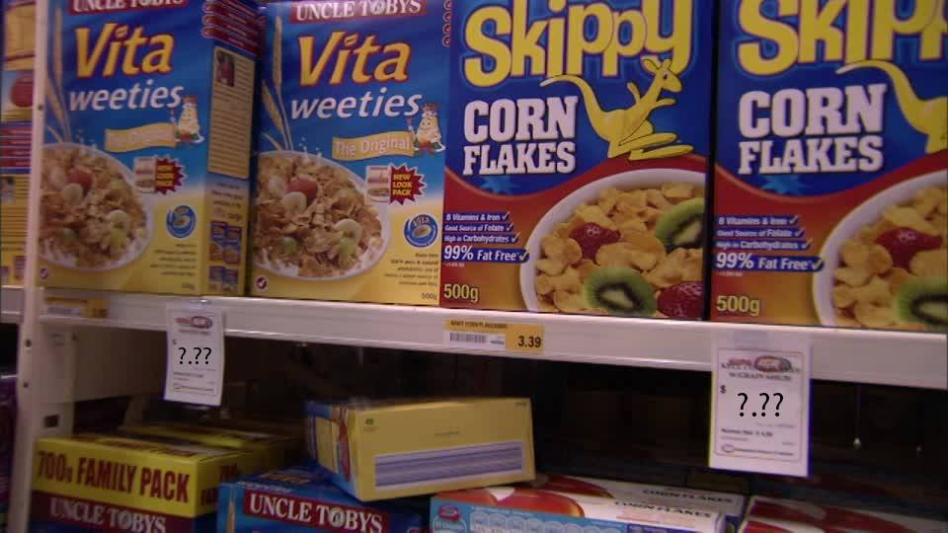
Ever struggled with finding a price tag for an item?

Slide 4
videjko

Slide 5
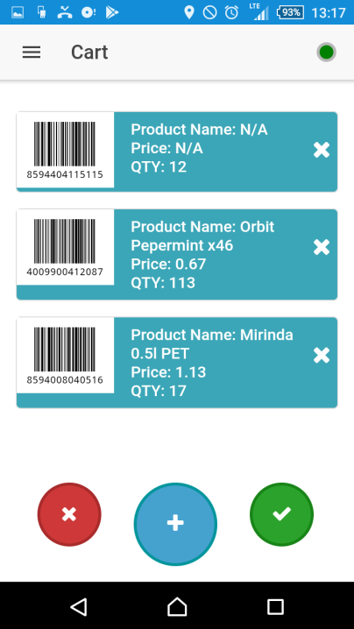
What Scan2Shop offers?
Market
Full digitalization of medium to large supermarket within few a day’s
Statistics per user
Customer
Tracking of bills in digital form
Statistics
Possibility to check price of untagged item
Both
Checkout time reduced!

Slide 6
Future ideas
Price checking within multiple stores
Full order statistics (per week, month, year, store…)
Desktop version of order history

Slide 7
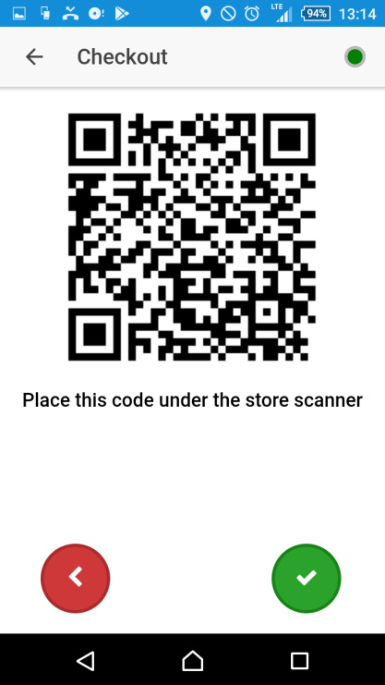
Technologies
ionic (apache cordova, angular 4)
node.js
socket.io
Mongo DB
Indexed DB (offline storage)
IBM Bluemix
Compose for Mongo DB
SDK for Node.js

Slide 8

Shop, sell, digitalize

