Slide 1
Arguments and Moral Skepticism
Daniel Hampikian

Slide 2
Structure of the Class
What an argument is (overview)
Truth
Validity and Soundness
In Class Exercises: Determining Validity and Soundness
Fallacies
Induction
Moral Skepticism

Slide 3
An argument is…
Propositions
Not the same as sentences: Cogito Ergo Sum, I think therefore I exist
Premises
Indicator words: since, because, for, if, follows from, given that, provided that, and assuming that
Conclusion
Indicator words: thus, therefore, hence, so, then, consequently, as a result, shows that, means that, implies that, establishes that, can be concluded that
Notes:
Deductive and inductive (validity guarantees truth preservation – If the premises are true the conclusion must be true vs. inductive and abductive arguments can only make the conclusion likely or probable if they are strong inductive or abductive arguments… maybe mention in the context of ‘proving.’

Slide 4

Water slides can be people-preserving, or not…
Notes:
How can you tell if a water slide is people preserving without jumping in it? Look at it’s structure!

Slide 5
IF people were to go in…
Notes:
Draw 1 a water slide that preserves people (people in, people out) with people at the bottom, 2 a waterslide that preserves people but there’s no one in it, and a water slide 3) alongside one that drops people and one where people get stuck and people get into the pool from the other direction (there are already people in the pool). Then write next to each –1 corresponds to a valid, truth preserving argument (Draw people at the bottom), 2 corresponds to a valid argument with a false conclusion, 3 corresponds to a invalid argument with a false conclusion, and 4 corresponds to an invalid argument with a true conclusion.
The purpose of evaluating the waterslide is you want to safely reach the bottom and have fun with the people there, you want the waterslide to bring you and the others to the bottom. The purpose of evaluating an argument is to see if it gives you a reason to accept the conclusion as true.

Slide 6

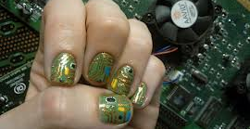
A circuit can be electricity preserving, or not…

Slide 7
Good and Bad Circuits
Notes:
Again, you can have a working circuit – the circuit casues the electrivity because it is current preserving, or a broken circuit no light, or a broken circuit with a light. Emphasis the broken circuit with a light or the waterslide that is broken with people at the bottom as anologous to the way a valid argument can have a true conclusion.

Slide 8
Like a good waterslide, a good argument preserves something…
This is truth.
A good argument is one where if the premises are true, it’s structure ensures that the conclusion will be true.
Truth goes in and inevitably comes out of a good argument, just as people go in and inevitably come out of a good waterslide.
Notes:
What preserves electricity or current in a circuit is it’s structure, what preserves people in a waterslide is it’s structure, and what preserves truth in an argument is its structure! Not whether there are people at the bottom of the waterslide, or whether the lightbulb happens to be on (draw a double circuit for an alarm clock with a backup battery or lightning for the circuit example, and not whether the conclusion is true or false for an argument. When we want to know whether these things are good, whether they perform their function or what they are intended to do, we want to know about their structure.

Slide 9
A good argument has these properties:
Truth
Logical Validity
Not the same as truth
If the premises are true…
Without validity, an argument…
Soundness
Must be logically valid and the premises true, which guarantees the truth of the conclusion

Slide 10
Deductive Arguments: Truth
Whether a statement is true is distinct from whether or not you or anyone else believes it.
A statement is true just in case reality is the way that it describes. Truth is determined by objective states of affairs. (Assumes a theory of truth called the correspondence theory)
Other considerations:
True for me just means belief
Self fulfilling prophecies
Notes:
Self fulfilling prophecies. Emphasize that believing something is distinct form that thing being true. When belief causes an action that changes reality to correspond to that belief, something is not made true simply be believing, but by belief causing an action which causes a change in the world.

Slide 11
Categories of Arguments
Deductive arguments: if the argument is sound, the conclusion is guaranteed to be true
Inductive argument: if the argument is strong, the conclusion is probable or plausible
Abductive arguments: if the explanation is the best possible explanation, then it is likely to be true.

Slide 12
Examples of deduction
All cats are mammals
All mammals are animals
Therefore all cats are animals
If morality is what God wills, then genocide would be moral if God willed it
Genocide would not be moral if God willed it
Therefore morality is not what God wills
Notes:
Symbolize these – the second is modus tonens

Slide 13
Deductive Arguments: Logical Form
Validity is a property of logical form. To say an argument is valid is to say it is truth preserving (if the premises are true, the conclusion must be true). This argument is valid:
All A’s are B’s
All B’s are C’s
---------------------------------------
All A’s are C’s
***Substitute any premises into these variables and it will still be valid even if the conclusion is false:
All cats are beings who perform experiments
All beings who perform experiments are scientists
Therefore all cats are scientists.

Slide 14
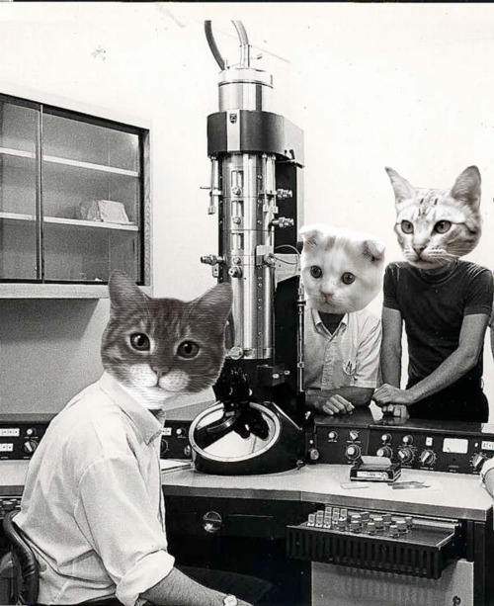
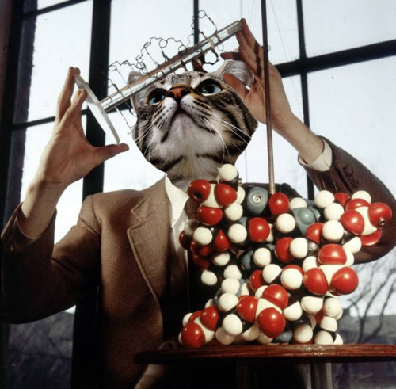
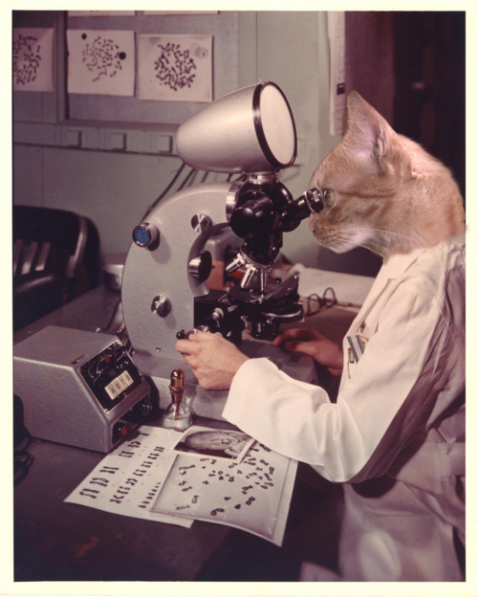
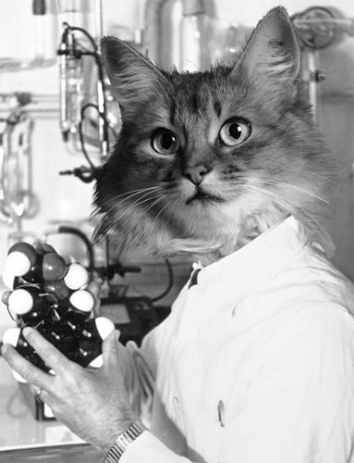
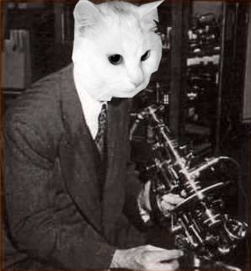
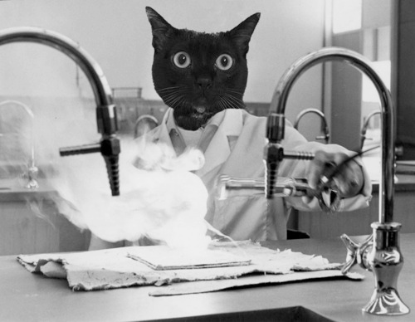
Notes:
Cat Scientist Collage!!!

Slide 15
Deductive Arguments: Invalidity
Deductive invalidity is the property of an argument where its premises might be true and the conclusion false.
This argument is invalid:
If (P) the soul does not exist, then (Q) death harms us.
(Q) Death does harm us.
Therefore (P) the soul does not exist.
If P, then Q (T)
Q, (T)
Therefore P (F)
Notes:
If it Is raining, then the ground is wet….
If I have won the lottery, I have bought a ticket…..

Slide 16
Enthymemes
If Jupiter is a planet in our solar system, then it orbits our sun
Jupiter is a planet
Therefore Jupiter orbits our sun
An enthymeme is an unstated premise or conclusion in an argument
If we add “Jupiter is in our solar system”… then,
Notes:
Principle of charity

Slide 17
Examples
All rational beings are humans
Some humans are immoral
Therefore some rational beings are immoral
I choose to act morally
If I choose to act morally, then I am doing what I want
All people who do what they want are acting selfishly
Therefore I am acting selfishly
Notes:
The first is invalid, all rational beings are immoral, but the class of humans that are immoral may be distinct from the class of humans that are rational. The second is valid but not sound, and involves a combination of class logic and propositional logic

Slide 18
Affirming the consequent
If you win the lottery, you have bought a lottery ticket
You have bought a lottery ticket
Therefore you will win the lottery
Affirming the consequent is a formal fallacy

Slide 19
Denying the Antecedent
If the earth is flat, people will believe the earth is flat
The earth is not flat,
Therefore people will not believe the earth is flat
Denying the antecedent is a formal fallacy

Slide 20
Formal Fallacies
2 common invalid argument forms that are tempting when inferring from conditionals, or if then statements are the following fallacies:
If X then Y If X then Y
Y Not X
----------- ------------
Therefore X Therefore not Y
(affirming the consequent) (denying the antecedent)
Notes:
If it Is raining, then the ground is wet….
If I have won the lottery, I have bought a ticket…..

Slide 21
Validity and Soundness
An argument is sound just in case it is logically valid and the premises are true. An argument may be valid but not be sound, or have true premises and true conclusions but not be sound. Consider this example:
If (P) a terrorist were president, then (Q) we ought to impeach them;
(P) a terrorist is president;
Therefore (Q) we ought to impeach him.
This is a logically valid argument, but not a sound argument.
If P, then Q (T)
P, (F)
Therefore Q (F)
Notes:
Use pictures of a waterslide that works but doesn’t have people at the bottom. A good waterslide is one that is structured so that IF people go down it, they will come out the other end!!!! If a terrorist were president, we ought to impeach them; Barrack Obama is not a terrorist and is president, therefore it is false that we should impeach him.
This is an argument with true premises and a true conclusion, but it is not logically valid. Compare: If Hitler is not a strong leader, then we should impeach him, Hitler is a strong leader, therefore we should not impeach him.

Slide 22
If machines can process information, then they can think
Machines can process information
------------------------------------------------
Therefore they can think
If the politician deliberately lies, then they will say false information
The politician says false information
---------------------------------------------------
Therefore the politician deliberately lies
If we went to war for economic gain, then the war was unjust,
We did not go to war for economic reasons,
----------------------------------------------------
Therefore the war was not unjust
If I get an A in the course, I have kept up with the readings
I have not kept up with the readings
--------------------------------------------------------
Therefore I do not get an A in the course
Notes:
Calculators can process information, so the first argument is false. Valid, not sound
Invalid, the polician could be mistaken
Invalid We could have gone to war to genocide a certain race
Valid, and SOUND!!!!

Slide 23
Relevancy
The premises or evidence must not only be true and validly support the conclusion, the premises or evidence must also be relevant to the conclusion or claim. This argument contains irrelevant premises:
X is Y gender, race, or sexual orientation.
If X is Y gender race, or sexual orientation, then they cannot perform job Z well.
------------------------------------------------------
Therefore X cannot perform job Z well.
Informal Fallacies are often the result of a failure of relevance
Notes:
For example; race, gender, sexual orientation, and religion are not relevant, in general, to determining job performance. Many informal fallacies are a result of a failure of relevancy of the premises to the conclusion…

Slide 24
Ad Hominem
The character, credentials, reputation, position, or office of an individual is used to challenge the soundness or plausibility of his or her claim.
These factors are, in general, irrelevant to the soundness of any particular claim.
Notes:
If Charlie Sheen tells you that the economy cannot survive another mortgage crisis because the banks will collapse if a large amount of the population defaults on their debt, and you challenge this claim on the grounds that Charlie Sheen is a known drug addict and spouse abuser, then you are committing the (personal form of the) ad hominem fallacy. If you seek to challenge someone’s claim purely on the grounds of their theoretical position or affiliation, then you are committing the circumstantial form of the ad hominem fallacy: His views on welfare cannot be trusted because he is a democrat. Her views on war cannot be trusted because she is a republican

Slide 25
Slippery Slope
This is the fallacy of assuming or arguing that if an action or event were to obtain it would start a long and dubious causal chain leading to disastrous results that don’t actually follow. Because the causal chain is dubious, the end being disastrous is not relevant to the morality of the initial action or event.
Ex: The government regulating health care will lead to the government completely controlling health care, which will lead to the government controlling other businesses, which will lead to the government regulating which products we can buy, which will lead to the government controlling other aspects of our personal life including our income and freedom of choice and expression, which will result in a communist militant state massacring its citizens.
Compare: The government not regulating health care will result in many people being refused treatment, which will result in the poor and sick dying because of this refusal of treatment, which will result in the loss of family members and a rise of criminality in lower socioeconomic classes who will then rise up and wage a class war on the rich who can afford such treatment, resulting in the utter destruction of our society.

Slide 26
Deductive Arguments: Circularity
Finally, a good argument should help determine whether or not the conclusion is true rather than assuming that it is true.
Circular arguments assume the conclusion in the premises, and so do not help to establish whether or not the conclusion is true.
A circular argument: God exists because it is written he exists in X holy doctrine. This doctrine must be true, because it was inspired by God.
Notes:
argument should give you a reason to accept the truth of the conclusion, it

Slide 27
Good deductive arguments are:
Relevant
Sound
Non-circular

Slide 28
Overview of Induction
Induction is a form of reasoning in which if the premises are true and the conclusion is supported by those premises, the conclusion is justifiably considered probable or likely to a certain degree, but not certain. Most scientific reasoning and all empirical reasoning is inductive.
This stands in contrast to deduction, which is a form of reasoning where if the premises are true and the argument valid, the conclusion must be true.

Slide 29
Classification and arbitration continued
Induction can similarly (for our purposes) be divided into four general patterns of inference: causative reasoning, analogical reasoning, generalizing, and explanatory reasoning.
To evaluate inductive arguments and claims, and to be able to form good inductive inferences and explain those inferences to others, we must first determine what makes each of these forms of inferences (not valid, but) reliable or trustworthy.

Slide 30
In general, a reliable or trustworthy inductive inference is one in which if the premises or evidential claims are (very likely to be) true, then the conclusion must be highly probable.
To determine the reliability of any particular inductive inference, then, it is necessary to understand what factors increase the likelihood of the conclusion for each form of inductive reasoning, and what factors lead to errors or mistakes within these forms of induction.
This chapter discusses those factors, which we can call ‘reliability conditions’, for the causative and analogical forms of inductive reasoning. The next chapter will discuss the reliability conditions for generalizing and explanatory reasoning.

Slide 31
Causative reasoning
As David Hume explicitly argued, a cause is not something we can observe, rather we can only observe one event occurring after another. We must establish a casual relation by a process of reasoning, rather than by mere observation of temporal sequences.
A good causal argument is one that establishes that an event caused or produced the consequent event in question, such that because the prior event happened it is necessary that the consequent event should occur.

Slide 32
Causative reasoning
Consequent events that bear a causal relation to the prior event that produced them must be distinguished from subsequent events that merely happen after a prior event, with no causal connection between the two.
Note that often there are a series of events and prior conditions that are necessary for the consequent event to be caused or produced by the prior event.

Slide 33
Determining causation
John Stuart Mill’s methods of agreement, difference, agreement and difference, and concomitant variations (or correspondence) are ways to distinguish events with casual connections from mere temporal sequences of events.
Think of these as four conditions of reliability for causative reasoning.

Slide 34
Agreement and Difference
If there is a genuine causal relation between one event and another, than there must be a common prior factor that is the cause of the consequent event.
This common prior factor must be present in all cases where the consequent event occurs prior to that event.
This common prior factor must also not be present in all cases in which the event does not occur.
Since there are many common prior factors and many differing prior factors for any given event, to determine causation we must combine these two methods and factor out any common prior elements that are present when the consequent event does not occur, and examine which events are common only and always when the consequent event does occur.

Slide 35
Concomitant variations (correlations)
The next reliability condition for causative reasoning is used primarily when we cannot control for negative instances and there is a continuous flow of events.
The method of concomitant variations is Mill’s name for the reasoning process of determining whether or not there is a natural correlation between the changes in two entities. If there is a strong correlation between these changes, it is likely that there is a causal relation.

Slide 36
Necessary and sufficient conditions
Causes are always (naturally) necessary conditions of the consequent event.
Sufficient conditions are the sum of the necessary conditions that inevitably result in the consequent event.
Are all necessary conditions also causes of any consequent event that they are causally downstream from?

Slide 37
Proximate and remote causes
Proximate causes are events which immediately trigger the consequent event.
Remote causes are those prior background conditions that are casually downstream from the proximate cause.
Most events will have multiple causes, and some will be periphery remote causes while others will be the main proximate causes. A good or reliable causal inference is one which takes this into account rather than citing one event as the only cause of the consequent event.

Slide 38
Common mistakes in causal reasoning
Confusing cause and effect in cases where there is concomitant variation.
Failing to distinguishing between statistical correlation and causal connection (both kinds of subsuming errors are possible).
Mistaking psychological connections for causal connections when the causal and the psychological are at odds (the gambler’s fallacy, for instance).

Slide 39
Analogical reasoning
Reasoning by analogy is a form of inductive inference in which two entities that are alike in many respects are, because of these similarities, inferred to be alike in some further respect.
For instance, a successful basketball team and a successful company might both require good teamwork, strong leadership, excellent communication, and be composed of people who work towards a common goal. It might be inferred, because of these common properties, that a successful basketball team and a successful business also have in common a healthy and vigorous competitive attitude among the people who compose them.

Slide 40
Factors that make analogical arguments reliable
Resemblance: the more similarities that the two entities have in common besides the factor that is being analogically inferred, the more probable the conclusion
Quantity: the more individual entities from the two cases being compared that are examined (and that bear the relevant resemblances), the more likely the conclusion
Quality: the greater the difference in the kinds of subclasses of entities being compared among the number of entities being compared, the stronger the inference becomes
Notes:
(the qualities of being composed of people, having strong leadership, etc., show that businesses and basketball teams are fairly similar entities even though they exist for different purposes).
(compare 50 basketball teams and 50 businesses, and all the successful ones bear those qualities in common).
(compare college, high school, professional, and amateur teams to local, corporate, and foreign businesses).

Slide 41
Generalization
Reliability factors:
Size (depending on what type of thing is being generalized about) and emergent statistical regularities
Randomness of the sample selection for the generalization and of the source of statistical information.
Stratification (inclusion of all relevant subclasses)

Slide 42
Explanatory Reasoning (IBE)
Reliability factors
Consistency
Plausibility
Comprehensiveness
Simplicity
Predictability

Slide 43
Inductive Reasoning Concluded
All four types of inductive reasoning mutually support each other when applied to the same inference.
Often you begin an inductive inference or argument with a temporal succession, correlation, hypothetical guess as to why something occurred or is the case, or an unsupported analogy or generalization.
Then you determine whether the inference or argument can be made stronger or more likely to be true (or if it is someone else's claim, you judge its reliability or trustworthiness by determining if they make it stronger) by determining whether the conclusion is supported by what makes each individual form of inductive reasoning more reliable, and by seeing whether the other forms of induction also support that inference.

Slide 44
If you begin, for instance, with a temporal succession of events and a correlation between a polluted water source and a disease, you might form a hypothesis that drinking from the polluted water source is causing the disease.
To support this inference you would need to see if all and only cases of the illness are people who drink from that water source. We might then form an analogy between other cases of illness similar to this one that were caused by a similar water source
Next we might generalize that all people who drink the water will get sick based on the sample of people who do get sick because that sample includes people form out of town, women, children, people of different ages, people who eat different foods, etc, and so is properly randomized and stratified and has an appropriate size.
Then you might further support this inference by forming a hypothesis about what it is in the water that is causing that illness (microorganisms, for instance bacteria), and test that hypothesis by
seeing if it is consistent with the bulk of other hypothesis and we accept,
by determining if it is plausible,
by determining if the hypothesis is, or can be made, comprehensive (what do the microorganisms do to the body to cause the illness?),
and by seeing whether it is the simplest possible explanation (the microorganisms are just that, not also a punishment from God or the Devil on the specific population) and whether we can predict events (such as the illness and the specific effects the microorganism has on the body) from that explanation to confirm it empirically.

Slide 45
Induction Concluded
What makes an analogical inference more likely to be true is whether an explanatory hypothesis, which will involve causal reasoning and generalizing over entities of the kind being compared, explains the underlying structure that makes that analogy hold of the entities being compared.
Similarly, what makes a causal inference more likely to be true is whether an analogy can be drawn, whether the generalization over events of that type can be supported, and whether an explanatory hypothesis supports the inference that one event causes another by offering an explanation of why this occurs.

Slide 46
Induction Concluded
A generalization is similarly more likely to hold over the population if it is supported by an explanation of the causal factors that make that generalization true, and if an analogy can be drawn between other populations that the generalization also holds for.
Finally an explanatory hypothesis is more likely to be true just in case a well supported causal inference(s) confirms that explanation and a well supported generalization(s) that fits with the collective independent body of accepted scientific knowledge we have about the world (hypothesis are often about what causes an event to occur and generalizes over all events of that type), and whether an analogy can be drawn between other events of a similar type that have the relevant underlying structure to explain why that analogy occurs.

Slide 47
Assessing an argument
Deductive parts
Do any categorical syllogisms in the argument violate any of the rules for validity (or is there a counter example that can be demonstrated with circle diagrams?)
Are all sentential inferences valid (according to simplified truth tables or can a counter example in which the premises are true an the conclusion false be demonstrated)?
Are the premises true?

Slide 48
Assessing an argument
Inductive parts
Are causal claims supported by the method of agreement of prior factors and the lack of the cause in all cases when the effect does not occur and correlation?
Are analogical claims supported by the two cases sharing many other similarities and by a large and diverse number of cases compared
Are generalizations based an appropriately large sample of the population that is randomized and properly stratified?
Are explanatory hypothesis
Comprehensive
Allow for predictions
Consistent with scientific knowledge
As simple as possible
Plausible

Slide 49
What’s wrong with this argument?
90% of people polled favor capital punishment as a justified punishment for convicted murderers.
Therefore, the death penalty is morally justified.

Slide 50
Moral Skepticism
The view that because different cultures have different moral norms, and because different people have different moral opinions, that there is not such thing as objective moral truths.
The cultural difference argument:
In some societies, X is generally believed to be morally acceptable
In other societies, X is generally believed to be morally wrong
Therefore, for all X, X is neither right or wrong, but only a matter of opinion.
Note: not a claim about what we can know about morality…
Notes:
Premises are true, but does the conclusion follow? A counterexample is an instance of an argument with the same form as the argument under consideration where the premises are true and the conclusion is false. If this is possible, then the argument is not logically valid, and can tell us nothing about the conclusion.

Slide 51
A counterexample to this form of argument:
In some societies, people believe(d) the earth was flat
In other societies, people believe the earth is round,
Therefore the earth is neither objectively flat nor round, the shape of the earth is merely a matter of opinion.
Subjective and objective
The apparent structure of moral claims is different from mere claims of opinions
Notes:
A COUNTER EXAMPLE IS AN INSTANCE OF THE SAME LOGICAL FORM OF AN ARGUMENT YOU ARE CONSIDERING WHERE THE PREMISES ARE TRUE AND THE CONCLUSION FALSE.

Slide 52
So this argument is not valid, but…
Is its conclusion, that morality is only a matter of opinions that exist only in our minds, true?
Are there different arguments for this conclusion?
The provability argument:
If morality were objective, then there ought to be some way of proving moral truths
There is no way of proving moral truths
Therefore morality is not objective.
Is it valid? Is it sound?
Notes:
Is it valid? Is it sound?

Slide 53
Moral ‘proofs’ are just sound (or strong) arguments applying moral principles to facts
To argue that Jones is a bad man
Habitual liar
Manipulates people
Breaks agreements and laws
Is cruel to others
To argue a test is unfair
The test is too long (no others students finished)
The test covered material not covered in class
The test stressed trivial matters not stressed by the teacher
Notes:
General moral principles, apply them to the situation, come to moral conclusions. (lying is in general wrong) (using people in general is wrong)

Slide 54
Moral claims are not just opinions
We provide arguments as reasons justifying our moral claims
These arguments can be better or worse depending on their logical structure and the truth of their premises
The assessment of arguments is (or should be) independent of cultural standards and personal opinions.
Two kinds of moral reasons that are independent of culture and personal opinions are reasons based on wellbeing reasons based on autonomy.
Notes:
For example, a bad argument is ‘my culture regards X to be wrong, therefore X is wrong.’ Since the entire culture might be right or wrong, and it is being assumed to be right, no reason has been given establishing the truth of the conclusion. To be autonomous is to live in a way that you determine according to your own projects and desires. One’s wellbeing refers to one’s overall health and happiness.

Slide 55
Post HGP Eugenics
The science of improving the genetic composition of a population (usually a human population).
Ridley is an advocate, who acknowledges the sad history of
Eugenic sterilization laws resulting in compulsory sterilization of more than 100,000 Americans following 1927 Buck v. Bell.
And Hitler’s misguided eugenic project that resulted in the murder of millions of people
Notes:
(Human Genome Project have mapped the human genome) MENTION: Carrie Bell, who lived with her mother in a colony for epileptics and the feeble minded had a child who was declared an imbecile at 6 months old, and the state wished to sterilize in order to prevent her brining more imbeciles into the world. Justice Holmes said, quote; “Three generations of imbeciles is enough!” Rejection of immigrants might also part of a state mandated eugenic movement, as well as general discrimination against the groups the state does not desire to reproduce in the population. These are all violations of autonomy. But it seems to be the state violating autonomy in a misguided understanding and application of eugenics.

Slide 56
An argument against:
In the past, eugenics has been used to justify the state enforced sterilization of thousands and the death of millions
Eugenics is unjustified because of these past ways of practicing population ‘improvement.’
Therefore genetic engineering is, as a form of eugenics, is unjustified.

Slide 57
The Genetic Fallacy
The fallacy of concluding from the past origin of something its current meaning or value.
Compare: medicine originated from doctor’s applying, among other things, bloodletting techniques (leaches, bleeding, etc.) which were actually harmful to the sick.
So current medical treatment is harmful to the sick.

Slide 58
Similarly…
The murder of innocents and misguided notions of inferior and superior races is what made the eugenic program of Hitler wrong, and
The government coercion of sterilization, rather than eugenics itself, is what made the sterilization of below average intelligence Americans wrong (would it have been wrong if they volunteered?).
Notes:
Decreaes wellbeing and increases suffering in a population, and neglects the autonomy of individuals (the right to live according to your own desires, interests, and projects) but what does this is the way improving the genetic population was done in these examples. Does post HGP eugenics to cure diseases in infants violate anyone’s autonomy, especially if private rather than State enforced? Does it descrease anyone’s wellbeibng? Could it lead to eithier of these things?

Slide 59
The argument for eugenics
There is nothing intrinsically wrong with eugenics, if genetic engineering is not incorporated into politics in a way that involves violations of autonomy.
And there is a lot to be gained:
Prevention of Huntington’s disease, down syndrome, anencephaly, and many other genetic disorders
Increased chance of intelligence, strength, beauty, etc.
Notes:
And we already do it: screening followed by abortion, pre-implantation genetic diagnosis through in vitro fertilization followed by implantation of a healthy embryo and rejection of one that carries the faulty gene, and gene therapy.

Slide 60
Essentially, a benefits argument
Greater benefits for society, with no likely harms. But consider:
The message that people with genetic disorders should be eliminated?
Decreased diversity?
Genetic engineering only for the wealthy?
Or is this a slippery slope fallacy?
Could this be something wrong about the way it is practiced, rather than something that makes it wrong in general?
Notes:
Diversity would be maintained, artistic people would select artistic genes, athletes athletic genes, etc. To say that new life would be better without the disease is different from saying that current life with the disease is bad, inferior, or wrong. Or is it? Genetic engineering only for the wealthy is a real risk, but perhaps only initially?

Slide 61
Ought we genetically engineer humans?
What, if anything, is the genetic engineering of humans morally permissible for? Consider whether you think it is permissible for the prevention of diseases, the enhancement of strength, beauty, intelligence, or none of the above.

Slide 62
Alcohol, Drugs, and Rape
The central issues:
Often times rape involves consuming alcohol and/or drugs both by the rapist and the victim. The moral issue at stake is the question of whether (and to what extent) the fact that the victim has been voluntarily drinking or taking drugs should effect our determination of whether a rape has occurred.
A related issue is the extent to which alcohol or drug impaired sex, if classified as a rape, should be punished in comparison to physically or psychologically forced rape not involving alcohol or drugs. Should impaired sex be criminalized?

Slide 63
Terminology and Statistics
Rape: forced sexual intercourse including both psychological coercion as well as physical force. Forced sexual intercourse means penetration by the offender(s). Includes attempted rapes, which includes verbal threats of rape. (Bureau of Justice statistics)
http://www.bjs.gov/index.cfm?ty=tp&tid=317

Slide 64
Rape is one of the most under-reported crimes - 75-95 percent of rape crimes are never reported.
The CDC in 1995 found that 20% of 5,000 women on 138 college campuses experienced a rape (not an attempted rape). The National Institute of Justice and the Bureau of Justice statistics confirmed this study, holding that approximately 1/5 to /41 quarter of women in higher education facilities is likely the current statistic of women raped.

Slide 65
As of 2005, 1 in 6 women reported a rape in the US and 1 in 33 men in the US. There were far more unreported rapes.
Of those reported, 38% are raped by a friend or acquaintance, 28% by an intimate, 7% by a relative, and 26% by a stranger.
In 47% of all REPORTED rapes, both the victim and the perpetrator had been drinking. 30.9% of rapes occur in the perpetrators home, 26.6 percent of rapes occur in the victim’s homes.

Slide 66
Actus Reus and Mens Rea
A man is guilty of rape if he not only commits the actus reus of rape (sex without his partners consent), but does so with the requisite mens rea (guilty mind) – intentionally, knowingly, recklessly, or negligently.
The article by N. Dixon focuses on situations where the after a woman has been drinking she acquiesces to sex.

Slide 67
Two clear cases:
Fraternity gang rape (for instance the 1988 Florida State University fraternity members having sex with a passed out 18 year old woman with an almost lethal blood alcohol level and then dumping her at a different fraternity).
Regretted sexual encounter

Slide 68
Impaired sex and mens rea
Speech slurred, unsteady on feet, a woman has sex with a man after going home with him and acquiescing while drunk, but cannot even remember having sex the next day or the acquiescence.
What is important in such cases is the role of the man in helping or not helping the woman get into the impaired state.
If a man uses such a strategy it implies that he doubts she would agree were she sober, and disregarding those doubts meets the mens rea of rape.

Slide 69
A feminist response
Roiphe and Paglia claim that women, as autonomous adults who know the risks of alcohol consumption are responsible for minimizing the danger of impaired sex.
To regard this solely as a matter of the man’s responsibility is to degrade women as beings who cannot make autonomous decisions about sex and alcohol.
Since women are partially responsible given that they have a duty to make their sexual wishes known to their partners, impaired sex is in many cases not best described as rape.

Slide 70
The Pineau approach:
Communicative sexuality: it is never reasonable to assume that a woman consents to aggressive noncommunicative sex. In general, the burden is on the man to ask and ensure that their female partners consent, which is impossible for many cases of impaired sex.
Men should then refrain from sex when they cannot be sure that a ‘yes’ is sincere – reflecting lasting values and desires.

Slide 71
An argument for criminalizing impaired sex
This relatively minor restriction on men’s sexual freedom would then need to be weighed against the gain of the (greater chance of) prevention of the enormous harm of rape.

Slide 72
An arguments against criminalizing impaired sex
Drawing of boundaries: what constitutes impaired sex as opposed to consensual tipsy sex? How can men conform their behavior to a boundary with no clear distinction?
Suppose we make it a certain blood alcohol level, and hold men responsible for finding out someone else's blood alcohol level before having sex or else abstain.
Does this constitute an unjust impediment of the government into our sex lives?

Slide 73
Conviction and punishment
Measuring of blood alcohol of a woman at the time of a rape would also be impossible for many cases
Perhaps a better option is education and moral disapproval – making it clear to others that by having sex with someone who is significantly impaired by alcohol or drugs , you prevent someone from being able to make a fully autonomous decision reflecting their deeply held wishes and values.
If they can’t consent, then any sexual activity is a kind of rape (forced rather than consenting sex).

Slide 74

In class peer based learning exercise:
Do you think that so called ‘pick up artists,’ or men who attend bars with the explicit and sole purpose of having sex with impaired women are doing something akin to rape? Consider whether they meet the mens rea and the actus reus of rape if they are successful.
Notes:
What is the difference between being a pick up artist and meeting women over a few drinks? It seems to be one of motive. If you want to get to know a woman and find out who they are, what their values are, and vice versa, the motive is not meaningless (or negatively meaningful) impaired sex.

