Slide 1
Feminism and the Ethics of Care
Dr. Daniel Hampikian

Slide 2
Male and Female Ways of Thinking
Initially, the feminist movement of the 1960 and 70s denied that women and men differ psychologically (the only difference were because of oppressive social conditioning)
If men and women think differently, this could be (and was) used as a basis for discriminating against women:
Aristotle: Women ought to be ruled by men because they are not as rational.
Kant: Agreed and added that women lacked “civil personality” and should have no voice in public life.
Jean-Jacques Rousseau held that women possess different virtues (fit for the home) then men (who had virtues that fit them for leadership.

Slide 3
Now
Most feminists believe women think differently than men about ethics.
However, they do no think that these ways of thinking are thereby inferior, nor do they think that these differences justify discrimination
Female thinking it is thought can yield insight into typically male-dominated areas.

Slide 4
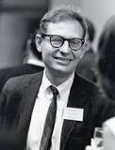
Kohlberg’s Stages of Moral Development
Lawerence Kohlberg (1927-1987) was an educational psychologist who asked children of varying ages questions like the following dilemma to reveal their thinking about morality (Heinz’s dilemma):
Heinz’s wife is near death, and her only hope is a drug that a pharmacist is selling for 200 dollars that Heinz does not have. Heinz tried to pay half now and half later, the pharmacist refused to accept this offer. Would it be wrong for Heinz to steal the drug?

Slide 5
The six stages:
Kohlberg concluded that there are six stages of moral development. As the child develops they conceive of right and wrong in terms of:
1. obeying authority and avoiding punishment
2. satisfying one’s own desires and letting others do the same, through fair exchange
3. cultivating one’s relationships and performing the duties of one’s social roles
4. obeying the law and maintaining the welfare of the group
5. upholding the basic rights and values of one’s society
6. abiding by abstract, universal moral principles
Notes:
Only a small minority of adults make it to stage five.

Slide 6
Jake and Amy
Jake thought that human life is more than money and that Heinz should steal the drug
appeals to impersonal principles
Whereas Amy suggests that to steal and for the wife to die would both be bad, so she refuses to accept the terms the problem is posed in and suggests that Heinz should talk to the pharmacist or find some other way to make the money
a response typical of a lower stage of moral development than Jake, despite the fact that they are the same age

Slide 7
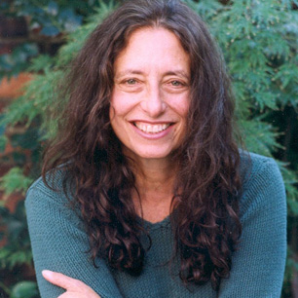
Coral Gilligan
Her 1982 book In a Different Voice objects that Kohlberg’s assessment of Amy is wrong.
Amy responds in a female-typical fashion to the personal aspects of the situation.
This is not inferior to Jake’s male-typical response (to analyze the situation in terms of a conflict between life and property that can be resolved by logical deduction and abstract principles)

Slide 8
Male and Female
Feminists like Carol Gilligan have argued that the male way of thinking is to appeal to impersonal principles in a way that involves abstracting from the details of particular situations (an ethic of principle)
The female way of thinking is as follows:
“Caring, empathy, feeling with others, being sensitive to each other’s feelings, all may be better guides to what morality requires in actual contexts than may abstract rules of reason, or rational calculation, or at least they may be necessary components of an adequate morality.” -Virginia Held

Slide 9
To Care Is To…
Be sensitive to and aware of the unique needs and interests of those who are near and dear
Primarily through an emotional feeling of loving concern for their well-being rather than through a universal and impartial benevolence.

Slide 10
To Empathize is To
Not just sympathize with others, but literally feel emotions and thoughts more appropriate to the situation of another
Feeling bad for someone who slips (or slips up) in a pageant versus literally feeling their embarrassment.
(There are neurological studies indicating that empathy is part of a larger perception-action neurological mechanism found in social mammals)

Slide 11
Caring and Empathizing
Are often a better guide as to what you should do and how you should do it in close and personal relationships.
Are central to the feminist way of understanding morality more in terms of the concrete personal relationships of people rather than impartial theories of morality applied to particular situations.

Slide 12
Small Differences
(In general) Women tend to score higher than men on tests that measure empathy
Women have a lower tendency than men to enjoy seeing people punished who have treated them unfairly
Women seem to care more about close personal relationships, whereas men care more about larger networks of shallow relationships
There are differences in the way that women and men think about ethics, but they are not very great and will vary for individuals (most men are slightly more justice oriented, most women are slightly more caring oriented).

Slide 13
Genetic and Social Factors
Probably both contribute to create these small differences.
Optimum reproductive strategies (for passing on genes) differ
Men can father thousands of children, women have a far more finite number. So men’s optimum gene passing strategy involves maximize impregnation with multiple partners, for women it will be to invest heavily in each child and have sex only with men willing to stick around
It is important to understand this is not a claim about what people should do, only what might have contributed to our genetically primed characteristics due to the activities of our distant genetic ancestors

Slide 14
Implications for moral judgment
Family and friends: being a loving parent is not motived purely by wanting to do your duty (Annette Baier), sometimes being impartial and treating people equally are antagonistic to being loving.
The ethics of care begins with a conception of the moral life as a network of relationships with specific people, attending to their needs, and maintaining their trust. It is suited to describe such relationships.
From an impartial point of view, we ought to promote the interests of everyone alike. But the ethics of care confirms the priority of our family and friends.
Notes:
Metion the hospital pateint (Stocker), the dutiful mother questioning whether she should love her child (Slote)

Slide 15
Caring for Children and Animals
The ethics of care appeals to intuition and feeling rather than on principle. Our emotional responses to (close) humans are different than our responses to children in distant countries who need our help and (distant) animals, and most people do not care about the suffering of livestock.
A relationship of care exists between one’s children and one’s pets, but not distant livestock. (Nel Noddings)

Slide 16
Objections
However, intuitions are not always reliable (many thought slavery was acceptable and the subordination of women was God’s plan, a relationship of care would not have existed between slaves or women for such people even though it should have).
Second, animals and children dying in far away countries need our help even if they cannot respond to us personally (which only would affect our satisfaction at helping).
Caring is by nature bias. This can lead to unjustified preferential treatment.

Slide 17
Feminism and Virtue
Many feminists believe that moral philosophy incorporates a male oriented bias. This bias overlooks considerations of care and empathy that a feminist alternative must supplement in order to completely understand morality and moral relations.
The contrast between being a certain kind of person (like a loving parent or caring friend) and doing your duty is part of a larger conflict between virtue ethics (the ethics of care is best understood to be a part of the ethics of virtue) and theories of obligation that emphasize impartially doing one’s duty and fulfilling one’s obligations.

Slide 18
Gun Control
http://www.nytimes.com/2013/04/09/us/politics/obama-in-connecticut-to-push-for-gun-control.html?pagewanted=1&_r=0 (Obama’s Speech)
http://www.nbc.com/saturday-night-live/video/gun-control-cold-open/n35538/ (SNL Sketch)
http://ac360.blogs.cnn.com/2013/04/10/buying-guns-no-questions-asked/?hpt=ac_t4 (CNN)
http://www.unodc.org/documents/data-and-analysis/IHS-rates-05012009.pdf (UN Statistics)
http://www.cdc.gov/nchs/fastats/injury.htm (CDC)

Slide 19
Gun Control: A Case Study
(CDC) (Rounding to the nearest thousand) 19,000 out of 38,000 suicides are caused by discharge of a firearm, and 11,000 out of 16,000 deaths by assault (homicide) are caused by discharge of a firearm.
(UN) The US homicide rate (per 100,000) is 5 to (for example of a highly restrictive gun control country of similar developed nation and average socioeconomic status) the UK’s 1.6 (per 100,000)
Comparing just gun ownership to intentional homicide is not enough, you want to know how many deaths are caused by gun ownership to total homicide and compare that to the restrictiveness of the laws determining who can own a gun and under what circumstances.
Notes:
Procedure for research: start by just searching google, wikipedia, scholarly journals and books, rty to find peer frevied studeis and avoid popular media and opinionated biased sources. Decide after a preliminary search what statistics are most relevant to the issue, and think about the best way to find them and compare them. Ask an expert. Then search again, this time going to the sources recmoneded to you from the neutral peer revied journals, books, and the expert that your intial search resulted in. Gather as much data as you can stand, and then think about what it means to the moral issue. All this is to be done after you diced precisely what the issue is.

Slide 20
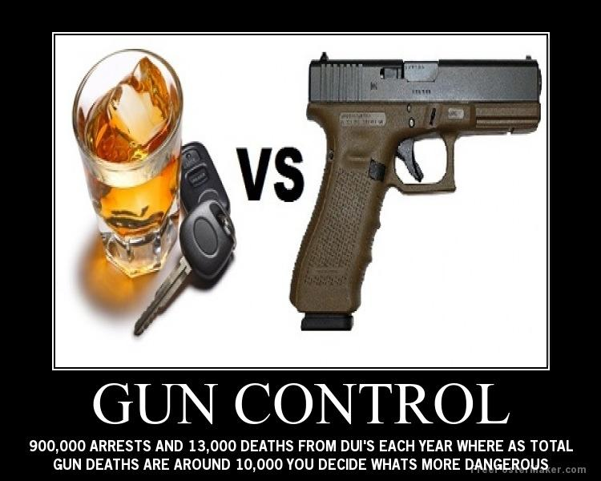
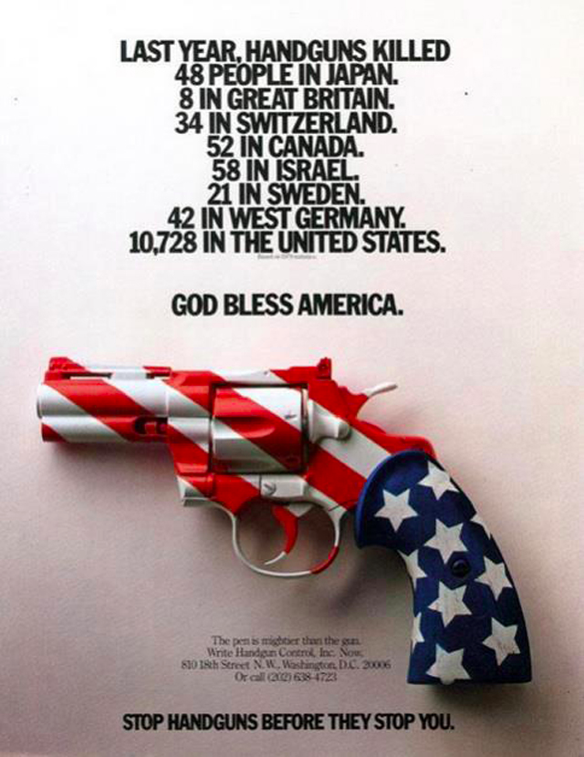
In Class Peer Based Learning Activity
Is there a difference between the way that masculine justice oriented and feminine care oriented moral thought will regard the issue of gun control in the US?
Notes:
http://www.ncbi.nlm.nih.gov/pmc/articles/PMC2759797/#bib1 (possessing a gun makes you almost 5 times as likely to get shot when being robbed by someone with a gun). See: http://lewrockwell.com/orig13/newman-d1.1.1.html for a critique of the statistical interpretation, and of course it itself is subject to a critizque because it does not take into account total homicide due to gun versus total homicide and developed nation socioeconomic status as well as gun restriction for ownership laws and enforcement of those laws. Both of these are flawed pictures. More guns means more gun deaths, of course. And America has the most per capita. Notice too that we do have laws requiring you not to drink and drive, this is the point of restrictive laws.

Slide 21
What rights are involved?
The rights of innocent people to be protected against homicidal people with guns:
This could be criminals (gun control works both ways, less criminals with guns but less gun owners able to protect themselves – however you are 4-5 times as likely to be shot in a robbery if you are carrying a gun according to a recent study in the American Journal of Public Health:http://www.ncbi.nlm.nih.gov/pmc/articles/PMC2759797/#bib1
Or it could be the government (an unlikely potential threat that must be compared to the immediate threat of the massacres and homicides currently occurring)

Slide 22
Utilitarian Reasons:
Does having liberal gun control laws make homicides, suicides, and injuries more or less likely?
Most statistical data, and common sense, seem to indicate that having higher restrictions on who can own a gun and under what circumstance reduce the overall homicides, suicides, and injuries in a society that is not threatened by totalitarian government control.
It’s just easier to kill, injure or commit suicide with a gun, and assuming these things usually happen at a person’s least rational times, why not make it harder for people who are not rational or moral to do such things?

