Slide 1
Just War Theory
Dr. Daniel Hampikian

Slide 2
When is a war just?
Jesus himself and the early Christians thought the answer to this was never.
Christianity is widespread and endorses pacifism, yet there are very few pacifistic Christians.
St. Augustine came up with the following definition of a just war:
Declared by a legitimate competent authority
Waged for a just cause
Fought using just means
Notes:
What is wrong with this definition as it is? It is circular or begs the question: what is a just cause, what is a just means?

Slide 3
Competent Authority
Controlled use of force undertaken by persons organized in a functioning chain of command
The force is directed by those persons to an identifiable political result
Not genocide or religious conversion
An alteration in government structure or authority

Slide 4
Right Intention
Not for political gain of private interests (winning an upcoming election, for instance)
Fought because of moral but realistic intentions

Slide 5
Just Cause
Self defense is just, plunder (economic gain) is not
Is military intervention justified to bestow the benefits of Western civilization on less advanced civilizations?
The UN rejects anticipatory self defense as a just cause, do you agree?

Slide 6
Proportionality and last resort
The evil that results from the war must be less than the evil that would result had the war not been fought
If the just cause can be achieved by means other than war, or the war cannot achieve the just cause, a war fought for that cause is not a just war.

Slide 7
Jus ad bellum
Competent Authority
Moral Intentions
Just Cause
Reasonable Chance
Last Resort
Proportionality
(Just Peace)
Notes:
Jus ad bellum (Latin for "right to war") is a set of criteria that are to be consulted before engaging in war, in order to determine whether entering into war is permissible; that is, whether it is a just war.

Slide 8
Jus in bello
Necessity (no more destruction of life and property than necessary for a specific just cause)
Proportionality (the amount of destruction must be proportionate to the military objective
Discrimination (between civilian and military personal, structures, supplies, and vehicles)
Objective (no civilian targets killed or destroyed)
Subjective (no intending to target civilians)
Notes:
The law in waging war

Slide 9
In Class Exercise:
Did the dropping of the bombs on Hiroshima and Nagasaki meet the requirements of jus ad bellum and just in bello? Support your answer with a reason involving one of the criterion of just war theory.
Notes:
(The official intention was to quicken the end of a war and avoid unnecessary loss of American life)

Slide 10
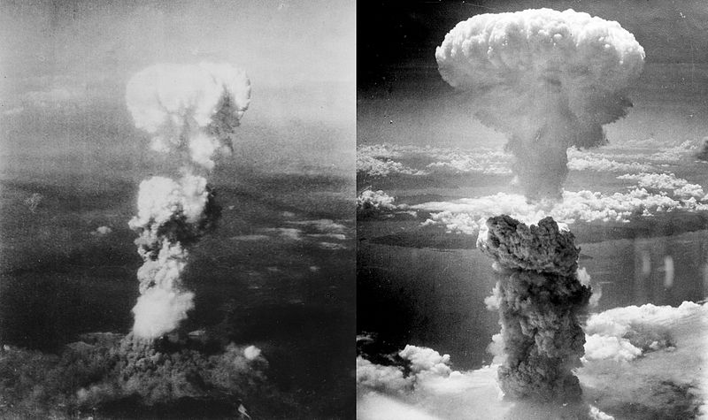
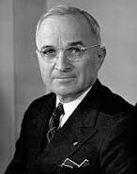

(Hiroshima on the left, Nagasaki on the right)
Notes:
90-166 thousand died in Hiroshima, 60-80 thousand in Nagasaki. More than a hundred thousand civilians died in the extended Iraqu war as well. Should war be opposed because it inevitably leads to unjust means?

