Slide 1
Kantian Deontology
Dr. Daniel Hampikian

Slide 2
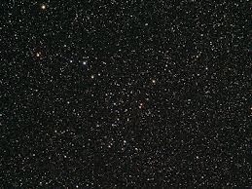
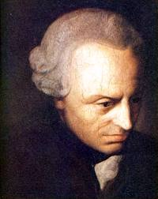
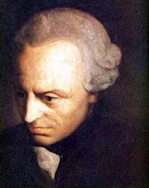
Immanuel Kant (1724-1804)
German Enlightenment Era Philosopher
“Two things fill the mind with ever new admiration and increasing awe, the more often and steadily reflection is occupied with them: the starry heaven above me and the moral law within me.”
Notes:
The Critique of Practical Reason 5 161-2, from http://www.rep.routledge.com/article/DB047

Slide 3
Are there absolute moral rules that don’t depend on what we want?
Elizabeth Anscombe: “Come now: if you had to choose between boiling one baby and letting some frightful disaster befall a thousand people … what would you do?” She opposed the involvement of Britain in WWII.
Harry S. Truman and his advisors ordered the atomic bombing of Hiroshima to avoid an assault on the Islands of Japan that would be bloodier than D-Day. He was aware the bombs would destroy entire cities, not just military.
This followed the US 1939 condemnation of the bombing of cities and civilian targets.
Notes:
Are there some things you ‘just odn’t do?

Slide 4
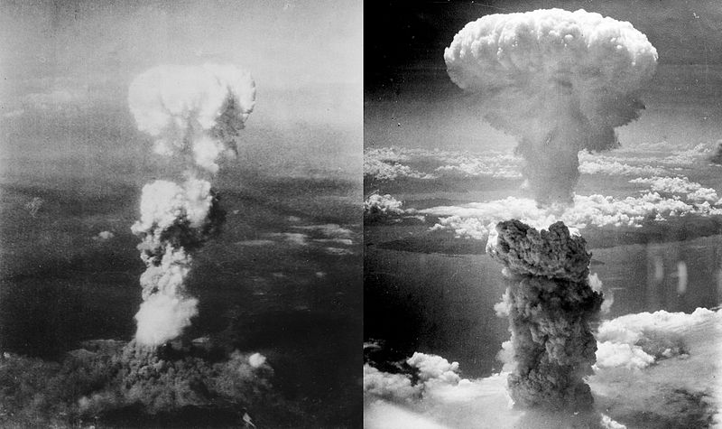
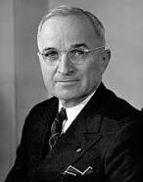
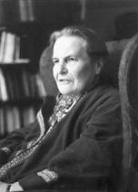
(Hiroshima on the left, Nagasaki on the right)
Notes:
90-166 thousand died in Hiroshima, 60-80 thousand in Nagasaki. More than a hundred thousand civilians died in the extended Iraqu war as well. Should war be opposed because it inevitably leads to unjust means?

Slide 5
A good will (acting according to absolute moral rules)
“Nothing can possibly be conceived in the world, or even out of it, which can be called good without qualification, except a good will. Intelligence, wit, judgment, and the other talents of the mind, … courage, resolution, perseverance, … are undoubtedly good and desirable in many respects; but these gifts of nature may also become extremely bad and mischievous if the will which is to make use of them … is not good. Power, riches, honour, even health, and the general well-being and contentment with one’s condition which is called happiness, inspire pride, and often presumption, if there is not a good will to correct the influence of these on the mind.” (Kant 1-2)
Notes:
Immanuel Kant, Fundamental Principles of the Metaphysics of Morals, trans Thomas K. Abbot 2nd ed. (London: Longmans, Green, 1879), 1-2.

Slide 6
Hypothetical and Categorical Imperatives
There are two things that words like ‘ought’ ‘should’ could mean:
They could mean that if we have certain desires we should do things to satisfy those desires (hypothetical imperatives)
They could mean that we are obligated to do something that it is our duty to do (no matter what your desires are) (categorical imperative)
Notes:
If you want people to think you are kind, you should be kind to people. You should be kind to people (even if you don’t care if people think you are kind, or care about other people, or even want to be a good person).

Slide 7
How can we be obligated regardless of our desires?
Categorical oughts and shoulds (moral obligations) are derived from a principle that you will accept if you are rational : The Categorical Imperative
First formulation: Act only according to that maxim by which you can at the same time will that it should become a universal law.

Slide 8
The Categorical Imperative
When you are thinking about doing something, the rule you would be following if you did that thing is your maxim.
If that maxim could become a universal law without contradiction and you would be willing to let that state of affairs happen, then your action is morally permissible.
If that maxim could not become a universal law, then your action is morally forbidden no matter what the consequences.

Slide 9
Perfect and Imperfect Duties
Some of the duties derived from the categorical imperative are perfect duties, or rules that must always be followed and have no exceptions: examples include not breaking promises, not lying, and not to committing suicide.
Some are imperfect duties, or rules that do not always have to be followed and that do have exceptions: examples include developing your talents, and helping others.

Slide 10
Logically inconsistent maxims and maxims you wouldn’t will…
A perfect duty is necessitated by a maxim that you cannot will become a universal law without contradiction: lying to get a loan
An imperfect duty is one that is necessitated by a maxim such that you can will it become a universal law without contradiction. However, if everyone followed that maxim it would result in an undesirable state of affairs: not helping others in need
Notes:
(make a promise with no intent to keep it just in case it serves your interests to manipulate someone)(not helping others in need could be a rule followed by everyone without contradiction, but then no one would help you when you are in need).

Slide 11
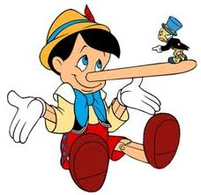


First Example: Lying
Lying to obtain a loan: could it be a maxim everyone followed?
No, if everyone did this, then people would know that a promise to pay the money back is not to be trusted.
Notes:
Did you know animals can lie?

Slide 12
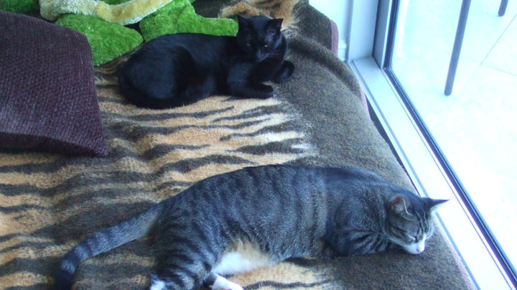
Lying Cats

Slide 13
Kant’s reply to the Nazi example:
If Nazis ask if your Jewish friend is in your house, and you tell them a lie, a bad consequence may happen as a result of your lie (they may be sneaking out the back and get caught because of your lie).
Or a good consequence may happen because you told the truth.
You cannot control the consequence, therefore you should only act according to the right reason.
Notes:
Is this reply adequate? Suppose you are a Dutch fishermen, like those who smuggled Jews out of Nazi Germany and Poland…

Slide 14
Second Example: Suicide
For love of myself I will take my life when a longer duration will be more painful then pleasant.
The maxim as a universal law is to destroy life by the feeling (self love) whose purpose it to impel the improvement of life.
The feeling of self-love is aimed at destroying the self, hence contradicting its own aim.
Notes:
Should suicide really be conceived of as having this motive? Self love? And can it really be considered immoral in all cases: Soldier jumping on a live grenade, killing yourself to protect state secrets, killing yourself to spare your family crippling medical bills and suffering, etc.

Slide 15
Third Example: Developing Talents
Only act to promote your own indulgence and comfort (do not develop talents)
Can be universalized without contradiction, but if everyone followed this maxim would lead to a undesirable idle society.
This is an imperfect duty

Slide 16
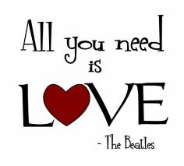
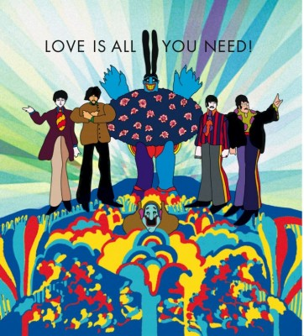
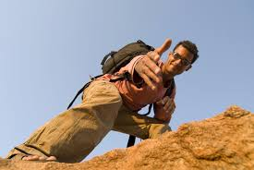
Fourth Example: Helping Others
Never help others out of love and sympathy, only help yourself.
Could be universalized without contradiction, but would not be desirable for any particular person in such a world: we all occasionally need the love and sympathetic help of others.

Slide 17
Human dignity as rational agents
Humans are different from mere things, Kant thought, in that we are rational agents who give things value.
Mere things have value only for us, and we use them as a means to achieving the goals, desires, and plans we have.
Each human being, as a rational agent, has this property of being an “end-in-itself” or a creator of ends that is intrinsically valuable because it is the origin of all values.

Slide 18
The Second Formulation
Act so that you treat humanity, whether in your own person or in that of another, always as an end and never merely as a means.
Consider lying to obtain a loan. Even if you are doing this for a good reason, you are manipulating the person you are lying to.
You are treating them as a means, or a tool, to achieve your goal.
If you tell them of the goal, and they agree to give you the money, then you are not lying and treating them as an end (a rational agent that makes goals and has desires and hence values)

Slide 19
The moral status of animals according to Kant
“But as so far as animals are concerned, we have no direct duties. Animals… are there merely as a means to an end. That end is man.” (Kant, Lectures on Ethics 1779).
Even if animals are more than just “mere things” as Kant thought because they have desires and goals, they do not have intrinsic self worth as rational agents, or free agents capable of making their own decisions, setting their own goals, and guiding their conduct by reason.
As a result, we have no direct duties to animals from a Kantian perspective.

Slide 20
Combining the first and second formulations
Kant thought that the two versions of the categorical imperative were two ways of stating the same idea, but the two principles are in fact distinct, occasionally leading to different conclusions about the rightness of an action.
For example, the maxim “when the usual antiterrorist tactics fail to stop terrorists from killing many people, the authorities should threaten and kill the terrorists relatives.” This passes the first test (although it would not be desirable, it isn’t self-defeating) but not the second.
The most plausible Kantian approach is to consider these two principles to be two parts of a single test that determines the rightness of an action
Notes:
If a maxim is a categorical imperative, then it must pass both tests (be universiliziable and not involve treating someone as a mere means).

Slide 21
Two theories of punishment
Utilitarian (consequentialist)
Kantian (retributivist)
We will compare and contrast how these ethical theories apply to the idea of punishment in general,
And then consider how they apply to the justification or lack of justification for capital punishment.

Slide 22
Utilitarian theory of punishment
Reasons to punish people are all justified by the overall good it does society weighed against the suffering of the punished.
Punishment provides comfort and gratification to victims and their loved ones
It protects society by removing threats
It deters criminals from committing crimes
It can rehabilitate wrongdoers with psychological therapy, educational opportunities, and job training.

Slide 23
Deontological Theory of Punishment
Retributivist: it is just to punish people for crimes – they deserve it.
If we imprison a criminal to benefit society, rehabilitate them, or kill them to deter others, we are using them as a mere means (for our own end).
Moreover, they deserve punishment proportionate to their crime because they are rationally endorsing their crime by freely choosing to commit it.
By doing so, they are implying that doing such a crime is the sort of thing that should be done, or in other words they are willing that their maxim become a universal law.
So in treating them as they have treated others, we are merely doing to them what they have already decided should be done to other people.
Yet, why stoop to their level? (Perhaps it would be unjust for the guilty to go unpunished – they attempt to receive a benefit by harming others, so in a fair system where each member gets what they deserve the immoral ought to get punishments and the moral rewards.)
Notes:
? (Perhaps it would be unjust for the guilty to go unpunished – they attempt to receive a benefit by harming others, so in a fair system where each member gets what they deserve the immoral ought to get punishments and the moral rewards.)

Slide 24
Capital Punishment (Pojman)
Deontological (backward-looking) reasons for having the death penalty:
Retribution: the guilty deserve to be punished in proportion to the severity of their crime (because they have willfully done something wrong).
Retribution is different from vengeance because a legal system determines whether and to what extent someone should be punished, and that legal system is the product of (hopefully) a just “rule of law” society.

Slide 25
Defining and clarifying the issues and terms:
What the issues are:
Is capital punishment immoral in principle? Is there something intrinsically immoral about capital punishment regardless of the circumstances surrounding the practice?
If capital punishment is sometimes moral and sometimes immoral, depending on the circumstances surrounding the action or practice, then what kinds of considerations and moral reasons determine when capital punishment is immoral?
Relevant terms and distinctions:
What is the right characterization of the death penalty? Is it the worst possible penalty? What makes it worse than life imprisonment? What is it properly used as a penalty for? What is it actually used as a penalty for? Which is the more morally relevant, the actual use of the death penalty or the in principle rightness or wrongness?

Slide 26
Deterrence
Utilitarian reasons:
Assuming much crime occurs as the result of a cost/benefit analysis, where the cost is determined by likelihood of getting caught and the severity of the penalty, murder is deterred in two ways:
The would be murderers that don’t receive the death penalty refrain from murder out of fear
The murderers who do receive the death penalty do not murder guards, prisoners, or others
Effectiveness is increased by public executions and speedy trials (but would this be a good thing?)

Slide 27
The Best Bet Argument
To have the death penalty is to bet on the innocent, to not have it is to bet on the murderers: | We have the death penalty | We do not have the death penalty
The death penalty deters (more than life imprisonment) | Some innocents are saved, some murderers are killed | No innocents are saved that could have been saved, no murderers are killed
The death penalty does not deter (more than life imprisonment) | No innocents are saved, some murderers are unnecessarily killed | No innocents are saved, no murderers are unnecessarily killed

Slide 28
Objections:
The death penalty occasionally punishes the innocent, which is to commit the same or a worse crime than murder
Not the same crime (no intention to kill the innocent)
Society has a right to protect itself and give murderers what they deserve even if it means a possibility that some errors are made
Other errors are tolerated: car accidents, fire trucks/ambulances injuring people, etc.

Slide 29
More Objections:
The death penalty discriminates against the poor and minorities over rich people and whites.
A law applied in a discriminatory manner is not necessarily an unjust law. It is the discriminatory manner of the application that is unjust.
If our current practices do discriminate in this way, we ought to reform our justice system to stop discrimination, not remove the death penalty.
Perhaps we should expand the scope of the death penalty to include severe white collar crime.

Slide 30
Capital Punishment (Bright)
Of 20,000 annual murders in the US, fewer than 300 people are sentenced to death, and 55 are executed each year
In the South 85 percent of the executions happen and there is the highest murderer rate
In the Northeast 3 percent of the executions happen and there is the lowest murderer rate
Only 33% of the world’s countries use the death penalty (the US is the only NATO country that still uses it since 2001).

Slide 31
The unfair and arbitrary process leading to the death penalty
http://www.innocenceproject.org/understand/Eyewitness-Misidentification.php
Over 100 people condemned to death in the last 30 years have been exonerated and released.
Eyewitness identification highly inaccurate
Incompetent lawyering
False confessions
Prosecutors decide death penalty (arbitrarily) and often there is prosecutional misconduct (20-30 percent of exoneration cases involve such misconduct).
Fingerprint analysis
Misuse of DNA evidence in cases http://ac360.blogs.cnn.com/2011/09/07/video-knoxs-prosecutors-under-fire/?iref=allsearch

Slide 32
Utilitarian reasons summarized:
Consequentialist (Utilitarian) reasons for or against:
Consequentialist reasons for considering it immoral: The startling false positive rate. Many of the cases, about 20-30 percent, involve prosecution misconduct. There are great inequities in the way that the death sentence is meted out to minorities and those who are not socioeconomically well off. No study has shown it deters more than life imprisonment, and it is a drain on the resources of tax payers, degrades and sends a message that death is an appropriate punishment to others in our society.
Consequentialist reasons against considering it immoral: It may prevent future murders of guards or prison officials (and people if there is a chance the murderer will get parole), and may also deter more than life imprisonment because it is the worst of all penalties (supposedly).

Slide 33
Deontological reasons summarized:
Deontological reasons for or against:
Deontological reasons for considering it immoral: It violates a persons right to life in the same way that that person violated another’s right to life. It may even set a precedent for this disvaluing of lives.
Deontological reasons against considering it immoral: Doesn’t the greatest crime, the irrevocable and irreparable loss of life, deserve the greatest punishment, different in quality from all other punishments? In principle an innocents life, even if only potentially threatened, has more right to be protected than a murderers, and so if there is even a marginal deterrence from capital punishment this might suffice to justify it. There does seem to be one, since psychologically the greater the punishment the more likely it is to discourage.

Slide 34
In Class Peer Based Learning Exercise
If there were a fair way of determining who is actually guilty of murder (or a comparable crime); do you think that capital punishment is a justifiable punishment? Be sure and support your answer with a (Kantian or Utilitarian) moral reason.
Notes:
Remind them that this whole exersize is premised on the idea that there are differences in the way that your peers think, and that these differences will help you understand other people’s perspective as well as better undertand and draw your own conclusions by having to explain your reasons to others. There is a movement in ethics in recent years called care ethics that is a feminist movement that holds that men and women in general have different ways of understanding morality. These are slight differences, and do nto imply superiorirty or inferirority of either gender. Rather, these differences allow us to better understand morality especially givent hat ethics has been a male dominated field for thousands of years, they in particular allow us to see areas that thinking from a masculine perspecitve might blind us too. The next section we will be feminism and the ethics of care.

Slide 35



Readings for Next Time:
Chapter 11 (RTD)

