Slide 1
Social Contract Theory
Dr. Daniel Hampikian

Slide 2
Thomas Hobbes
Thomas Hobbes (17th century British philosopher)
In the Leviathan, his most famous work, argues for a conception of morality as rules people accept for their own benefit.

Slide 3
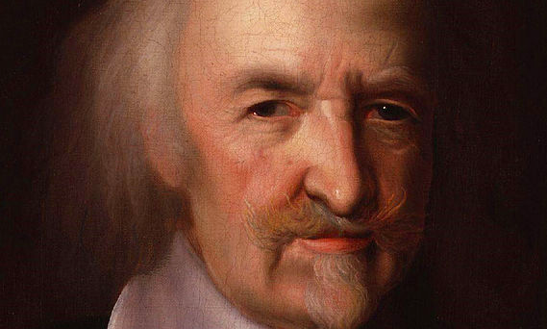
Here he is:

Slide 4
If there were no way to enforce social rules….
Life would be nasty, brutish, and short.
This is because of four natural facts. There is
Equality of need (of food and resources)
Scarcity
Equality of human power (no one a group can’t overpower)
Limited altruism

Slide 5
Constant state of war
We would seize what we need to survive from and prepare it from attack from anyone.
In order to escape this state of nature, we need to create a stable and cooperative society that can produce more goods and distribute them in a peaceful and rational way
So we set aside self-interested designs in favor of rules that benefit everyone on the condition that everyone else do the same

Slide 6
The Social Contract Theory
“Morality consists in the set of rules, governing behavior, that rational people will accept on the condition that others accept them as well.” (Elements 83)
Breaking these rules results in the state and public opinion punishing
We should be moral because it is in our own self interest
Morality is objective in that accepting these rules is rational for everyone in every society

Slide 7
The Prisoner’s Dilemma
A problem formulated by social scientists Flood and Dresher that shows another reason supporting social contract theory
Consider what would be in your best interests to do if your are captured and asked to falsely testify against another prisoner, Smith. He is asked to falsely testify against you, and you are not allowed to communicate with each other.

Slide 8
What should you do?
 | You testify against Smith | You do not testify against Smith
Smith Testifies against you | You get 5 years Smith gets 5 years | You get ten years Smith goes free
Smith does not testify against you | You go free Smith gets 10 years | You get 1 year Smith gets 1 year
Notes:
See what the minimum amount of jail time is for each possibility: Smith confesses or he does not confess.

Slide 9
An enforceable agreement
Suppose you could communicate. Does what you should do change?
The most rational thing to do would be for neither to confess, but only if there is a way to prevent Smith from reneging on the bargain (and only if there is a way to prevent you from doing the same).

Slide 10
How does this support Social Contract Theory?
 | You live selfishly | You live benevolently
Others live selfishly | Hobbes’ state of nature (no one profits very much) | Others profit most You suffer most
Others live benevolently | You profit most Others suffer most | Both profit somewhat Neither suffers very much
Notes:
Acting selfishly is never taking anyone else's interests into account, taking what you need, lying stealing, etc., when it is in your interests, living benovelently is taking other’s interests into consideration as equally important to your own (Impartiality, part of morality)

Slide 11
State enforced agreement
The agreement is to live morally, respecting the interests of others in exchange for them respecting your interests.
The agreement must be enforceable to prevent free riders, hence the state.
Morality is restricting your freedom to profit from harming others in exchange for others restricting their freedom to profit from harming you.

Slide 12
Additional Reasons for Social Contract Theory
This theory specifies what morally binding rules are (those that promote harmonious social living) and how they are justified (because without them cooperation would be impossible).
It explains why it is rational to follow moral rules – we agree because social harmony is better than Hobbes’ state of nature, and we actually follow them because punishments are enforced
Notes:
Prohibitions against murder, assualt, stealing, lying, promise breaking, etc.

Slide 13
Additional Reasons for Social Contract Theory
It explains when it is rational to break moral rules: when others do not follow them.
It explains why supererogatory acts are admirable but not morally required
Notes:
Morality is a matter of accepting certain rules on the condition that others accept them as well. If they break those rules, you are under no obligation to follow them (remember, you only do so because it is advantegous if everyone follows those rules).
Sacrificing yourself to save 5 others is not an agreement you can rationally expect other people to follow, we cannot rationally expect strangers sacrifice themeselves to save us, and even if this were enforced their fear of death would prevent the potential punishment from enusreing they agree to such a contract. Rationaly people will not agree to moral rules that are too demanding because others will not follow them.

Slide 14
Civil Disobedience: Gandhi and King
Laws are basically good for society, and disobedience to the laws weakens respect for the laws and damages the state.
According to social contract theory, we have an obligation to obey the law because if everyone obeys it then social cooperation and harmony is possible, and everyone benefits from the agreement.
If the laws are only beneficial for some (free riders) then the disadvantaged are released from their obligation to follow the laws.
Notes:
Mohandas Gandi led the Indian independence movement (1869-1948) marched to distill salt from saltwater in protest of the Biritish governments imperialistic laws to profit from salt sales. In America, MLK jr. led the Montgomery Bus riot which began after Rosa Parks was arrested for refusing to give up her bus seat to a white man.

Slide 15
MLK Jr.’s Letter
Dr. Martin Luther King Jr.’s Letter From the Birmingham City Jail (1963)
A reply to a statement issued by his fellow clergy men who sympathized with his cause but not his methods of nonviolent civil disobedience.
Negotiation is preferable, but if one side will not negotiate or will not negotiate fairly, then nonviolent protests and civil disobedience serve to provide tension and point out injustice
Just and unjust laws, unjust laws can be broken
One kind of unjust law is a code that one group compels on another and that is not binding on the first group
Everything Hitler did was legal, but unjust.

Slide 16
Problems for the theory
Not a real contract/agreement: but the rules are valid because without them everyone would be worse off, not agreeing to the rules is irrational.
This defense abandons the idea that morality is an agreement, but still holds that morality is a set of rules that govern behavior that rational people will accept on the condition other people accept them as well.
Notes:
Not a real contract, but an implicit agreement.

Slide 17
Problems for the theory
Human infants
Nonhuman animals
Future generations
Oppressed populations
Very elderly people
Mentally disabled people
Notes:
What do these groups have in common? They cannot benefit us by agreeing with rules to restrict their powers to harm us.

Slide 18
MLK Jr.’s I have a dream speech:
http://www.youtube.com/watch?v=smEqnnklfYs

