Slide 1
Virtue Ethics
Dr. Daniel Hampikian

Slide 2
The Questions of the Ancients
“What is the good of man?” (Aristotle) The virtuous activity of the soul
“What is the best way (Dao) to live” (Confucius) Junzi
Except for Hume and the Sentimentalist movement, until Anscombe in the 19th century ethics was dominated by a conception of morality based on laws (moral or religious) that it was one’s duty to follow.
The question was “What is the right thing to do?” not “What traits of character make someone a good person?”

Slide 3
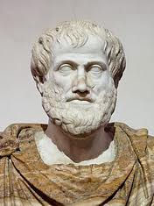
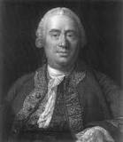
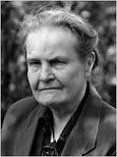
“Modern Moral Philosophy”
Anscombe’s article in 1958 that argued that modern moral philosophy is misguided because it rests on the incoherent notion of a law without a lawgiver.
After that influential article, virtue ethics was revived and is currently considered once again a viable option.
Hume Anscombe

Slide 4
A theory of virtue
Will explain what a virtue is
Will account for why virtues are good to have (for Aristotle eudaimonia or flourishing was a matter of being virtuous)
Will list the virtues
And explain what constitutes each individual virtue

Slide 5
What is a Virtue?
Aristotle: A trait of character manifested in habitual action.
An honest person is truthful not just occasionally or when it benefits them, but from a firm and unchangeable character.
Virtues, unlike vices, are good in the sense of being commendable or praiseworthy.
A moral virtue is a trait of character, manifested in habitual action, that is good for anyone to have.

Slide 6
The Virtues (a partial list):
Benevolence, civility, compassion, conscientiousness, cooperativeness, courage, courteousness, dependability, fairness, friendliness, generosity, honesty, industriousness, justice, loyalty, moderation, patience, prudence, reasonableness, self-discipline, self-reliance, tactfulness, thoughtfulness, tolerance, kindness
According to Aristotle, each virtue is a mean between two extremes (an excess or a deficiency, both of which are a vice)
Courage as the mean between rashness and cowardice

Slide 7
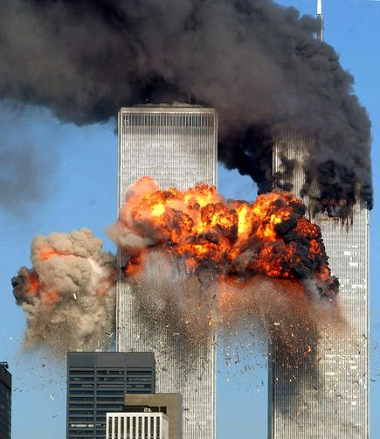
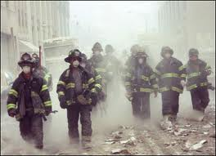
In Class Peer Based Discussion:
Were the 9/11 terrorists brave? If so, what makes the bravery of the first responders good and the bravery of the terrorist bad? If not, why?
Notes:
Try to get them to see that you really need several virtues being balanced by rational thought in order to be virtuous in the sense of a virtuos person (phronesis, or practical widsdom might be good here: the ivrtue of knowing what the various morally relevant facts require of you (and how it works in tandem with the other virtues).

Slide 8
Generosity
The willingness to expend one’s resources to help others is a mean between stinginess and extravagance.
Jesus and the utilitarians disagree (and most affluent people disagree with Jesus on this matter today, which is why they buy products that aren’t necessary to survival while children could be saved with that money)

Slide 9
Loyalty
To friends and family
Friends take care of each other even when it is inconvenient, and they do so preferentially. The same is true of family.
Justice and Benevolence require equal treatment of everyone, but the virtue of loyalty explains why it is ethical to treat our friends and family partially

Slide 10
Each virtue is valuable for different reasons
Loyalty is essential to friendship, generosity to helping people, and courage to overcoming danger.
Aristotle offers a general answer to this question: the virtuous person will fare better in life, they will flourish.
We are social creatures who want the company of others. Qualities such as loyalty, fairness, generosity, and so on are needed to successfully interact with others, to pursue our interests, and to flourish with others.

Slide 11
Are Virtues Relative?
Modesty is different across cultures, the virtues of a soldier are not necessarily the virtues of a monk scholar.
Certain virtues, however, will be needed by all people in all times.
Everyone needs courage, because no one can avoid danger or risk, in every society there are some who are better off than others, hence generosity will be prized, and everyone needs friends that are loyal.

Slide 12

What are the advantages of Virtue Ethics?
Virtue Ethics is appealing because it provides a natural and attractive account of moral motivation.
The Michael Stocker example…
Notes:
Smith visits from a sense of obligation, not because he likes you or cares about you. We would not want to be such a person or live a society with only such people. Therefore, theories of morality must empathize personal qualities such as friendship, love and loyalty (virtues) rather than purely obligation and right action.

Slide 13
Doubts about the “ideal” of Impartiality
Impartiality is central to Kantianism and Utilitarianism.
However, why should we be impartial when our family and friends are concerned?
Beneficence requires equal regard for everyone and is a virtue, as is loyalty which involves partiality towards loved ones. A complete moral theory would need to explain how these virtues relate to one another.

Slide 14
Virtue and Conduct
Virtue ethics can supplement utilitarianism or Kantianism. If so, it will rely on those theories to supply an account of right conduct and provide them in turn with an account of moral character.
Some virtue ethicists think of virtue ethics as an alternative to these approaches. Then the reason to do any particular action is that it would be virtuous to do that action (fair, honest, benevolent, etc.)
The right thing to do would then be whatever a virtuous person would do.

Slide 15
Virtue Ethics is Incomplete
It cannot explain why the virtues are virtues without relying on another ethical theory (they promote welfare, or your own interests, or are needed to live with others in a stable society)
It cannot say exactly how the virtues apply (being kind could be to avoid causing suffering or to do what someone would prefer if your wondering whether to tell someone bad news that they would want to know)
Virtue Ethics cannot tell us how to resolve all conflicts of virtues, like conflicts between honesty and kindness.

Slide 16
So Virtue Ethics…
Is best seen as part of our overall theory of ethics rather than as being a complete theory in itself
For instance, you might hold that actions, social policies, and the virtues that lead to a society in which everyone is maximally happy and satisfied are moral.
This would be combining a utilitarian account of right action with a virtual ethical account of good character

Slide 17
Being ethical requires that you exercise an Aristotelian virtue: Phronesis
This is often translated as “practical wisdom”
It involves first understanding what types of considerations make something right or wrong (does it neglect someone’s rights, does it create suffering, etc.)
Seeing and understanding the ethically relevant facts in particular concrete circumstances
Knowing how your actions will effect those involved
And then acting morally and refraining from acting immorally

Slide 18
Template for Phronesis in Moral Judgment and Action:
Defining and clarifying the issue and terms:
What the issue is:
Is X moral/immoral in principle? Is there something intrinsically moral/immoral about X regardless of the circumstances surrounding the action or practice of X?
If X is sometimes moral and sometimes immoral, depending on the circumstances surrounding the action or practice, then what kinds of considerations and moral reasons determine when X is moral and when X is immoral?
Relevant terms and distinctions central to the issue:
Ethically relevant facts:
What actions or inactions can be taken to affect this issue?

Slide 19
Template for Phronesis in Moral Judgment and Action:
Consequentalist reasons (does this action or practice result in more suffering than happiness?)
Consequentalist reasons for considering it immoral:
Consequentalist reasons against considering it immoral:
Deontological reasons: (does this action or practice treat people according to their rights as rational agents?)
Deontological reasons for considering it immoral:
Deontological reasons against considering it immoral:

Slide 20
Template for Phronesis in Moral Judgment and Action:
Virtue ethical reasons (is this action or practice something a virtuous person would do?):
Virtue ethical reasons for considering it immoral:
Virtue ethical reasons against considering it immoral:
Social Contract reasons: (does this action or practice fall under a set of rules that regulate behavior that everyone accepts on the condition others do so as well)
Social contract reasons for considering it immoral:
Social contract reasons for considering it moral:

Slide 21
Template for Phronesis in Moral Judgment and Action:
Thought Experiments and Comparison Cases
Consider comparison case X which we regard to immoral/moral because of Y features. There is no morally relevant difference between case X and case Z which both share Y features, so we should conclude that case Z is immoral/moral as well.
Consider thought experiment X which we regard to immoral/moral because of Y features. There is no morally relevant difference between case X and case Z which both share Y features, so we should conclude that case Z is immoral/moral as well.

