Slide 1

Daniel Han-Chen, Johnny Wong

Slide 2
Disclaimer + Legal Stuff
All content in these courses are for educational purposes only. UNSW’s Mathematics and Statistics School and any UNSW entity including the Data Science Society and ARC is not responsible for any misuse or usage of our material in any commercial or educational practice and endeavor. Any UNSW entity and the society will not be in any way responsible for any damages caused if you are attending or watching these lectures online / or in person.
2. We thank UNSW’s Mathematics and Statistics School for allowing us to provide these lectures free of charge to all students.
3. NO RECORDINGS allowed. Strict rules. Only the society can record any material. All material will be placed on YouTube. If you want to record, please ask us first for permission. If we say yes, you must note the original owners of these lessons.
4. We’ll try our best to acknowledge all work and materials that we use within our presentation. If we forgot about some, we’re terribly sorry. Please contact us, and we’ll place an acknowledgement to the original author.
UNSW Data Science Society
Artificial Intelligence Lab

Slide 3
Linear regression
Scatter plot two variables
Line of best fit
MSE
Deriving coefficients
Other cost functions
Analysis of residuals
Heteroskedasticity
Autocorrelation
Confidence intervals

Slide 4
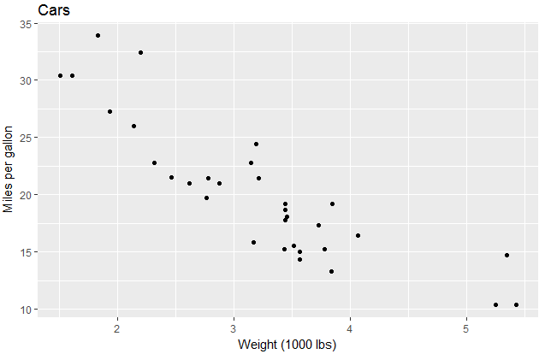
Two variables

Slide 5
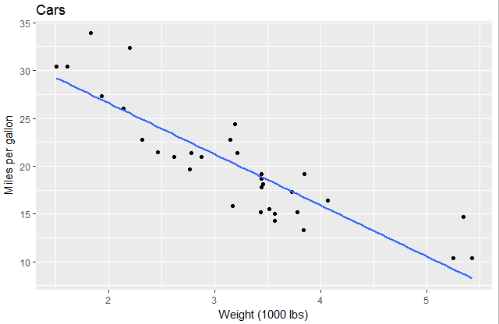
Linear regression – line of best fit

Slide 6
How good is the line?
How can we quantify how good the line is?
What is considered the “best” line?

Slide 7
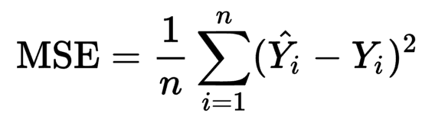
How good is the line?
How can we quantify how good the line is?
What is considered the “best” line?
Mean squared error

Slide 8
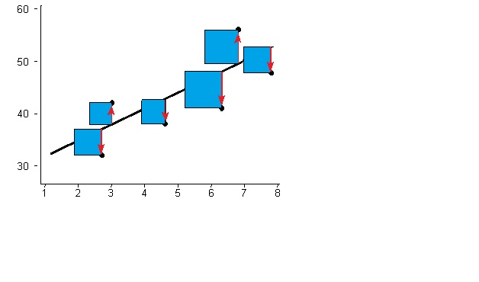
Geometric interpretation

Slide 9
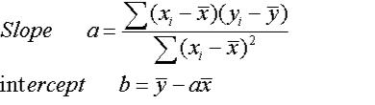
Derivation of coefficients
We want to minimise the MSE
We can think of the MSE as a function of the regression coefficients.
Different lines will have different MSE
Find the coefficients of the line that has the lowest

Slide 10
Other cost functions?

Slide 11

Analysis of residuals
Where does the model go wrong?
${\hat{y}}_{i}=a+bx_{i}$
$y_{i}=a+bx_{i}+ε_{i}$

Slide 12
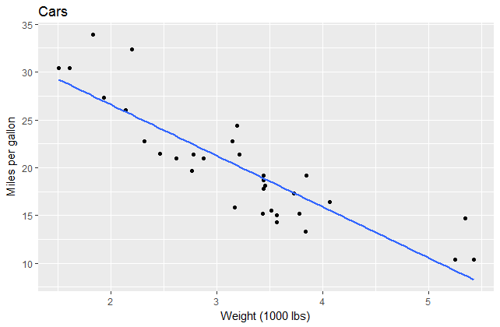
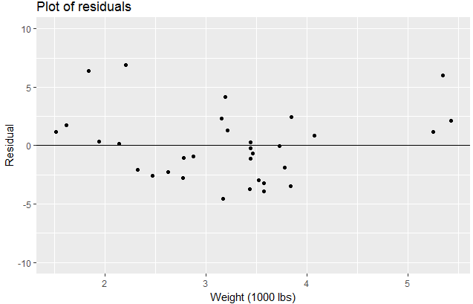

Slide 13

Breakdown of a model
Actual value = deterministic component + stochastic component
$y_{i}=a+bx_{i}+ε_{i}$
We want to capture all that we can in the deterministic component and have the residuals be completely unpredictable

Slide 14
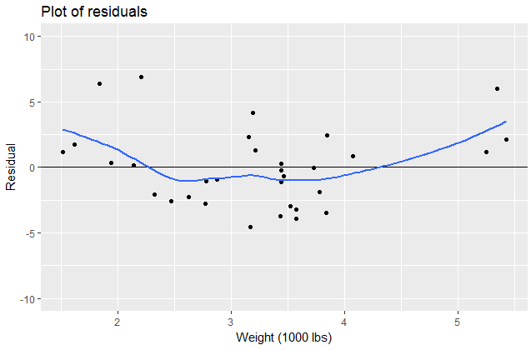
Diagnosing residuals
Are they completely random?
Seems like there is a parabolic trend. But sample is fairly small so may be just coincidence

Slide 15
Diagnosing residuals
Are they completely random?
Seems like there is a parabolic trend. But sample is fairly small so may be just coincidence

Slide 16
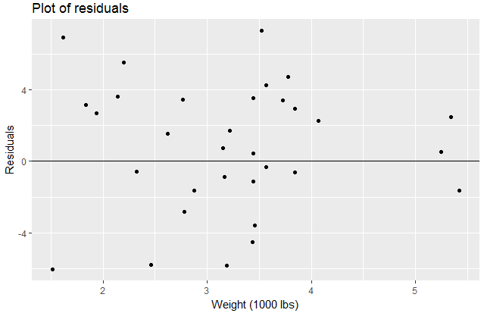

What should random residuals look like?
IID – independent and identically distributed
For linear regression, it is assumed that $ε_{i}$ is IID normal
$ε_{i}\sim$Normal(0, $σ$)

Slide 17
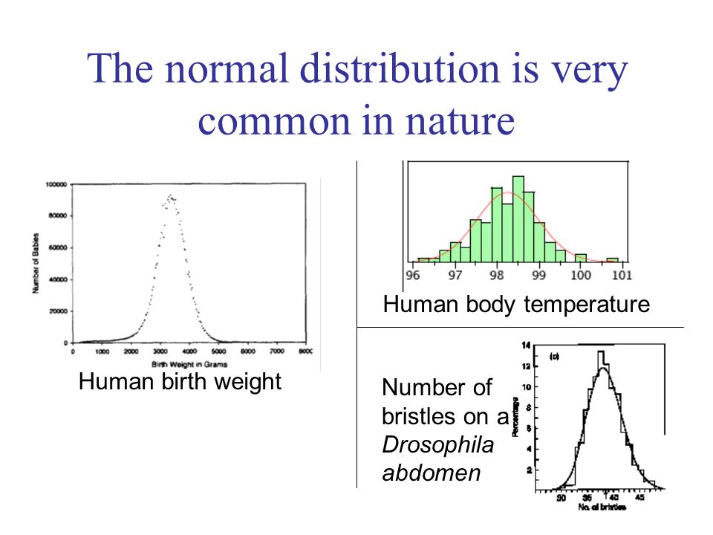
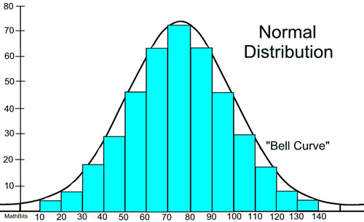
Normal distribution

Slide 18
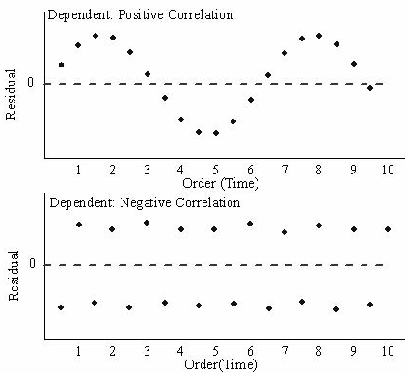
What shouldn’t random residuals look like?
Autocorrelation

Slide 19
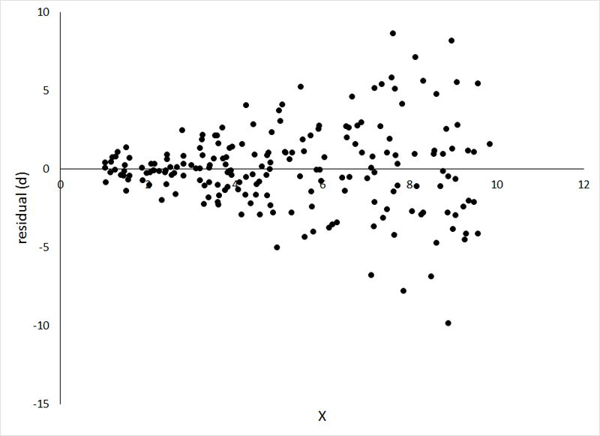
What shouldn’t random residuals look like?
Heteroskedasticity

Slide 20
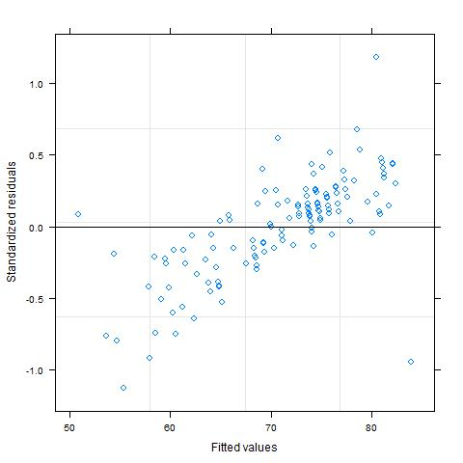
What shouldn’t random residuals look like?
Bias

Slide 21
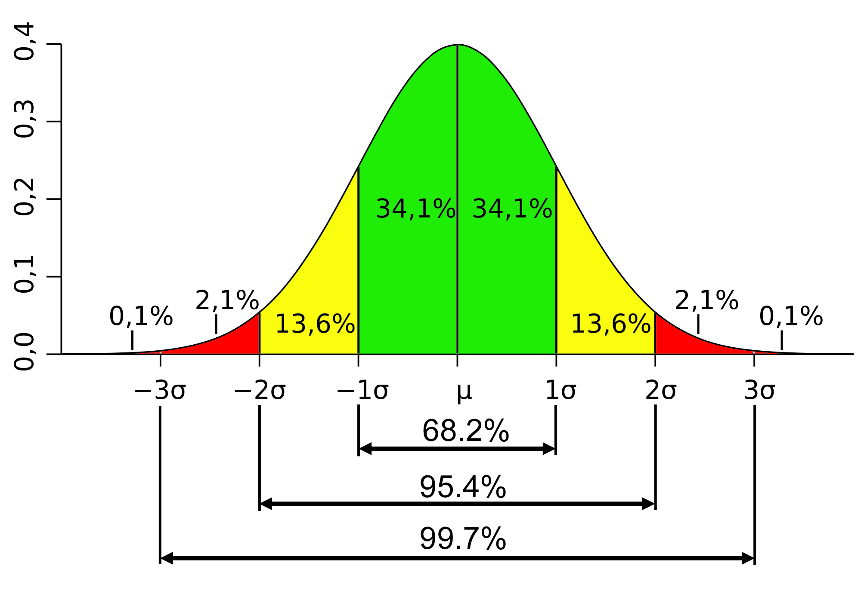

Confidence intervals
Suppose I have a standard Gaussian (Normal) random variable
Defined by mean ($μ$) and standard deviation ($σ$)
I can be 95% confident that the value is between -1.96 and 1.96

Slide 22

Prediction intervals
$$y_{i}=a+bx_{i}+ε_{i}$$
$ε_{i}\sim$Normal(0, $σ$)
$y_{i}\sim$Normal($a+bx_{i}$, $σ$)
95% confident that
$$y_{i}=a+bx_{i}±1.96σ$$

Slide 23
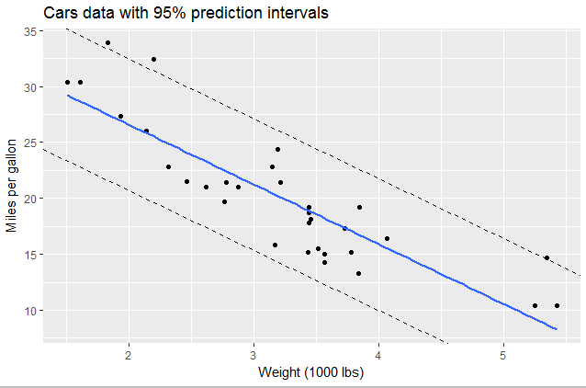
Prediction intervals

Slide 24
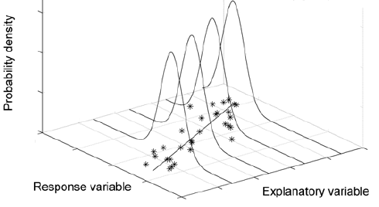
Prediction interval
In linear regression, you’re predicting the MEAN of the response variable

Slide 25
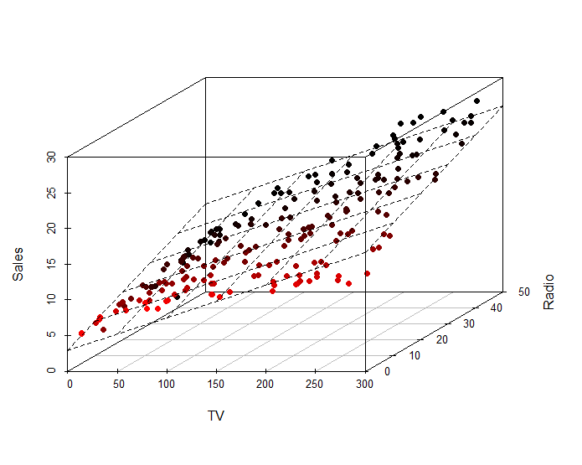
Multivariate regression
For higher dimensional data

Slide 26
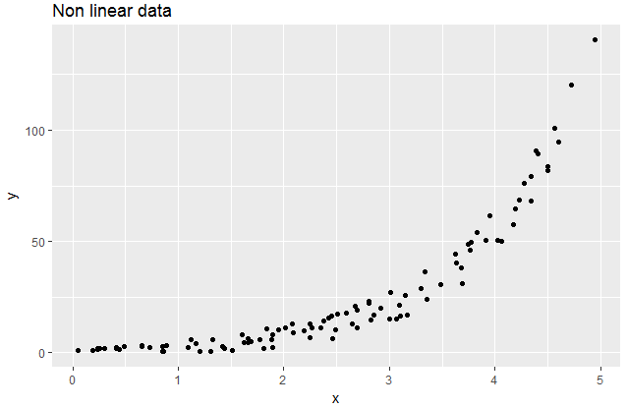
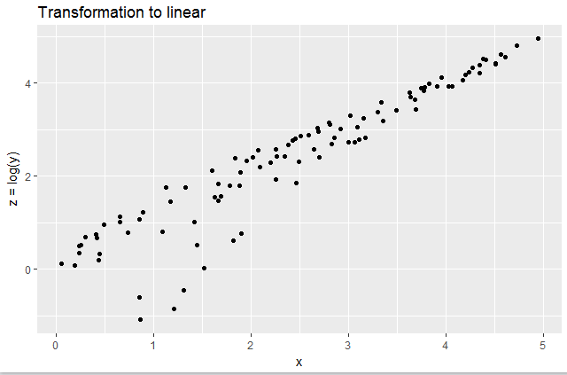
Generalised linear models (GLM)

Slide 27
https://www.kaggle.com/iliassekkaf/computerparts/data

Slide 28












…
…
Singular Value Decomposition SVD
$$X=UV^{T}$$
Eigendecomposition
Markov Systems
$$X=VΛV^{T}$$
$$X^{θ}=VΛ^{θ}V^{T}$$
Pseudoinverse
$$X^{+}=V^{+}U^{T}$$
…
Principal Component Analysis PCA
$$PCA_{0:c}=sort{\left(∑ in U∑V^{T}\right)}_{0:c}$$
…
Linear Regression
$$\hat{θ}=X^{+}y$$
$$\hat{σ}=\frac{||y−\hat{y}||}{n−d}$$
Lasso Regression (L1)
$$θ_{L1}\sim \min{||y−\hat{y}||} +λ_{L1}|θ_{L1}|$$
Weighted Linear Regression
$$θ_{WLS}={\left(X^{T}WX\right)}^{−1}X^{T}Wy$$
Confidence Intervals
$$\hat{θ}±t_{1−\frac{α}{2},n−d}\hat{σ}\sqrt{diag\left(V∑^{2+}V^{T}\right)}$$
Ridge Regression (L2)
$$θ_{L2}\sim \min{||y−\hat{y}||} +λ_{L2}\left|\left|θ_{L1}\right|\right|$$
$$θ_{L2}={\left(X^{T}X+λ_{L2}I\right)}^{−1}X^{T}y$$
Generalized Linear Regression
$$θ_{GLS}= {\left(X^{T}∑^{−1}X\right)}^{−1}X^{T}∑^{−1}y$$
Prediction Intervals
$$\hat{y_{i}}±t_{1−\frac{α}{2},n−d}\hat{σ}\sqrt{1+x_{i}\left(V∑^{2+}V^{T}\right)x_{i}^{T}}$$
…
Elastic Net Regression (L1, L2)
$$θ_{ENet}\sim \min{||y−\hat{y}||}+λ_{L1}|θ_{L1}|+λ_{L2}\left|\left|θ_{L1}\right|\right|$$
UNSW Data Science Society
Artificial Intelligence Lab

Slide 29







Generalized Linear Regression
$$θ_{GLS}= {\left(X^{T}∑^{−1}X\right)}^{−1}X^{T}∑^{−1}y$$
…
Gradient Descent
$$θ←θ−λ_{LR}C$$
Elastic Net Regression (L1, L2)
$$θ_{ENet}\sim \min{||y−\hat{y}||}+λ_{L1}|θ_{L1}|+λ_{L2}\left|\left|θ_{L1}\right|\right|$$
Activation Functions
$$a=σ_{sigmoid}=\frac{1}{1+e^{−x}}$$
Support Vector Machine
$$θ_{SVM}\sim \min{|φ_{SVM}}\left|+λ_{L2}\right||θ_{SVM}||$$
$$∀φ_{SVM}=\max{(0,1− <y,Xθ_{SVM}>)}$$
Logistic Regression
$\hat{y}=$ $σ_{sigmoid}(Xθ)$
…
…
Neural Network
$\hat{y}=a(…a(a(Xθ_{H1})$ $θ_{H2})…θ_{Hd})$
…
UNSW Data Science Society
Artificial Intelligence Lab

Slide 30











Perceptron
$$\hat{y}=\left\{\begin{aligned}1 \\ 0\end{aligned} \begin{matrix}θX>0 \\ else\end{matrix}\right.$$
Neural Network
$\hat{y}=a(…a(a(Xθ_{H1})$ $θ_{H2})…θ_{Hd})$
Convolutions
$$X∗K$$
Convolutional Neural Net
$$\hat{y}=a(…a\left(\left(X∗K_{1}∗K_{2}∗…\right)θ_{H1}\right)…θ_{Hd})$$
Recurrent Neural Net
$$\hat{y}=G_{R}(…G_{R}(G_{R}(Xθ_{H1}) θ_{H2})…θ_{Hd})$$
Bidirectional
$G_{LSTM>}⨁$ $G_{LSTM<}$
De-Convolutional Neural Net
$$X=a(…a\left(\left(X∗K_{1}∗K_{2}∗…\right)θ_{H1}\right)…θ_{Hd})$$
Long Short Term Memory $$\hat{y}=G_{LSTM}(…G_{LSTM}(G_{LSTM}(Xθ_{H1}) θ_{H2})…θ_{Hd})$$
(De) Convolutional Recurrent Neural Net
$$(X or \hat{y})=NN_{RNN}NN_{CNN}$$
Gated Recurrent Net $$\hat{y}=G_{GRU}(…G_{GRU}(G_{GRU}(Xθ_{H1}) θ_{H2})…θ_{Hd})$$
…
…
…
Embeddings
$$(X_{reduced} or \hat{Vec})=NN$$
UNSW Data Science Society
Artificial Intelligence Lab

Slide 31
https://www.kaggle.com/anthonypino/melbourne-housing-market.
UNSW Data Science Society
Artificial Intelligence Lab

