Slide 1
Instant Messenger Chatting Application
Biztek Technical Proposed Solution

Slide 2
About Instant Messenger
Objective
Infrastructure
Server side
Client side
Chat device
Chat features

Slide 3
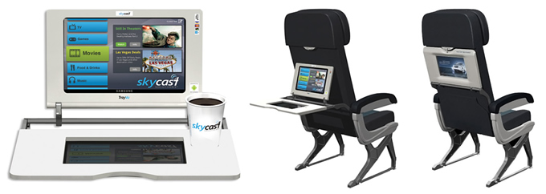
Objective
Menyediakan layanan Instant Messenger di pesawat terbang
Dapat mengusir kebosanan untuk perjalanan panjang

Slide 4
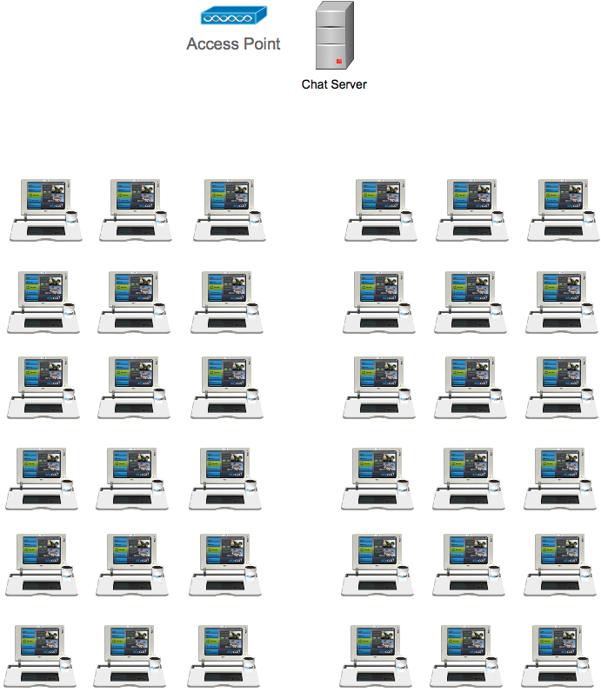
Infrastructure

Slide 5


Server Side
Linux Box
Jabber Messaging Server

Slide 6

Client Side
Android OS
Jabber Client Application

Slide 7
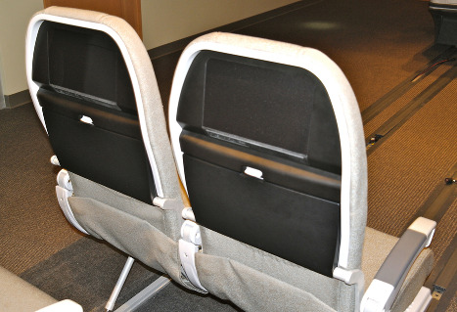
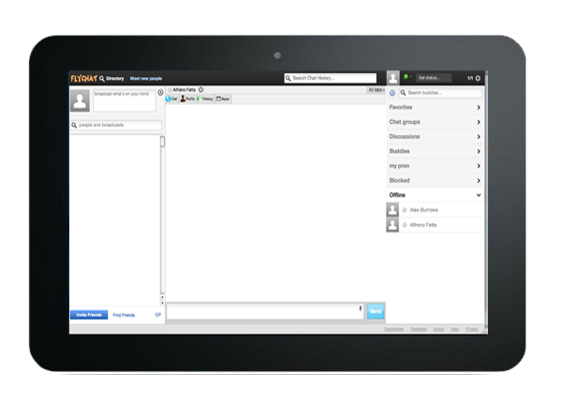
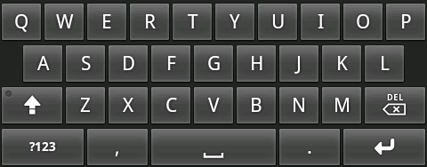
Chat Device
Touch Screen
On Screen Keyboard
Wifi Connection

Slide 8
FLYCHAT
Chat client application
Android based
Local chat

Slide 9
FLYCHAT Feature
Avatar Creator
Group or Individual Chatting
Animation Emoticon
Complete Status
Send
Received
Read
Pending
Retry

Slide 10
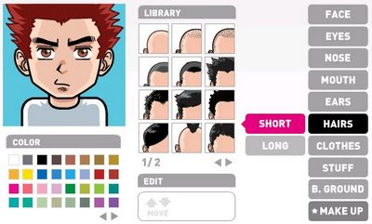
Avator Creator

Slide 11


Group/Invidual Chatting

Slide 12

Animation Emoticon

Slide 13
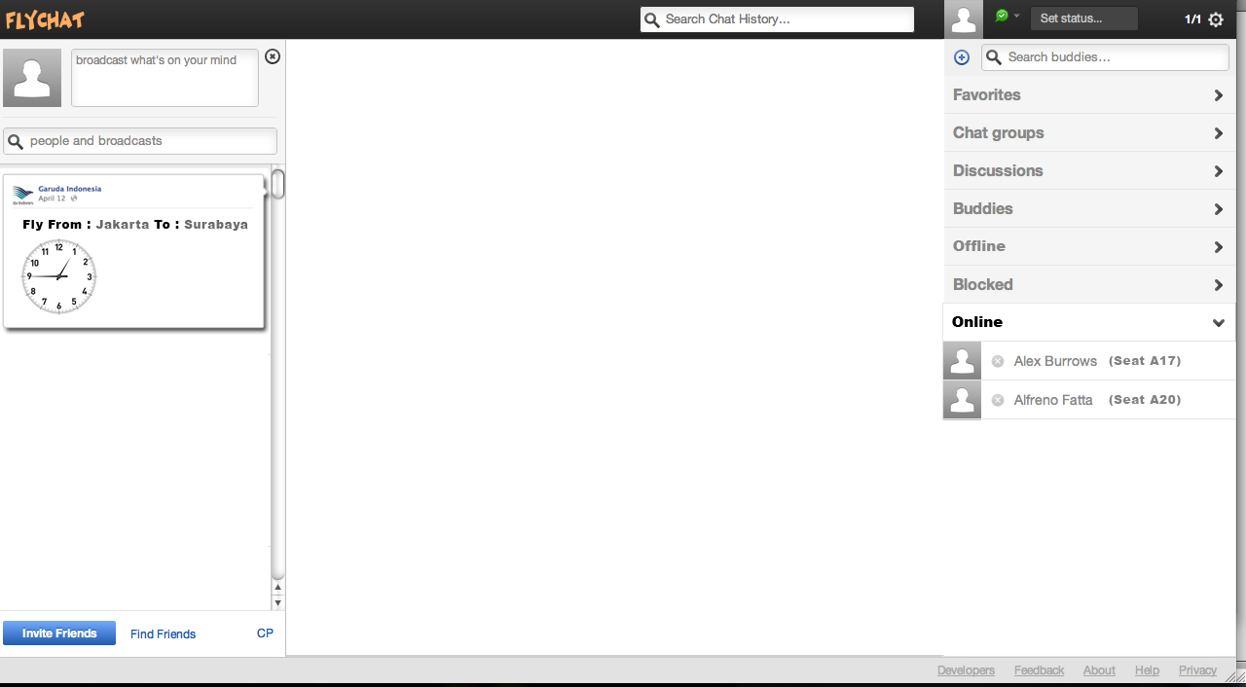
FLYCHAT APPLICATION

Slide 14
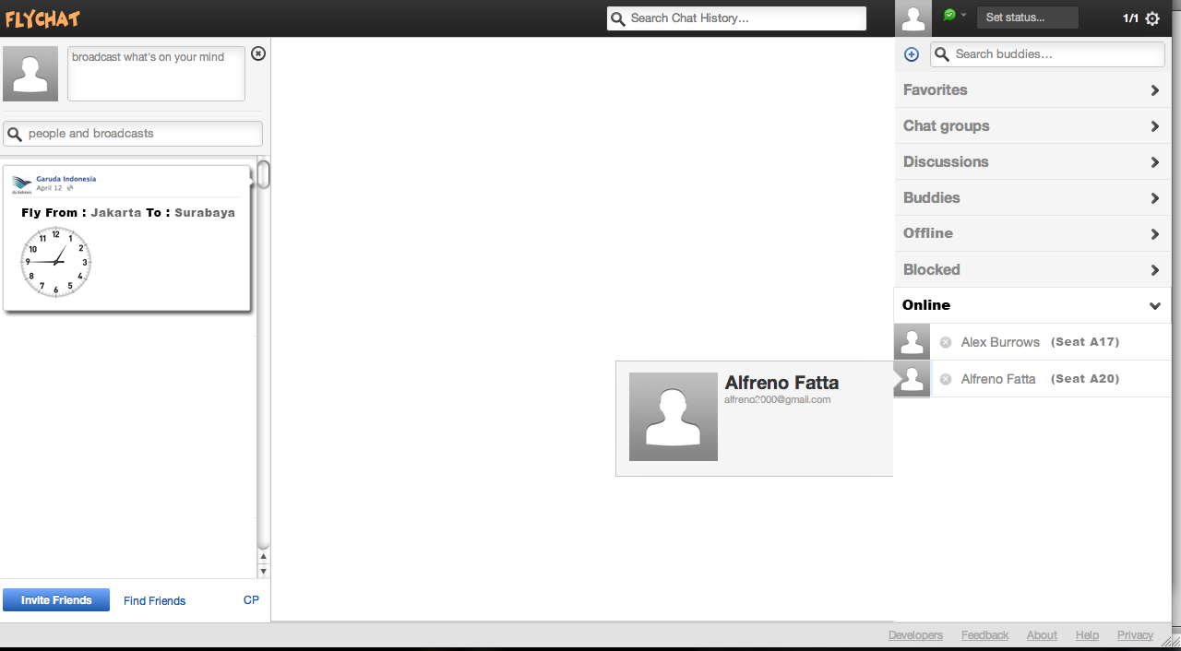
FLYCHAT – USER INFO

Slide 15
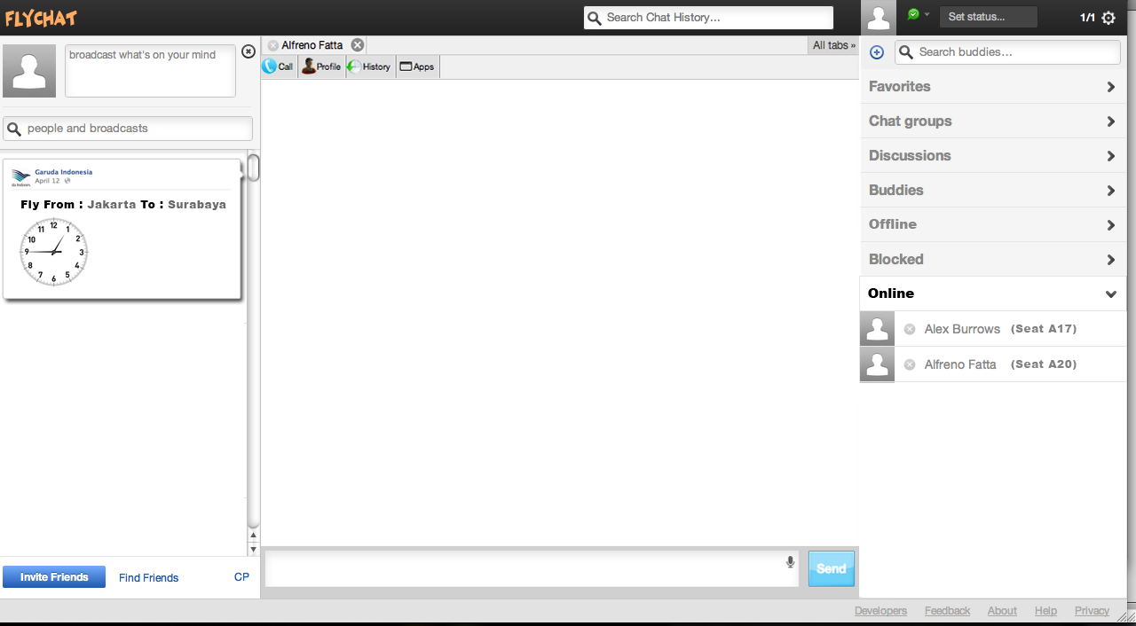
FLYCHAT – CHAT ON

Slide 16
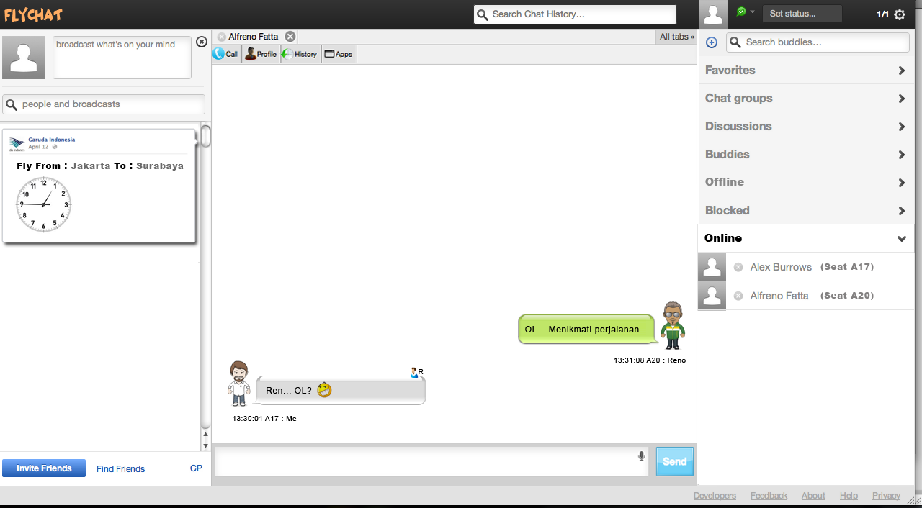
FLYCHAT - CHAT

Slide 17
FLYCHAT – INFO FEED

Slide 18
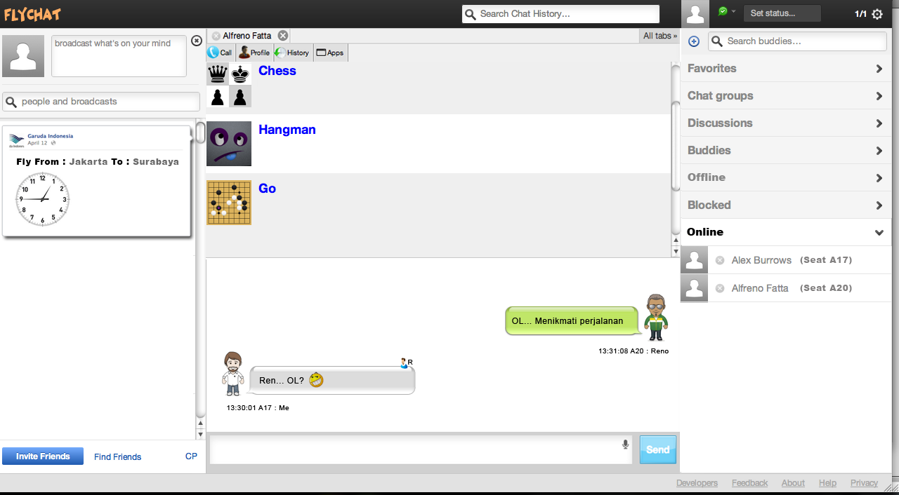
FLYCHAT – MULTIPLAYER GAME

