Slide 1
Fully Character-Level Machine Translation
Kyunghyun Cho
New York University
Courant Institute (Computer Science) and Center for Data Science
Facebook AI Research
Jason Lee, Kyunghyun Cho, Thomas Hoffman. Fully Character-Level Neural Machine Translation without Explicit Segmentation. TACL 2017.
Junyoung Chung, Kyunghyun Cho, Yoshua Bengio.
Character-Level Decoding for Neural Machine Translation without Explicit Segmentation. ACL 2016.

Slide 2
What is a sentence?
To a neural network, a sentence is just a sequence of one-hot vectors:
See Lecture 2.
What is the level of tokens with the minimal preprocessing?

Slide 3
What is a sentence?
A sequence of words?
(Welcome, to, Montreal, !)
A sequence of subwords?
(Wel, come, to, Mont, real, !)
A sequence of sequences of letters?
((W,e,l,c,o,m,e),(t,o),(M,o,n,t,r,e,al),(!))
A sequence of characters?
(W,e,l,c,o,m,e, ,t,o, ,M,o,n,t,r,e,a,l,!)
A sequence of bits…?
Research focus
Subword-level translation (Sennrich et al., 2015)
Hybrid char/word translation (Luong et al., 2016)

Slide 4
What is a sentence to a neural network?
Index | Word
1 | the
2 | a
3 | ,
4 | and
5 | of
6 | .
7 | to
…
Vocabulary
A sentence is a sequence of one-hot vectors
Underlying symbols are not visible to a neural network

Slide 5
What is a sentence to a neural network?
A sequence of words?
(Welcome, to, Montreal, !)
A sequence of subwords?
(Wel, come, to, Mont, real, !)
A sequence of sequences of letters?
((W,e,l,c,o,m,e),(t,o),(M,o,n,t,r,e,al),(!))
A sequence of characters?
(W,e,l,c,o,m,e, ,t,o, ,M,o,n,t,r,e,a,l,!)
A sequence of bits…?
They are all just a sequence of one-hot vectors to a neural network…

Slide 6
Why not (sub)word-level modelling?
Difficult to handle morphology
Morphologically rich languages → exploding vocabulary
Rare morphological variants: 과학/기술/정보/통신/부
Difficult to handle misspelling
Especially serious with user-generated content (social media, reviews, blogs…)
Patterns of misspelling cannot be captured: could → cld, would → ?
Modelling inefficiency
“kolmi/vaihe/kilo/watti/tunti/mittari”: one vector?
“kolme”: one vector???

Slide 7
Problems with character-level modelling
Can a neural network generate a long, coherent sequence?
Can a neural network capture highly nonlinear orthography?
Can character-level modelling be done efficiently?

Slide 8
Generating a long, coherent sequence
Source: subword (BPE) sequence → Target: character sequence
Language pairs: En→Cz, En→De, En→Fi, En→Ru
Training sets: WMT’15
Evaluation sets: newstest 2015
Evaluation metric: BLEU
BPE→Char ≅ BPE→BPE
Yes, a recurrent network can generate a long (100~300), coherent sequence
[Chung et al., 2016 ACL]

Slide 9
Going fully character-level
Orthography is highly arbitrary without clear patterns
Start: “quit”
Insert “e” at the end: “quite”
Swap the last two letters: “quiet”
Complexity of attention grows quadratically w.r.t. the length
For each target symbol, all the source symbols must be considered
BPE-to-BPE: 30 x 30
BPE-to-Char: 30 x 120
Char-to-Char: 120 x 120

Slide 10
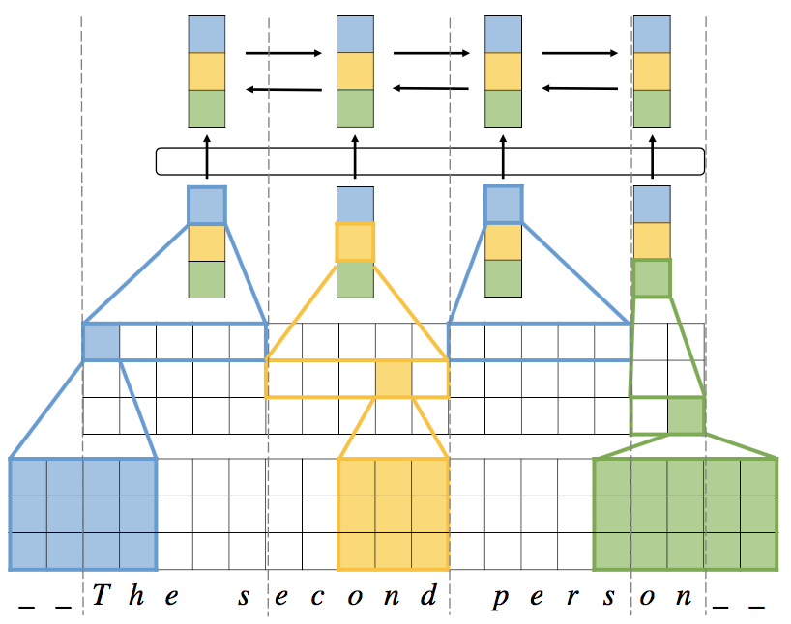
Going fully character-level
Character-Level Encoder
Attention over a convolutional feature map [Xu et al., 2015]
High-way network for nonlinear mapping [Srivastava et al., 2015]
Max pooling for computational efficiency
Multi-width convolution for a character sequence [Kim et al., 2015]
[Lee et al., 2017 TACL]

Slide 11
Going fully character-level
BLEU
Adequacy*
Fluency*
(*) Thanks to Yvette Graham for her help with human evaluation!
[Lee et al., 2017 TACL]

Slide 12
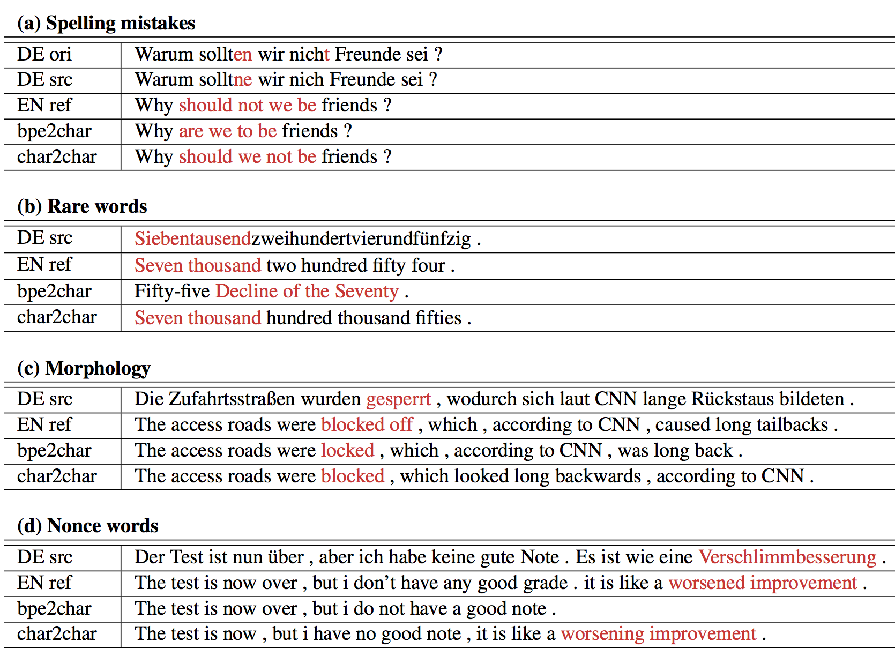
[Lee et al., 2017 TACL]

Slide 13
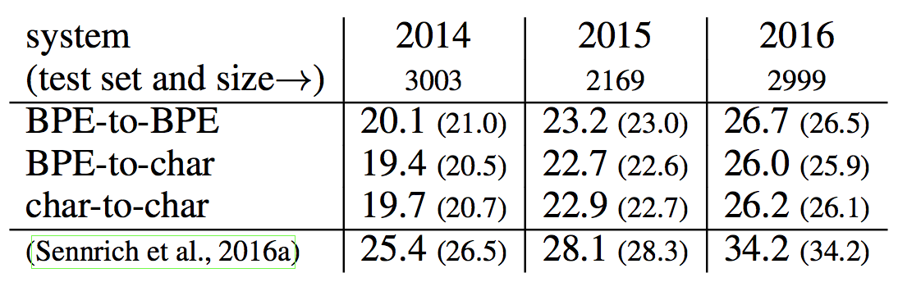
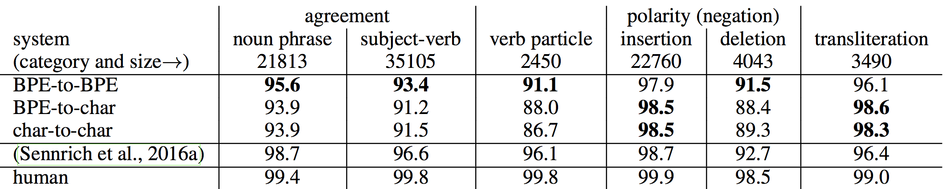
Going fully character-level: Analysis
Language pair/direction: En→De
Similarly performing models (BLEU)
Different properties:
Better transliteration with char-level modelling
Better syntactic properties with BPE-level
[Sennrich, 2017]

Slide 14
What does NMT do?
Continuous space representation of a sentence
Encoder
Decoder

Slide 15
What does NMT do?
Sequence of “discrete” symbols → Set of “continuous” vectors
Continuous vectors encode semantics of discrete symbols
Continuous vectors are stripped of hard, linguistic symbols
Can we map multiple languages on a single continuous space?

Slide 16
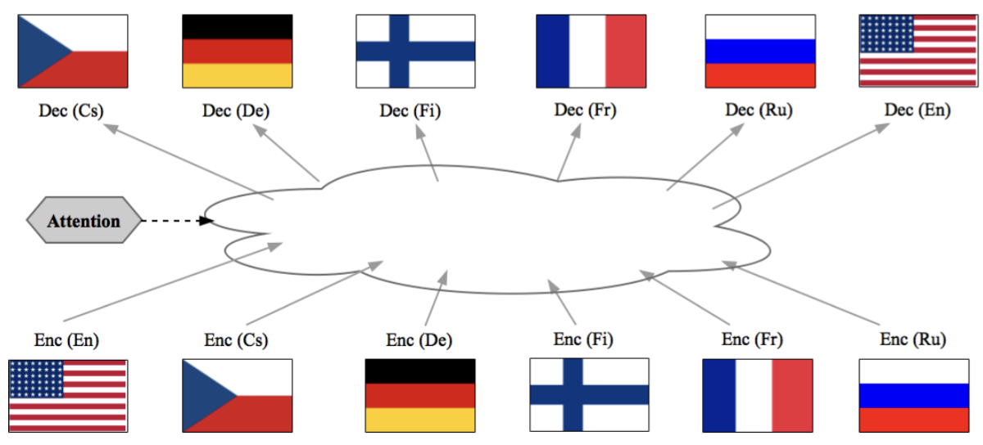
Multilingual Neural Machine Translation
Can this continuous vector space be shared across multiple languages?
(Lee et al., 2017; Ha et al., 2016; Johnson et al., 2016; Firat et al., 2016; Luong et al., 2015; Dong et al., 2015)

Slide 17
Character-Level, Multilingual Translation
Characters are often shared across many languages
Latin alphabets for most of European languages
A sentence is given as a sequence of characters (inc alphabets, punctuation marks and blank spaces)
{De, Cs, Fi, Ru} => En
No language ID
[Lee et al., 2017 TACL] for character-level modelling
[John et al., 2016; Ha et al. ,2016] for subword-level modelling

Slide 18
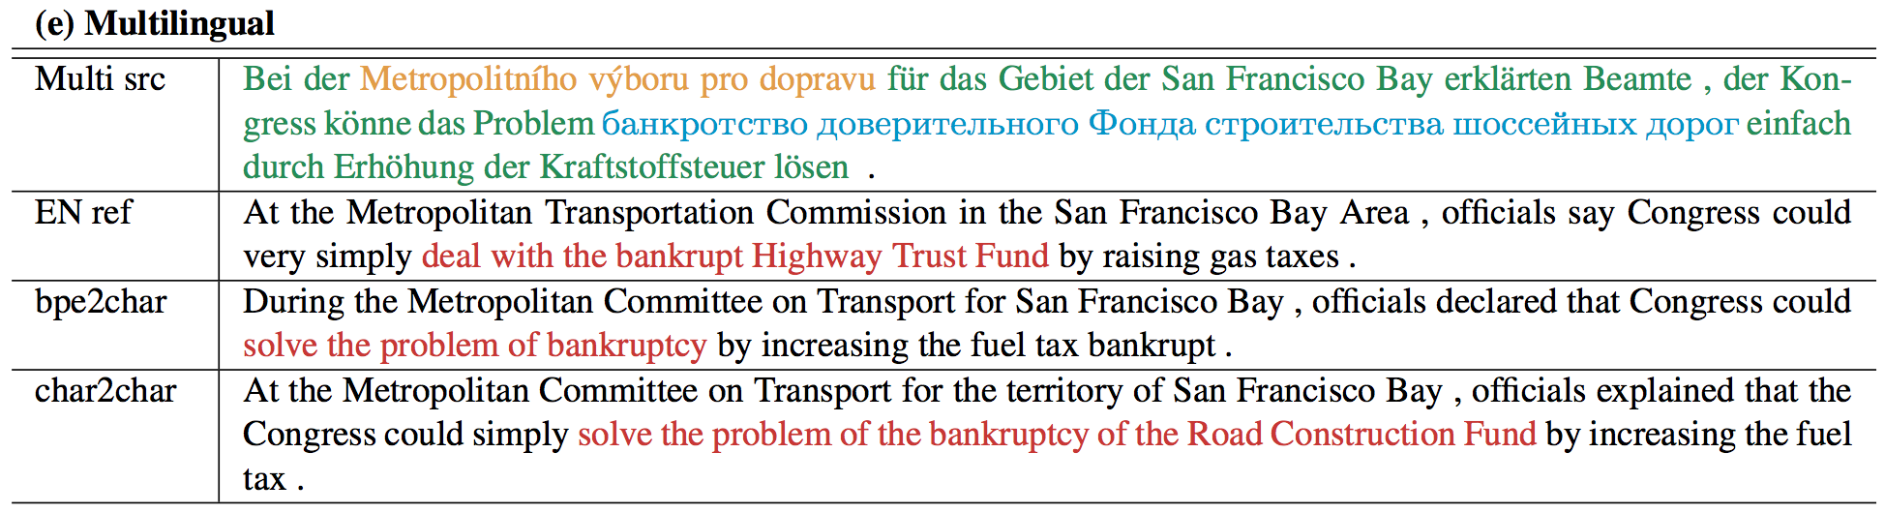
Character-Level, Multilingual Translation
Robust to intra-sentence code switching
Huge saving in parameters: 4x less parameters without loss in BLEU
[Lee et al., 2017 TACL] for character-level modelling
[John et al., 2016; Ha et al. ,2016] for subword-level modelling

Slide 19
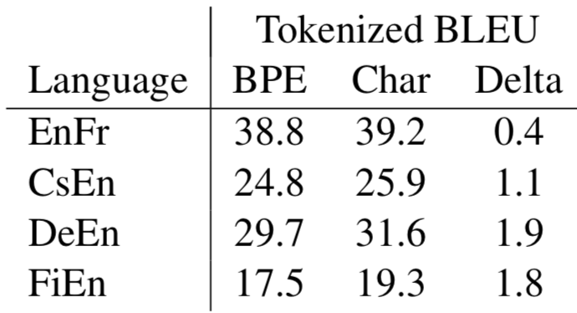
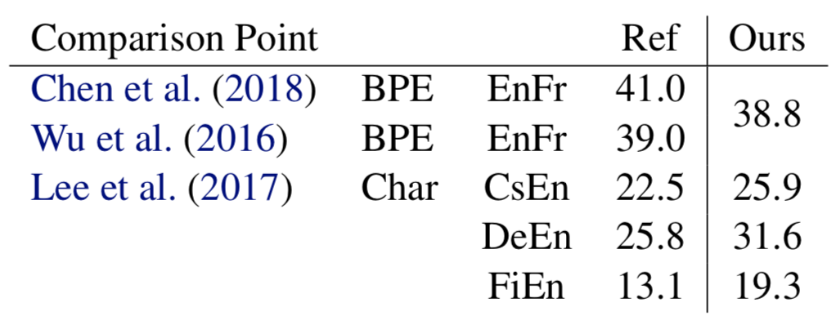
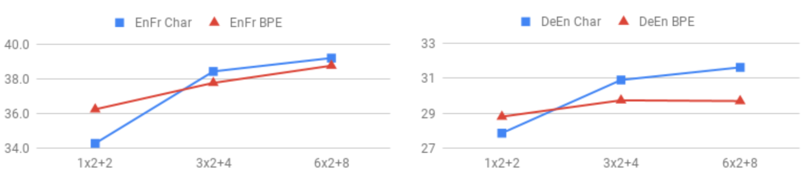
It really works!
Fresh off the press [Cherry & Foster et al., 2018] this morning
Better result than [Lee et al., 2017] but a similar conclusion
Character-level modelling requires depth: not surprising but important!

Slide 20
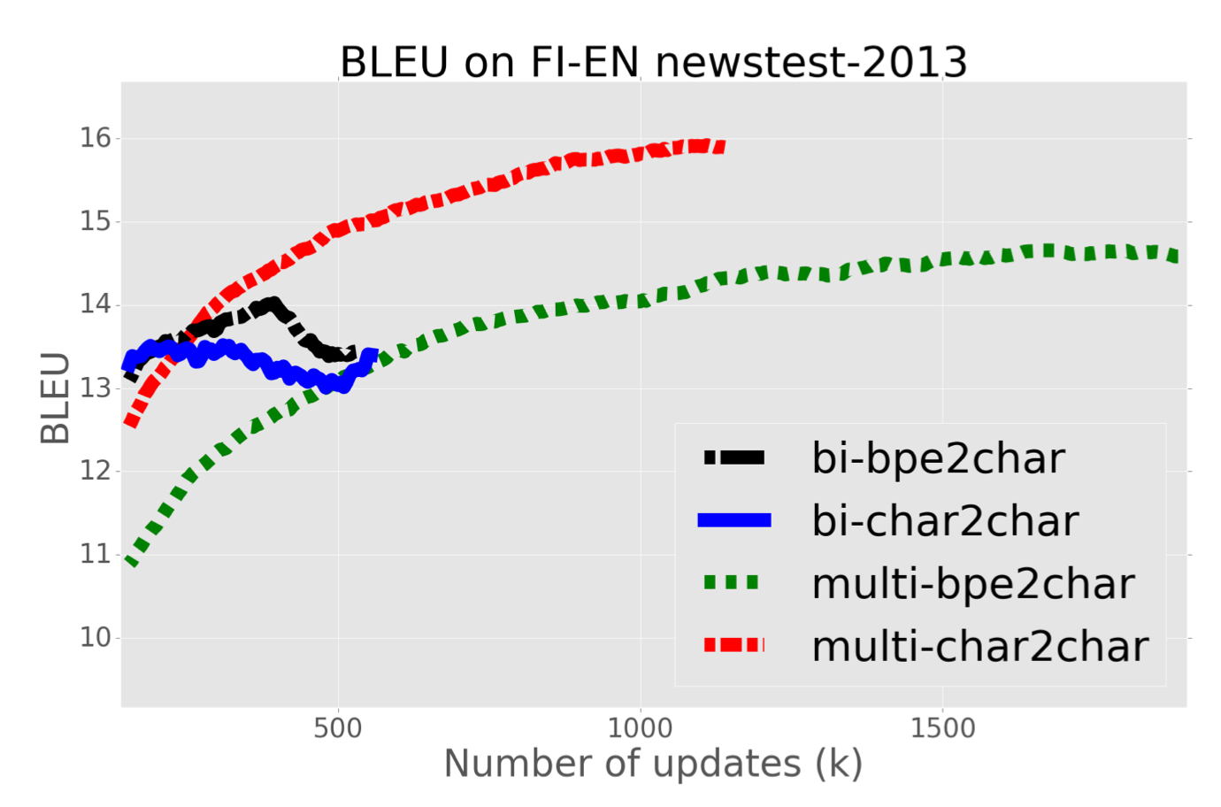
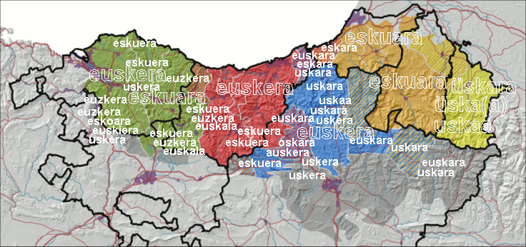
Character-level, Multilingual Translation
Prevents overfitting with low-resource language pairs
Perhaps, a way to build a MT system for all the languages in the world?
[Lee et al., 2017 TACL]

