Slide 1
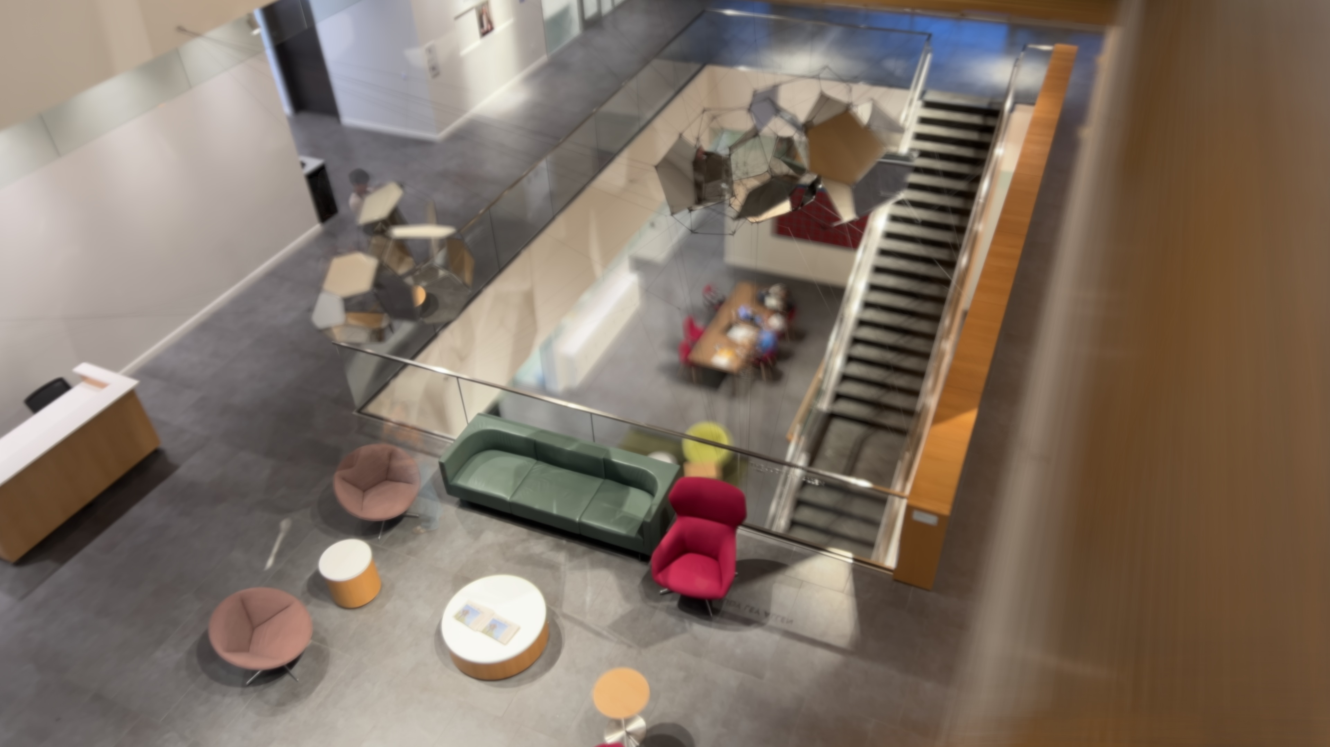
Notes:
This is one photo, made from a 45-second iPhone video of the O'Connor lobby. The furniture on the upper floor is sharp and the floor below is blurred, like a tilt-shift lens. There's no blur filter: the blur is real.

Slide 2
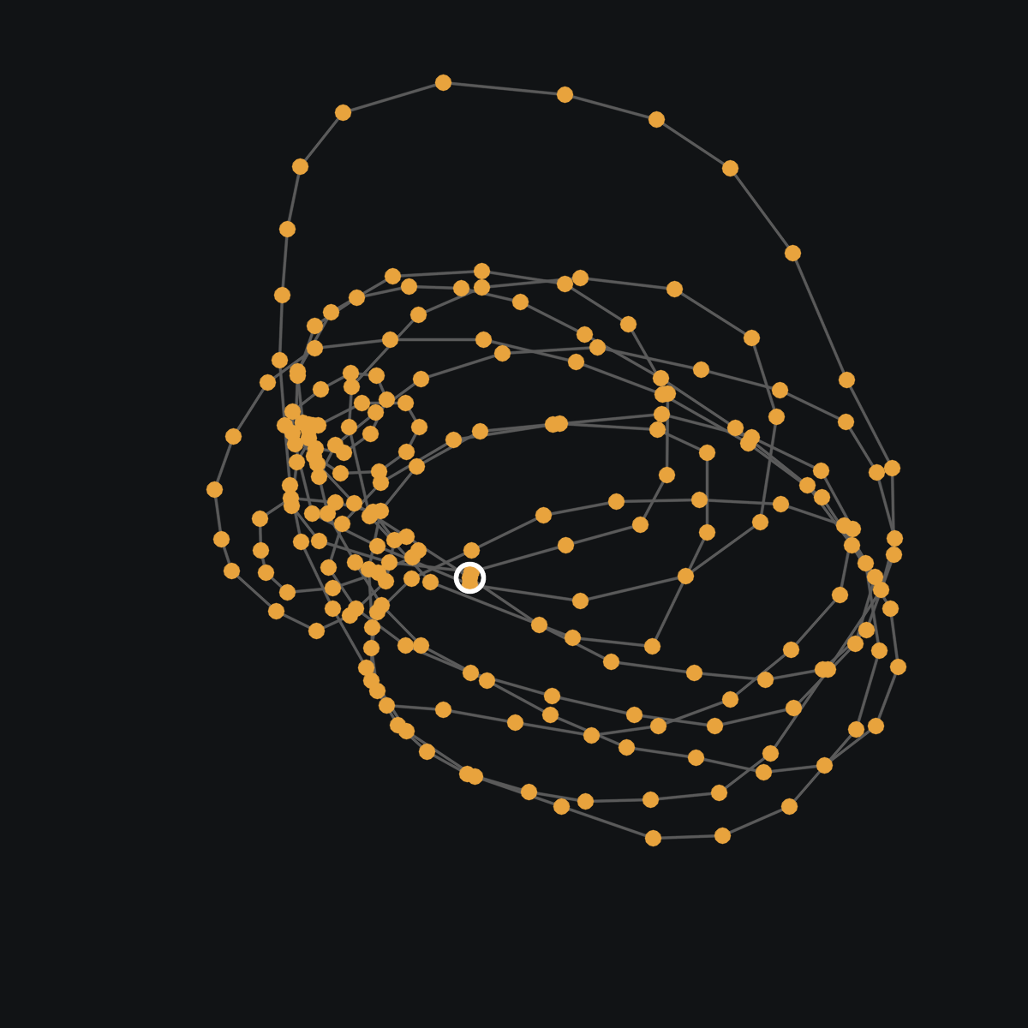
A video sweep is a big lens
1
Each frame is one view through a lens an arm's length wide
2
Line the frames up on one plane, then average them
3
Everything off that plane blurs by its real parallax
b = D · f · |1/z − 1/z₀|
blur in pixels; D = sweep width
Where the phone was in each of 213 frames
Notes:
A lens adds up the views from every point across its opening. Moving the phone in a spiral collects those views one frame at a time, from an opening about an arm's length wide. Line the frames up on one plane and average: that plane stays sharp and everything else blurs by its parallax, the same circle-of-confusion formula as a real lens.

Slide 3
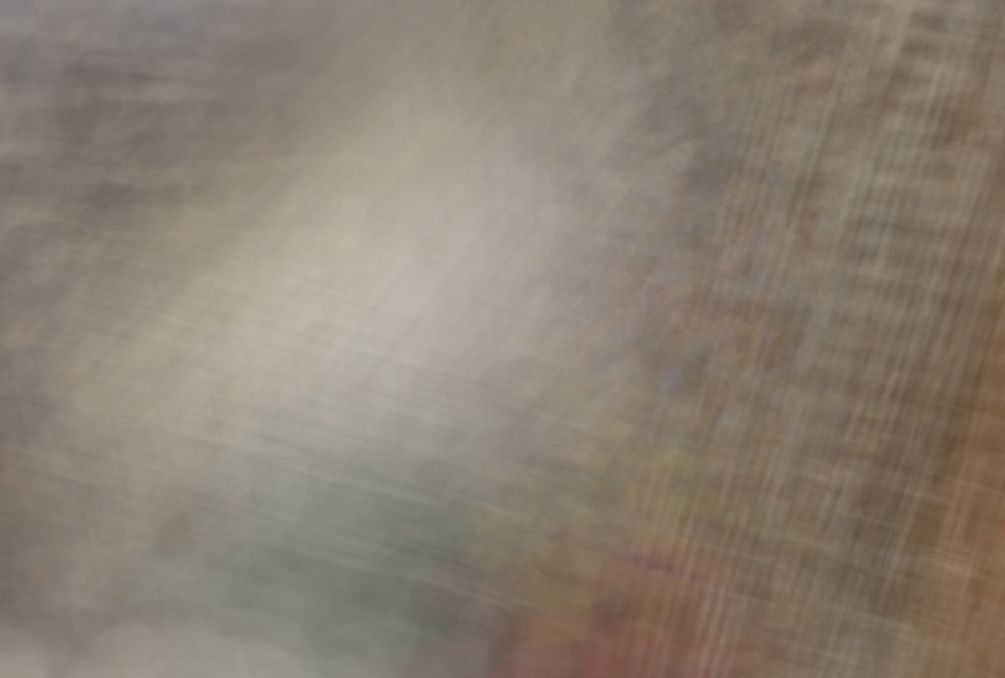
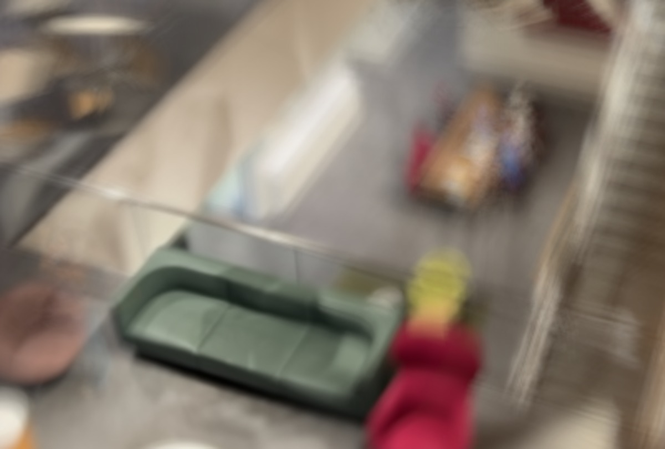
By hand: stack, line up, average
Frames averaged as shot
Nudged so the sofa lines up, then averaged
Photoshop: frames as layers → line up the sofa → Stack Mode › Mean
Notes:
You can do this by hand. Load the frames as layers in Photoshop. Averaged as shot, nothing lines up. Nudge each layer so the sofa overlaps, average again, and the sofa is sharp while the table on the floor below smears. To tilt the plane you'd drag four corners of every layer instead, which is too tedious for two hundred frames.

Slide 4
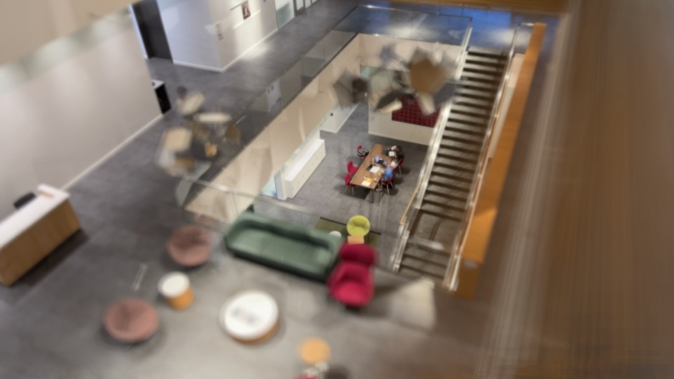
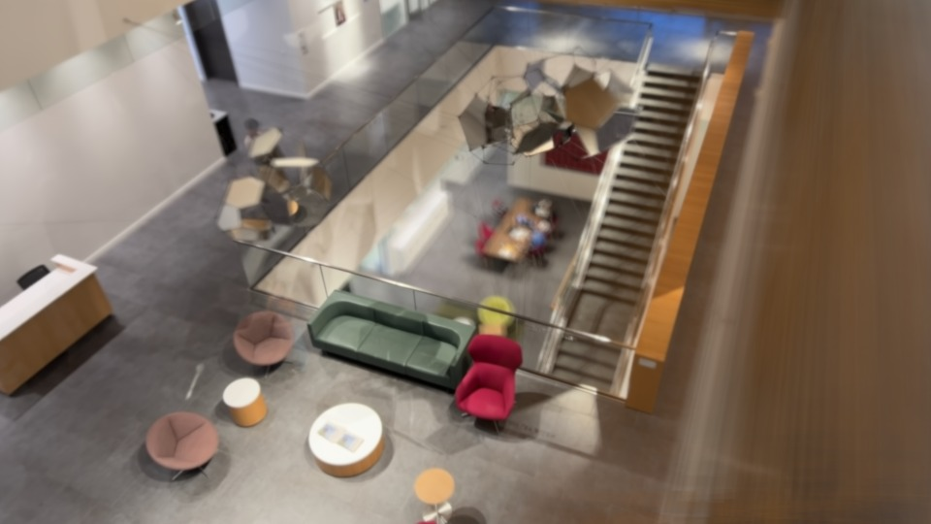
In code: any plane, after the shot
Focused on the floor below
Focus plane tilted 26° along the upper floor
COLMAP recovers where the phone was, so the warp for any plane is computed.
aperture-tilt-shift.vercel.app
Notes:
My program does the lining up from geometry. COLMAP works out where the phone was in every frame, so the warp for any plane can be computed, including tilted planes and planes with nothing on them to line up by eye. Same video, two focus planes: the floor below, or tilted along the upper floor. You can try it live at the link.

