Slide 1
STARK Procurement
Scope Definition Brief • Kim Christensen • March 2026
Engineering > Prompting

Slide 2
01
Executive Summary

Slide 3
What We're Building
A Procurement System handling the complete Purchase-to-Pay workflow:
PR Ingestion → PO Generation → Supplier Communication → Invoice Matching → Approval
NOT building:
Warehouse Management • Financial Accounting • E-commerce • Demand Planning

Slide 4
Scale & Volume
Metric | Annual Volume
Purchase Orders | 750,000
PO Value | €1.1B
Suppliers | 10,000
Branches | 84
System Users | 30 procurement staff

Slide 5
02
System Architecture

Slide 6
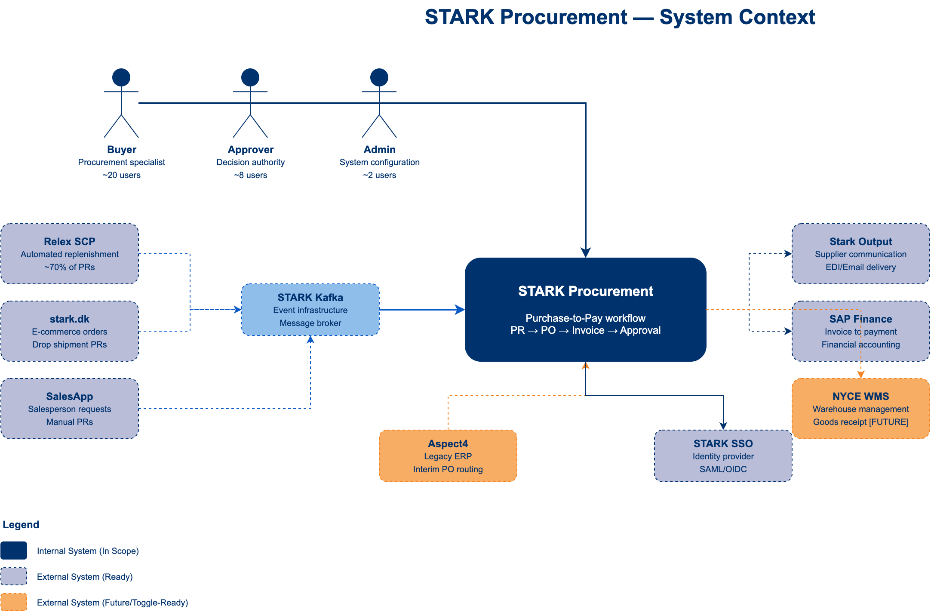
System Context — External Boundaries
C4 Level 1: STARK Procurement and its interactions with external systems

Slide 7
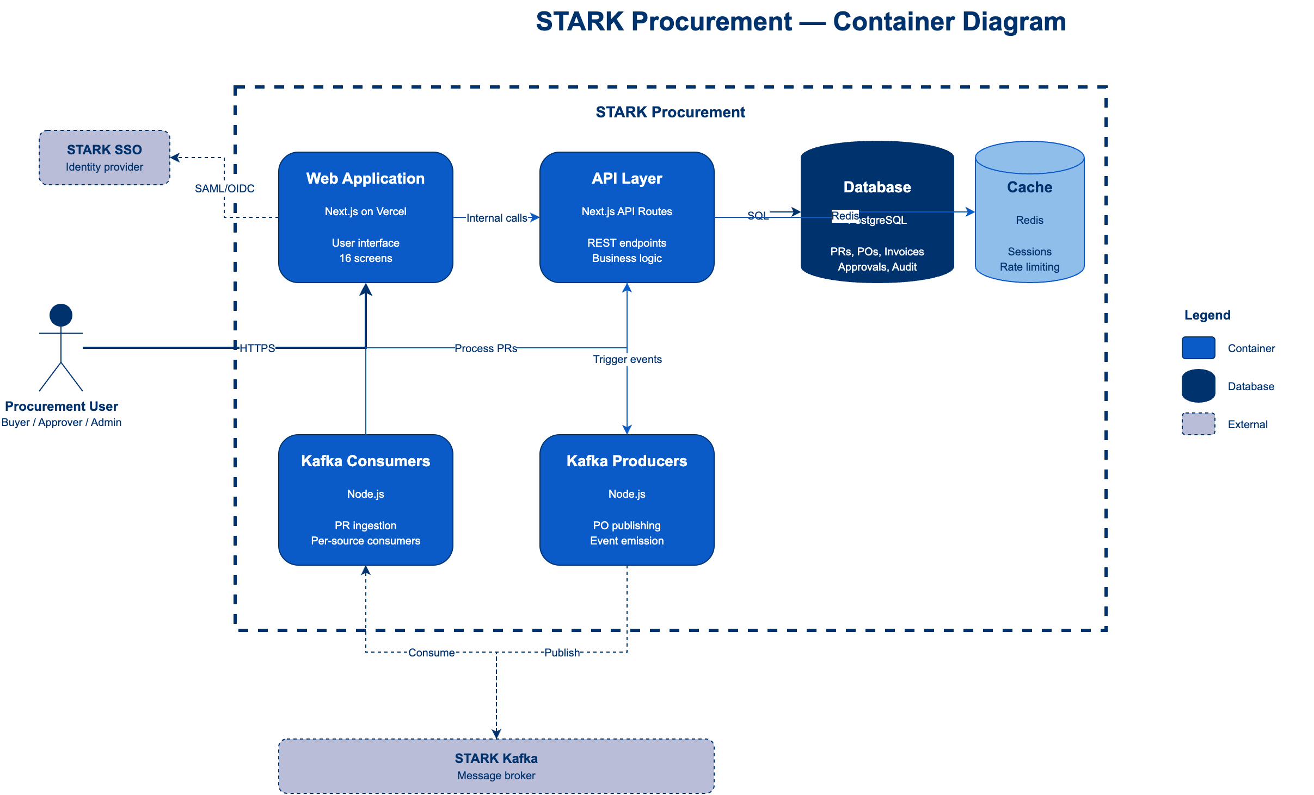
Container Architecture — Internal Components
C4 Level 2: Web Application, API Layer, Database, Cache, Kafka Consumers/Producers

Slide 8
03
Process & Workflow

Slide 9
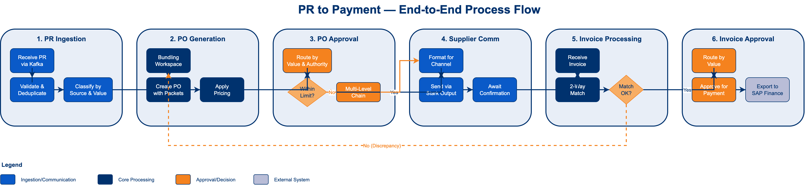
End-to-End Process Flow
PR to Payment: 6 stages from ingestion through invoice approval

Slide 10
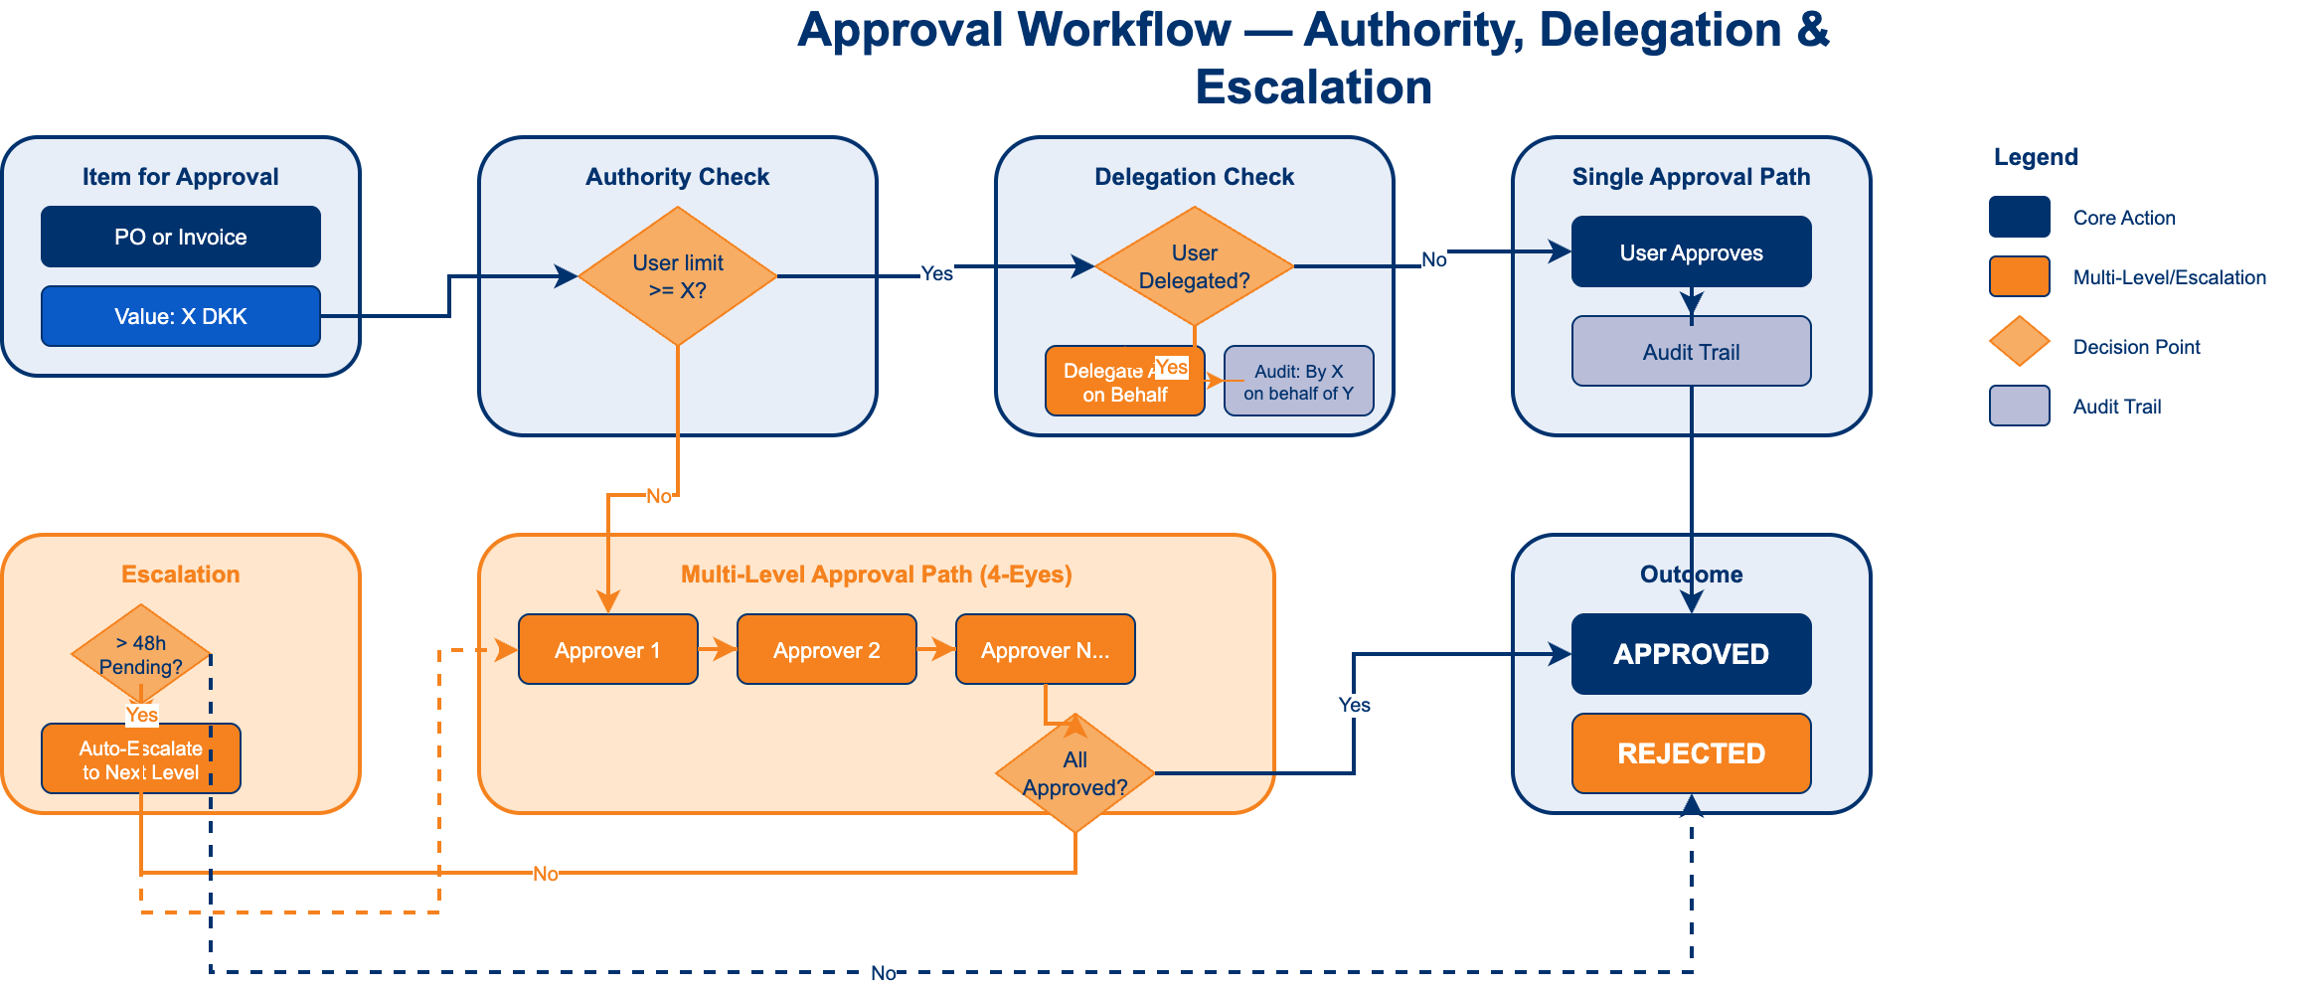
Approval Workflow
Authority matrix, delegation, multi-level approval (4-eyes), and escalation

Slide 11
04
Integration Architecture

Slide 12
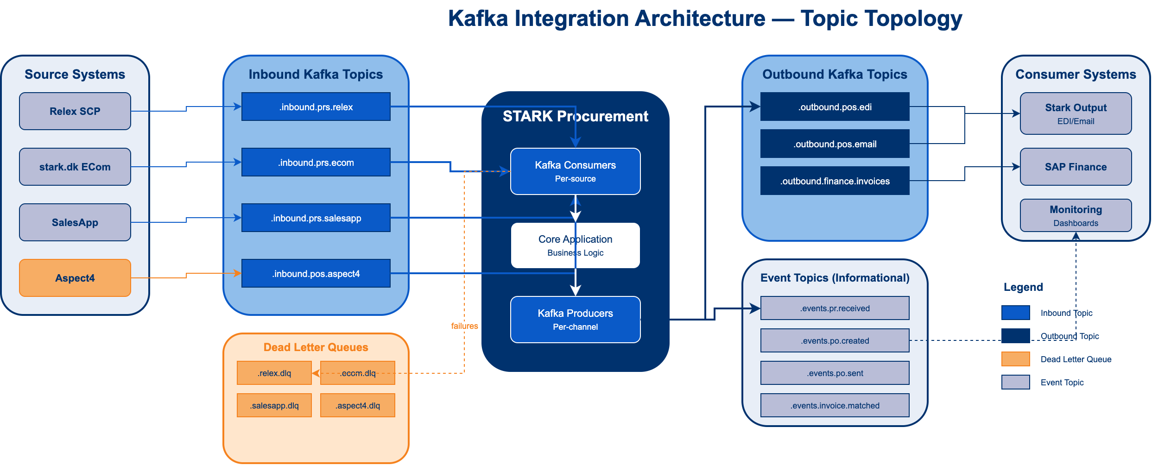
Kafka Integration — Topic Topology
Per-source inbound topics, per-channel outbound, DLQ patterns

Slide 13
Kafka-Native Integration
Per-source inbound topics: Relex, ECom, SalesApp, Aspect4
Per-channel outbound topics: EDI, Email, Finance exports
Dead Letter Queues (DLQ) for failure handling per source/channel
Event topics for informational notifications (IDs + metadata)
REST fallback for non-Kafka sources
ACL-based security with SASL/mTLS authentication
Customer provisions topics; vendor delivers specs and code

Slide 14
05
Data Model

Slide 15
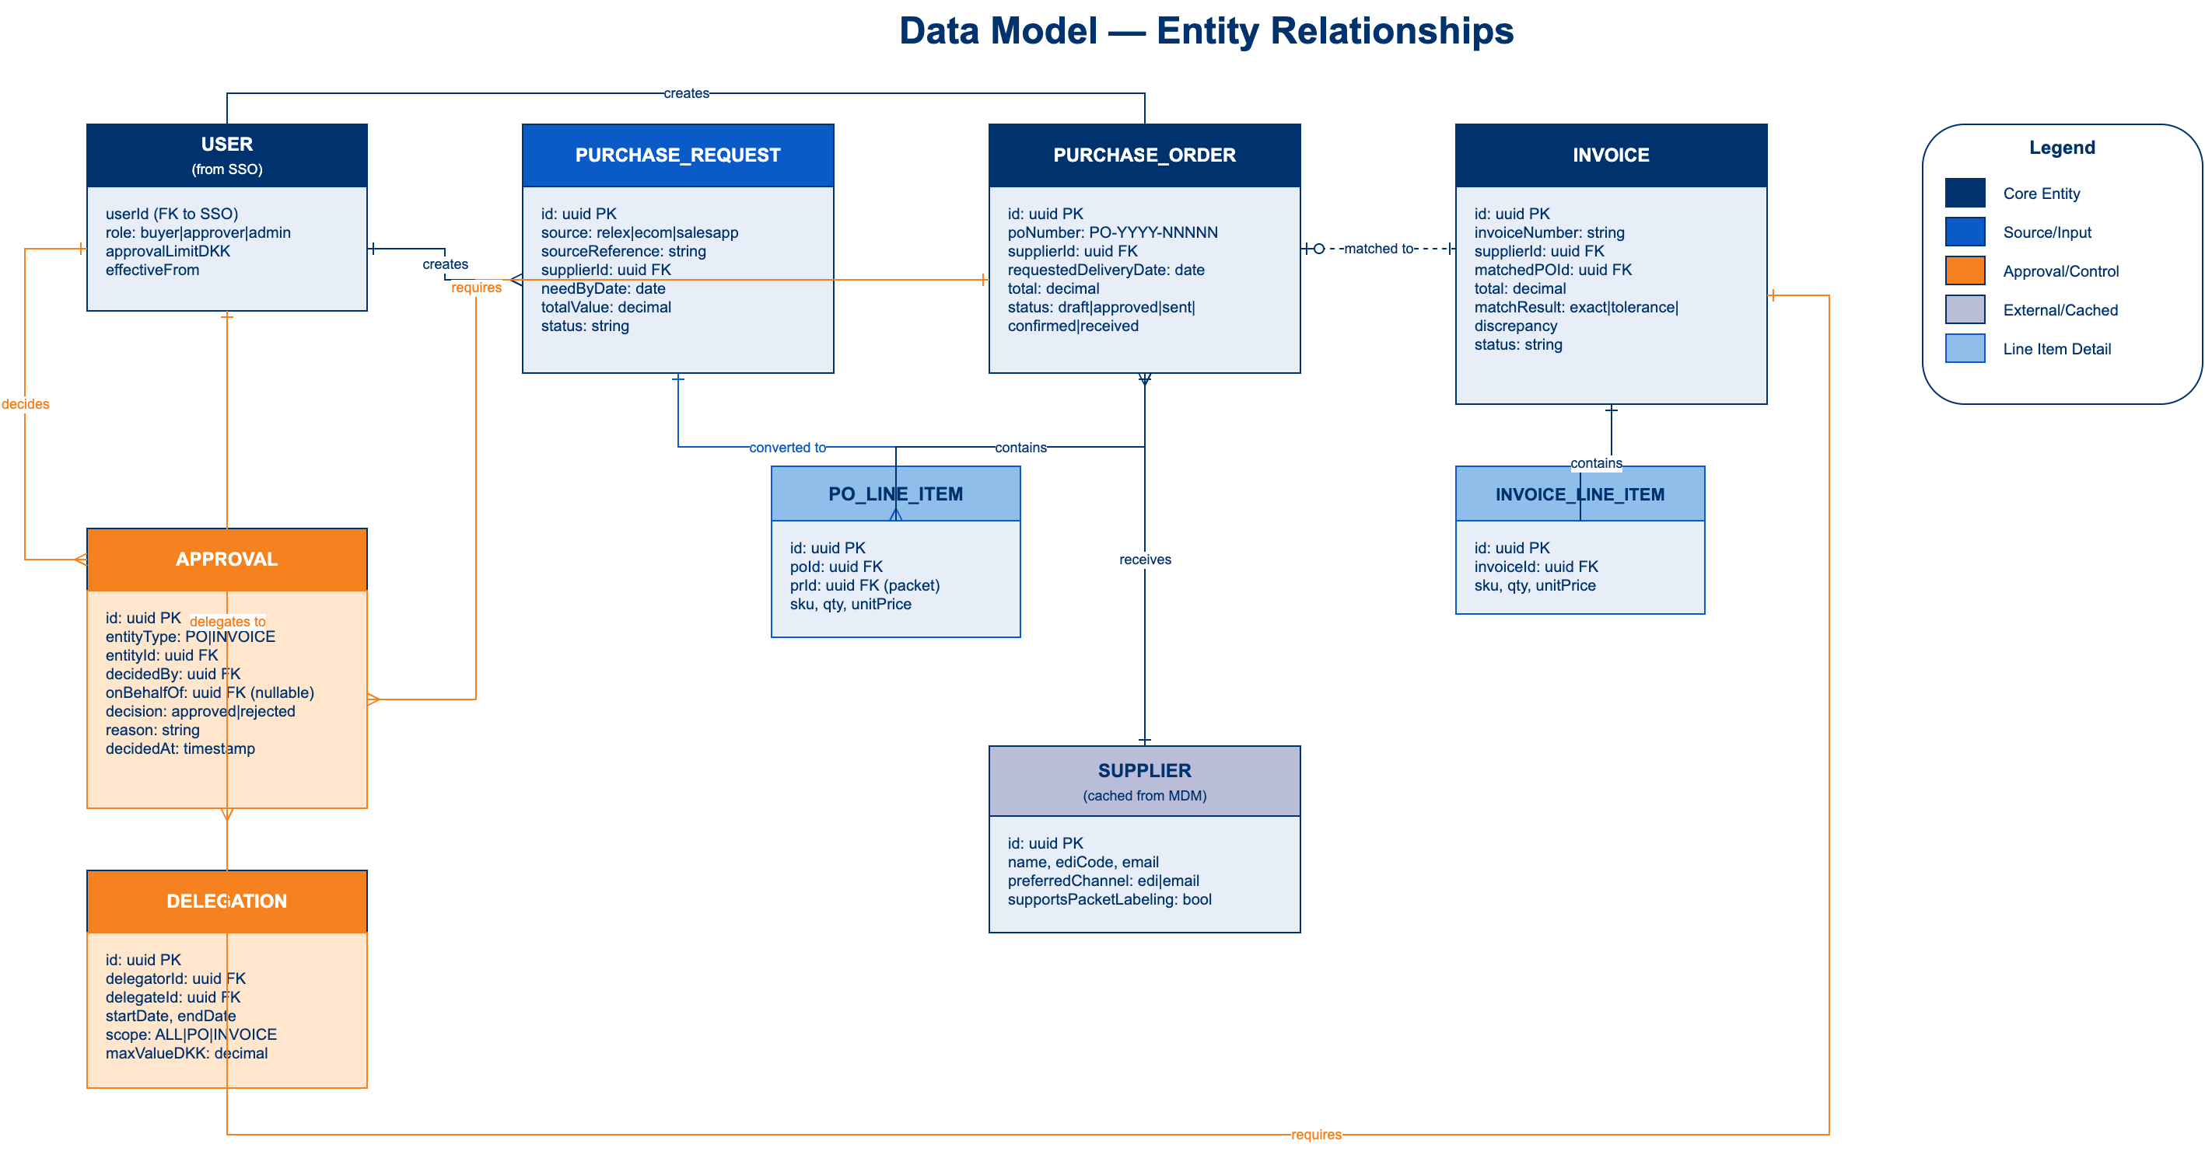
Entity Relationships
Core entities: PR, PO, Invoice, Approval, Delegation, Supplier

Slide 16
06
User Experience

Slide 17
Users & Roles
Role | Count | Primary Function
Buyer | ~20 | PR review, PO creation, bundling, invoice matching
Approver | ~8 | PO approval, invoice approval, exception handling
Admin | ~2 | System configuration, user support, reporting

Slide 18
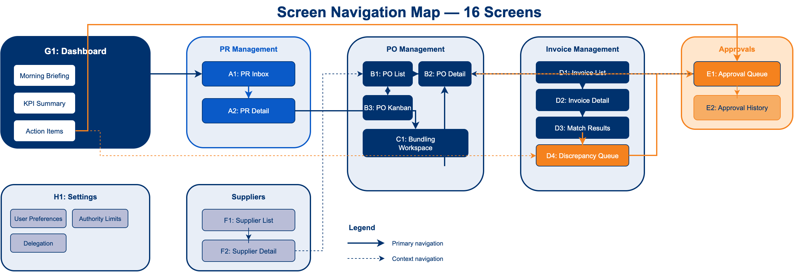
Screen Navigation — 16 Screens
Dashboard-centric navigation with functional modules

Slide 19
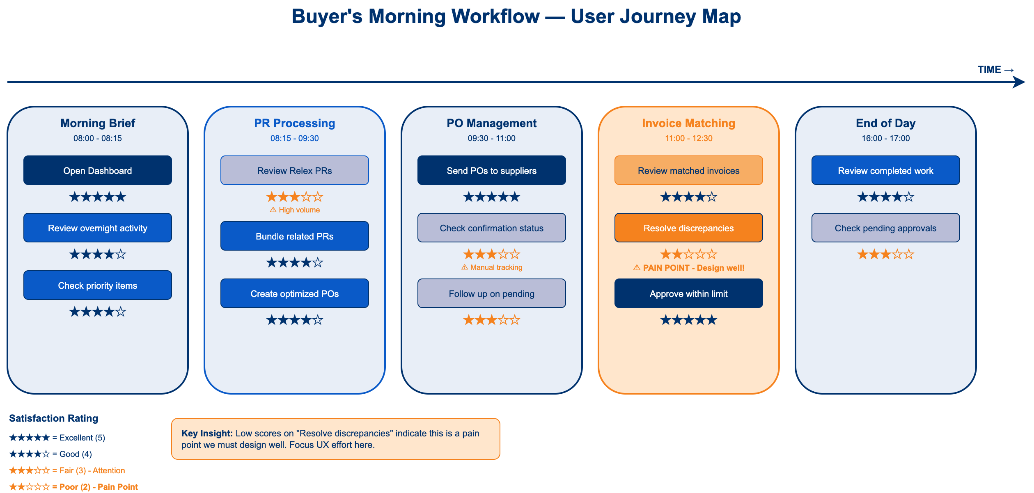
Buyer's Morning — User Journey
Pain point identified: 'Resolve discrepancies' needs careful UX design

Slide 20
07
Scope Summary

Slide 21
What's IN Scope
16 screens: Dashboard, PR Inbox, PO Management, Invoice Matching, Approvals
Bundling Workspace: Group PRs into optimized POs with packet labeling
2-Way Invoice Match: PO to Invoice with tolerance rules
Approval Workflow: Per-user limits, multi-level chains, delegation
Kafka Integration: Per-source consumers, per-channel producers, DLQ handling
Audit Trail: Full traceability of all decisions and changes

Slide 22
What's OUT of Scope (Phase 1)
Stock Transfer Orders (STO) — Requires NYCE WMS [FUTURE]
3-Way Invoice Match — Requires goods receipt from NYCE [FUTURE]
SAP Finance Integration — Direct API [FUTURE]
Supplier Portal — Enhancement, not MVP [Phase 3]
Mobile Native App — Enhancement [Phase 3]
Advanced Analytics/BI — Different project [BI team]

Slide 23
Dependencies We Assume Ready
Relex PR feed — READY (automated replenishment)
ECom PR feed — READY (drop-shipment PRs)
Stark Output — READY (EDI/Email delivery to suppliers)
SSO/IAM — READY (user authentication)
STARK Kafka cluster — READY (customer provisions topics)
Supplier Master Data — READY (via MDM)

Slide 24
08
Next Steps

Slide 25
Proposed Next Steps
1. Review and sign-off on scope boundaries
2. Confirm Kafka topic provisioning timeline
3. Align on integration schema specifications
4. Schedule technical deep-dive with STARK IT team
5. Finalize fixed-price commitment based on agreed scope

Slide 26
Agentic Engineering
This is NOT 'AI-assisted development'
AI-assisted: Human writes code, AI suggests completions
Agentic: AI agents execute engineering tasks autonomously
Agents do the work. Humans set the direction.
Fixed price per delivery. No rates. No surprises.

Slide 27
"Agents do the work. Humans set the direction. That's Agentic Engineering."
— AGENTIC AGENCY

Slide 28
Thank You
Questions & Discussion
Engineering > Prompting

