Slide 1
Thermal Masking + Tactile Illusions

Slide 2
Ideation

Slide 3
Overview of Haptic Illusions
Marked and often surprising discrepancy between a physical stimulus and its corresponding precept

Slide 4
Overview of Haptic Illusions
Marked and often surprising discrepancy between a physical stimulus and its corresponding precept
Robustness – how often illusion occurs
Strength – how compelling illusion effect is

Slide 5
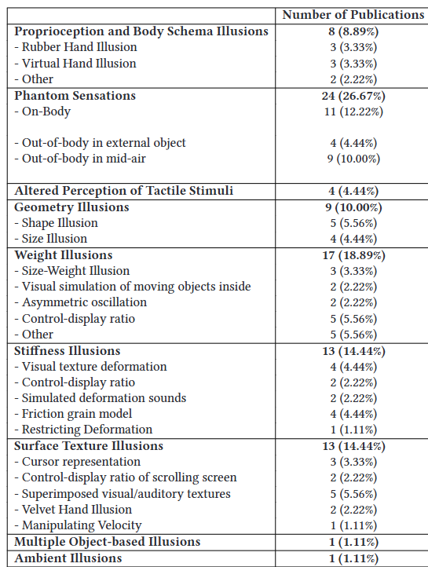
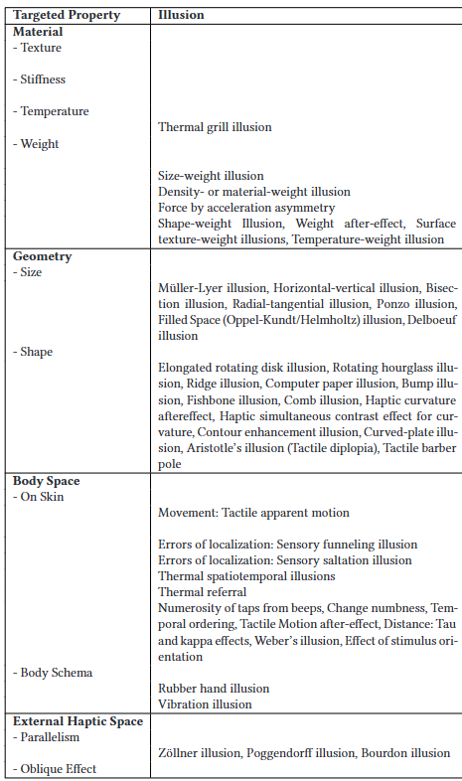
Overview of Haptic Illusions
Marked and often surprising discrepancy between a physical stimulus and its corresponding precept
Robustness – how often illusion occurs
Strength – how compelling illusion effect is
Haptic Illusions can be generally categorized into 2 groups based on targeted percept:
Object Properties – ex. Material, weight, geometry
Haptic Space Perception – external space, body, both
2024 Survey Statistics

Slide 6
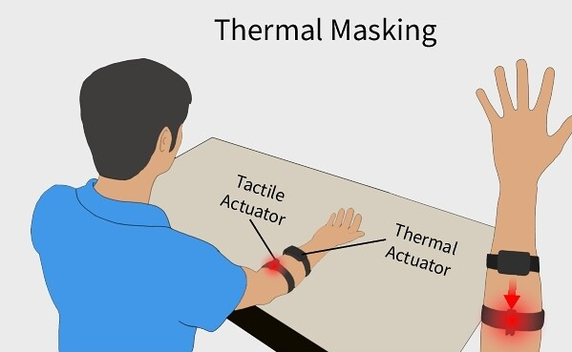
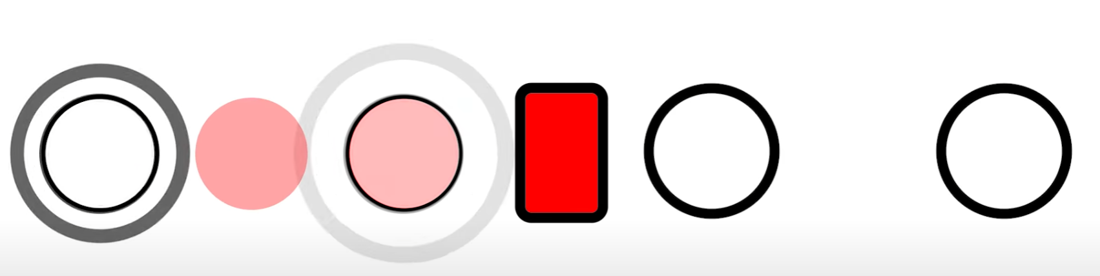
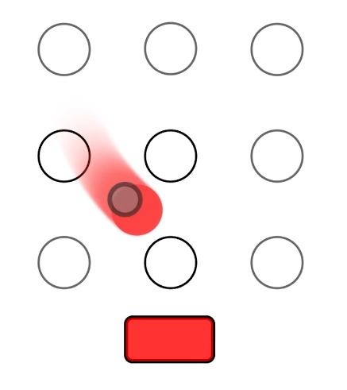
Combining Illusions
How can we integrate thermal masking with existing tactile illusions?
Thermal-in-Motion & HeatFlow
Apparent Tactile Motion, Phantom Sensations, and Thermal Masking
What else can we do?

Slide 7
Combining Illusions
How can we integrate thermal masking with existing tactile illusions?
Similar to HeatFlow, but now exploring wider capabilities of the phenomena
What other (vibrotactile) illusions can we explore?

Slide 8
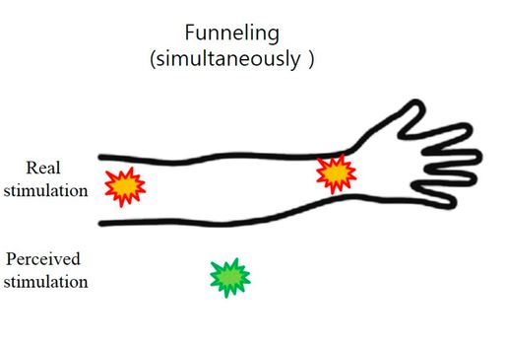
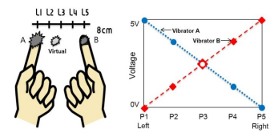
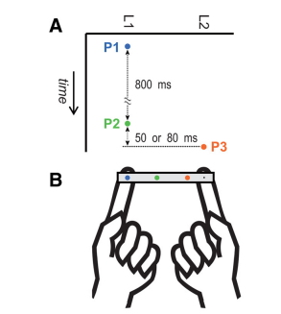
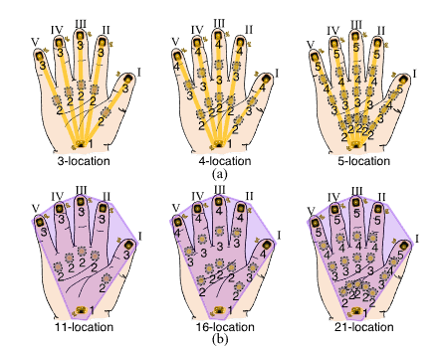
Combining Illusions
How can we integrate thermal masking with existing tactile illusions?
Similar to HeatFlow, but now exploring wider capabilities of the phenomena
What other (vibrotactile) illusions can we explore?
Does thermal masking work with phantom sensations?
Funneling Effect
Cutaneous Rabbit / Saltation
Six-Finger Illusion
Rubber / Virtual / Alien Hand

Slide 9
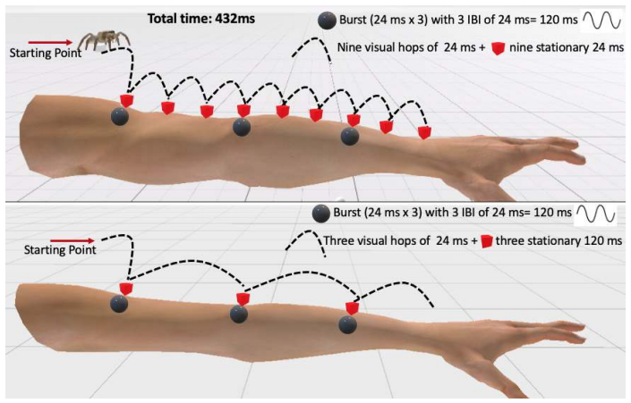
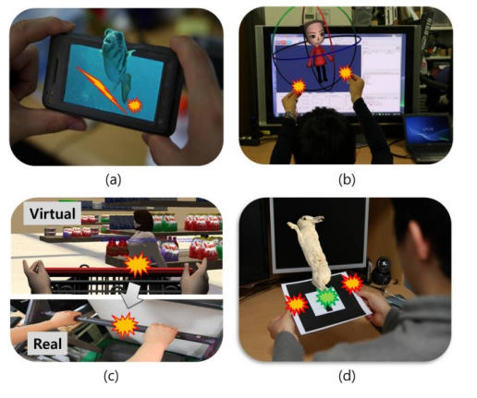
Combining Illusions
How can we integrate thermal masking with existing tactile illusions?
Similar to HeatFlow, but now exploring wider capabilities of the phenomena
What other (vibrotactile) illusions can we explore?
Does thermal masking work with phantom sensations (In VR)?
Funneling Effect
Cutaneous Rabbit / Saltation
Six-Finger Illusion
Rubber / Virtual / Alien Hand

Slide 10
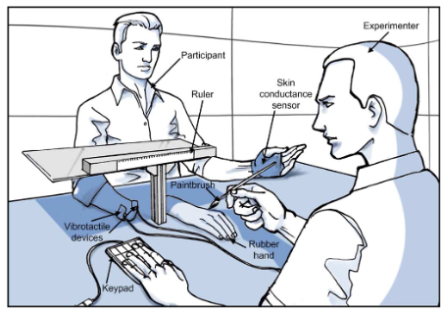
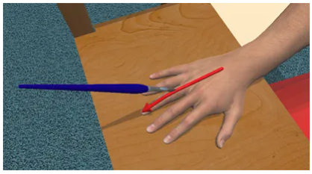
Combining Illusions
How can we integrate thermal masking with existing tactile illusions?
Similar to HeatFlow, but now exploring wider capabilities of the phenomena
What other (vibrotactile) illusions can we explore?
Does thermal masking work with phantom sensations (In VR)?
Funneling Effect
Cutaneous Rabbit / Saltation
Six-Finger Illusion
Rubber / Virtual / Alien Hand

Slide 11
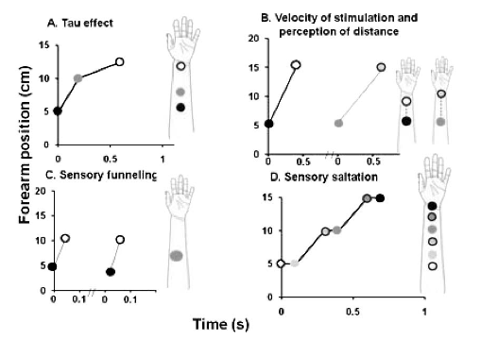
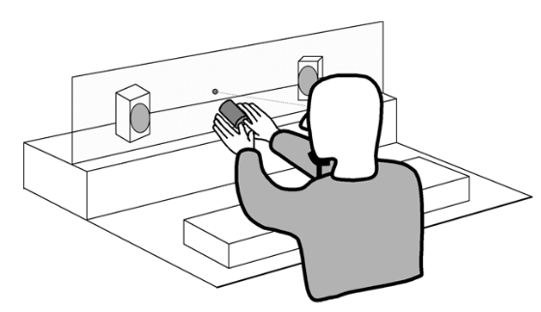
Combining Illusions
How can we integrate thermal masking with existing tactile illusions?
Similar to HeatFlow, but now exploring wider capabilities of the phenomena
What other (vibrotactile) illusions can we explore?
Does thermal masking work with phantom sensations (In VR)?
Funneling Effect
Cutaneous Rabbit / Saltation
Six-Finger Illusion
Rubber / Virtual / Alien Hand
Can we modulate perceptual properties based on known tactile effects?
Tau / Kappa Effect
Audio-Tactile Interactions
Object Stiffness, Texture, Weight, etc.

Slide 12
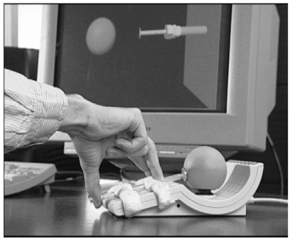
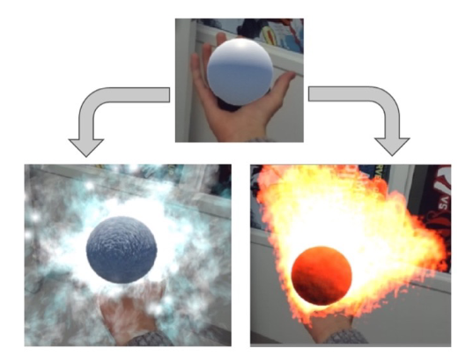
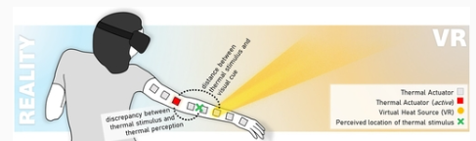
Combining Illusions
How can we integrate thermal masking with existing tactile illusions?
Similar to HeatFlow, but now exploring wider capabilities of the phenomena
What other (vibrotactile) illusions can we explore?
Does thermal masking work with phantom sensations (In VR)?
Funneling Effect
Cutaneous Rabbit / Saltation
Six-Finger Illusion
Rubber / Virtual / Alien Hand
Can we modulate perceptual properties based on known tactile effects?
Tau / Kappa Effect
Audio-Tactile Interactions
Object Stiffness, Texture, Weight, etc.
Visual Interaction & Pseudo-Haptics
Does pseudo-haptics exist for thermal properties?
Can we induce thermal masking with pseudo-haptics?

Slide 13
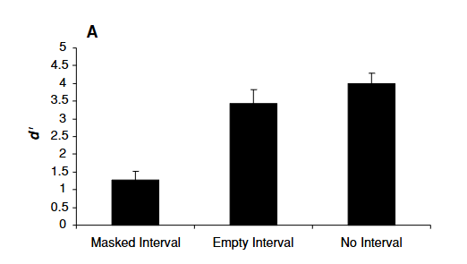
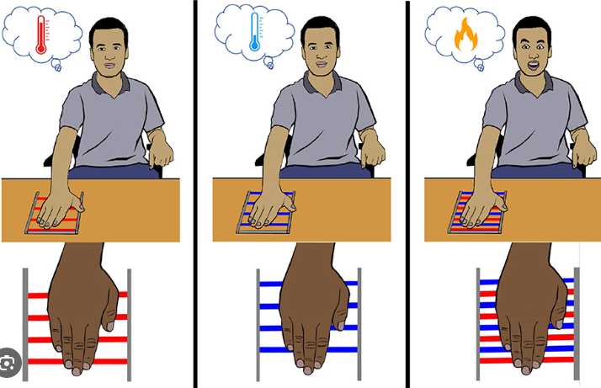
Combining Illusions
How can we integrate thermal masking with existing tactile illusions?
Similar to HeatFlow, but now exploring wider capabilities of the phenomena
What other (vibrotactile) illusions can we explore?
Does thermal masking work with phantom sensations (In VR)?
Funneling Effect
Cutaneous Rabbit / Saltation
Six-Finger Illusion
Rubber / Virtual / Alien Hand
Can we modulate perceptual properties based on known tactile effects?
Tau / Kappa Effect
Audio-Tactile Interactions
Object Stiffness, Texture, Weight, etc.
Visual Interaction & Pseudo-Haptics
Does pseudo-haptics exist for thermal properties?
Can we induce thermal masking with pseudo-haptics?
Other Effects
Change Blindness (Tactile)
Thermal Grill

Slide 14
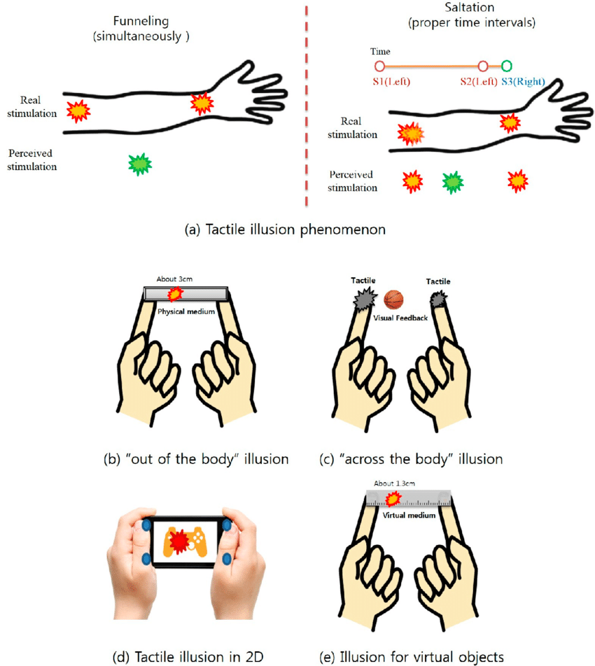
Combining Illusions
How can we integrate thermal masking with existing tactile illusions?
Similar to HeatFlow, but now exploring wider capabilities of the phenomena
What other (vibrotactile) illusions can we explore?
Does thermal masking work with phantom sensations (In VR)?
Funneling Effect
Cutaneous Rabbit / Saltation
Six-Finger Illusion
Rubber / Virtual / Alien Hand
Can we modulate perceptual properties based on known tactile effects?
Tau / Kappa Effect
Audio-Tactile Interactions
Object Stiffness, Texture, Weight, etc.
Visual Interaction & Pseudo-Haptics
Does pseudo-haptics exist for thermal properties?
Can we induce thermal masking with pseudo-haptics?
Other Effects
Change Blindness (Tactile)
Thermal Grill
+

Slide 15
Combining Illusions
Next Steps
What illusions to focus on?
Funneling & Saltation – Classical & wide impact
Visual Interaction (VR) – Compelling effects for experiences
Phantom Hand / Limb – Neurophysiological Insights
Challenges
Longer stimuli duration for thermal masking
Lower perceptual precision of thermal stimuli
+

Slide 16
Literature Review

Slide 17
Overview of Haptic Illusions
Robustness – how often illusion occurs
Strength – how compelling illusion effect is
Haptic Illusion can be generally categorized into 2 groups based on targeted percept:
Object Properties – ex. Material, weight, geometry
Haptic Space Perception – external space, body, both
Standard Vibrotactile Stimulus – 200ms pulse
2024 Survey Statistics

Slide 18
Tactile Illusions
Tactile and Haptic Illusions - Lederman, Susan J., and Lynette A. Jones. "Tactile and haptic illusions." IEEE Transactions on Haptics 4.4 (2011): 273-294.
Tactile Illusions - Hayward, Vincent. "Tactile illusions." Scholarpedia of Touch. Paris: Atlantis Press, 2015. 327-342.
Survey - Kurzweg, Marco, et al. "Survey on haptic feedback through sensory illusions in interactive systems." ACM Computing Surveys 56.8 (2024): 1-39.

Slide 19
Cutaneous Rabbit / Saltation
Phantom sensation (P2) by temporal interval of two actuators
Uninterrupted series of taps at different locations leads to “hopping” effect
Demonstrated directly on skin, across two different arms, wearables, hand-held objects, and virtual objects
Experimental Procedures
Activate vibrotactile actuators simultaneously with temporal interval
Block visual and auditory cues
Participant responds where intermediate sensation was felt along axis
Classical – 5 taps at 3 locations each
Reduced – 1 tap each
Ideas for Thermal Integration
Does thermal masking occur with phantom sensations? In VR? Can visuals influence the perceived location?
Can masking occur on an external object, similar to tactile sensations?
Can masking cross between the arms?

Slide 20
Cutaneous Rabbit / Saltation
Original Paper - Geldard, Frank A., and Carl E. Sherrick. "The cutaneous" rabbit": a perceptual illusion." Science 178.4057 (1972): 178-179.
Out of Body - Miyazaki, Makoto, Masaya Hirashima, and Daichi Nozaki. "The “cutaneous rabbit” hopping out of the body." Journal of Neuroscience 30.5 (2010): 1856-1860.
Revisited - Flach, Rüdiger, and Patrick Haggard. "The cutaneous rabbit revisited." Journal of Experimental Psychology: Human Perception and Performance 32.3 (2006): 717.
Virtual Objects - Lee, Jaedong, Youngsun Kim, and Gerard Kim. "Funneling and saltation effects for tactile interaction with virtual objects." Proceedings of the SIGCHI Conference on Human Factors in Computing Systems. 2012.
Visual-Emotional Interplay - Ziat, Mounia, et al. "Emotional Dimensions of the Cutaneous Rabbit Illusion in Virtual Reality: The Interplay of Visual and Tactile Stimuli." International Conference on Human Haptic Sensing and Touch Enabled Computer Applications. Cham: Springer Nature Switzerland, 2024.

Slide 21
Funneling
Phantom sensation by amplitude difference of two actuators
Simultaneous presentation
Demonstrated directly on skin, as a wearable, on hand-held objects, and with virtual objects
Experimental Procedures
Activate vibrotactile actuators simultaneously with amplitude difference
Block visual and auditory cues
Participant responds where sensation was felt along axis
Ideas for Thermal Integration
Does thermal masking occur with phantom sensations? In VR? Can visuals influence the perceived location?
Can masking occur on an external object, similar to tactile sensations?
How would thermal grill affect this?

Slide 22
Funneling
Virtual Objects - Lee, Jaedong, Youngsun Kim, and Gerard Kim. "Funneling and saltation effects for tactile interaction with virtual objects." Proceedings of the SIGCHI Conference on Human Factors in Computing Systems. 2012.
Original Paper - v. Békésy, G. "Funneling in the nervous system and its role in loudness and sensation intensity on the skin." The Journal of the Acoustical Society of America 30.5 (1958): 399-412.
Glove - Luo, Hu, et al. "Perceptual localization performance of the whole hand vibrotactile funneling illusion." IEEE Transactions on Haptics 16.2 (2023): 240-250.

Slide 23

Apparent Tactile Motion/ Phi / Beta Movement
Phantom sensation of a single moving stimulator from temporal interval
Relative intensity can control perceived direction
Tactile Rivalry – Perception of direction changes in ambiguous but consistent tactile cues
Perceived direction could be influenced by conditioning cues in previous trials (ex. Conditioning with a left sweep led to perceived right movement next trial
Experimental Procedures
2+ vibrotactile actuators activate in succession with some interval
Ask if sensation was a single, moving cue and what direction
Ideas for Thermal Integration
HeatFlow
Does extra sensory information from thermal cues influence direction perception?
How long does thermal linger in referred location?

Slide 24
Apparent Tactile Motion/ Phi / Beta Movement
Intensity Order - Hoffmann, Rebekka, et al. "The intensity order illusion: temporal order of different vibrotactile intensity causes systematic localization errors." Journal of Neurophysiology 122.4 (2019): 1810-1820.
Tactile Rivalry - Carter, Olivia, et al. "Tactile rivalry demonstrated with an ambiguous apparent-motion quartet." Current Biology 18.14 (2008): 1050-1054.

Slide 25
Tau Effect / Kappa Effect
Tau - Temporal interval between successive stimuli affects perceived distance
Kappa – Distance between successive stimuli affects perceived temporal interval
Ideas for Thermal Integration
Does temporal interval affect masking location? Does distance?
Does masking affect the perceived quality of tactile cues?
How crazy can thermal masking patterns get? (ex. Through a body part, simultaneous tactile spaced far apart, max area, etc.)

Slide 26
Tau Effect / Kappa Effect
Tau - Helson, Harry, and Samuel M. King. "The tau effect: an example of psychological relativity." Journal of Experimental Psychology 14.3 (1931): 202.
Kappa – Yoblick, Darryl A., and Gavriel Salvendy. "Influence of frequency on the estimation of time for auditory, visual, and tactile modalities: the Kappa effect." Journal of Experimental Psychology 86.2 (1970): 157.

Slide 27
Change Blindness
The inability to notice change in tactile stimulation
Experimental Procedures
7 tactors placed all over body (wrist, elbow, forearm, waist, back, ankle, leg)
2-3 tactors selected to play two 200ms pattern consecutively
In half of the trials, one of the stimuli would randomly change locations in the second pattern
The two patterns were split by one of three conditions
No Interval: no break in between
Empty Interval: 110ms break in between of no stimulation
Masked Interval: patterns split by 50ms of no stimulation, 10ms of masking (all tactors activate simultaneously), and 50ms of no stimulation
Ideas for Thermal Integration
Thermal blindness?
Can thermal prevent tactile blindness?
d’: Perceptual Sensitivity (Accuracy)

Slide 28
Change Blindness
Tactile Blindness - Gallace, Alberto, Hong Z. Tan, and Charles Spence. "The failure to detect tactile change: A tactile analogue of visual change blindness." Psychonomic bulletin & review 13.2 (2006): 300-303.

Slide 29
Audio-Tactile Illusions
Tactile influences audio - Localization of audio can be influenced by tactile stimulation
Audio cues paired with synchronous tactile stimulation were perceived closer to the tactile location than reality
Audio influences tactile – Audio can improve tactile frequency perception
Audio tones affected detection and perceived frequency of tactile cues
Parchment-Skin Illusion – Audio features can affect hand texture and roughness
Experimental Procedures
Audio played in spatial location
Audio paired with spatial tactile stimulation, either synchronous or asynchronous
Participant responded if audio and tactile occurred in same location (congruency)
Staircase on difference between audio and tactile location, until 10 incongruent responses
Ideas for Thermal Integration
What would happen if thermal is introduced with tactile cues and thermal-related audio (ex. Fire whoosh, ice crackle) ?
Can we elicit wetness with parchment-skin?

Slide 30
Audio-Tactile Illusions
Tactile Capture of audition - Caclin, Anne, et al. "Tactile “capture” of audition." Perception & psychophysics 64.4 (2002): 616-630.
Audio improves tactile perception - Crommett, Lexi E., Alexis Pérez-Bellido, and Jeffrey M. Yau. "Auditory adaptation improves tactile frequency perception." Journal of neurophysiology 117.3 (2017): 1352-1362.
Parchment-Skin - Jousmäki, Veikko, and Riitta Hari. "Parchment-skin illusion: sound-biased touch." Current biology 8.6 (1998): R190-R191.

Slide 31
Thermal Grill
Simultaneous hot and cold stimulation is perceived as burning pain sensation
Ideas for Thermal Integration
Does thermal grill occur with masking? Will the sensation change?
Can thermal grill be masked?

Slide 32
Thermal Grill
Thermal Grill - Craig, Arthur D., and M. Catherine Bushnell. "The thermal grill illusion: unmasking the burn of cold pain." Science 265.5169 (1994): 252-255.

Slide 33
Phantom Limb / Alien Hand
Vibrotactile stimulation can elicit embodiment of phantom hand / limb
Phantom hand ownership from vibrotactile cues is comparable to original experiment with brush
Phantom movement of a limb can also be induced by vibrotactile stimulation
Experimental Procedures
Congruent brushstroke on real hand and vibrotactile cues on phantom hand
Ideas for Thermal Integration
Will adding thermal cues enhance illusion?
Can thermal be masked to phantom fingers?

Slide 34
Phantom Limb / Alien Hand
Vibrotactile Phantom Hand - D'Alonzo, Marco, Francesco Clemente, and Christian Cipriani. "Vibrotactile stimulation promotes embodiment of an alien hand in amputees with phantom sensations." IEEE Transactions on Neural Systems and Rehabilitation Engineering 23.3 (2014): 450-457.
Phantom Limb Movement - Taylor, Mitchell W., Janet L. Taylor, and Tatjana Seizova-Cajic. "Muscle vibration-induced illusions: review of contributing factors, taxonomy of illusions and user’s guide." Multisensory Research 30.1 (2017): 25-63.

Slide 35
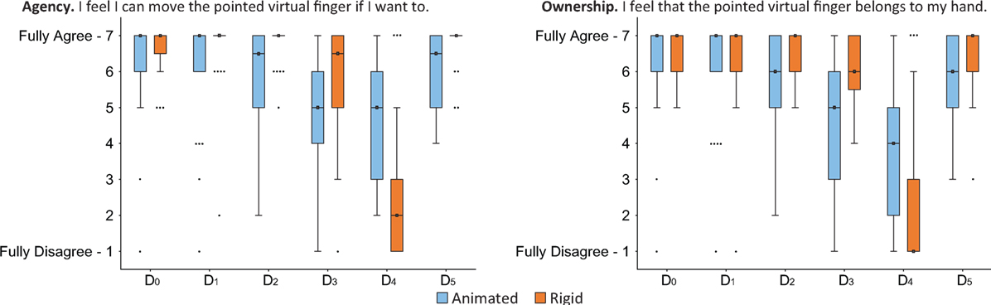
Six-Finger Illusion in VR
Congruent visual and tactile stimulation leads to belief and ownership of a illusory sixth finger in VR
Found participants would attempt to control their 6th virtual finger when asked
Experimental Procedures
Establish embodiment by having participants follow guided hand-movement exercise, then ask participant to lift individual fingers. See if any real finger lifts for the 6th virtual finger
Congruently apply brushstroke stimulation to 5 real fingers and 6 virtual fingers. For the 6th virtual finger, the real ring finger is stimulated
Ideas for Thermal Integration
Would thermal stimulation enhance the illusion?
Can thermal stimulation be felt on the illusory 6th finger? Maybe conflicting cues?

Slide 36
Six-Finger Illusion in VR
Six-Finger Illusion in VR - Hoyet, Ludovic, et al. "“Wow! i have six Fingers!”: Would You accept structural changes of Your hand in Vr?." Frontiers in Robotics and AI 3 (2016): 27.

Slide 37
Pseudo-haptics
Control-Display Ratio – Changing ratio between user control and visual display affects perceived object properties
Visual cues can affect perceived friction, stiffness, mass, texture,
Ideas for Thermal Integration
Does there exist pseudo-haptics for thermal properties?
Can thermal masking be induced with pseudo-tactile stimulation?

Slide 38
Pseudo-haptics
Survey - Lécuyer, Anatole. "Simulating haptic feedback using vision: A survey of research and applications of pseudo-haptic feedback." Presence: Teleoperators and Virtual Environments 18.1 (2009): 39-53.
CDR on Mass - Dominjon, Lionel, et al. "Influence of control/display ratio on the perception of mass of manipulated objects in virtual environments." IEEE Proceedings. VR 2005. Virtual Reality, 2005.. IEEE, 2005.
Force Feedback - Lécuyer, Anatole, et al. "Pseudo-haptic feedback: Can isometric input devices simulate force feedback?." Proceedings IEEE Virtual Reality 2000 (Cat. No. 00CB37048). IEEE, 2000.

Slide 39
Visual Cues
Color-Temperature Illusion – Visual color and cues can affect perceived temperature of a neutral object
Visual cues can also affect perceived localization and spatial features of thermal cues
Ideas for Thermal Integration
How will visual cues affect perceived temperature, location, and other qualities of thermal stimulation during masking?

Slide 40
Visual Cues
Color-Temperature Illusion – Wilson, Connor, Daniel J. Rea, and Scott Bateman. "Temperature illusions in mixed reality using color and dynamic graphics." arXiv preprint arXiv:2406.03241 (2024).
Visual Localization - Günther, Sebastian, et al. "Assessing the influence of visual cues in virtual reality on the spatial perception of physical thermal stimuli." Proceedings of the 2024 CHI Conference on Human Factors in Computing Systems. 2024.

Slide 41
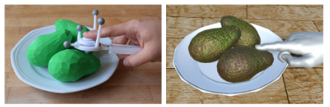
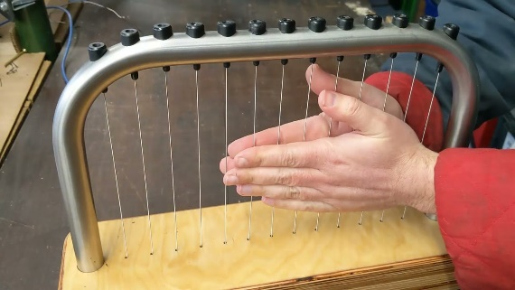
Object Properties
Transient vibration and visual deformation create illusory softness
Choi, Inrak, et al. "Augmenting perceived softness of haptic proxy objects through transient vibration and visuo-haptic illusion in virtual reality." IEEE Transactions on Visualization and Computer Graphics 27.12 (2020): 4387-4400.
Rubbing wires between the hands changed perceived material (Velvet Hand Illusion)
Yokosaka, Takumi, Scinob Kuroki, and Shin’ya Nishida. "Describing the sensation of the ‘velvet hand illusion’in terms of common materials." IEEE Transactions on Haptics 14.3 (2020): 680-685.
Cold objects are perceived as heavier (Temperature-Weight Illusion)
Kuhtz-Buschbeck, Johann P., and Johanna Hagenkamp. "Cold and heavy: grasping the temperature–weight illusion." Experimental brain research 238.5 (2020): 1107-1117.
Vibrotactile cues can elicit stiffness and friction
Kildal, Johan. "3D-press: haptic illusion of compliance when pressing on a rigid surface." International Conference on Multimodal Interfaces and the Workshop on Machine Learning for Multimodal Interaction. 2010.
Ideas for Thermal Integration
Can thermal cues affect object properties, like softness, texture, wetness, etc.?

Slide 42
Notes
May need LRAs for temporal precision (or not since thermal takes longer)
Will illusions hold at longer stimulation times required for thermal masking?
Promising Directions
Funneling and Saltation
Classical, fundamental illusions with broad impact
Directly related to masking mechanisms
Useful for interface design
Need to try
Sixth Finger and Phantom Limb
Interesting implications for underlying perceptual mechanisms
Masking Feature Modulation by Multimodal Cues
How exactly is masking influenced by other sensory cues (visual, audio)?
Insights for experience design

Slide 43
Notes
Vibrotactile works for rabbit as long as no vibration spatial propagation (stimulation decays over 8cm)
ERM used in virtual object paper

Slide 44
Meeting 1 To-Do
Investigate Cutaneous Rabbit, Funneling, Apparent Tactile Motion, maybe Tau & Kappa
Implement base tactile versions of illusions
Maybe try integrate thermal component

