Slide 1
Project 6 cs6328
team #3
bingyu huang
zhengyang xu

Slide 2

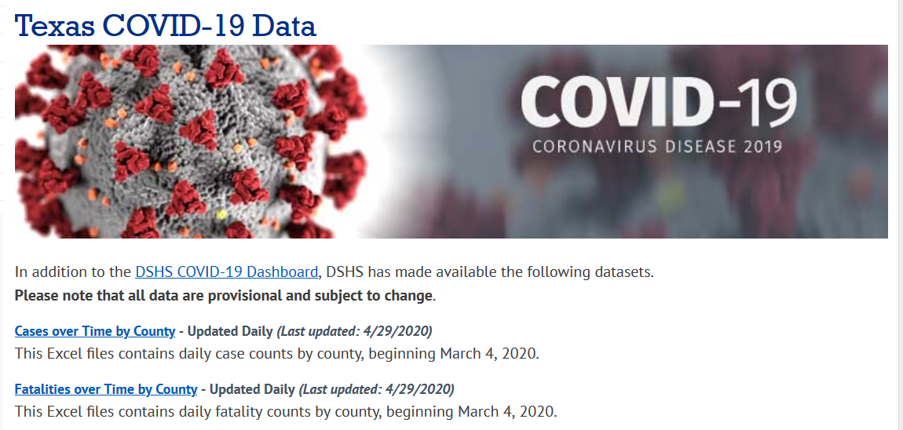
Basic Information
Number of counties in DFW area 9
Collin
Dallas
Denton
Hunt
Kaufman
Parker
Rockwall
Tarrant
Wise
Total number of Confirmed Cases in DFW area: 7007
Total number of Deaths Cases in DFW area: 196
Total number of Active Cases in DFW area: 6811
Data source
https://www.dshs.state.tx.us/coronavirus/additionaldata/
By 4/29/2020

Slide 3
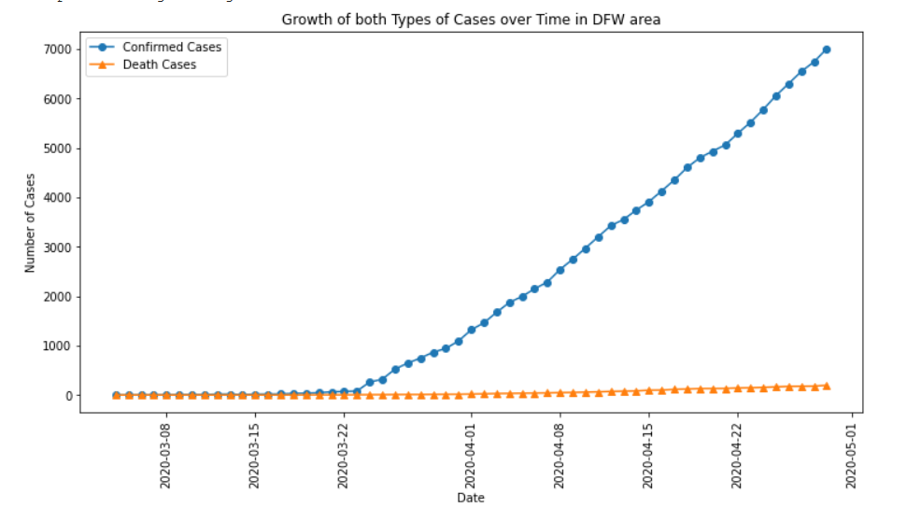
Cases over date
“As of April 14, 2020, CDC case counts and death counts include both confirmed and probable cases and deaths. This change was made to reflect an interim COVID-19 position statement issued by the Council for State and Territorial Epidemiologists on April 5, 2020. The position statement included a case definition and made COVID-19 a nationally notifiable disease.”
--CDC.gov

Slide 4
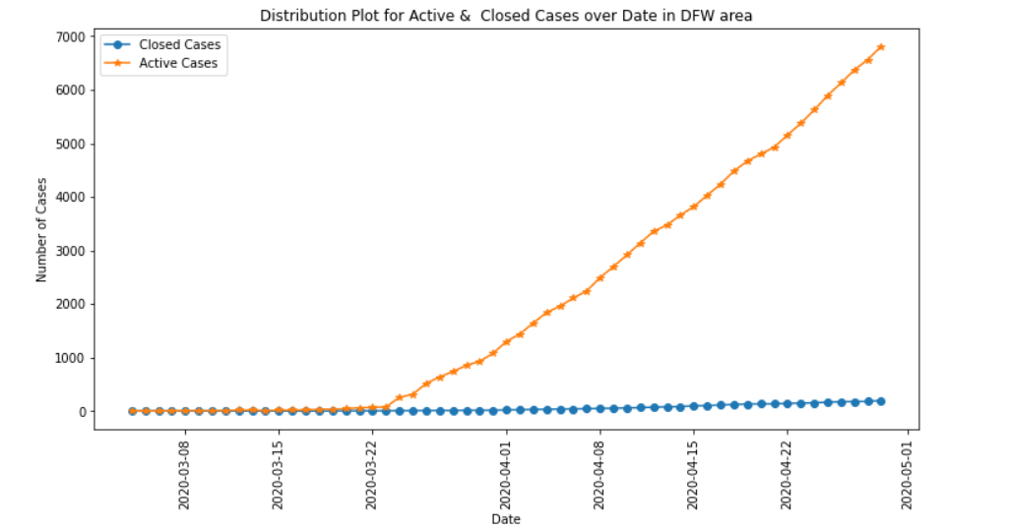
Focused point
Active Cases VS Closed Cases
Active ( tricky )
Confirmed – Recovered - Deaths
Closed ( fishy )
Recovered + Deaths

Slide 5
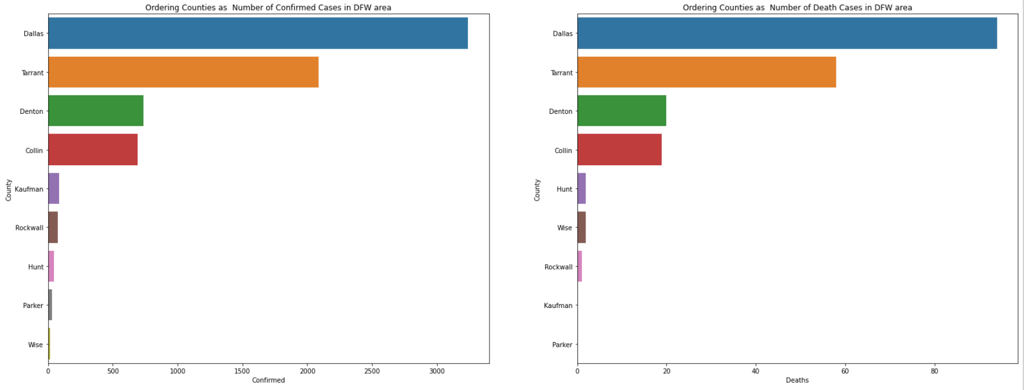
These could somehow set up a baseline about how much we could trust our current ‘reported’ data

Slide 6
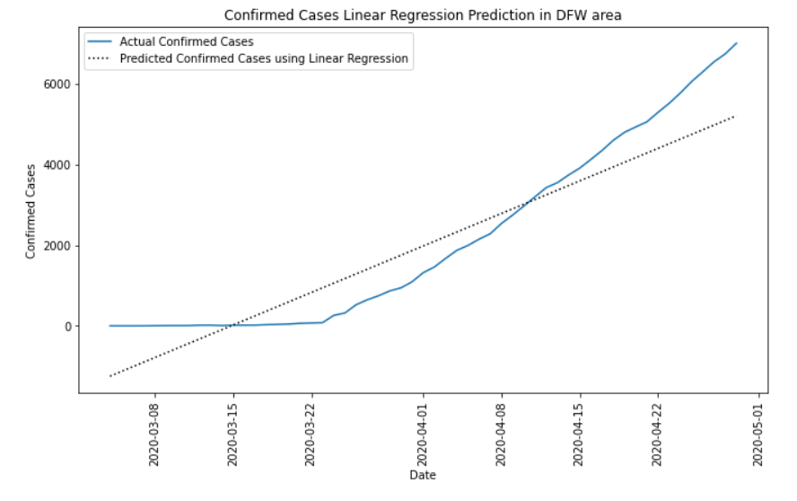
Linear reg
Compared with the global data, DFW prediction could be a proper fit for linear regression
Why
Ability to test
Smaller sandbox
Similar lifestyle

Slide 7
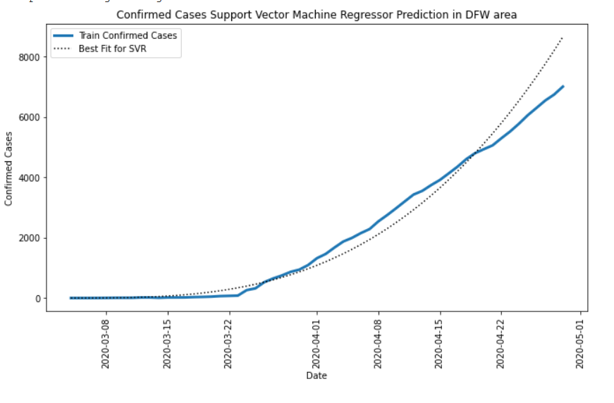
svm
SVR(C=1,degree=3,kernel='poly’, epsilon=0.01)
Seems to be a good fit if we set the parameter as above, degree as 2 or 4 would be a little bit off-road

