Slide 1

FallAlarm Fall detection and alarm app

Slide 2
Objective
To present the design, and implementation of an Android mobile App called FallAlarm, which is used to detect when a person carrying the phone falls and alarms (sends SMS to) an emergency contact

Slide 3
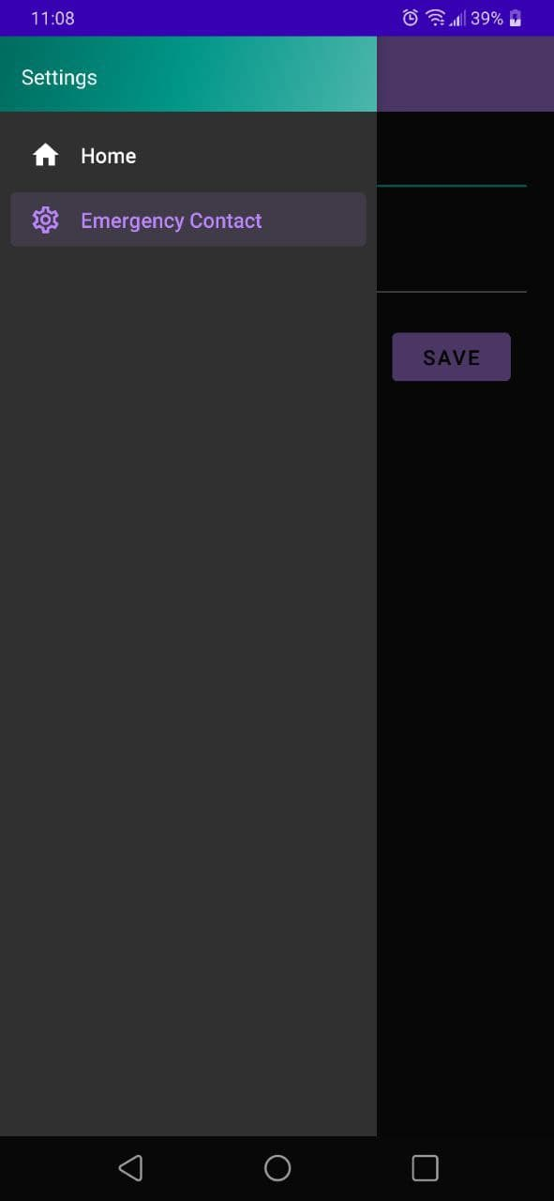
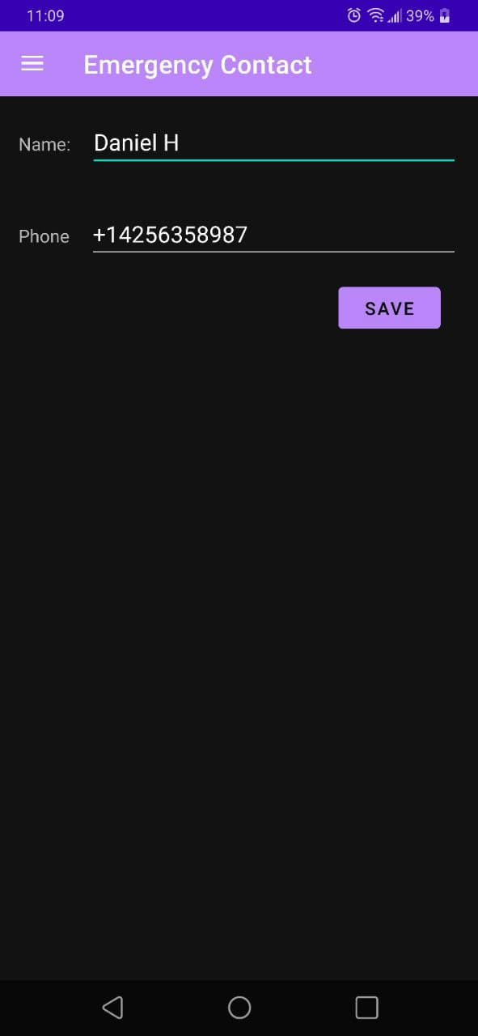
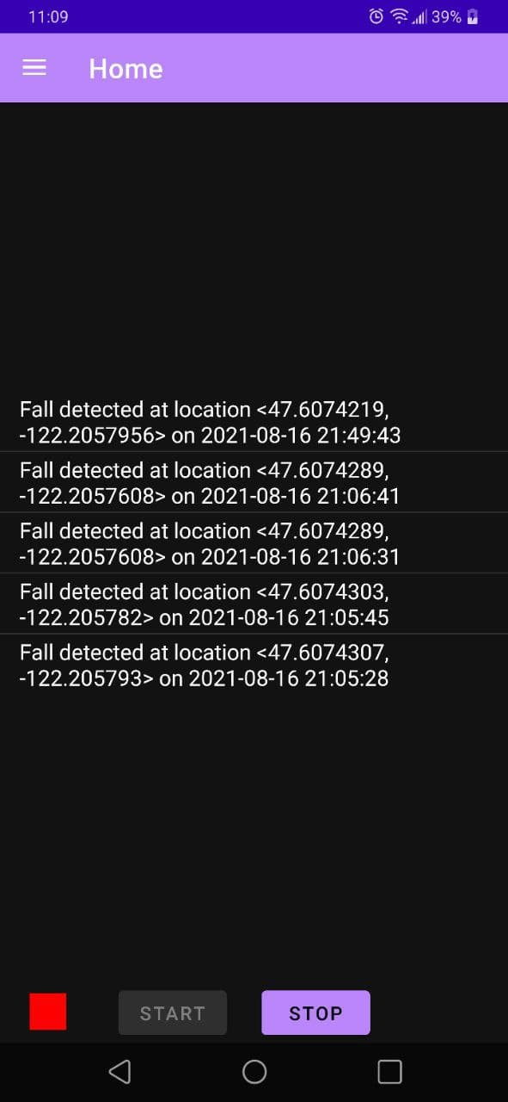
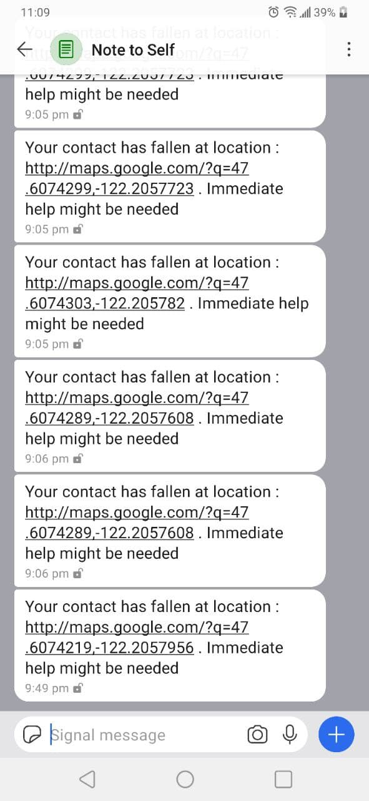
FallAlarm

Slide 4
Modeling and Algorithm Development
Simple Data Collection App
Acceleration Mag:
Am = √ (Ax ²+ Ay ² +Az ²)
Normal walking
Walk Sit Stand
Walk Fall

Slide 5
Collected Data
DURATION
UPPER THRESHOLD
LOWER THRESHOLD

Slide 6
Algorithm

Slide 7
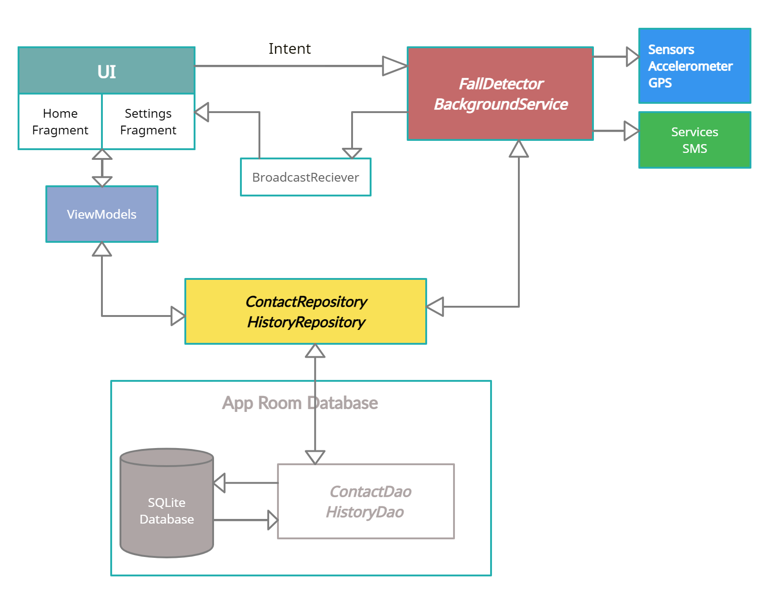
Design and Implementation

Slide 8
ISSUES
False Positives when the phone free falls
Mitigation: To Provide a ‘Cancel’ button
on the home page

Slide 9
Future Enhancement
Polishing and branding the UI
Adding validations for inputs such as phone numbers
Battery optimization since there is a background service.

Slide 10
Thank you!

