Slide 1

Health Portal
789 Final Project
Clients: Bill McCrury & Justin Loi
Contractors: Daniel Huynh & Jack McGowan

Slide 2
Group Members
Daniel Huynh
Database
Security
Deployment
Jack McGowan
Business Logic
External Integration

Slide 3
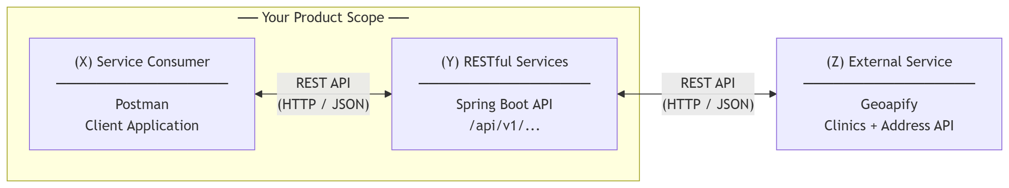
Elevator Pitch
We built a Patient Appointment and Vaccination Portal. It is a RESTful web service that lets healthcare providers manage patients, schedule clinic appointments, and track immunization records in one place. Patients can be registered, their vaccination history recorded for COVID-19, flu, MMR, and Hepatitis B, and appointments booked at real clinics discovered through live geographic search. The entire API is secure with JWT authentication, documented interactively via Swagger, and deployed on a public cloud so any authorized consumer can use it today.

Slide 4
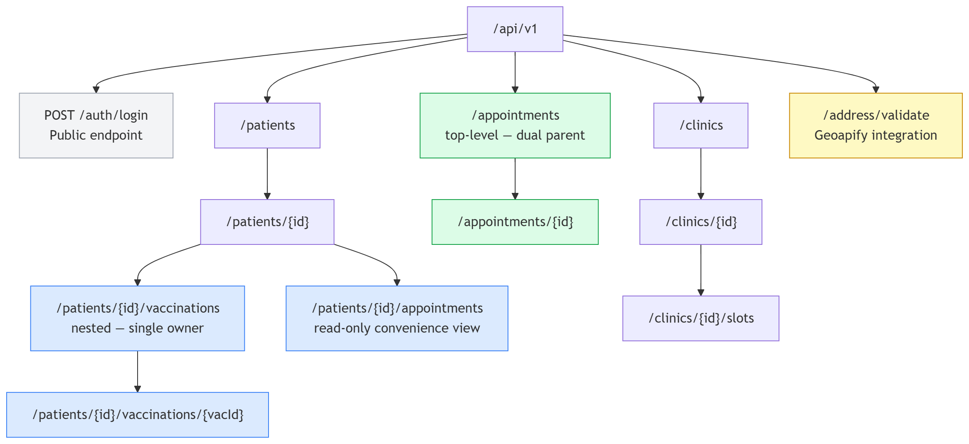
API Design

Slide 5
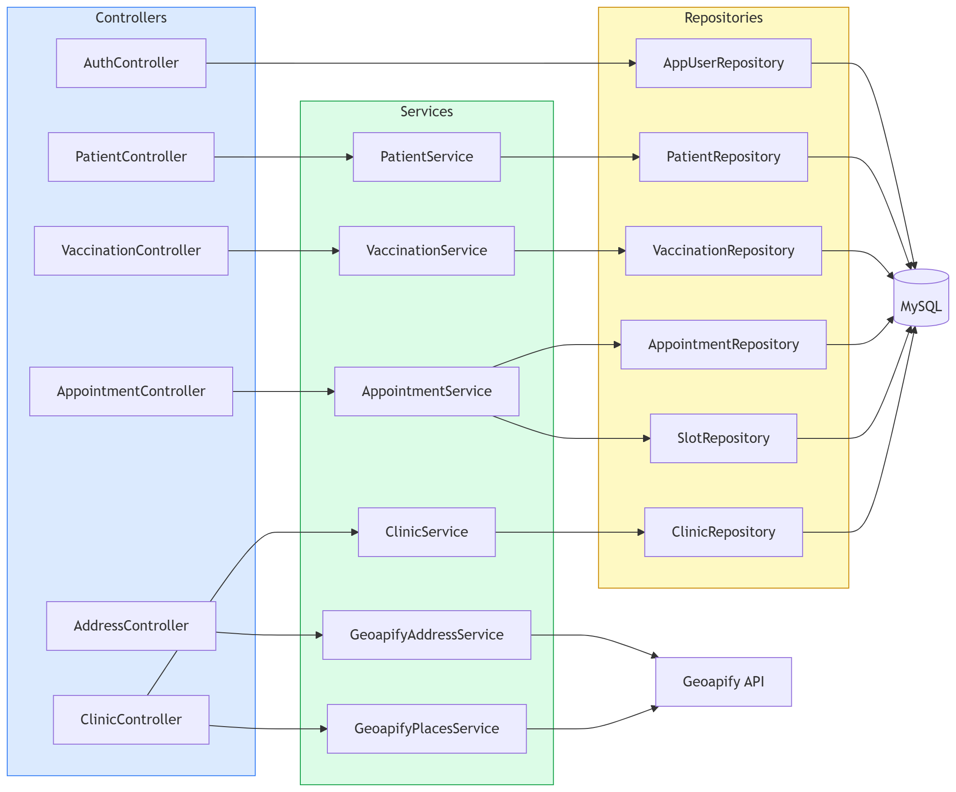
Component Map

Slide 6
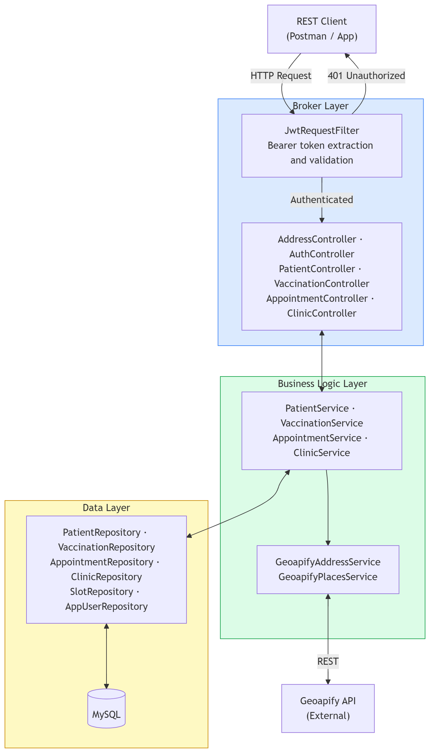
Component Layers

Slide 7
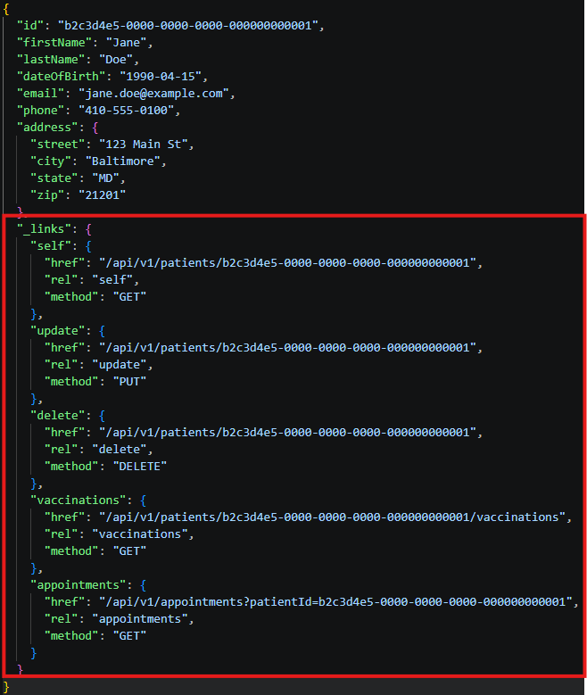
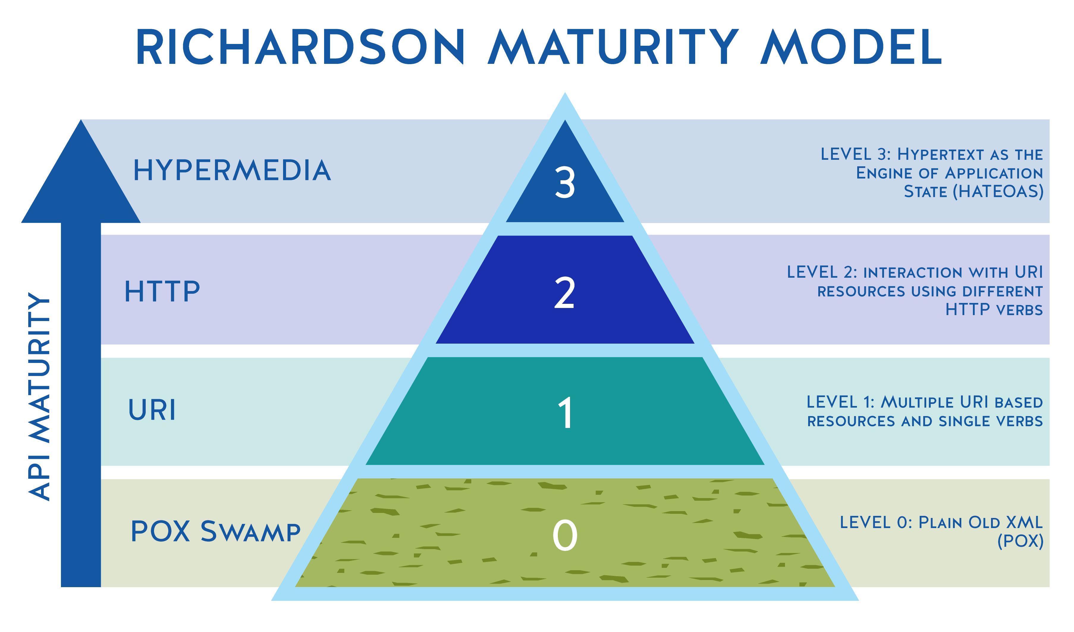
HATEOAS

Slide 8
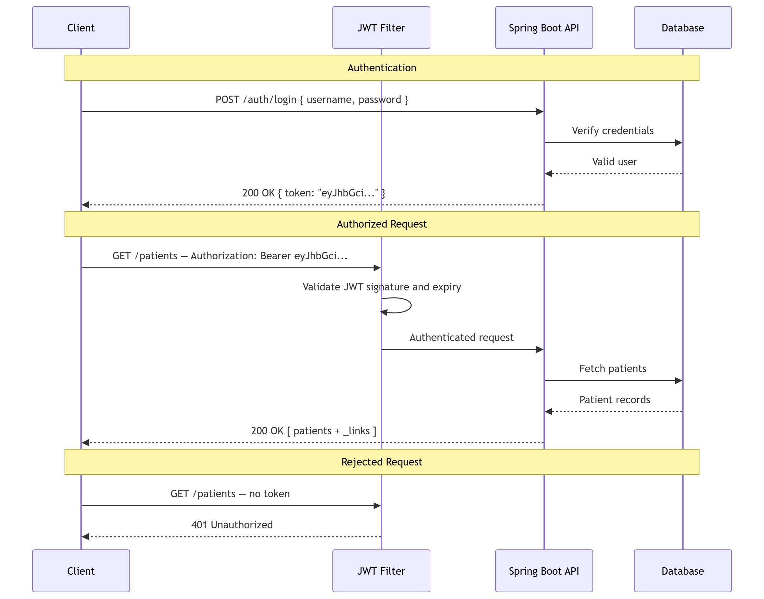
Security
JWT tokens
Get a token via /auth/login endpoint

Slide 9
Demo Time

Slide 10
Challenges & Issues
Appointment resource placement
Could have belonged under patients or clinics
Neither felt correct so went with top-level resource
Deploying a database
Didn’t go over in class
Discovered Heroku can provide a MySQL database

Slide 11
Next Steps
Role-based access
1
Current: Every token can access everything
Goal: Roles such as patient can only see their own records
Appointment reminder notifications
2
Use something like Twilio to send notifications when appointments get close
Patient-facing frontend as a client
3

Slide 12
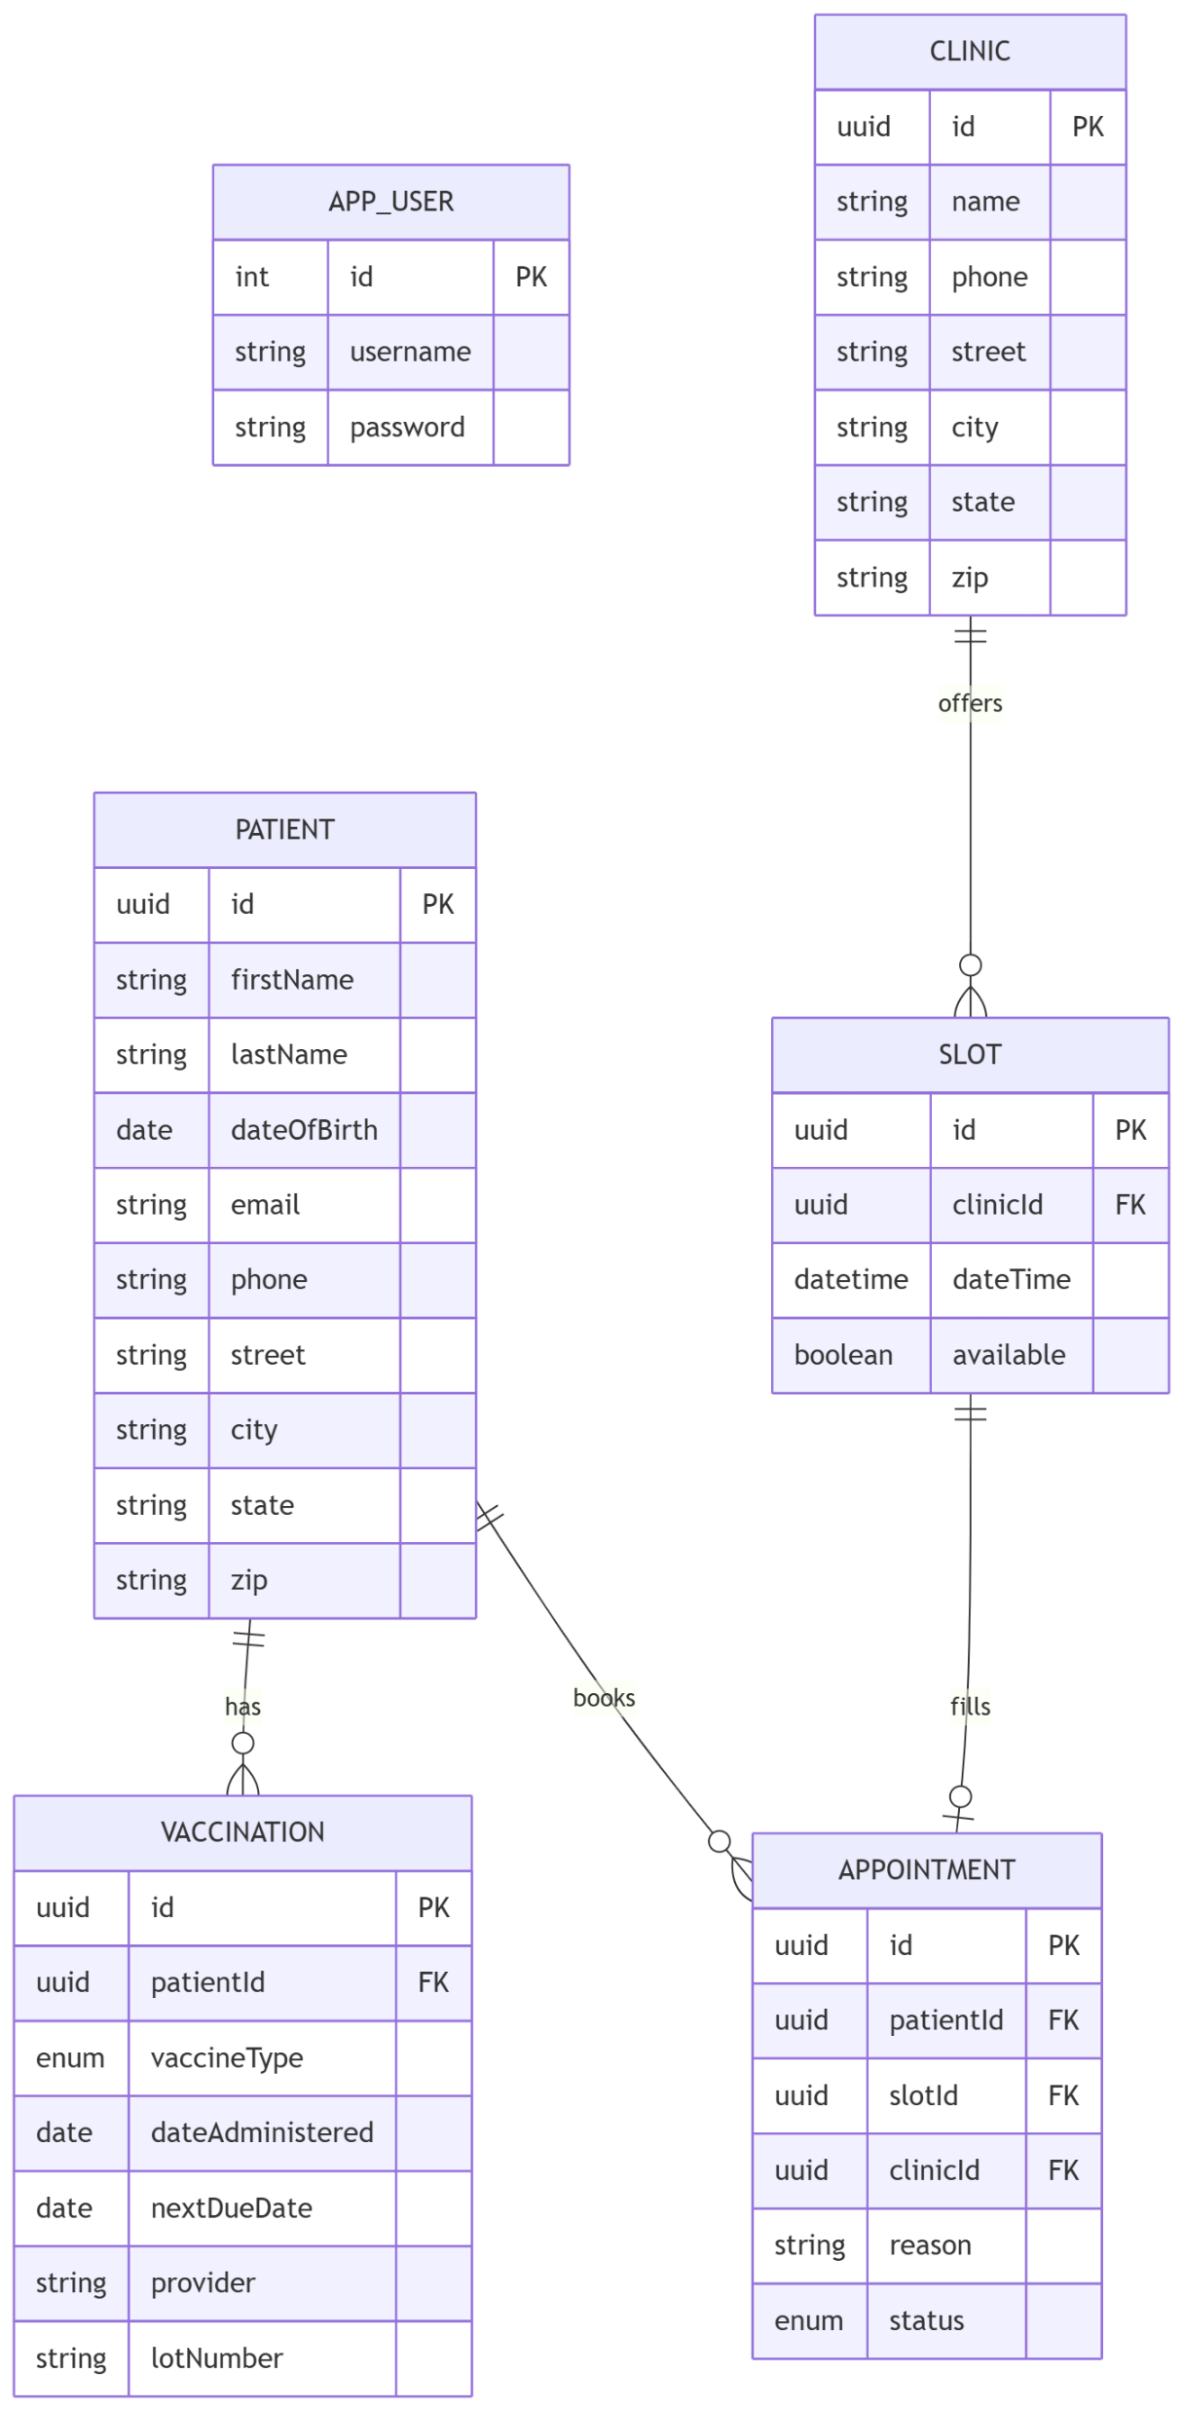
Appendix A: Relationship Diagram

