Slide 1
Health System Capacity and Life Expectancy Across Countries
Daniel Kang
DATS 2102: Data Visualization Final Project

Slide 2
Research Question
How do differences in healthcare infrastructure across countries relate to variation in life expectancy over time?
  Focus on cross-country comparison
  Designed for a non-expert audience

Slide 3
Data & Indicators
World Bank World Development Indicators (WDI)
  Life expectancy at birth (years)
  Physicians per 1,000 people
  Hospital beds per 1,000 people
  World Bank regional classifications

Slide 4
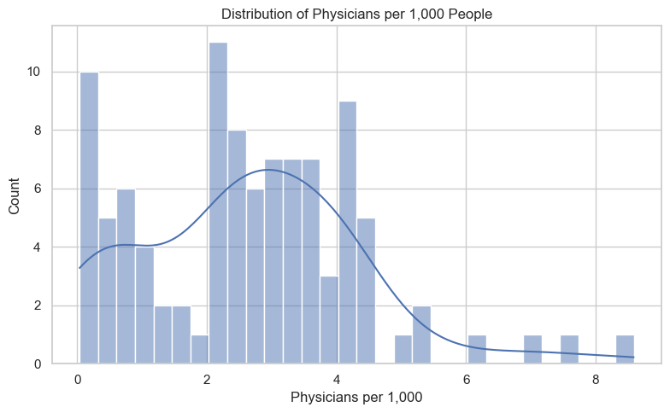
Distribution of Health System Capacity
Physician availability varies widely across countries
  Most countries have low physician density
  A small number of countries have very high capacity
  Distribution is right-skewed

Slide 5
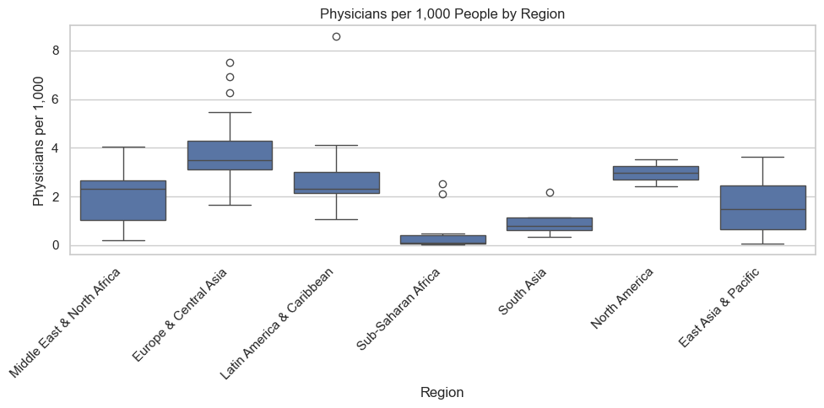
Regional Differences in Capacity
Health system capacity differs substantially by region
  Europe & Central Asia show higher median physician density
  Sub-Saharan Africa and South Asia have lower capacity
  Wide variation exists within regions

Slide 6
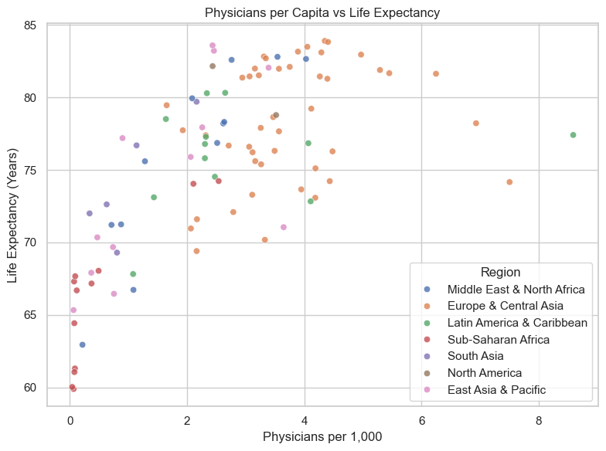
Capacity vs Life Expectancy
Higher health system capacity is associated with longer lives
  Countries with more physicians tend to cluster at higher life expectancy
  Relationship is positive but not linear
  Regional patterns remain visible

Slide 7
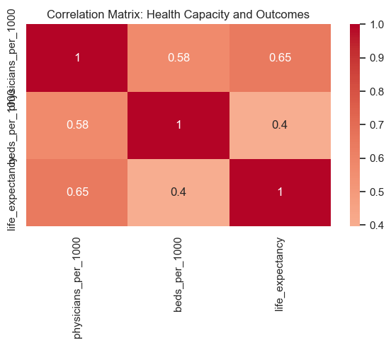
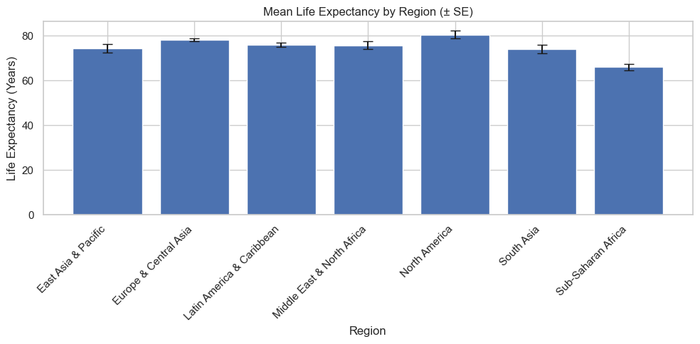
Correlations & Uncertainty
Relationships are moderate, not deterministic
  Life expectancy correlates positively with physicians and hospital beds
  Correlations are not strong enough to imply causality
  Regional means overlap when uncertainty is considered

Slide 8
Key Takeaways & Limitations
Health system capacity matters, but it is not the full story
Countries with similar capacity can have very different outcomes
Other factors likely play major roles:
  Public health systems
  Income and education
  Inequality and policy

