Slide 1

Virtual Reality in Music Education
Daniel Grech
Institute of Information & Communication Technology
MCAST, Paola, Malta

Slide 2
Motivation
To change the way music can be taught
Solve limitations about individuals wishing to learn music but can not physically due to disease or illness.
Making music education both cheaper and space-friendly using virtual reality technologies
Motivate more people to start learning about music by doing so in the comfort of their own home

Slide 3
Hypothesis & Questions
Hypothesis
The hypothesis of this research is that if people learn basic music education using solely virtual reality technologies, and if they able to compete with people learning basic music education physically.
Research Questions
How do users that learnt music solely from VR technologies compare to users that have a basic background in music?
Are using VR technologies in music education ideal learning tools?

Slide 4

Key Literature
Virtual Reality has a lot of potential and is currently starting to become utilised in all forms of education.
Tong et al. (2016) ran tests to see the potential multimedia technologies have in musical education, and these tests confirmed that multimedia technologies do have the potential to be used as learning tools.

Slide 5
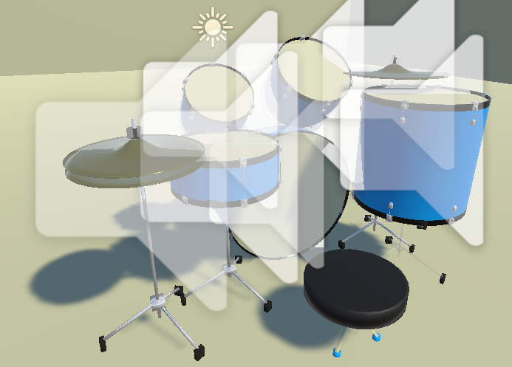

Research Methodology
A virtual reality drum kit was made in blender by a 3rd party and then uploaded to Unity.
In order for the drum kit to work, the user must have a working virtual reality headset and working virtual reality controllers for both hands.

Slide 6
Methodology
Research Task
Two individuals were placed in one room with a virtual drum kit and the other two individuals had a physical drum kit. Their objective was to replicate a simple beat provided to them.
Ethical Considerations
Consent was obtained from the four participants who tested the virtual reality drum kit
The participants were allowed to freely test the drum kit and were tasked to replicate a simple drum beat.

Slide 7
Prototype demonstration
https://www.youtube.com/watch?v=GExiH4X98L4

Slide 8
Results
All the participants managed to replicate the simple drum beat provided to them, even though half of the participants only used a virtual drum kit.

Slide 9
Evaluation
Overall the virtual reality drum kit has proven that it could compete with a physical drum kit.
The application does require a VR headset, making it problematic for those who do not own one.
When interviewed, the individuals also preferred to use a physical drum kit, which does make sense since it is more realistic, however when asked if they would use the virtual drum kit as a substitute, all of them said yes.

Slide 10
Conclusions
Using virtual reality technologies, a fully functioning drum kit was made and was able to compete with a physical drum kit.
This application and technology can impact many groups around the world, including:
People who are forced to stay home due to illness
People who can not afford instruments and subscriptions to music lessons
People who do not have enough space in their home to add an instrument
People who can not make a lot of noise as to not annoy their neighbours

Slide 11
Improvements/Future Recommendations
Making a more realistic room for the drum kit to be placed in
Attempting the same test with different instruments (primarily percussion instruments)
Testing to see whether virtual reality technologies in music education can compete with experienced musicians by producing more advanced beats

Slide 12
References
Tong, J. (2016) “Design and Implementation of Music Teaching Platform in College Based on Android Mobile Technology”, International Journal of Emerging Technologies in Learning (iJET), 11(05), pp. pp. 4–9. doi: 10.3991/ijet.v11i05.5686.

Slide 13
Thank you Daniel Grech

