Slide 1
ARTIFICIAL INTELLIGENCE
The slide material is from Wikipedia

Slide 2
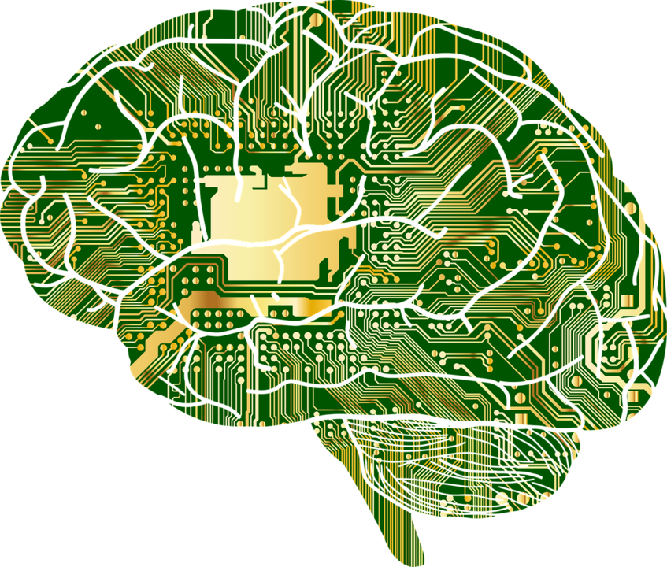
Artificial intelligence (AI) is intelligence demonstrated by machines, as opposed to the natural intelligence displayed by animals including humans.

Slide 3
Intelligence implies rationality; the conformity of one's actions with one's reasons for action.
Example:
I am hungry, therefore I eat.
Action: eat, Reason: hungry

Slide 4
More intelligence means more rationality

Slide 5
AI RESEARCH GOALS

Slide 6
Reasoning, problem-solving
Solving problems using fast, intuitive judgments.

Slide 7
Knowledge representation
Focuses on representing information about the world in a form that that can be used for solving complex problems.

Slide 8
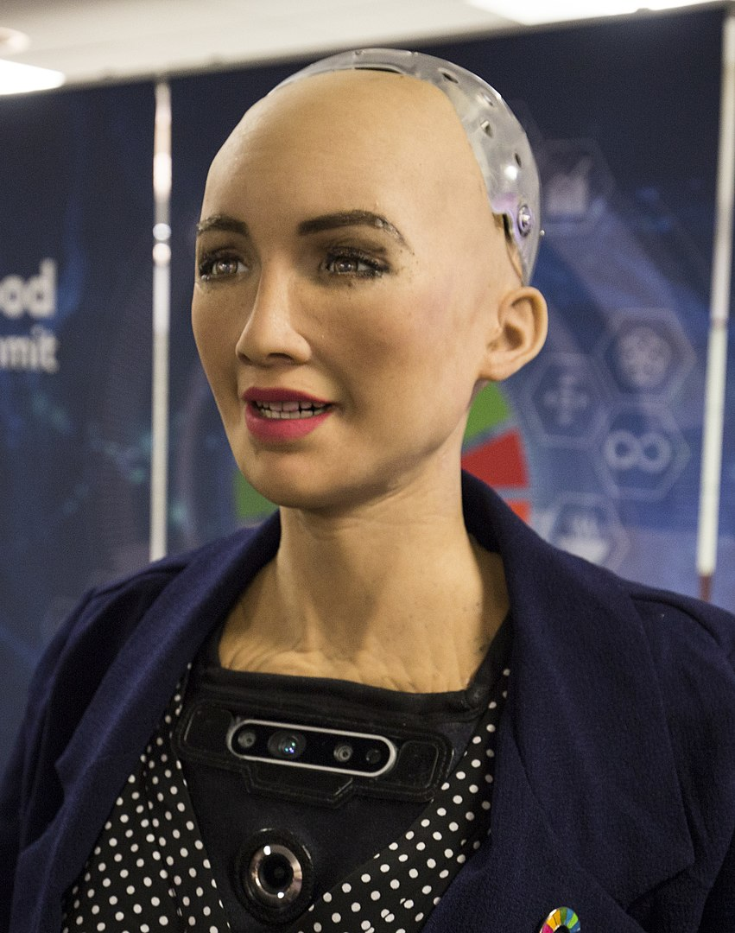
Planning
Concerned with making decisions or action sequences by intelligent agents, autonomous robots and unmanned vehicles.

Slide 9
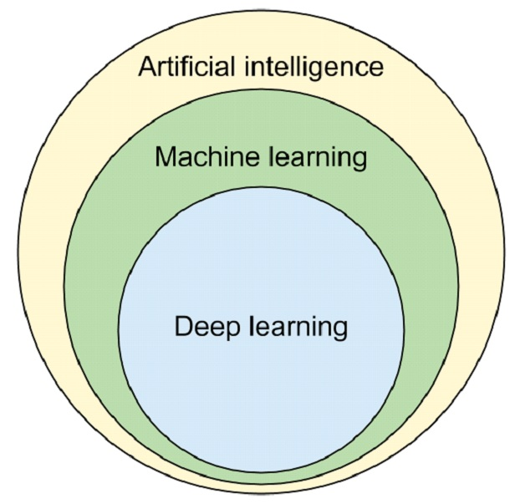
Learning
Machine learning builds models that leverage data to solve certain tasks

Slide 10
Natural language processing
Machines could read and understand human language, this frequently involve speech recognition, natural-language understanding, and natural-language generation.

Slide 11
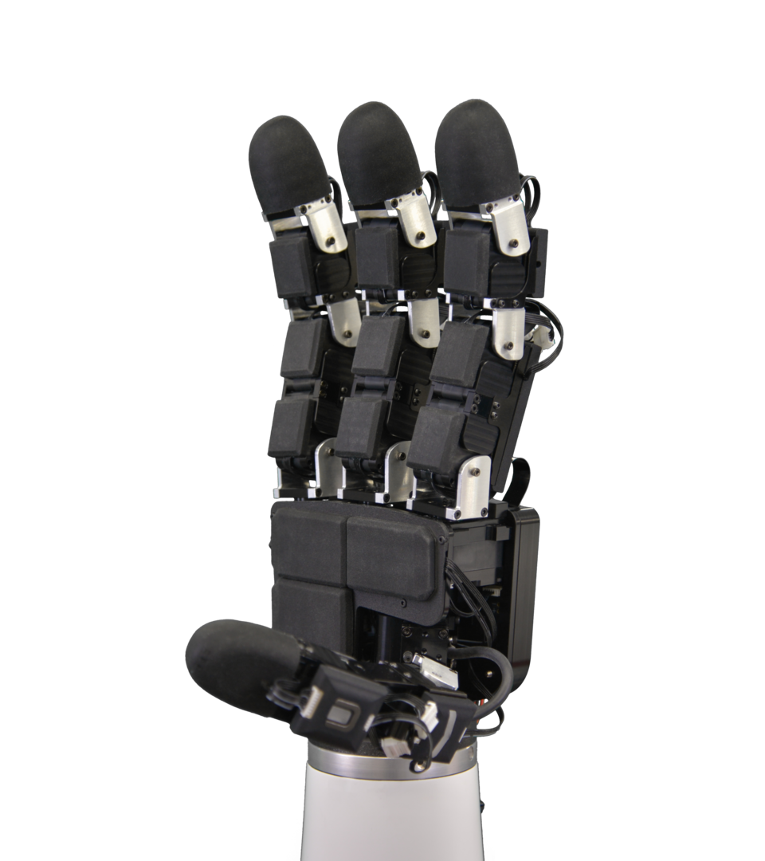
Perception
Interpret data in a similar way to humans using their senses to relate to the world around them.

Slide 12
Motion and manipulation
A robot needs to know its location and map its environment.

Slide 13
Social intelligence
Recognize, interpret, process or simulate human feeling, emotion and mood.

Slide 14
General intelligence
The ability of an intelligent agent to understand or learn any intellectual task that a human being can.

Slide 15
TOOLS

Slide 16
Search and optimization
Logic
Probabilistic methods for uncertain reasoning
Classifiers and statistical learning methods
Artificial neural networks
Specialized languages and hardware

Slide 17
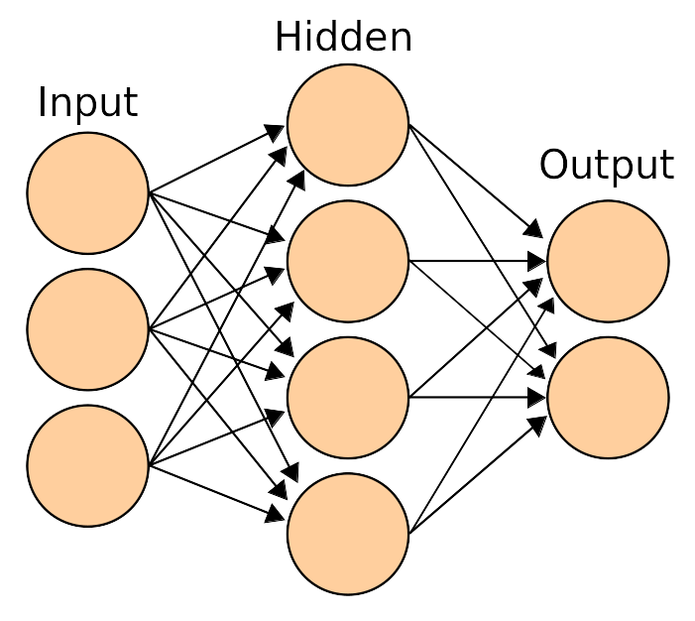
Artificial neural networks
Neural networks were inspired by the architecture of neurons in the human brain.

Slide 18
Specialized languages and hardware
Specialized languages and hardware for artificial intelligence have been developed.
i.e. Languages: software library TensorFlow
Hardware: AI accelerators such as GPU

Slide 19
APPLICATIONS

Slide 20
Search engines
(i.e. Google Search)

Slide 21
Recommendation systems and targeted advertising
(i.e. Netflix, YouTube, Amazon, AdSense, Facebook)

Slide 22
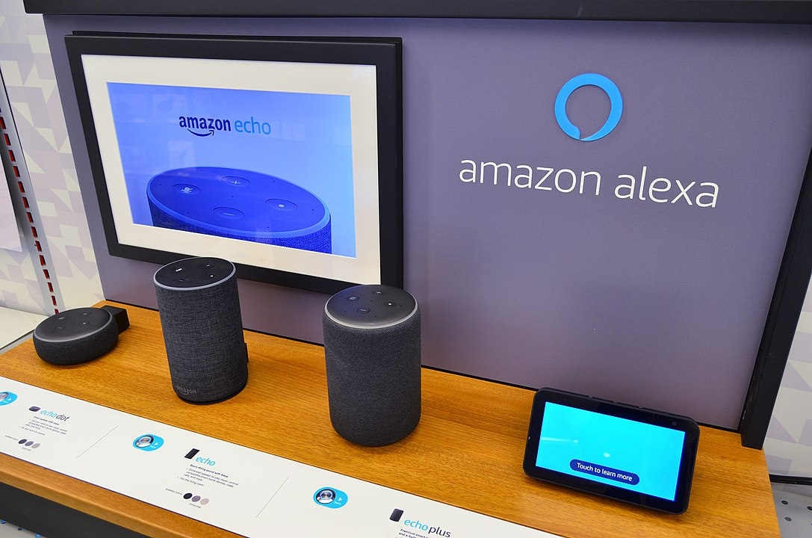
Virtual assistants
(i.e. Siri, Alexa)

Slide 23
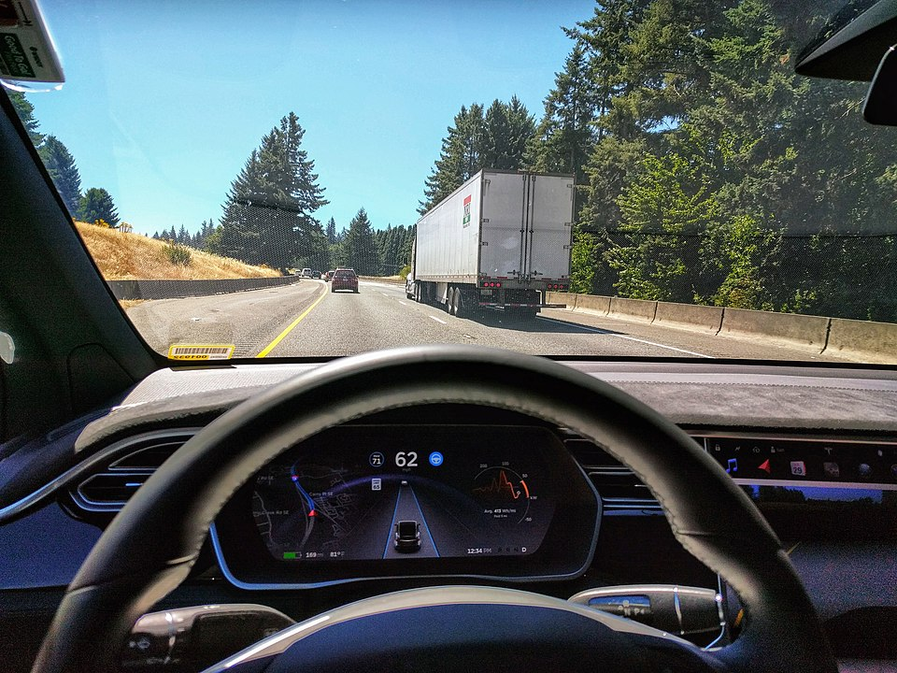
Autonomous vehicles
(i.e. Tesla)

Slide 24
Automatic language translation
(i.e. Microsoft Translator, Google Translate)

Slide 25
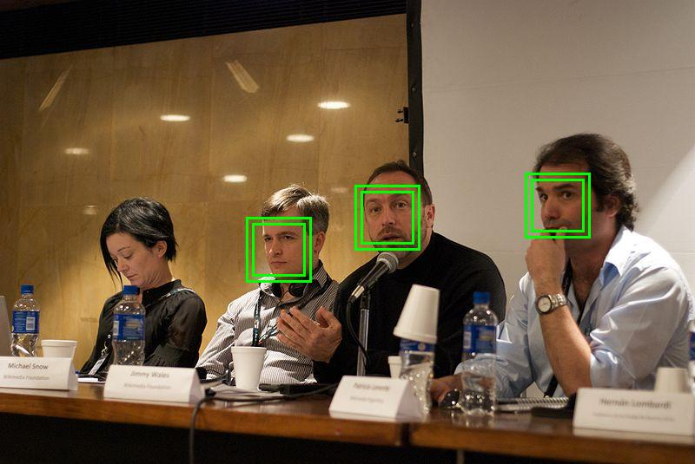
Facial recognition
(i.e. Apple Face ID, Microsoft DeepFace)

Slide 26
Image and text labeling
(i.e. Facebook, Apple iPhoto, TikTok, Spam filtering)

Slide 27
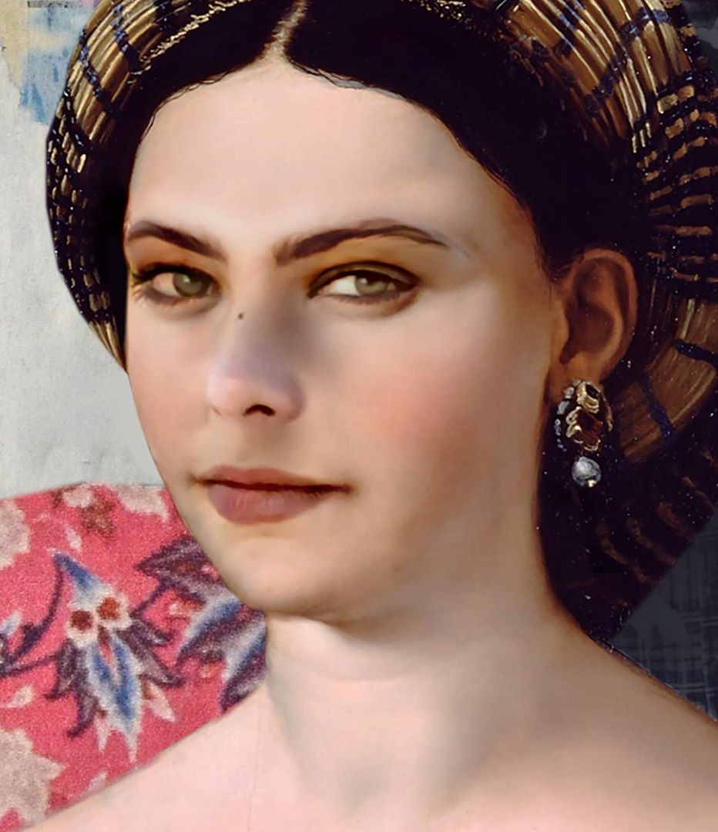
Video and image manipulation
(i.e. Deepfake)
Actress Ornella Muti, painted by AI in the style of Raphael.

Slide 28
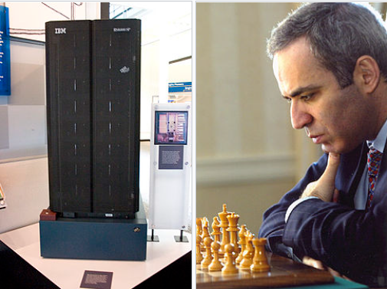
Playing games
(i.e. Deep Blue, Watson, AlphaGo)

Slide 29
Human-like text generation
(i.e. GPT3, Wu Dao)

Slide 30
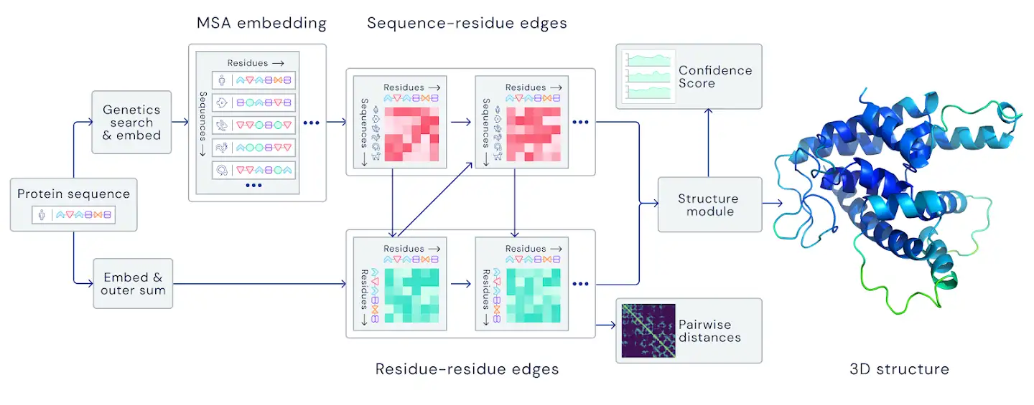
Protein structure
(i.e. AlphaFold2)

