Slide 1
DATA SCIENCE

Slide 2
Extract knowledge from data in a way that can be modelled to represent a phenomena, then make new predictions.

Slide 3
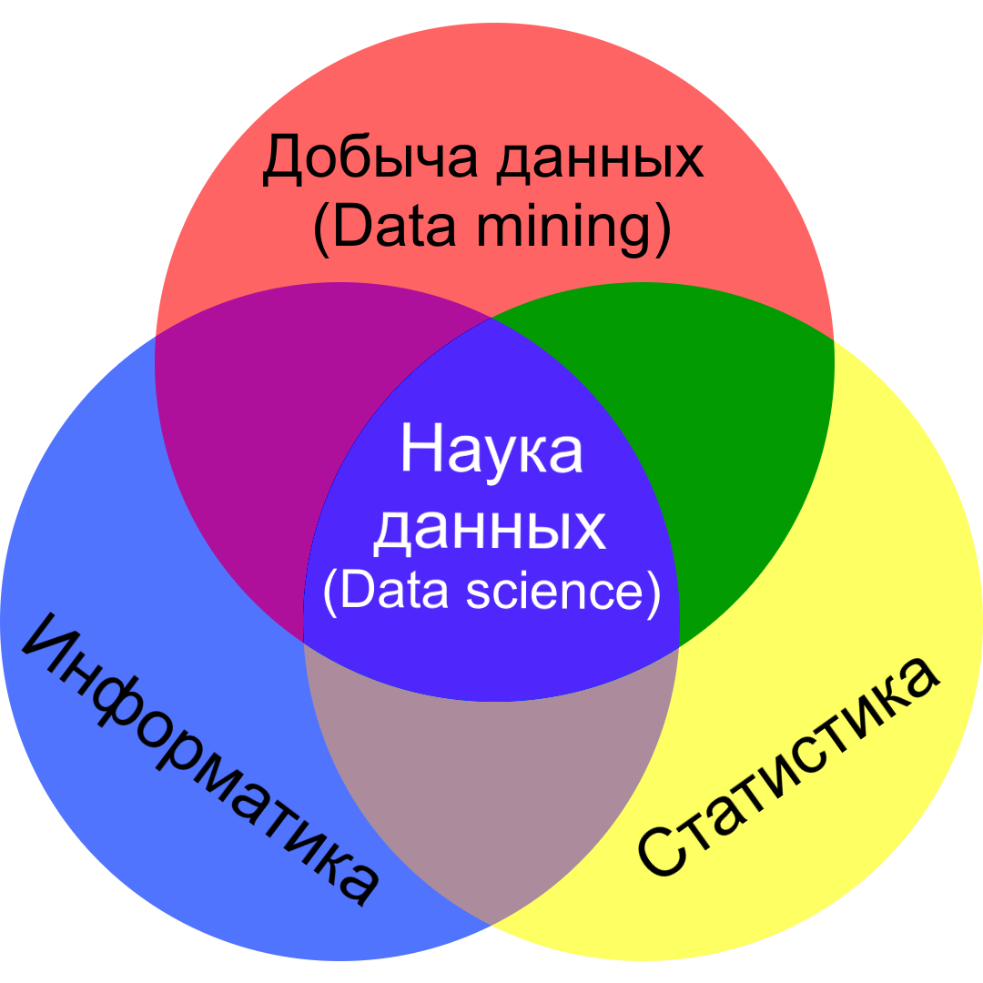

Slide 4
Data mining
Extraction of patterns and knowledge from large amounts of data.

Slide 5
Statistics
Inferential statistics can reasonably extend from the sample to the population as a whole.

Slide 6
Informatics
Machine learning algorithms build a model based on a data set, in order to make predictions.

Slide 7
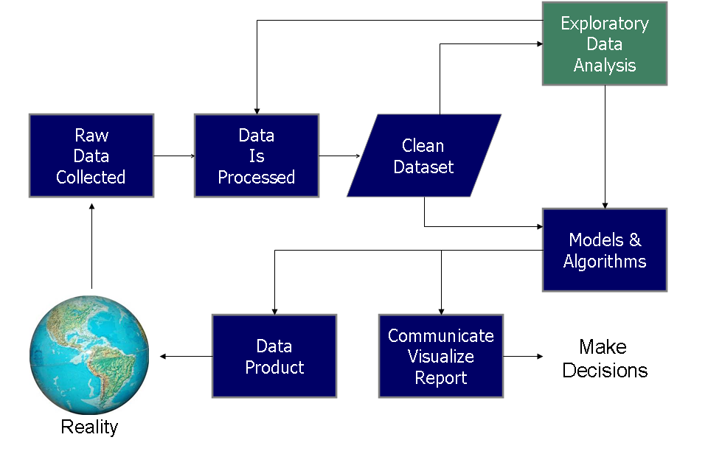
Data science pipeline
source: Doing Data Science, by Schutt & O'Neil (2013)
CC BY-SA 3.0

Slide 8
Course content

