Slide 1
DATA MINING

Slide 2
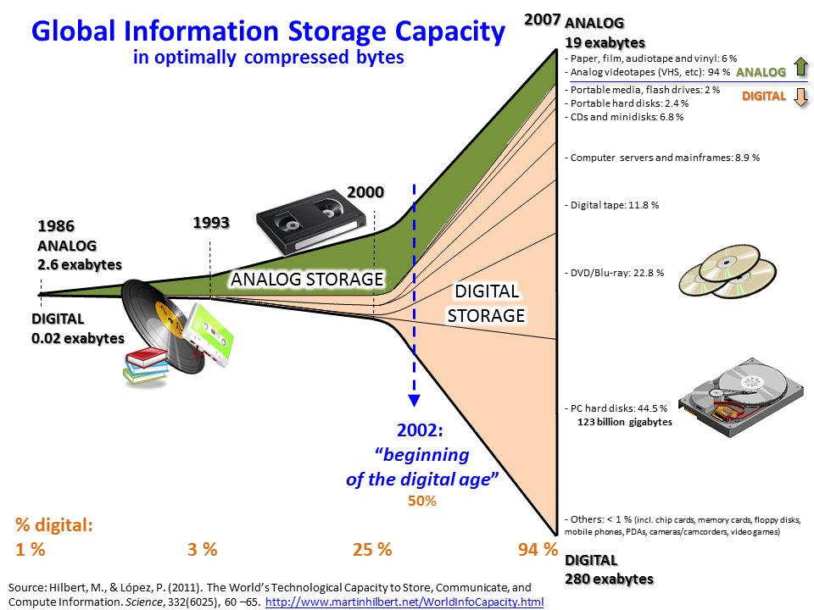
source: http://www.martinhilbert.net/WorldInfoCapacity.html
File:Hilbert InfoGrowth.png
CC BY-SA 3.0
Big Data
Data sets that are too large or complex to be dealt with by traditional data-processing application software.

Slide 3
Web scraping
Web harvesting, or web data extraction from websites.

Slide 4
Tools
Wget
Scrapy
Retrieving large files or mirroring entire web.
Open-source web-crawling framework written in Python.

Slide 5
Notebook link

