Slide 1

Applying Big Data Analytics to Open Health Care Data
Exploring Relationships Between Seniority
and Performance in Healthcare Providers
Daniel Clarke A. Ravishankar Rao, Ph.D. Maryelena Vargas
This research was jointly funded by
FDU Seed Grant
GS-LSAMP

Slide 2
Motivation
Big Data
Successful in finance, marketing, advertising
Lagging in other sectors (e.g. Healthcare)
Healthcare
‘Public’ data: Medicare, NY SPARCS, etc..
Some data more useful than others
Push toward transparency

Slide 3
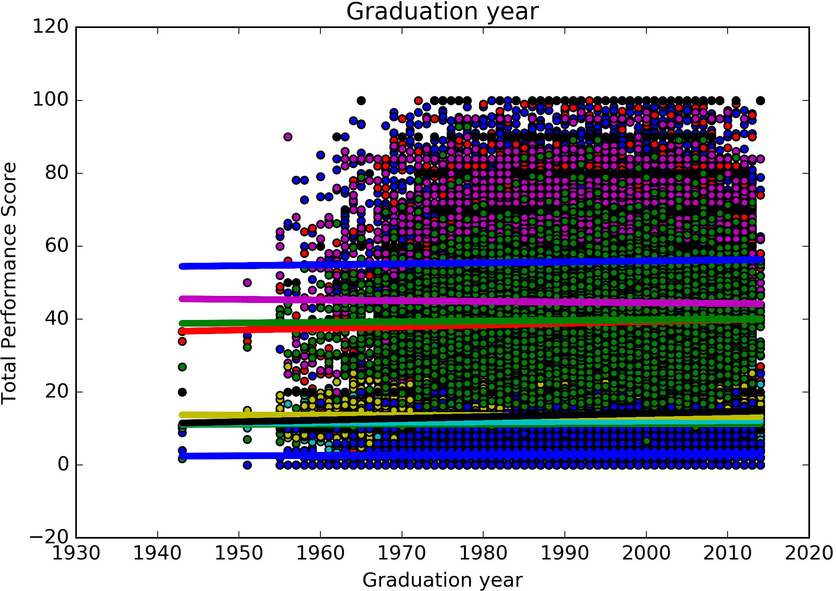
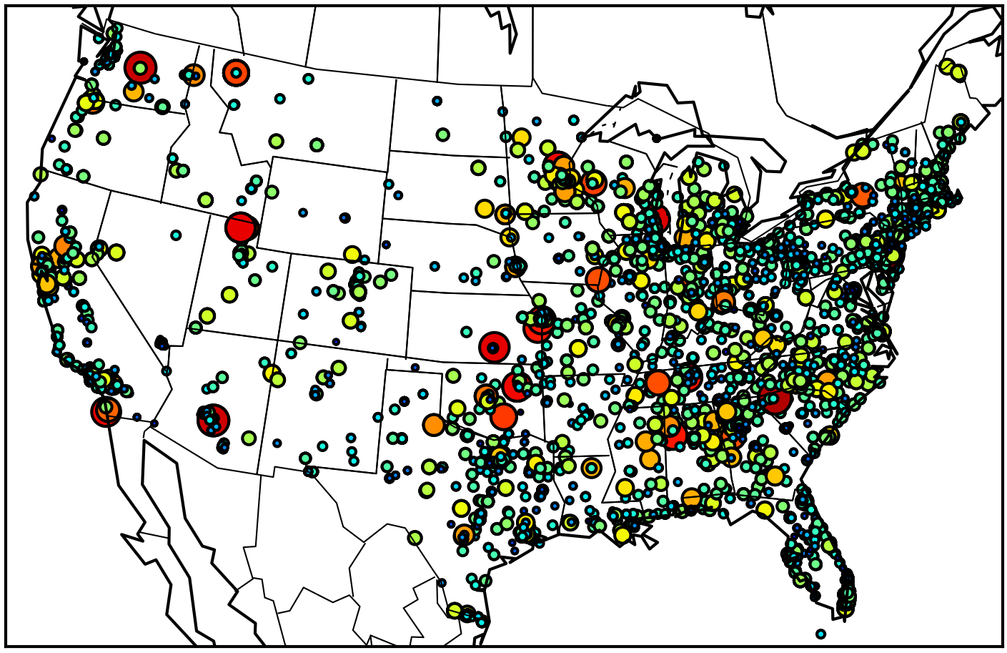
Is 8GB of Data Truly Accessible to the Public?
Figure 1. Hospital Scores on a Map
Figure 2. Hospital Scores vs Graduation Year

Slide 4
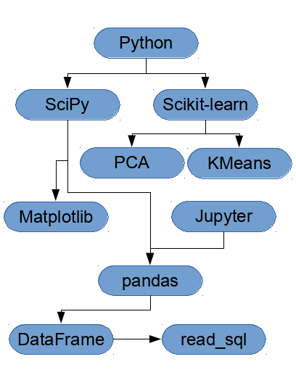
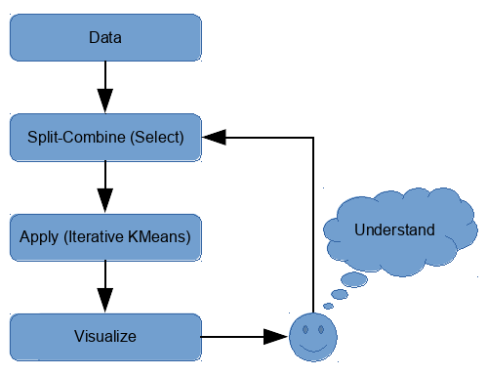
Goal
Building on Open Data and Open Source Toolkits
Develop automated high level techniques
Figure 3. Python big data ecosystem
Figure 4. Split-apply Combine Paradigm

Slide 5
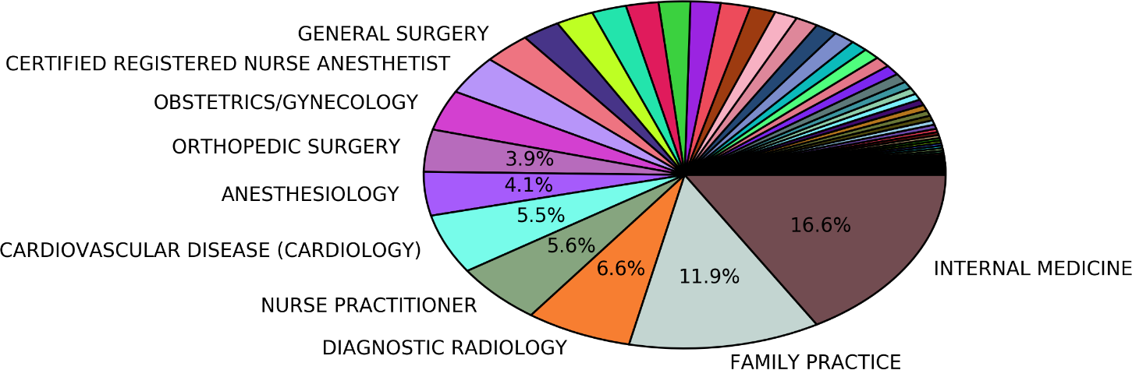
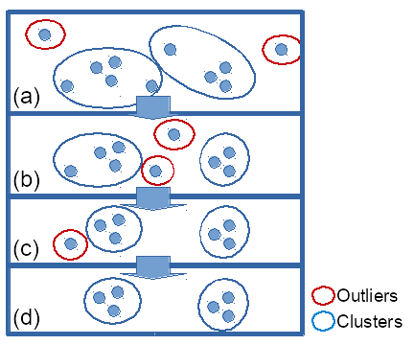
Base and Framework
Hospital Value-Based Purchasing
(3090 Hospitals)
Join
Medicare Practitioners
(868,384 Practitioners)
Figure 5. Practitioner specialty breakdown
Data
Draw
Process
NY SPARCS Outcomes
(1907 Outcomes)
Join
NY State Licensed Practitioners
(156 Practitioners)
Figure 6. Iterative KMeans

Slide 6
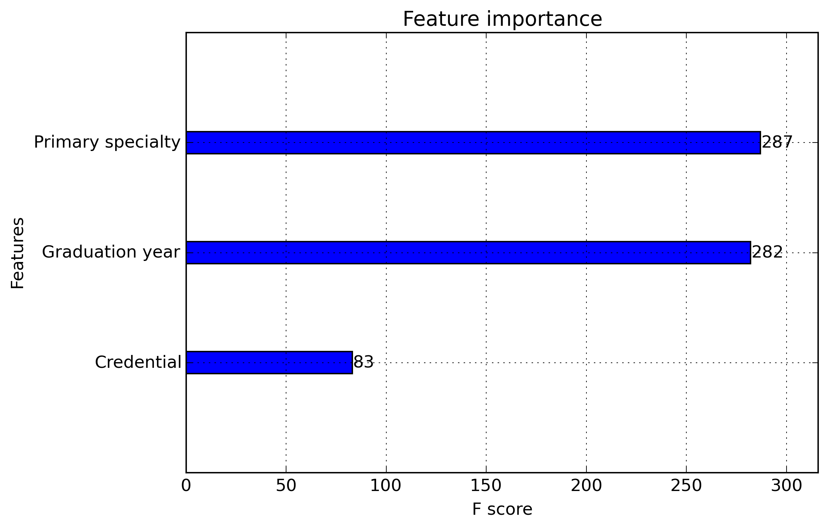
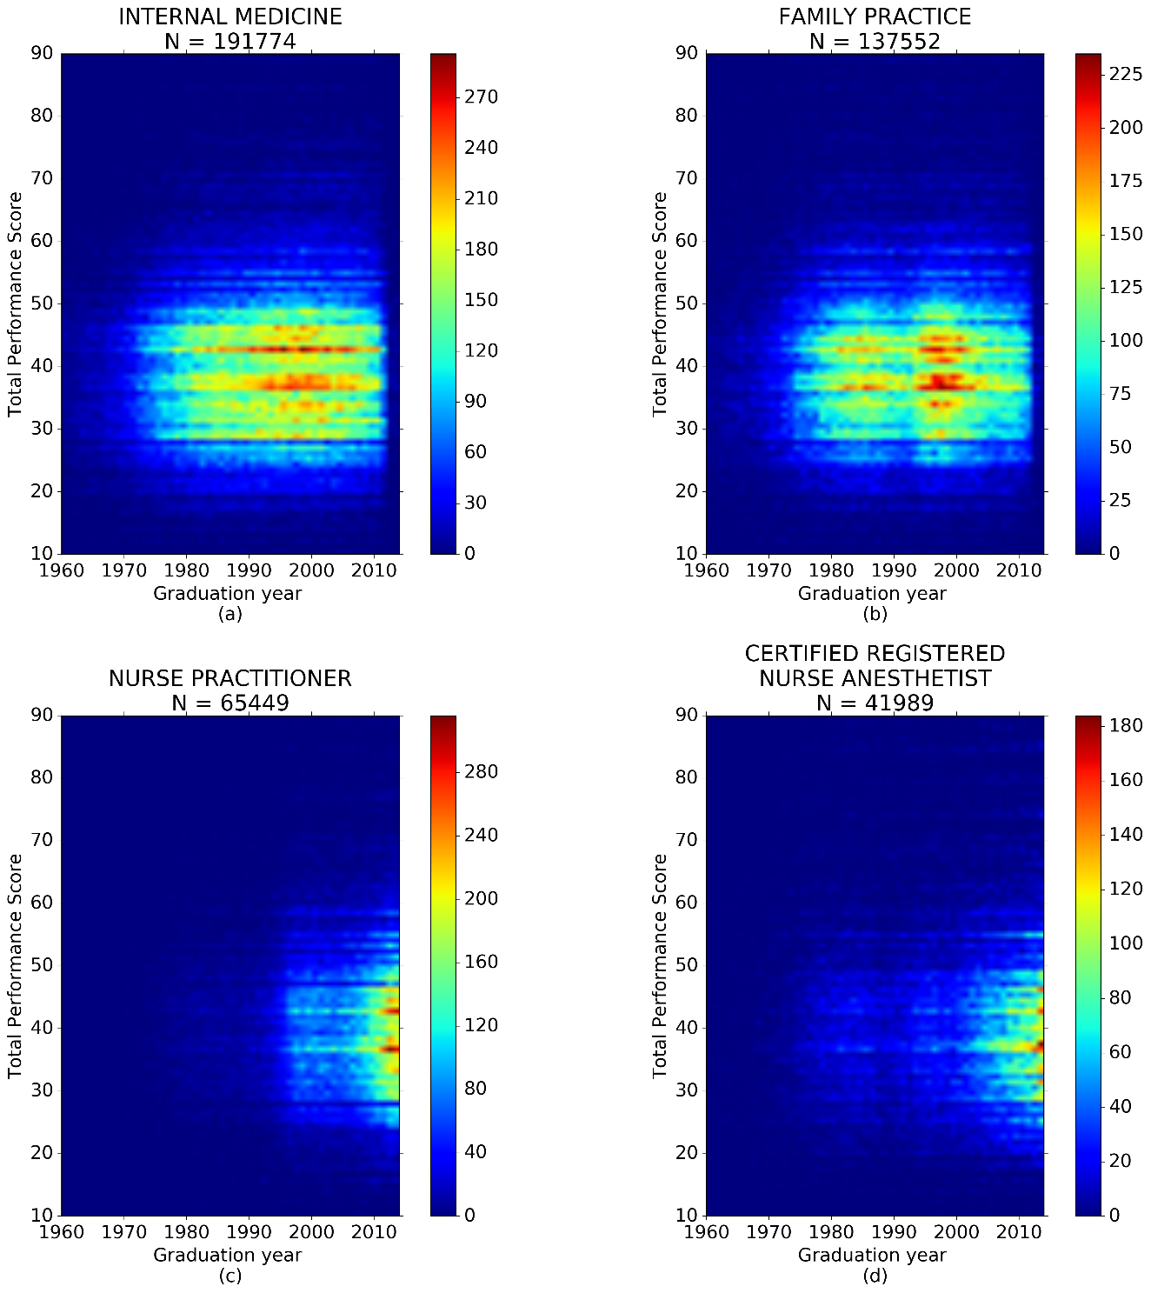
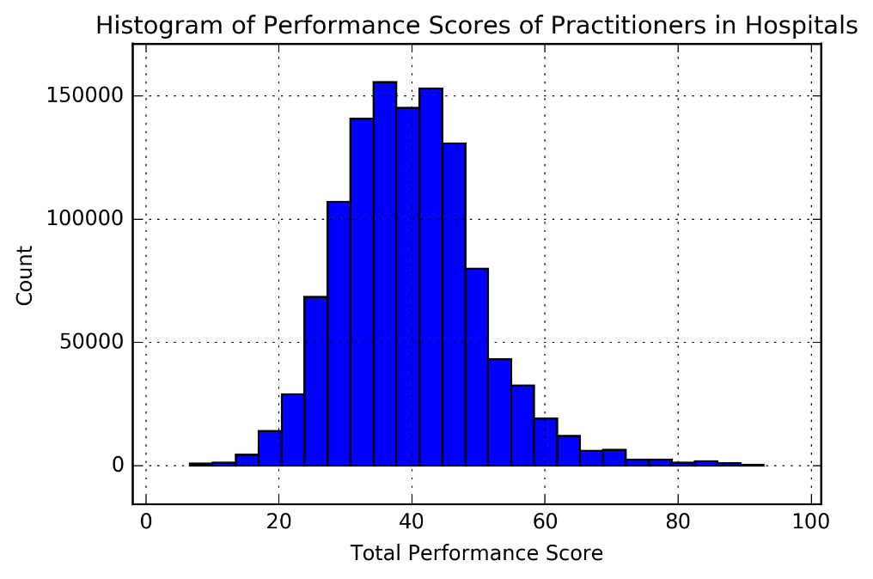
Analysis
Figure 7. XGBoost feature importance comparison
Figure 9. Performance scores for graduation years
Figure 8. Performance scores for graduation years

Slide 7
Results
Correlation between seniority and hospital performance score seems highly insignificant
29 out of 94 specialties had spearman rank correlation <= 0.164 with p < 0.05
Geriatric Psychiatry the best at m=0.164–a decade of youth gives a 1% edge
Specialty | Spearman correlation coefficient | Spearman P-value | R² | m | μ | σ | N
GERIATRIC PSYCHIATRY | 0.164 | 0.04507 | 0.049 | 0.164 | 38.638 | 8.254 | 150
ANESTHESIOLOGY ASSISTANT | 0.11 | 0 | 0.006 | 0.075 | 37.643 | 9.151 | 1742
HEMATOLOGY | 0.077 | 0.00781 | 0.004 | 0.055 | 39.558 | 9.811 | 1191
ALLERGY/IMMUNOLOGY | 0.063 | 0.00087 | 0.003 | 0.041 | 39.625 | 9.368 | 2820
MEDICAL ONCOLOGY | 0.058 | 0.00001 | 0.003 | 0.049 | 39.724 | 9.979 | 5864
PULMONARY DISEASE | 0.051 | 0 | 0.003 | 0.05 | 39.434 | 10.317 | 21587

Slide 8
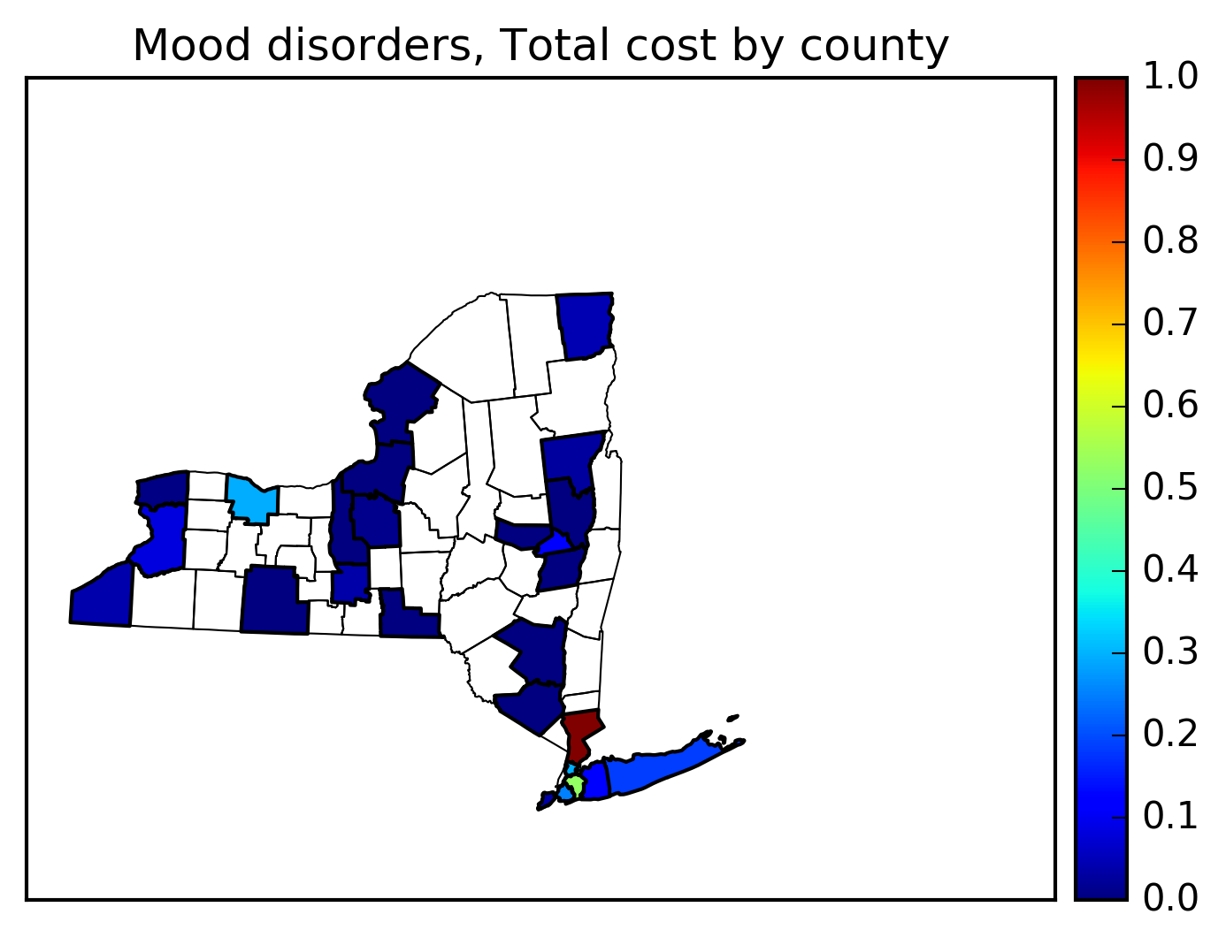
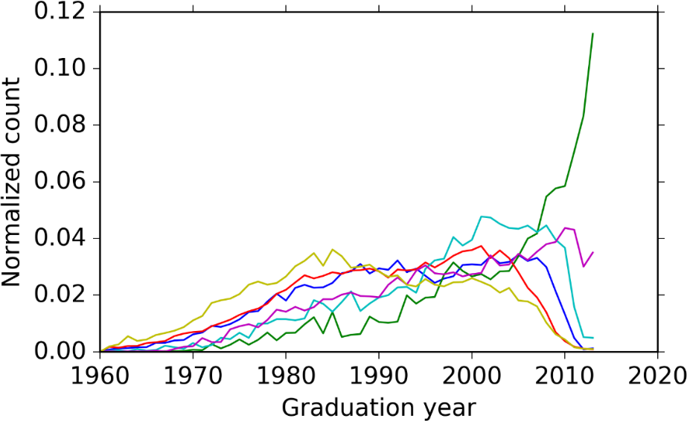
Conclusion
Age doesn’t factor into Hospital Value Based Purchasing Scores
Still more to explore
Figure 10. Iterative-KMeans Clustered Specialty Trends
Figure 11. NY State mood disorder cost heatmap
Framework in development
On GitHub at https://github.com/fdudatamining

