Slide 1
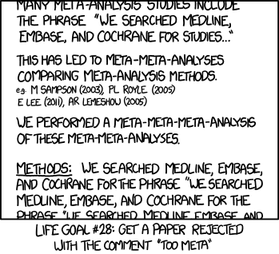

much ado about nothing? or why and how to do a decent meta-analysis
Daniel Becker
Odum School of Ecology
University of Georgia

Slide 2
how to synthesize studies
literature reviews
systematic reviews (meh?)
where has work been and where is it going
qualitative: find the main narratives, what’s missing
meta-analyses
examine claims and trends across studies
quantitative: makes use of effect sizes and sample size

Slide 3
goals of meta-analyses
you could argue there are three
determine if there is a mean effect across studies
quantify and explain variation between studies
test for presence of publication bias

Slide 4
goals of meta-analyses
determine if there is a mean effect across studies
meta-analysis originated in medicine, psychology
say there are 10 studies of treatment X on illness Y
each study has some treatment effect (e.g., odds ratio)
each study has some sample size
question: what is the overall effect of treatment X on reducing condition Y, given study differences?
helpful in resolving debates (X does or doesn’t do Y)

Slide 5
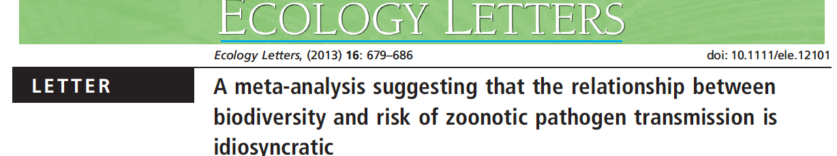
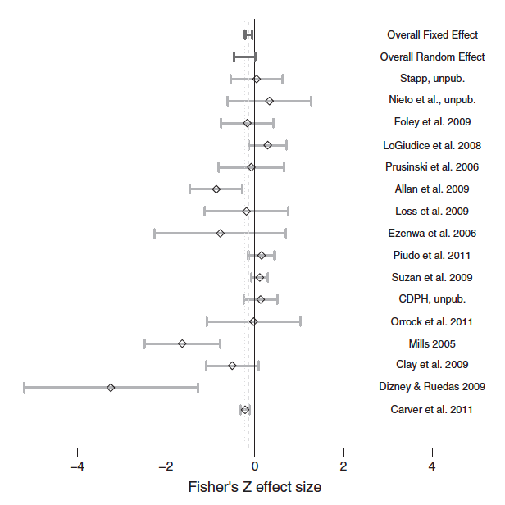
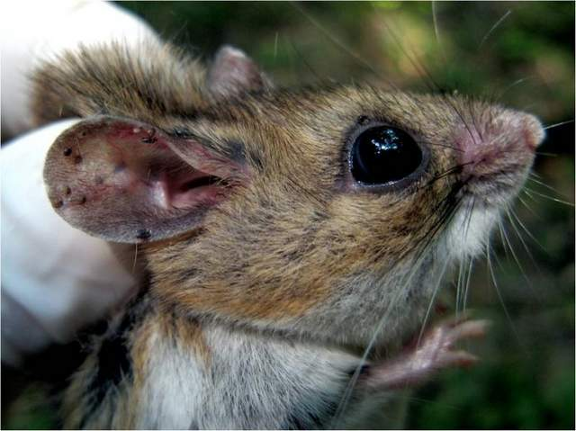
goals of meta-analyses

Slide 6
goals of meta-analyses
quantify and explain variation between studies
those 10 studies vary in more than sample size
maybe effect sizes vary widely
study location, cohort attributes, study design
question: do these study variables influence effects?
question: how?
helpful in determining differential study outcomes
also can help resolve debates (X does Y because Z)

Slide 7
goals of meta-analyses

Slide 8
goals of meta-analyses
test for presence of publication bias
those studies could be a handful of work “out there”
people may publish positive over negative results
file-drawer effect: non-significant results “stored away”
question: is the published body of work biased?
question: are potential studies “missing”?
helpful in motivating future publications
helpful in assessing what’s missing from literature

Slide 9
my goal for today
provide basics for how to compile a meta-analysis
literature search, data collection, converting effect size
provide background on main statistical methods
random-effects, moderator analysis, bias tests
show you the main data visualizations used
and walk through R code to actually do these
using the metafor package, which is great

Slide 10
before you start
have a solid question
needs to specify some group of studies
“is there an overall relationship between bird feeding and infection in wild birds?”
“does the relationship between bird feeding and infection in wild birds vary by feeder type, geography, etc?”
presumes effect sizes between comparison groups or some kind of linear relationship (correlation, etc)
bread and butter of meta-analyses

Slide 11
before you start
know the main steps
have a question
conduct a literature search
extract study data
convert and standardize effect sizes
test hypotheses, run models
make it all make sense

Slide 12
conducting a search
keep it systematic
Google Scholar, Web of Science, PubMed, etc
ideally use at least 2 searches
more is usually better

Slide 13
conducting a search
strings are your friend
(this OR that OR here OR there)
combine multiple strings with AND
(this OR that) AND urbanization AND bird
use asterisks to create inclusive searches
(this OR that) AND urban* AND bird
urban* would give urban, urbanization, urbanized, etc

Slide 14
keeping track of studies
need to compile search results
Web of Science = export to excel sheet
Google Scholar = terrible
Publish or Perish
free software
run and export search in Google Scholar

Slide 15
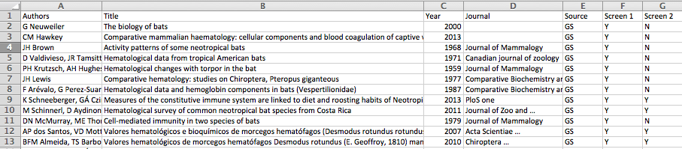
keeping track of studies
master excel sheet with several columns
author, title, date, journal, search engine

Slide 16
keeping track of studies
master excel sheet with several columns
author, title, date, journal, search engine
screen 1 and screen 2?

Slide 17
PRIMSA system
standard reporting system for meta-analysis
super annoying, but reviewers will hold you to it
http://www.prisma-statement.org/
Moher et al. 2009, Annals of Internal Medicine

Slide 18
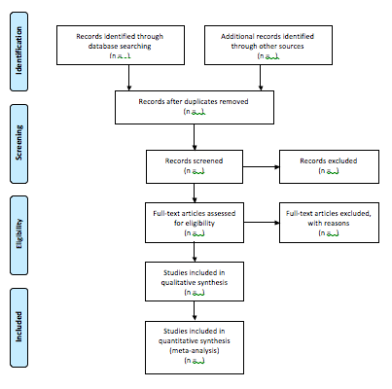
PRIMSA system

Slide 19
PRIMSA system
total records
remove duplicates
screen 1
abstracts, titles
screen 2
full text
matching studies
(with effect size data)

Slide 20
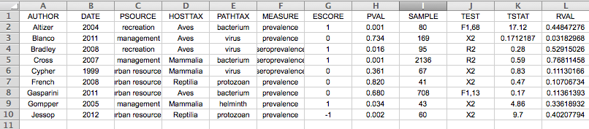
collecting data
basic spreadsheet, row per study
author, year, descriptive information about study
also direction of relationship (escore)
p value, sample size, test used, test stat, and r (?)

Slide 21
collecting data
basic spreadsheet, row per study
author, year, descriptive information about study
also direction of relationship (escore)
p value, sample size, test used, test stat, and r (?)
r is here a standardized effect size

Slide 22
standardizing effect size
all included studies report association between X and Y
sometimes studies report test statistics
X2, F_{df1,df2}, r, R², odds ratio
sometimes studies report the mean and SD/SE
mean/SD for control, mean/SD for treatment
extract these values, statistic, direction, and sample size
e.g., 0.8, R2, 1,100
e.g., 0.05, R2, 0,100

Slide 23
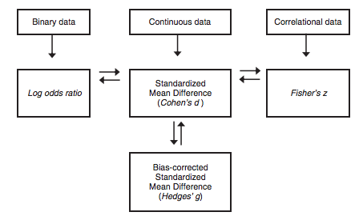
standardizing effect size
your job is to convert these into standard effect sizes
most used are Hedges’ g and Fisher’s Z
Borenstein et al. 2009, Introduction to Meta-Analysis

Slide 24
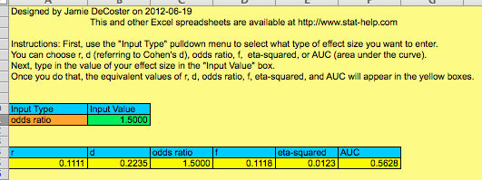
standardizing effect size
convert externally (by hand) or within R (automate)
let’s first go through the external method
option 1 = use an excel file somebody made for you
literally google “Converting effect sizes”

Slide 25
standardizing effect size
convert externally (by hand) or within R (automate)
let’s first go through the external method
option 2 = use formulas
google “Conversion of Common Test Statistics to r and d”

Slide 26
standardizing effect size
say we have a study with X²_{df=1} = 3, n = 100
r = sqrt(X2/N) = 0.17
d = 2 * sqrt(X2/(N – X2)) = 0.35
convert between the two
r = sqrt(d²/(4+d²)) = sqrt(0.1225/4.1225) = 0.17

Slide 27
standardizing effect size
say we have a study with X²_{df=1} = 3, n = 100
r = sqrt(X2/N) = 0.17
d = 2 * sqrt(X2/(N – X2)) = 0.35
convert between the two
r = sqrt(d²/(4+d²)) = sqrt(0.1225/4.1225) = 0.17
then follow formula to convert into gold standards
r to Z
d to g

Slide 28

standardizing effect size
study of blood pathogens between urban/rural habitat
present Mycoplasma prevalence but no statistics

Slide 29
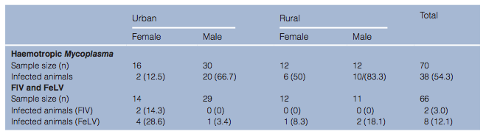
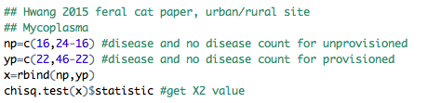
standardizing effect size
urban n = 46, rural n =24
urban prev = 22/46 (48%), rural prev = 16/24 (66%)
construct contingency table
calculate X² = 1.56
convert into r = sqrt(1.56/70) = 0.149
assign − sign (urban” reduces disease); r = −0.149

Slide 30
standardizing effect size
now in R
load up the metafor package
lines 19 to 106
escalc function
does the conversion work for you

Slide 31
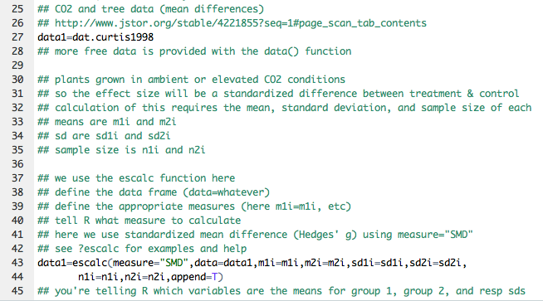
standardizing effect size

Slide 32
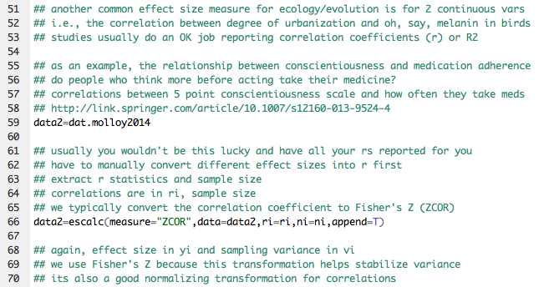
standardizing effect size

Slide 33
effect sizes, now what
recall the three goals of doing meta-analyses
determine if there is a mean effect across studies
quantify and explain variation between studies
test for presence of publication bias

Slide 34
general analysis notes
all analyses rely on some form of weighting
weights = 1/v_{i}, where v_{i} is the sampling variance
and v_{i} is calculated from effect size and sample size
small v_{i} = large sample size = large weight

Slide 35
general analysis notes
also differences in considering distribution of errors
recall linear models
y_{i} = β0 + β1x_{i1} + e_{i}, where e_{i} ~ N(0,σ²)
meta-analysis models are the same formula (ish)
but e_{i} ~ N(0,v_{i})
since the variances are known (v_{i}), results can differ

Slide 36
determining mean effect
two modes of inference
“fixed-effect” models
“random-effect” models
terminology is confusing
FE = conditional (mean among your studies)
RE = unconditional (true effect from population of studies)

Slide 37
determining mean effect
estimate μ (mean), τ² (variance) of studies
test the null that both = 0
μ = 0 = no significant effect across studies
τ²= 0 = no heterogeneity across effects

Slide 38
determining mean effect
in R we can use the rma function
lines 124 to 164
data from studies on relationship between conscientiousness and medication adherence
do people who think before acting take medicine?
correlations between conscientious scale and frequency
Fisher’s Z effect size
model=rma(yi,vi,data=data2)

Slide 39
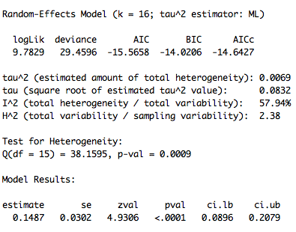
determining mean effect
summary(model)

Slide 40
determining mean effect
summary(model)
μ = 0.149 **
overall significant effect of X on Y

Slide 41
determining mean effect
summary(model)
μ = 0.149 **
overall significant effect of X on Y
τ² > 0
Q >> 0 **
significant heterogeneity in effect size
I² = 58%
% true heterogeneity

Slide 42
determining mean effect
significant overall positive effect
significant true heterogeneity between studies
(rather than heterogeneity by error)
estimate (0.149) different than mean of Y (0.16)
not huge, but could matter
shows difference from meta-analysis model
how can you visualize the results?

Slide 43
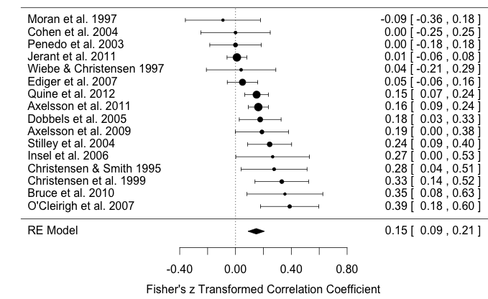
forest plots
show effect sizes and model estimate with CI

Slide 44
forest plots
effects ordered by estimate, weighted by sample size

Slide 45
forest plots
in R simple to do with forest() on model object
lines 188 to 201
forest(model)

Slide 46
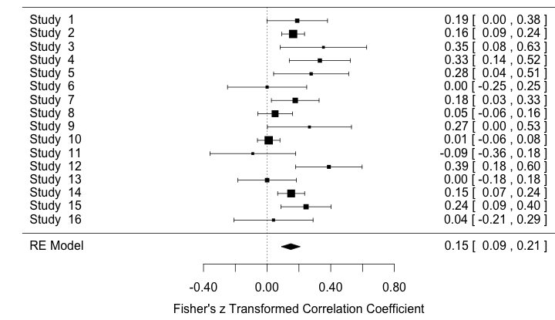
forest plots
sort of boring: add study label and sort by order

Slide 47
forest plots
make a “study” vector of author and year
data2$study=paste(data2$author,data2$year)
use slab within forest(), order=“obs”
forest(model,slab=data2$study,order=“obs)

Slide 48
forest plots
forest(model,slab=data2$study,order=“obs)

Slide 49
explaining variation
we also observed significant heterogeneity in effects
logical next step to ask what explains effect differences

Slide 50
explaining variation
we also observed significant heterogeneity in effects
logical next step to ask what explains effect differences
known as moderator analysis, mixed-effects model, etc
again the terminology is confusing
essentially just a regression (“meta-regression”)
again using weights and known variance

Slide 51
explaining variation
we also observed significant heterogeneity in effects
logical next step to ask what explains effect differences
known as moderator analysis, mixed-effects model, etc
again the terminology is confusing
essentially just a regression (“meta-regression”)
again using weights and known variance
account for study-level (or other) variables
e.g., geography, year, habitat, study design, etc

Slide 52
explaining variation
formula in R again used rma()
model=rma(yi,vi,mods=~X,data=data2)
lines 245 to 251
moderators are design and meanage
mem1=rma(yi,vi,mods=~design,data=data2)
mem2=rma(yi,vi,mods=~meanage,data=data2)
summary(mem1)

Slide 53
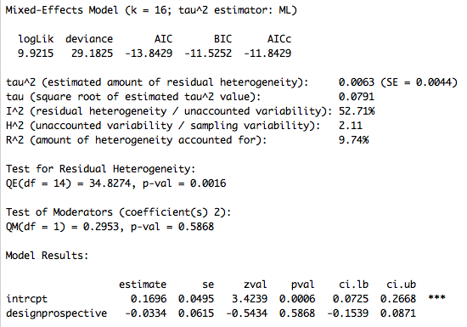
explaining variation

Slide 54
explaining variation
a few differences in the MEM
Q_{M} = test of overall significance for the predictor
R2 = what it usually means, more or less
pseudo-R2, compares the MEM with the REM
so design explains 10% more variation than the REM
obtain the same result with anova(full,reduced)
e.g., anova(mem1,model)
so study design doesn’t influence effect size
what about mean age of the cohort studied?

Slide 55
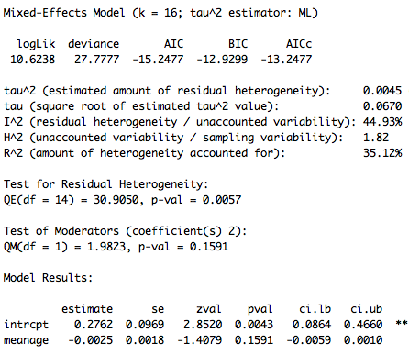
explaining variation
p = 0.16
R² = 35%
suggestive
studies with older cohorts more likely to find smaller effects
how to visualize?

Slide 56
bubble plots
scale points by weights (recall 1/v_{i})
plotrix package, rescale()
add model fit with abline(model)
plot(yi~meanage,data=data2,
cex=rescale(1data2$vi,c(0.75,3)))
abline(mem2)

Slide 57
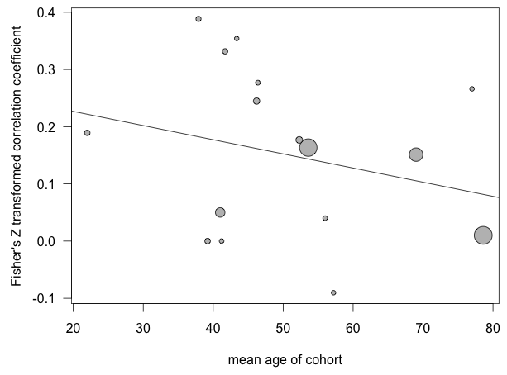
bubble plots

Slide 58
publication bias
last primary goal of meta-analysis
do people tend to publish more significant effects?
do people tend to publish results in one direction?
visualize this with funnel plots
effect size on X axis, measure of precision on the Y
unbiased datasets should show symmetrical triangle
we use funnel(model) in R

Slide 59
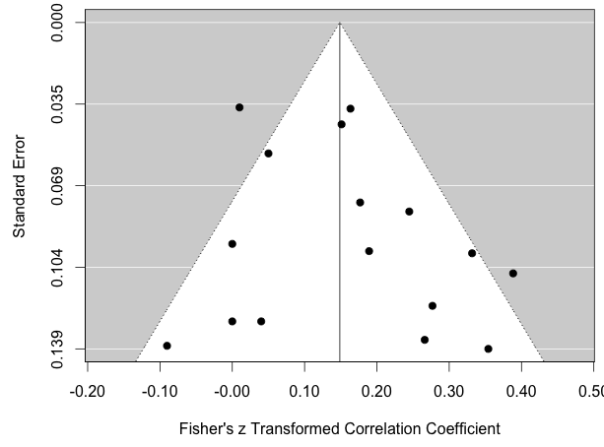
publication bias

Slide 60
publication bias
test for bias with correlating precision and effect size
regtest.rma(model) in R
specify the predictor (sei, ni, vi)
regtest.rma(model2,model=“rma”,predictor=“sei)

Slide 61
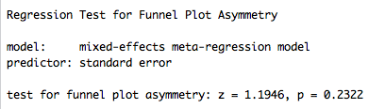
publication bias
test for bias with correlating precision and effect size
regtest.rma(model) in R
specify the predictor (sei, ni, vi)
regtest.rma(model2,model=“rma”,predictor=“sei)
not strong evidence of bias

Slide 62
publication bias
also common is to test if studies are “missing”
“file drawer” effect
imputs studies to correct plot assymetry
trimfill(model) in R
two methods
L0 = estimates number of effect sizes “missing”
R0 = tests if this number if different from 0
both impute “new” effects and test if the REM differs

Slide 63
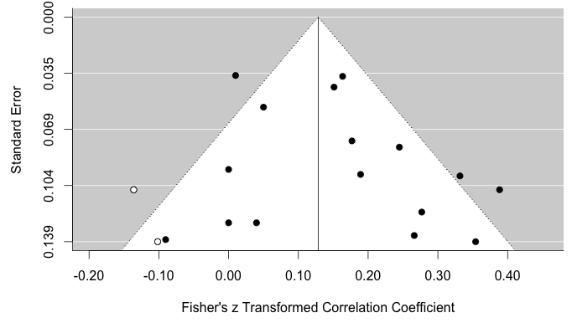
publication bias
trimL0=trimfill(model2,estimator=“L0”)
estimates 2 effect sizes would correct asymmetry
impute studies with funnel(trimL0)

Slide 64
next steps
weighted average, weighted regression, bias tests
related methods to test for outliers, etc in the R script
one major revision in meta-analysis methods
pertinent to ecology, physiology, evolution, etc
building models to account for clustering in data

Slide 65
next steps
weighted average, weighted regression, bias tests
related methods to test for outliers, etc in the R script
one major revision in meta-analysis methods
pertinent to ecology, physiology, evolution, etc
building models to account for clustering in data
multiple effect sizes from the same study
i.e., each row isn’t from a unique study
form of non-independence in data

Slide 66
multi-level models
similar to rma()
rma.mv() function
rma.mv(yi=yi,V=vi,random=list(~1|thing,~1|thing2),mods=~1,data=data)
lines 422 onward
main points
estimate of μ is smaller
slope of relationship between age and Z is significant
and from a study design view, random effects matter

Slide 67
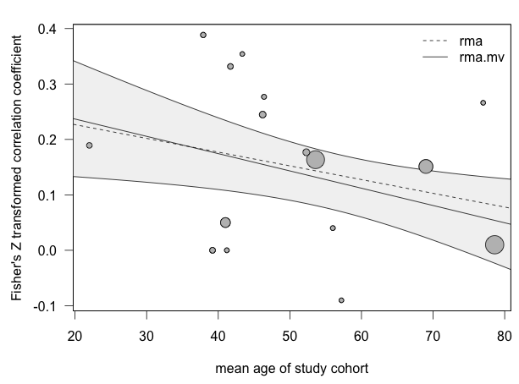
multi-level models

Slide 68
other resources
Viechtbauer 2010 Journal of Statistical Software
http://www.metafor-project.org/doku.php/metafor
?help for escalc, rma, and rma.mv
Borenstein et al 2009 Introduction to Meta-Analysis

