Slide 1

Computer Vision with PyTorch
Daniel J. Brooks
PyData Los Angeles
December 3, 2019

Slide 2

Contents
What is computer vision?
Importance of image data
Rise of convolution neural networks
What is PyTorch?
A popular framework for implementing neural networks
A brief introduction to PyTorch
Examples
Examples of common tasks, including classification, object detection, and segmentation
Notebooks are available on GitHub
https://github.com/danieljbrooks/PyTorchTutorial
Questions and answer session

Slide 3
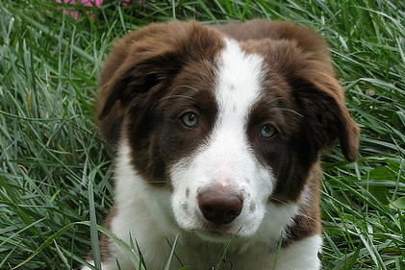
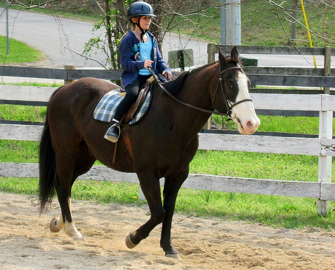
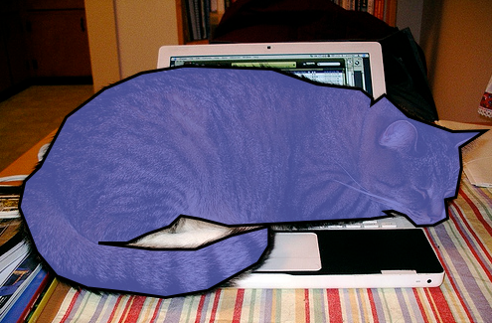
What is computer vision?
Computer vision (CV) is an interdisciplinary field focused on the development and use of algorithms to interpret digital images and videos
Common CV Tasks
Classification
Object Detection
Segmentation
Dog
Horse
Cat

Slide 4
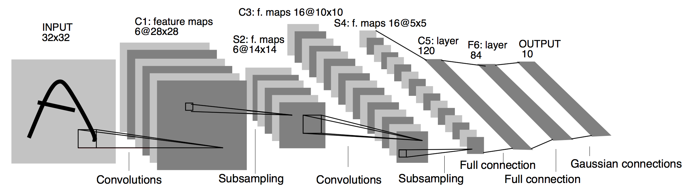
Convolutional Neural Networks
Convolution neural networks extract features from images
1. Represent input image as a matrix/tensor
2. Apply convolutions to create local feature maps
3. Use subsampling/pooling to reduce the size of feature maps
4. Network that produces target variable (fully connected layers for classification)
LeNet-5 Architecture

Slide 5
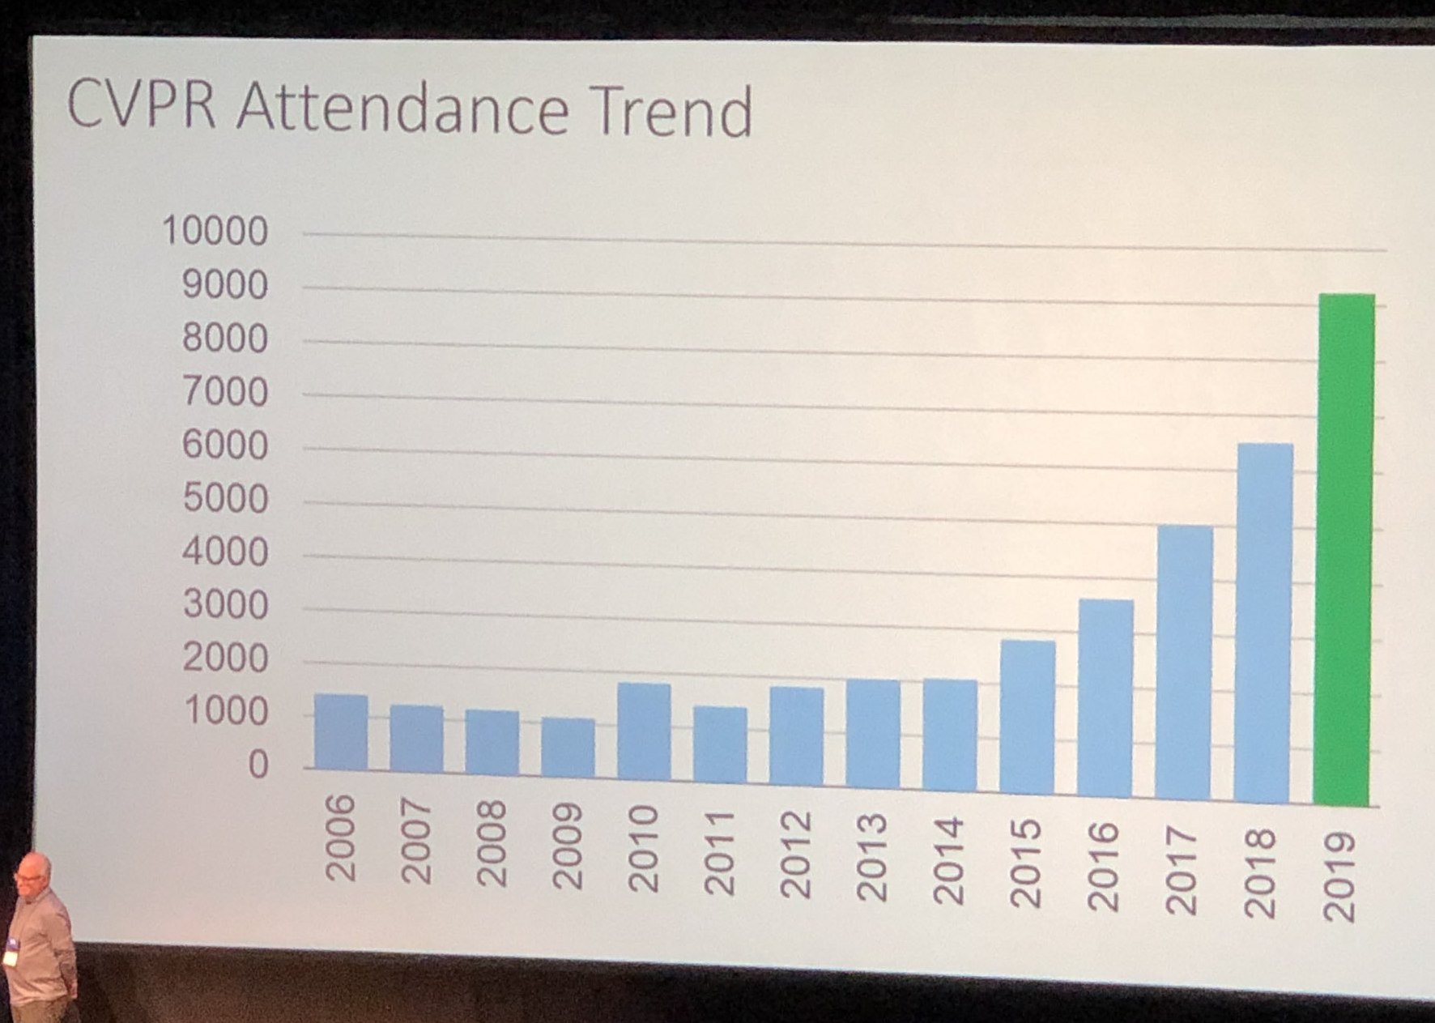
Growing interest in computer vision
Rapid advances and growing interest in computer vision
Improved algorithms
A convolutional neural networks (CNN) first won ImageNet in 2012
Better architectures are constantly being released
Improved hardware
Nvidia GPUs (with CUDA)
Google TPUs
Improved software
Tensorflow (2015)
PyTorch (2016)
AlexNet wins ImageNet

Slide 6
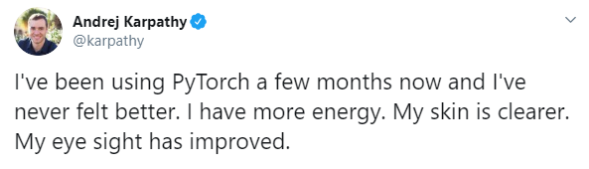

What is PyTorch
Popular framework for implementing neural networks
Developed by Facebook for rapid prototyping
Essentially numpy with GPU support
Torchvision library supports computer vision
Dynamically typed, research oriented
Example network
(Tensorflow has a compile statement here)

Slide 7
Examples
Check out the notebooks on the tutorial GitHub page
https://github.com/danieljbrooks/PyTorchTutorial

Slide 8
Additional Resources
PyTorch documentation and tutorials
http://pytorch.org
Stanford CS231n: Convolutional Neural Networks for Visual Recognition
http://cs231n.stanford.edu
Deep Learning Book by Ian Goodfellow
http://deeplearningbook.org

Slide 9
Questions?
Thank you for listening!
Contact:
Email:
Daniel.Brooks@alumni.caltech.edu
Twitter:
@cocacolamandan

