Slide 1
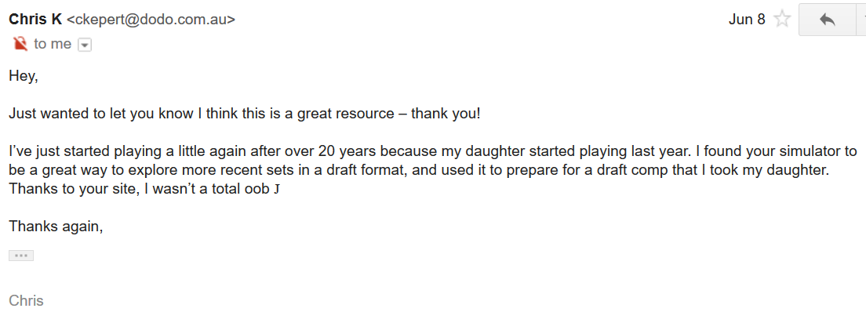
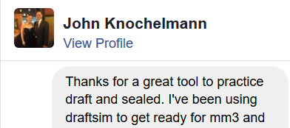
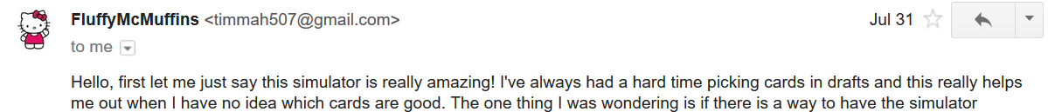

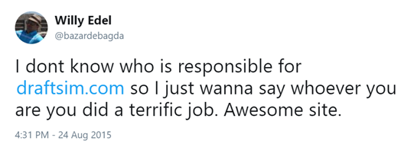
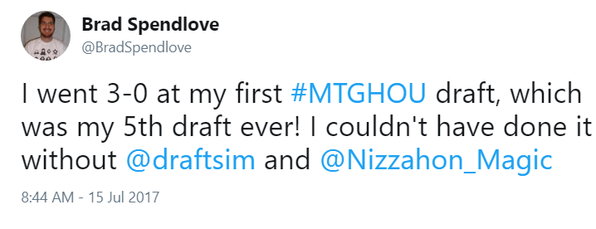
Community Impact
250,000+ unique visitors from 170+ countries in 2017
1.6 million sessions with average duration 12 minutes
Loyal and dedicated fanbase – only 16.01% new sessions
Just wanted to let you know I think this is a great resource – thank you!
I found your simulator to be a great way to explore more recent sets in a draft format, and used it to prepare for a draft competition that I took my daughter to.
-Chris

Slide 2
Community Impact
250,000+ unique visitors from 170+ countries in 2017
1.6 million sessions with average duration 12 minutes
Loyal and dedicated fanbase – only 16.01% new sessions
I found your simulator to be a great way to explore more recent sets in a draft format and used it to prepare for a draft competition that I took my daughter to.
-Chris

Slide 3
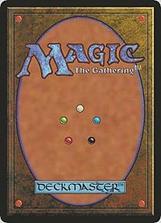
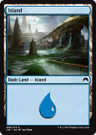
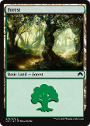
Model
250,000+ unique visitors from 170+ countries in 2017
1.6 million sessions with average duration 12 minutes
Loyal and dedicated fanbase – only 16.01% new sessions
Recommended Picks
Automatic Deckbuilding
Computer Opponents
Card rating = base rating + color bonus
Two Stage Model
1. Speculation
2. Committal
3.5
Professional
pick order lists
Search for two open colors
Prioritize a two color pair

