Slide 1
RAG, Fine-tuning, or Both
David Guo

Slide 2
What does RAG do?
Retrieves data from an external source (database, search engine, document repository, etc.)
Pass text to LLM as input within the context window
If that context provides the answer, the LLM can generate response
If not, either re-prompt or halluciate, if allowed.

Slide 3
What Does Fine-Tuning Do?
It nudges the weights of the model to map new spaces
Fine-tuning is indiscriminate. Different parts of the LLM represent different concepts.
Fine tuning could change all original weights or apply RoLA/qROLA.
Your data affects how LLM changes

Slide 4
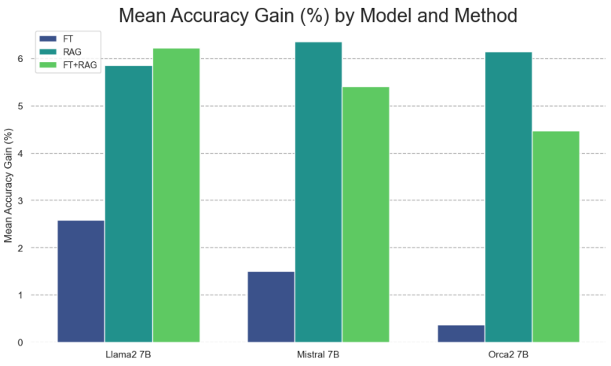
Which is better for Q&A?
A significant advantage for RAG over fine-tuning is evident.
FT improves accuracy of the base model.
Prompt engineering improves QA quality.
Fine-Tuning or retrieval? Comparing knowledge injection in LLMs.
arXiv.org. https://arxiv.org/abs/2312.05934

Slide 5
Recommendations
RAG is better when:
you need fast raw data loading
the data updates often
your data is non-text
questions actively require context (e.g. location, time)
computational or logical requirements that are hard to align
require a sandbox
Fine tuning is better when:
mimic style
minimize latency
massive contexts
opinionated or generative requests
include new functionality, like function calling
Fine-tuning might help RAG when:
Eek out final % (https://arxiv.org/abs/2310.01352)
Domain specific language or terminology, e.g. healthcare

Slide 6
Finding the missing pieces
For fine-tuning, quality QA pair generation is crucial.
RAG is better for less popular topics
RAG+FT works better on small models
FT works on Time Series data
The way to prompt matters

Slide 7
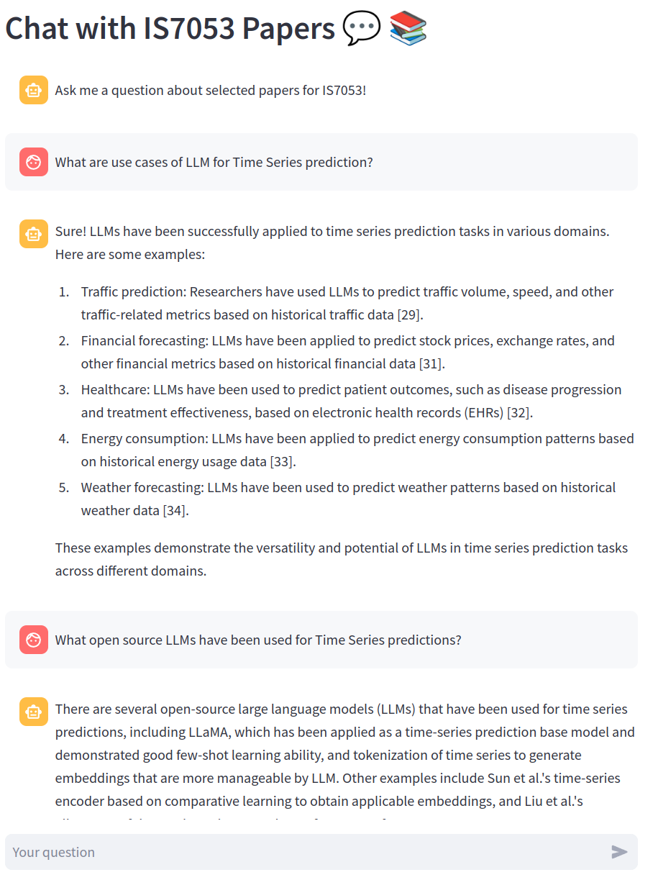
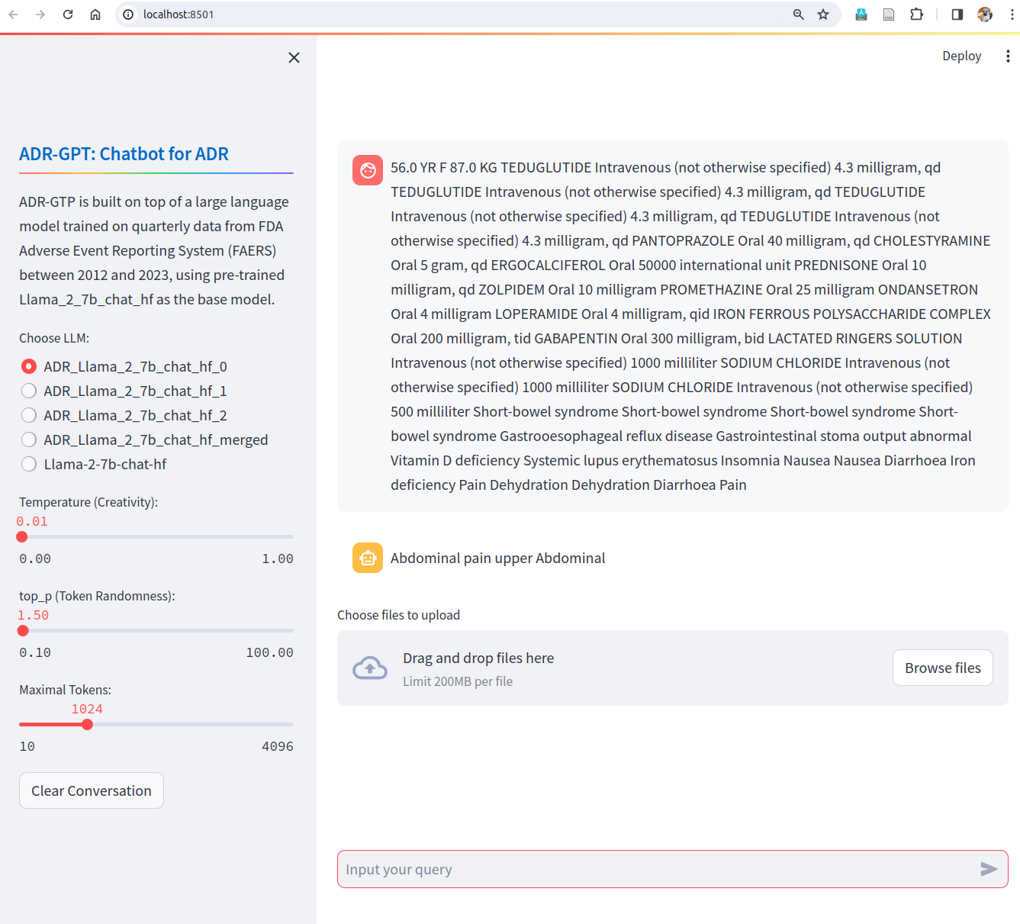
LLM backed Chatbots
RAG w/ Vector DB - Llama-Index
Fine-Tuning LLM - LangChain

Slide 8
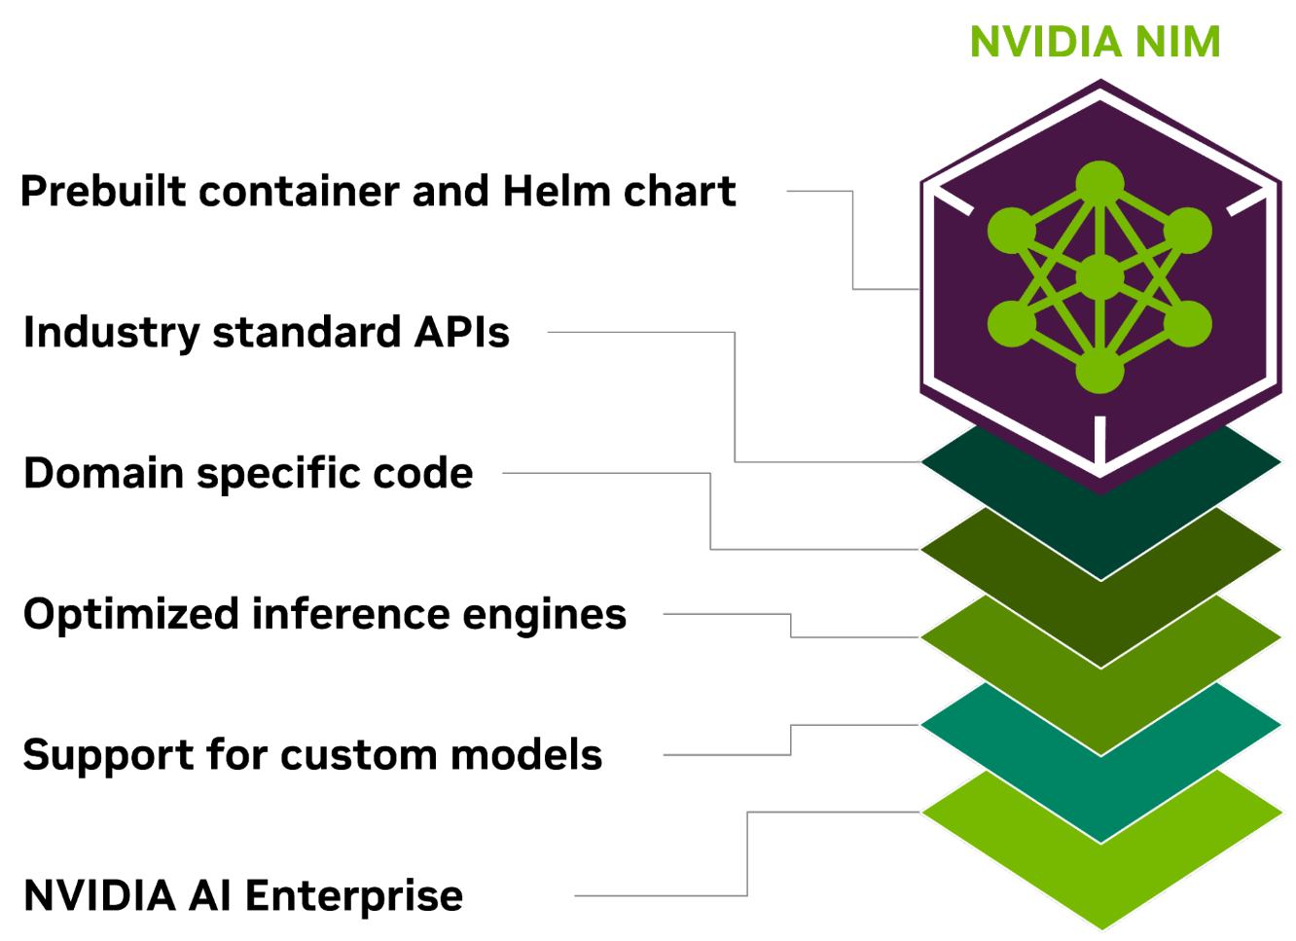
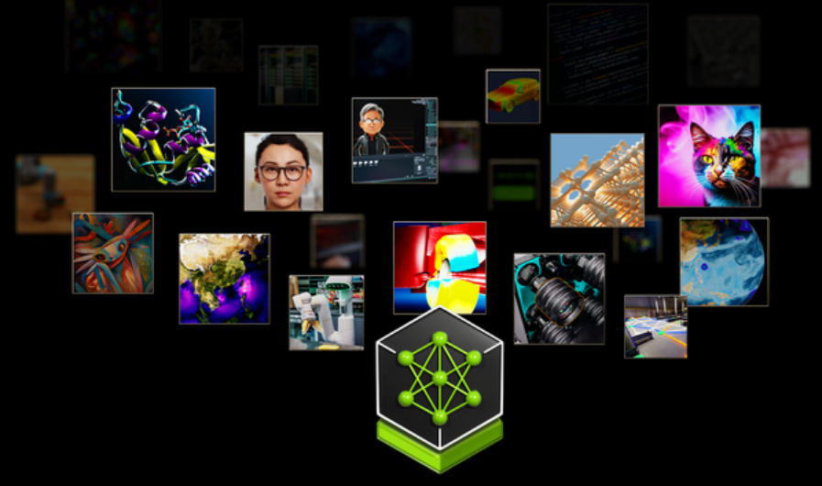
New Tool – Nvidia Inference Microservice

Slide 9
Reference
Fine-Tuning or retrieval? Comparing knowledge injection in LLMs, https://arxiv.org/abs/2312.05934
Fine Tuning vs. Retrieval Augmented Generation for Less Popular Knowledge, https://arxiv.org/abs/2403.01432
TPLLM: A Traffic Prediction Framework Based on Pretrained Large Language Models, https://arxiv.org/abs/2403.02221

