Slide 1




Lecture 2 Single-cell RNA sequencing data analysis and Seurat Daniel J Gorski, PhD Institut für Pharmakologie und Klinische Pharmakologie Universitätsklinikum der Heinrich-Heine-Universität Düsseldorf
SFB1116

Slide 2


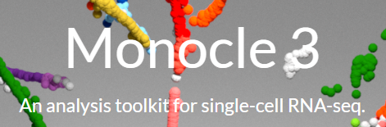

Topics
-Basic computational steps (count matrix to clustering)
-Overview of Seurat (single-cell genomics toolkit)
https://satijalab.org/seurat/
https://scanpy.readthedocs.io/en/stable/
https://cole-trapnell-lab.github.io/monocle3/
https://bioconductor.org/

Slide 3
Count matrix
-Each row is a gene (feature), each column is a sample (barcode/cell), the numbers in the matrix are the counts
 | Cell_1 | Cell_2 | Cell_3 | Cell_4 | ...
Gene1 | . | . | . | 1 | .
Gene2 | . | . | 4 | 2 | .
Gene3 |  | 3 | . | 2 | .
Gene4 | 1 | . | 7 | . | .
… | . | . | . | . | .
> SeruatObject[[“RNA”]]@data[1:5,1:5]]
 | AAACCTGAGAACAATC_Sham | AAACCTGAGGCTCATT_Sham | AAACCTGCAAGGACTG_Sham | AAACCTGCAGCCACCA_Sham | AAACCTGGTCAAAGAT_Sham
Xkr4 | 0 | 0 | 0 | 0 | 0
Sox17 | 0 | 3 | 0 | 0 | 0
Mrpl15 | 1 | 0 | 1 | 0 | 0
Lypla1 | 0 | 3 | 0 | 0 | 0
Gm37988 | 0 | 0 | 0 | 0 | 0

Slide 4
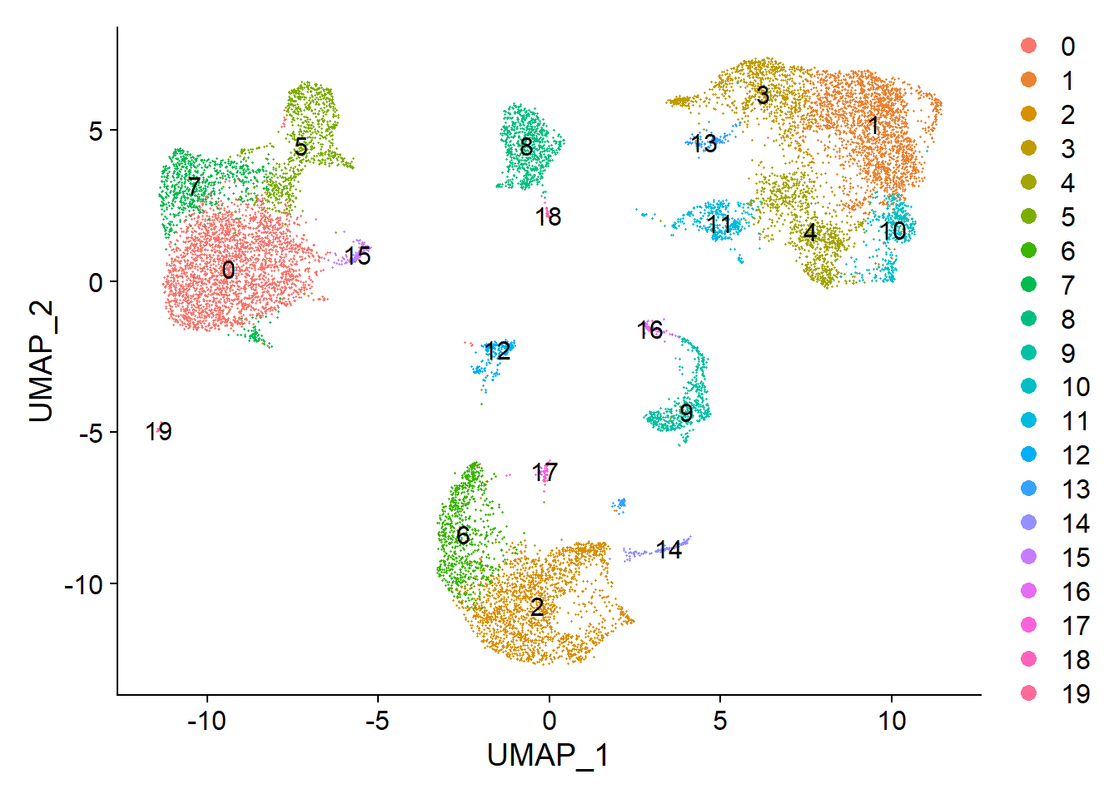
Clustering
-Each dot is a cell, colored by cluster, determined by transcriptional similarity, visualized in low dimensional space

Slide 5
Challenges
 | Cell_1 | Cell_2 | Cell_3 | Cell_4
Gene1 | . | . | . | 1
Gene2 | . | . | 4 | 2
Gene3 |  | 3 | . | 2
Gene4 | 1 | . | 7 | .
How do we identify and remove poor quality cells?
How do we control for variation in sequencing depth between cells?
How do we represent the expression of several genes at once? (This data is highly dimensional)
How can we find “cell types” in our data, and group them together?

Slide 6
Seurat functions
 | Cell1 | Cell2 | Cell3 | Cell4
Gene1 | . | . | . | 1
Gene2 | . | . | 4 | 2
Gene3 |  | 3 | . | 2
Gene4 | 1 | . | 7 | .
library(Seurat)
obj <- Read10X(data.dir = "../your_data/")
obj <- CreateSeuratObject(counts = obj)
obj <- PercentageFeatureSet(obj, pattern = "^mt-", col.name = "percent.mt")
obj <- subset(obj, subset = nFeature_RNA > 200 & nFeature_RNA < 2500 & percent.mt < 5)
obj <- SCTransform(obj)
obj <- RunPCA(obj)
obj <- RunUMAP(obj)
obj <- FindNeighbors(obj)
obj <- FindClusters(obj)
DimPlot(obj, label = TRUE)
Read in data
QC Filter
Normalize
Reduce dimension
Cluster
Plot

Slide 7
Computational steps
 | Cell1 | Cell2 | Cell3 | Cell4
Gene1 | . | . | . | 1
Gene2 | . | . | 4 | 2
Gene3 |  | 3 | . | 2
Gene4 | 1 | . | 7 | .
Quality control
Normalization
Feature selection and scaling
Dimensional reduction with PCA
Dimensional reduction UMAP
Clustering

Slide 8
Computational steps
 | Cell1 | Cell2 | Cell3 | Cell4
Gene1 | . | . | . | 1
Gene2 | . | . | 4 | 2
Gene3 |  | 3 | . | 2
Gene4 | 1 | . | 7 | .
Quality control
Normalization
Feature selection and scaling
Dimensional reduction with PCA
Dimensional reduction UMAP
Clustering

Slide 9
Quality control
-Low quality cells, are assessed by:
-Number of counts / cell
-Number of genes / cell
-Fraction of mitochondrial reads / cell
-Doublets: 2 or more cells in single droplet
-Ambient RNA: RNA molecules released into the cell suspension from lysed cells that contaminates other droplets
-Barcode swapping: DNA barcodes used to label multiplexed libraries swap on flow-cell illumina sequencing machines
Nature Communications volume 9, Article number: 2667 (2018)
Mol Syst Biol (2019)15:e8746

Slide 10
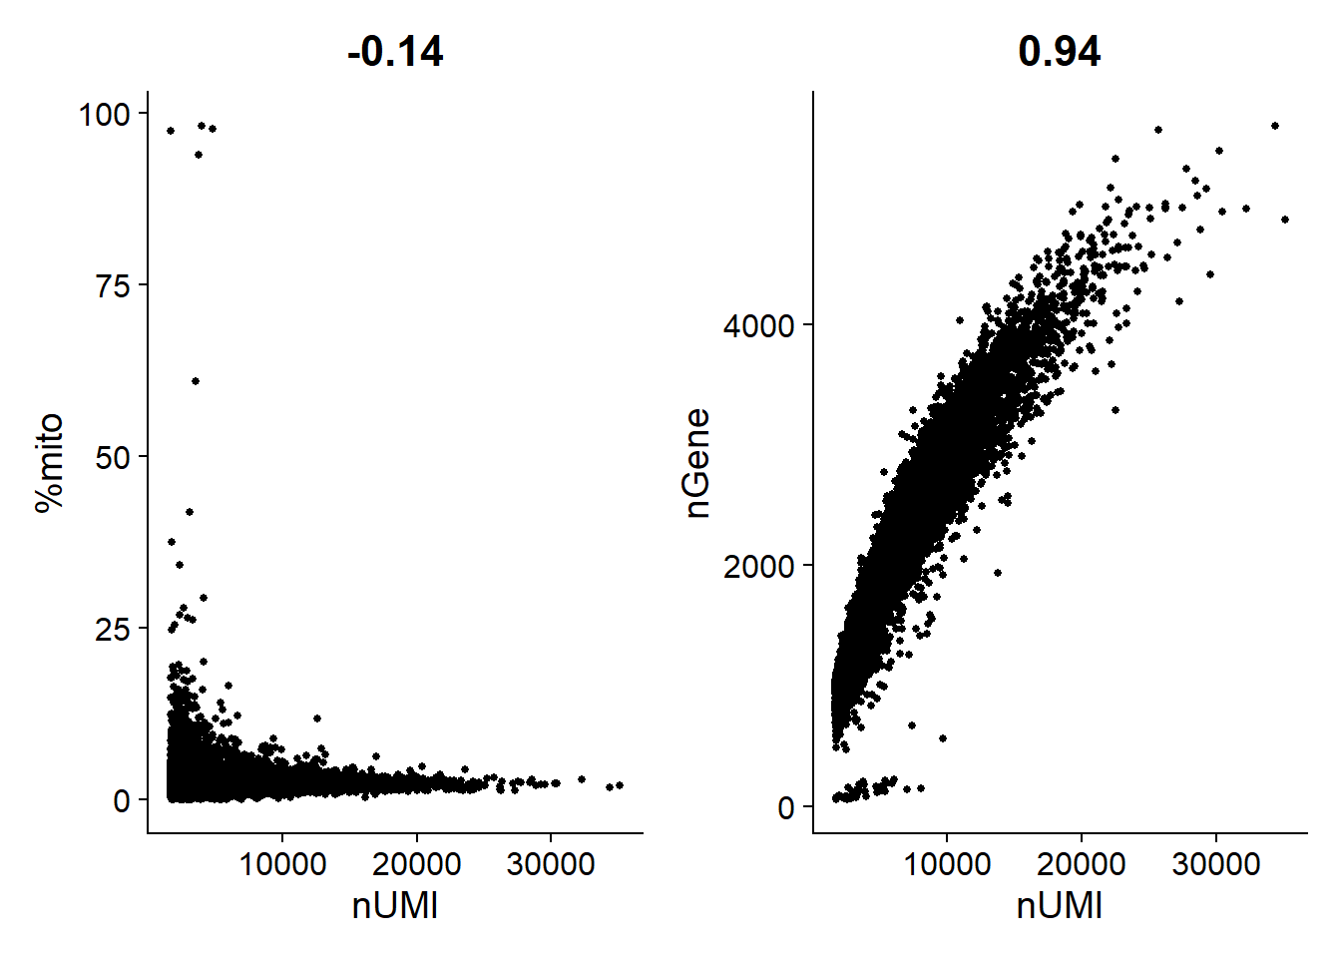
Low quality cells
Doublets (high count, large number of genes)
Lost their mRNA, mitochondrial genes were protected. (low count, high %mito)
Low quality library (high count, small number of genes)

Slide 11
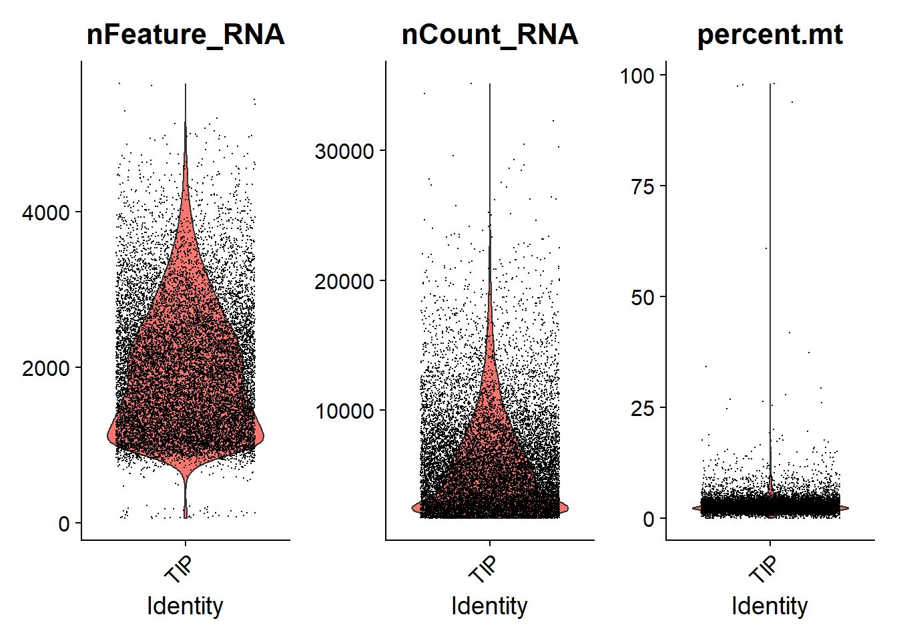
Low quality cells
-Low quality cells are removed by filtering, using a combination of attributes
4000
200
5%

Slide 12
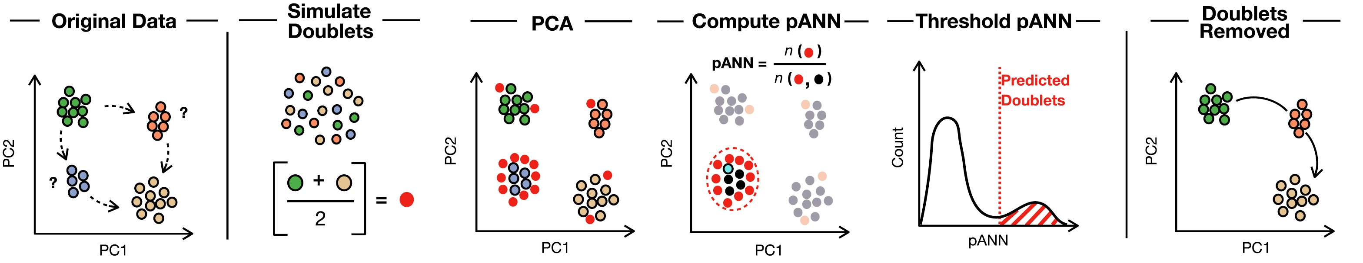
Removing doublets
-Typically removed by filtering out cells with a high number of counts or genes
-More sophisticated packages exists, e.g. Scrublet, DoubletFinder
DoubletFinder: Doublet Detection in Single-Cell RNA Sequencing Data Using Artificial Nearest Neighbors
Cell Systems, Volume 8, Issue 4, 24 April 2019, Pages 329-337.e4

Slide 13
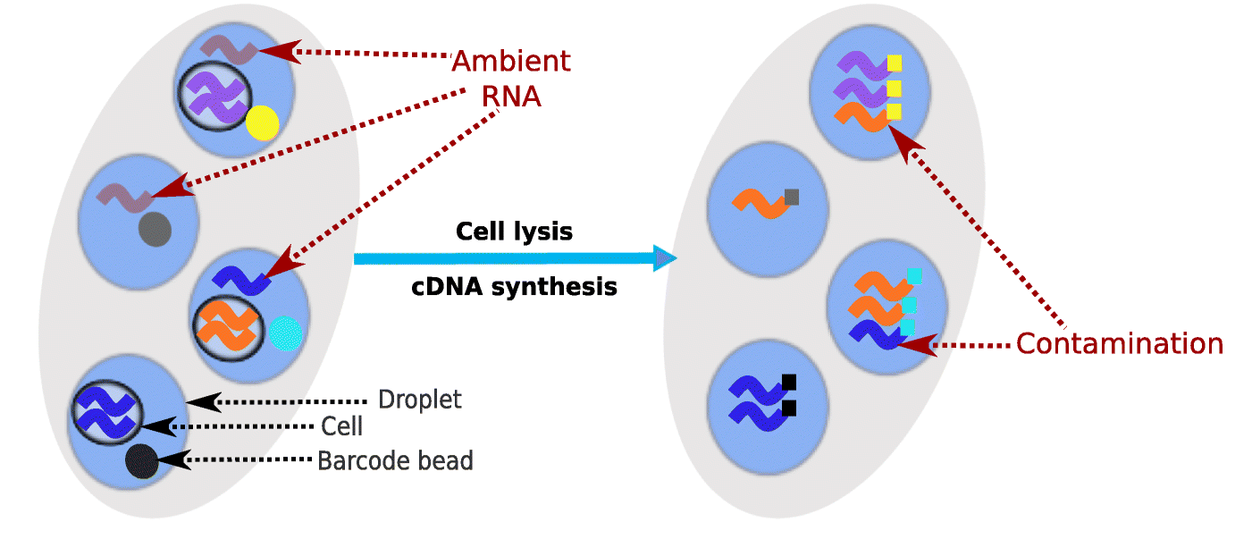
Ambient RNA and Barcode Swapping
-DropletUtil: https://bioconductor.org/packages/release/bioc/html/DropletUtils.html
-SoupX: https://github.com/constantAmateur/SoupX
-DropletQC: https://github.com/powellgenomicslab/DropletQC
-CellBender: https://github.com/broadinstitute/CellBender
-DecontX: https://github.com/campbio/celda
Genome Biol 21, 57 (2020). https://doi.org/10.1186/s13059-020-1950-6

Slide 14
Computational steps
 | Cell1 | Cell2 | Cell3 | Cell4
Gene1 | . | . | . | 1
Gene2 | . | . | 4 | 2
Gene3 |  | 3 | . | 2
Gene4 | 1 | . | 7 | .
Quality control
Normalization
Feature selection and scaling
Dimensional reduction with PCA
Dimensional reduction UMAP
Clustering

Slide 15
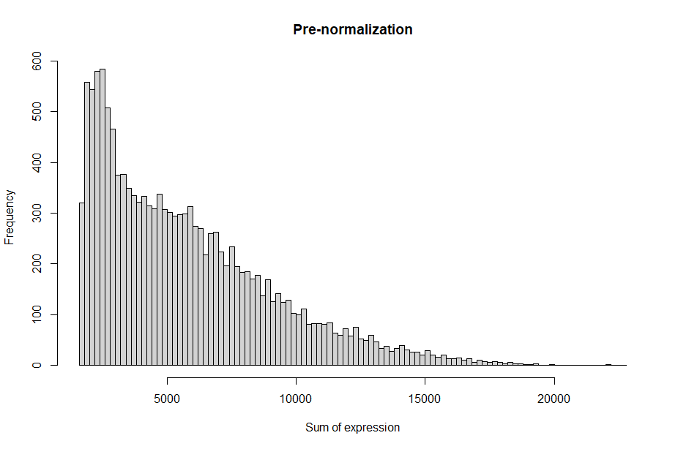
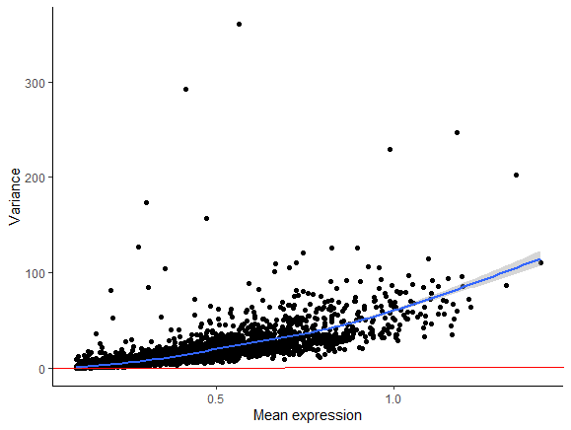
What is normalization and why do we do it?
-Normalization is the process of adjusting for systematic biases in our data, so we can accurately compare cells without the influence of technical effects:
Variation in sequencing depth, e.g. identical cells can be sequenced to different depths due to variation in cell lysis, reverse transcription efficiency, stochastic sampling
Large dynamic range, highly skewed
Highly expressed genes have higher variance (heteroscedasticity)

Slide 16
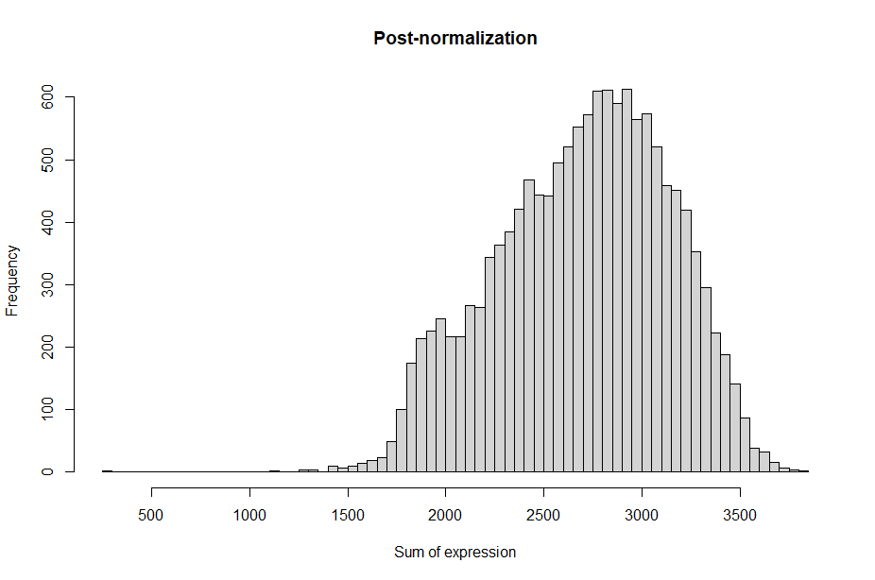
Traditional normalization steps
-Gene counts are divided by the total number of counts for that cell
-Then multiplied by a scaling factor (10,000)
-Then log transformed
Notes:
This does not produced normally distributed data, but comes close. It’s a crude method.

Slide 17
Computational steps
 | Cell1 | Cell2 | Cell3 | Cell4
Gene1 | . | . | . | 1
Gene2 | . | . | 4 | 2
Gene3 |  | 3 | . | 2
Gene4 | 1 | . | 7 | .
Quality control
Normalization
Feature selection and scaling
Dimensional reduction with PCA
Dimensional reduction UMAP
Clustering

Slide 18
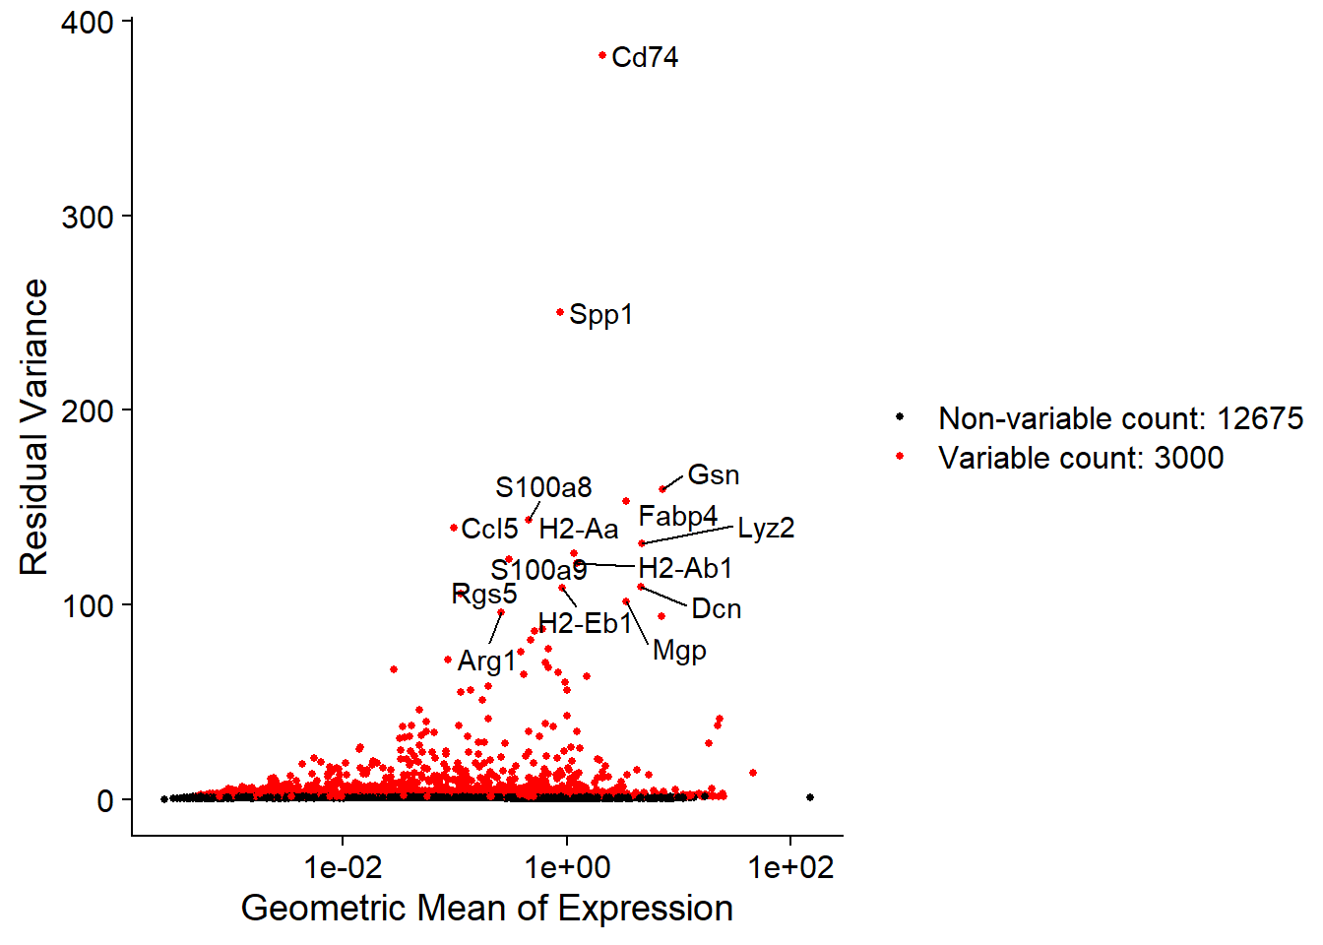
Highly variable feature selection
-Roughly ~20,000 genes in a data set
-Many genes are not informative (Noise)
-Highly variable genes likely represent important biological information (Signal)
-Highly variable genes are the outliers in a plot of mean expression vs variance
-Using only HV-features for downstream analysis (PCA) increases speed and Signal/Noise ratio

Slide 19
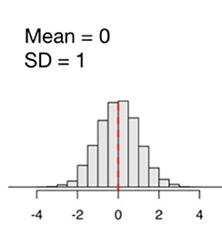
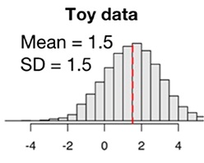
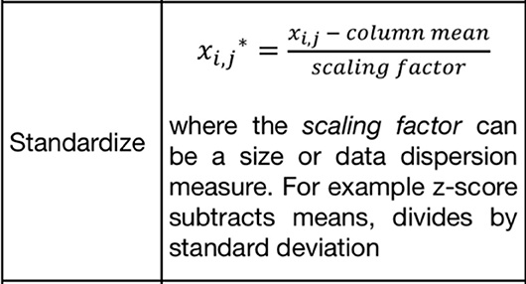
Feature scaling
-Downstream dimension reduction and unsupervised learning techniques require features (genes) to be scaled, this prevents highly expressed genes from dominating the analysis.
-In the Seurat workflow, genes are shifted so their mean expression is 0 and scaled so their variance is 1.
-This is often refered to as standardization (subtracting the mean and dividing by the SD)
Hsu & Culhane Front. Oncol., 23 June 2020
Notes:
Absolutely critical for PCA etc.. Which finds variance in the data, higher expressed genes have higher magnitude of variance naturally

Slide 20
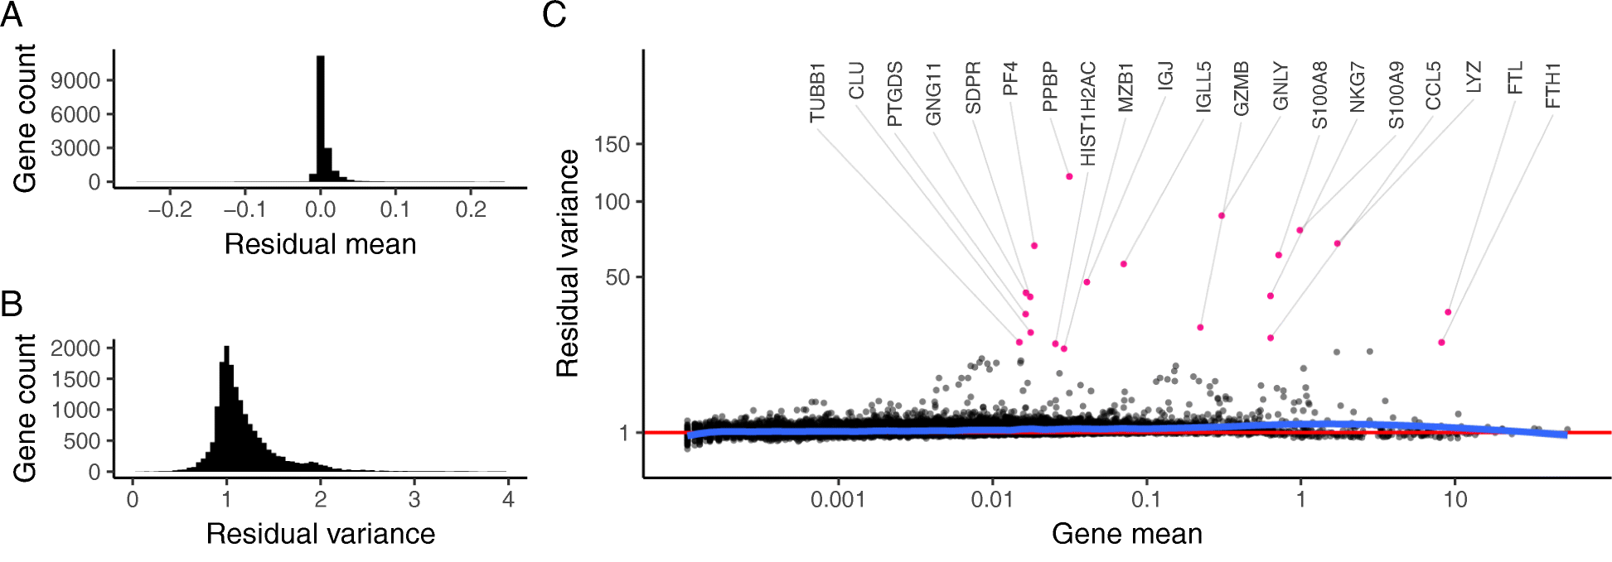
SCTransform
-Seurat team proposes that a single size factor does not effectively normalize lowly and highly expressed genes
-Updated method for normalization and variance stabilization. i.e. Performs normalization, hvf selection and feature scaling in a single function
-Fits a regularized negative binomial distribution (UMI v sequencing depth) for each gene, pearson residuals from this model are used as the normalized expression levels
-SCTransform combats technical noise better than traditional size/scaling factor normalization, allows for better detection of rare cell types
Hafemeister, C., Satija, R. Normalization and variance stabilization of single-cell RNA-seq data using regularized negative binomial regression. Genome Biol 20, 296 (2019) https://doi.org/10.1186/s13059-019-1874-1

Slide 21
Computational steps
 | Cell1 | Cell2 | Cell3 | Cell4
Gene1 | . | . | . | 1
Gene2 | . | . | 4 | 2
Gene3 |  | 3 | . | 2
Gene4 | 1 | . | 7 | .
Quality control
Normalization
Feature selection and scaling
Dimensional reduction with PCA
Dimensional reduction UMAP
Clustering

Slide 22
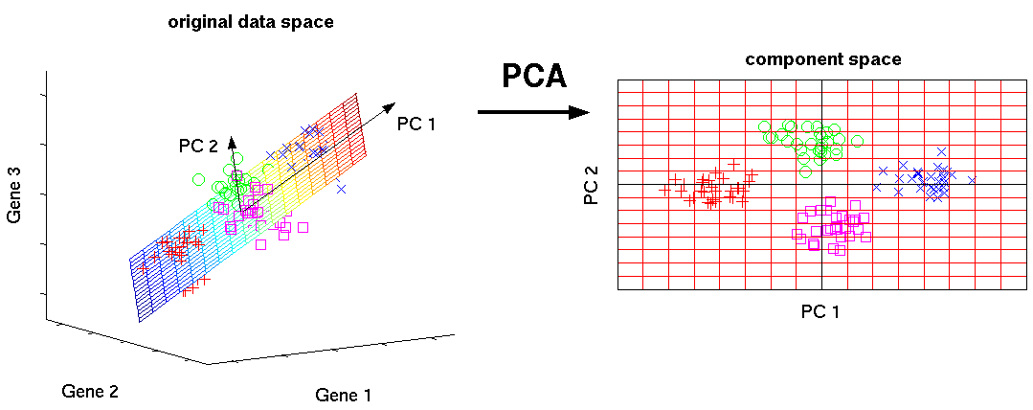
Principal components analysis (PCA)
-Unsupervised learning technique for visualizing high dimensional data
-Reduces the dimensions of a dataset by combining mutliple predictor variables (genes) into a smaller set of variables (principal components), weighted by linear combinations of the original set.
-The smaller set of variables, the principal components, „explain“ most of the variance of the full set of variables.
http://www.nlpca.org/pca_principal_component_analysis.html
https://www.youtube.com/watch?v=FgakZw6K1QQ&ab_channel=StatQuestwithJoshStarmer
https://stats.stackexchange.com/questions/2691/making-sense-of-principal-component-analysis-eigenvectors-eigenvalues
“Practical Statistics for Data Scientists, 2017, Peter Bruce and Andrew Bruce (O’Reilly)
Notes:
Often variables will co-vary, PCA can identify these.

Slide 23
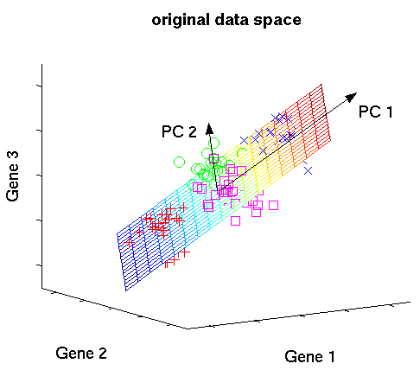
Principal components
-PCs are linear combinations of genes that maximizes variation
-Loadings are the weights that transform predictor variables (genes) into components
-“Linear combination“ is like a cocktail recipe.
e.g. PC1 is made of up 4 parts Gene 1, 2 parts Gene 2, 3 parts Gene 3, etc....
-The first PC accounts for the most variation in the data, the next PC is orthogonal to the first PC but explains the remaining variation, and so on..
Loading
PC
Z_{i} = w_{i,1}X₁ + w_{i,2}X₂ + w_{i,3}X₃ + ...
Variable
PC₁ = 4(Gene 1) + 2(Gene 2) + 3(Gene 3) + ...
Notes:
Imagine you plotted all the cells in high dimensional gene space, and fit a line that captured as much variation as possible. The loadings are the individual contributions of each gene to the slope of that line.

Slide 24
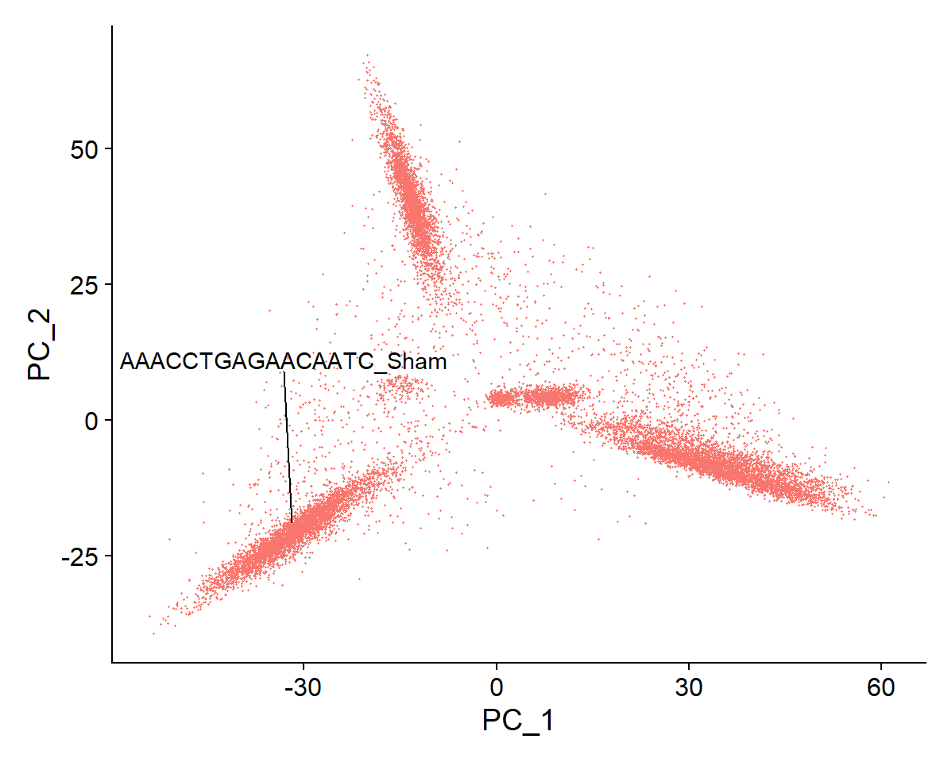
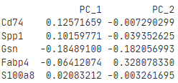
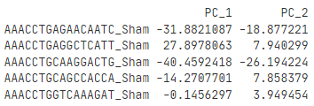
Each cell gets a PC score/embedding
0.12571659*(Cd74 expression in Cell₁) + 0.10159771*(Spp1 expression in Cell₁) + ... = PC_1-Cell₁
Loadings
Embeddings (PC score)

Slide 25
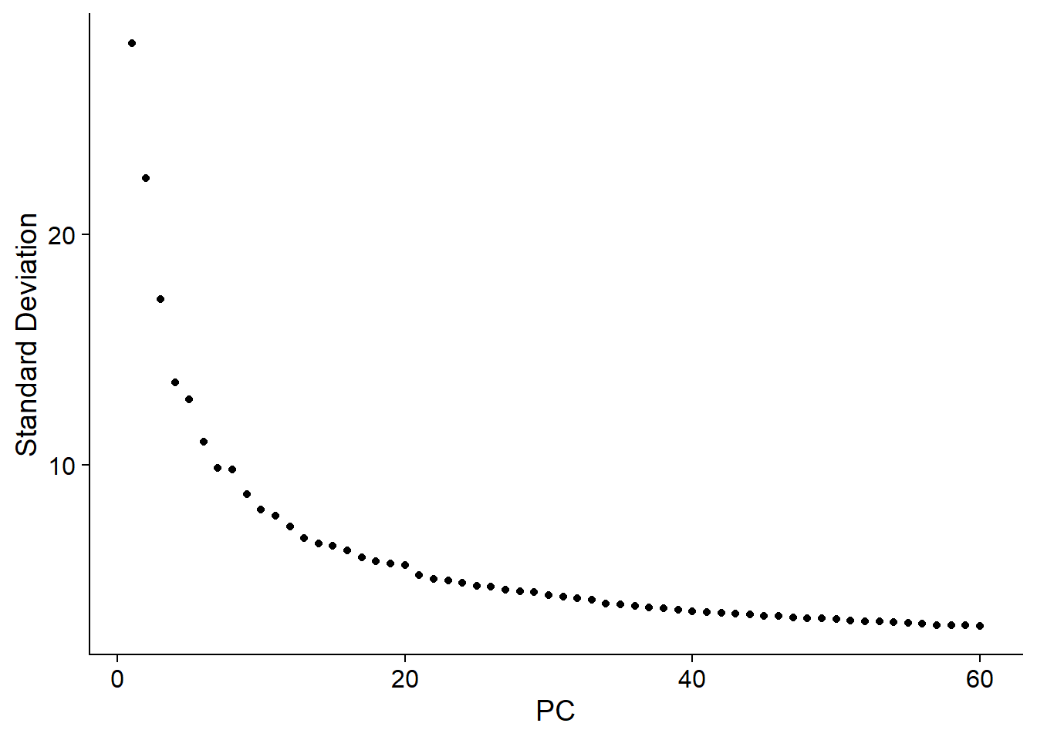
Principal components analysis (PCA)
-Elbow plot allows us to see how much of the variance is explained by each PC
-We can calculate as many PCs as original variables (genes), but how many do we need to use to sufficiently explain the variation in the data set?
-This is typical done by estimating were the plot levels off, here its between ~18-30 PCs
-Then we still have too many dimensions to plot!!

Slide 26
Computational steps
 | Cell1 | Cell2 | Cell3 | Cell4
Gene1 | . | . | . | 1
Gene2 | . | . | 4 | 2
Gene3 |  | 3 | . | 2
Gene4 | 1 | . | 7 | .
Quality control
Normalization
Feature selection and scaling
Dimensional reduction with PCA
Dimensional reduction UMAP
Clustering

Slide 27
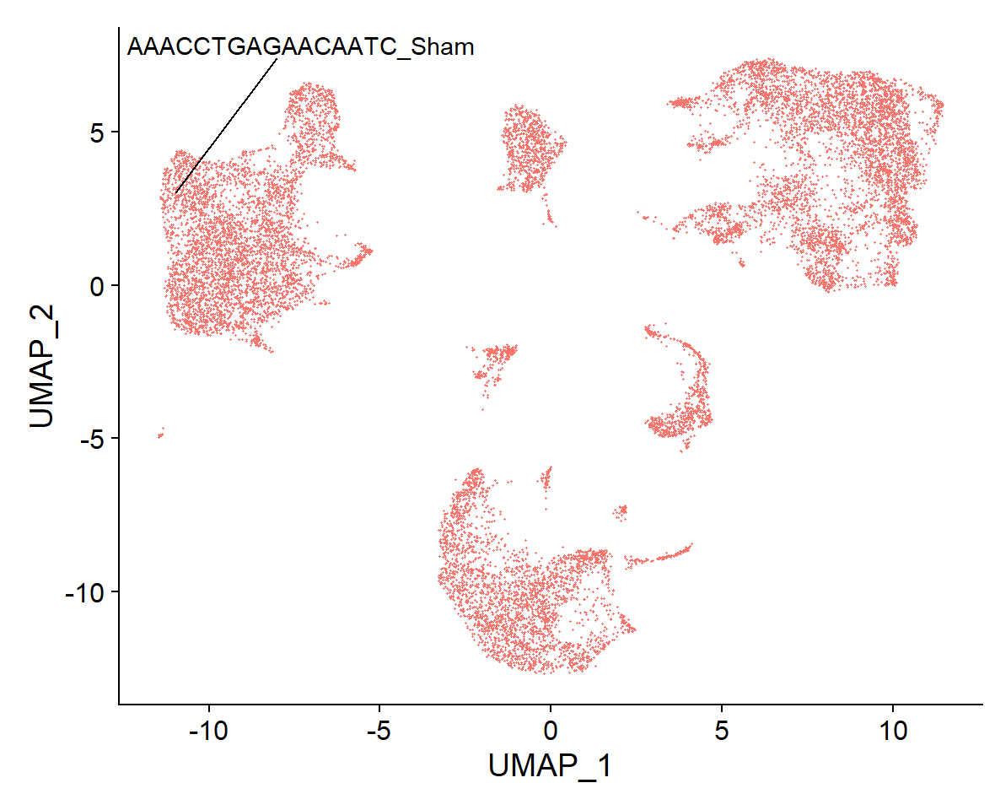
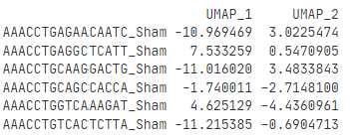
UMAP
-Uniform Manifold Approximation and Projection (UMAP) is a general purpose manifold learning and dimension reduction algorithm
-Places cells together in low dimensional space by learning the underlying “manifold”, thought to preserve the global and local “structure” better than tSNE
-Input PCA reduced data, UMAP reduces further to visualize in 2 dimensions
UMAP Embeddings
https://pair-code.github.io/understanding-umap/
https://umap-learn.readthedocs.io/en/latest/basic_usage.html

Slide 28
Computational steps
 | Cell1 | Cell2 | Cell3 | Cell4
Gene1 | . | . | . | 1
Gene2 | . | . | 4 | 2
Gene3 |  | 3 | . | 2
Gene4 | 1 | . | 7 | .
Quality control
Normalization
Feature selection and scaling
Dimensional reduction with PCA
Dimensional reduction UMAP
Clustering

Slide 29
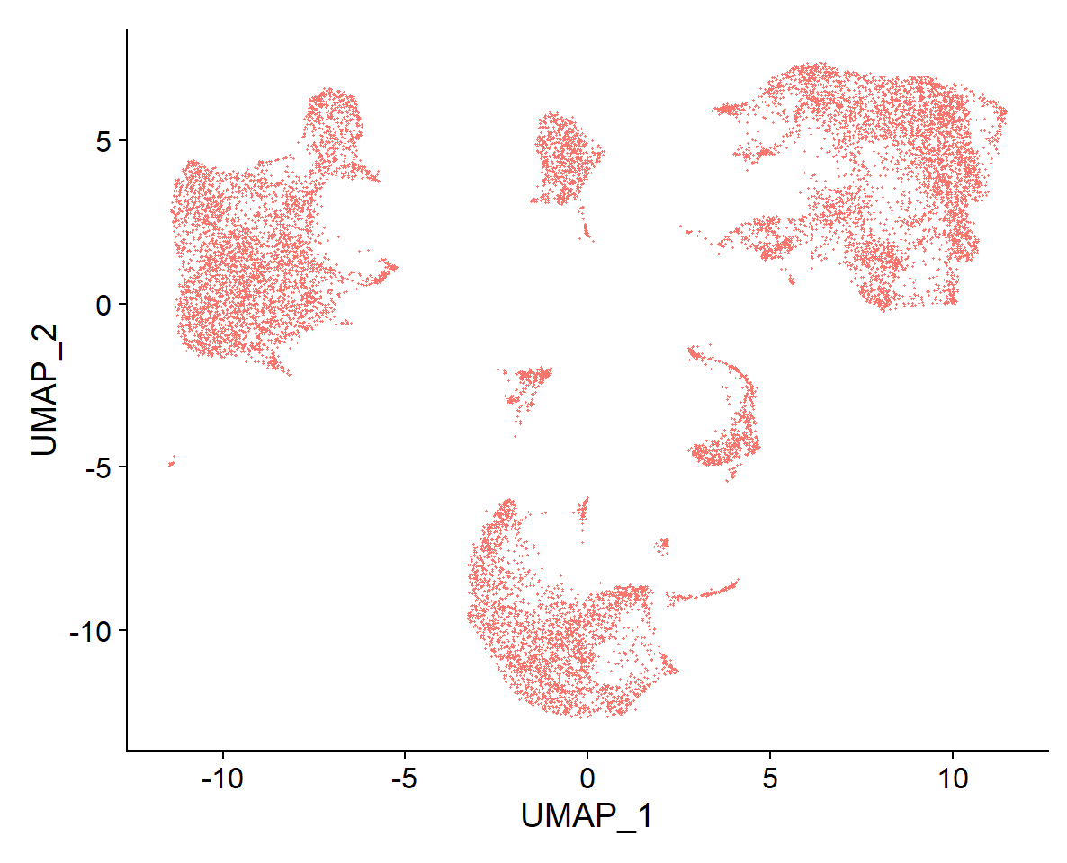
Clustering
-How do we partition the dots into sub-populations? How many cell types are there?
-Need to group the cells together based on transcriptome similarity, without any knowledge of lables or number of groups, therefore it‘s „unsupervised“

Slide 30
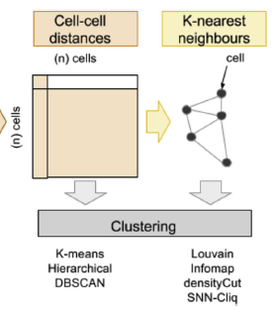
Clustering in Seurat
-Seurat toolkit employs graph based clustering
-k Nearest Neighbors (KNN) graph is constructed using euclidean distance in PCA space
-Edge weights between cells are refined by their shared overlap of local neighbors (Jaccard similarity)
-Clusters are found using a community detection algorithm (Louvain) that optimizes modularity, the relative density of edges inside communities compared to edges outside
cell
edge
https://en.wikipedia.org/wiki/Louvain_method
https://nbisweden.github.io/workshop-scRNAseq/lectures/scRNAseq_clustering_Asa_Bjorklund_2021.pdf
T.S. Andrews, M. Hemberg / Molecular Aspects of Medicine xxx (2017) 1e9

Slide 31
Clustering in Seurat

Slide 32
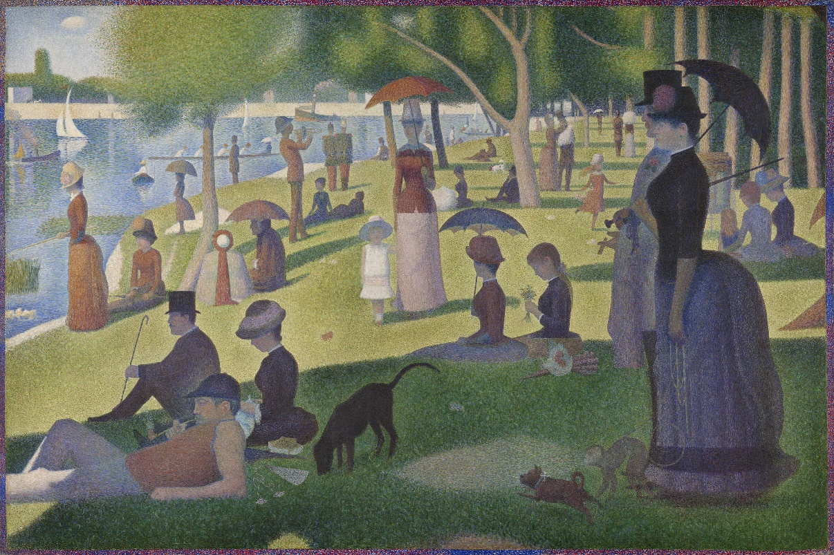
Seurat toolkit
-Seurat is a toolkit for single-cell genomics developed by the the Satija lab
-Enables users to analyze single-cell data from multiple modalities (RNA, Protein, Chromatin, Spatial)
-R library that consists of a collection of functions to read, analyze and plot single-cell data
-Excellent integration, multi-modal, and reference mapping functions
-Holds this data in a „object“, which contains many slots of data.
https://satijalab.org/seurat/
https://github.com/satijalab/seurat/wiki
https://satijalab.org/seurat/articles/essential_commands.html
Hao*, Hao*, et al., Cell 2021 [Seurat V4]
Stuart*, Butler*, et al., Cell 2019 [Seurat V3]
Butler* et al., Nat Biotechnol 2018 [Seurat V2]
Satija*, Farrell*, et al., Nat Biotechnol 2015 [Seurat V1]
A Sunday on La Grande Jatte — 1884, Georges Pierre Seurat

Slide 33
Seurat object
obj
count_data <- Read10X(data.dir = “path/to_your/data")
obj <- CreateSeuratObject(counts = count_data, project = “SFB1116", min.cells = 3, min.features = 200)
Slot | Function
assays | A list of assays within this object
meta.data | Cell-level meta data
active.assay | Name of active, or default, assay
active.ident | Identity classes for the current object
graphs | A list of nearest neighbor graphs
reductions | A list of DimReduc objects
project.name | User-defined project name (optional)
tools | Empty list. Tool developers can store any internal data from their methods here
misc | Empty slot. User can store additional information here
version | Seurat version used when creating the object

Slide 34
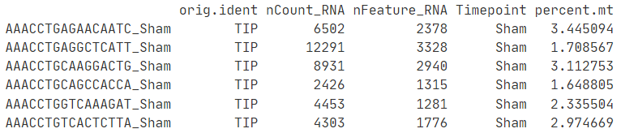
Seurat object metadata
obj
-Metadata is a data frame within the seurat object that holds any type of cell-level information (e.g. Timepoints, treatments, total counts).
obj@meta.data
any cell-level info
cells

Slide 35
Seurat object assays
obj
-Assays are individual representations of the expression data
-Matrices organized with genes as rows, and cells as columns
obj@assays
obj@assays$RNA
obj@assays$SCT
cells
cells
„RNA Assay“
„SCT Assay“
genes
genes

Slide 36
Seurat object assays
obj
-Within an assay, there are multiple slots holding different transformations of the data
obj@assays$RNA
obj@assays$RNA@scale.data
obj@assays$RNA@data
obj@assays$RNA@counts
„scale.data“
„data“
„counts“
Scaled data matrix
Used for Dim Reduction (PCA, UMAP)
Used for Heatmaps
Normalized data matrix
Used for differential gene expression
Used Feature and Violin plots
Unnormalized raw count data

Slide 37
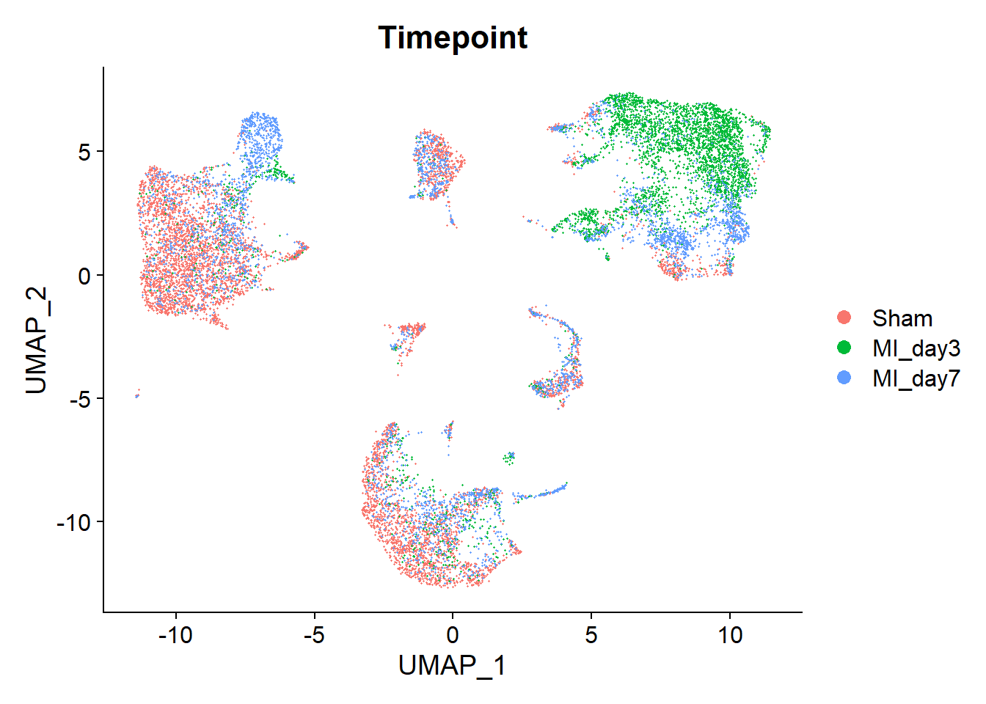
Seurat object identity
obj
-The active „identity“ of an object is the default way the object will split and display groups.
-The current active identity can be found using „obj@active.ident“
-It can be set using the „Idents()“ function
Idents(obj) <- “Timepoint“
DimPlot(obj)
Idents(obj) <- “seurat_clusters“
DimPlot(obj)

Slide 38
References
https://broadinstitute.github.io/2020_scWorkshop/
https://www.singlecellcourse.org/
https://nbisweden.github.io/workshop-scRNAseq/lectures/scRNAseq_clustering_Asa_Bjorklund_2021.pdf
https://satijalab.org/seurat/index.html
https://genomebiology.biomedcentral.com/articles/10.1186/s13059-019-1874-1
https://www.sciencedirect.com/science/article/pii/S0098299717300493?via%3Dihub
https://www.nature.com/articles/s41576-018-0088-9
https://www.frontiersin.org/articles/10.3389/fonc.2020.00973/full
https://www.embopress.org/doi/full/10.15252/msb.20188746
http://www.nlpca.org/pca_principal_component_analysis.html
Modern Statistics for Modern Biology, Holmes, S. Huber, W., 2019 ISBN: 9781108705295
Practical Statistics for Data Scientists, 2017, Peter Bruce and Andrew Bruce (O’Reilly)

