Slide 1
Process and Statistical Thinking
Almost any activity can be thought of as a process
Inputs
Outputs
Process
Notes:
3
2

Slide 2
Variation in the Process
There will almost always be variation in any process.
Our goal is to learn about the process, so that we can improve it.
Information is just variation that has a pattern.
Notes:
4
3

Slide 3
Variation Radiates Information
Inputs
Outputs
Process
Notes:
5
4

Slide 4
We Need Pattern Detectors
E
n
v
i
r
o
n
m
e
n
t
M
a
c
h
i
n
e
O
p
e
r
a
t
o
r
s
H
e
i
g
h
C
t
l
e
a
r
a
n
c
e
S
t
r
e
n
g
t
T
h
e
m
p
e
r
a
t
u
r
e
E
n
d
u
r
a
n
c
F
e
r
i
c
t
i
o
n
Balloon Volume
R
e
s
o
l
u
t
i
o
n
L
o
c
a
t
i
o
n
B
a
l
l
o
o
n
E
v
a
p
o
r
a
t
i
o
n
S
p
e
e
d
L
u
b
r
i
c
a
t
i
o
M
n
a
t
e
r
i
a
l
M
s
e
a
s
u
r
e
m
e
n
t
M
e
t
h
o
d
Inputs
Outputs
Process
Place Balloon on Nozzle
Lift Piston to Mark
Quickly Lower Piston
Release Air
x
Does
balloon
need more
air?
Yes
x
x
x
No
x
x
x
x
x
Release air until it seems right
Done
x
x
x
x
x
x
Pink
Defects
Red
Yellow
|
Blue
||||
Green
|
|
Notes:
6
5

Slide 5
Ishikawa’s Seven Tools
Histogram or Dotplot
Run Charts or Control Charts
Scatter Plots w/Stratification
Check Sheets
Pareto Diagrams
Flow Charts
Fishbone Diagrams
Notes:
7
6

Slide 6
Dotplot
740 750 760 770 780 790
Volume (ml)
Notes:
8
7

Slide 7
Histogram
6
5
4
Frequency
3
2
1
0
7
4
0
7
5
0
7
6
0
7
7
0
7
8
0
7
9
0
Volume (ml)
Notes:
9

Slide 8
Run Chart
8
0
0
7
9
0
7
8
0
Volume (ml)
7
7
0
7
6
0
7
5
0
7
4
0
Time
Notes:
10
9

Slide 9
Run Chart with Annotation
Operator #1
Operator #2
8
0
0
7
9
0
7
8
0
Volume (ml)
7
7
0
7
6
0
7
5
0
7
4
0
Time
Notes:
11
10

Slide 10
Run Chart with Annotation
Operator #1
Operator #2
8
0
0
7
9
0
7
8
0
Volume (ml)
7
7
0
7
6
0
7
5
0
7
4
0
Time
Notes:
11
10

Slide 11
Confounding
When two causes are changed simultaneously such that it is impossible to determine which cause produced the effect.

Slide 12
Check Sheet
Defects
Pink
Red
||
Yellow
||||
|
Blue
|
Green
|
Notes:
17
15

Slide 13
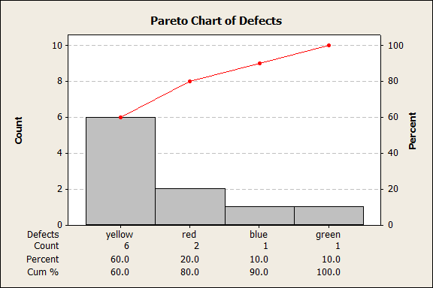
Pareto Diagram
Notes:
18
16

Slide 14
Cause and Effect Diagram
C
a
u
s
e
a
n
d
E
f
f
e
c
t
D
i
a
g
r
a
m
f
o
r
B
a
l
l
o
o
n
F
i
l
l
i
ng
E
n
v
i
r
o
n
m
e
n
t
M
a
c
h
i
n
e
O
p
e
r
a
t
o
r
s
H
e
i
g
h
t
C
l
e
a
r
a
n
c
e
S
t
r
e
n
g
t
h
T
e
m
p
e
r
a
t
u
r
e
E
n
d
u
r
a
n
c
e
F
r
i
c
t
i
o
n
Balloon Volume
R
e
s
o
l
u
t
i
o
n
L
o
c
a
t
i
o
n
B
a
l
l
o
o
n
Height
E
v
a
p
o
r
a
t
i
o
n
S
p
e
e
d
L
u
b
r
i
c
a
t
i
o
n
M
e
a
s
u
r
e
m
e
n
t
M
e
t
h
o
d
M
a
t
e
r
i
a
l
s
Notes:
20

Slide 15
Scatter Plot
x
x
780
x
x
x
x
x
x
Volume (ml)
x
x
x
x
x
x
x
750
x
x
x
0.975
0.990
1.005
1.020
1.035
Height (ft)
Notes:
14
13

Slide 16
Flow Chart
Place Balloon on Nozzle
Lift Piston to Mark
Quickly Lower Piston
Release Air
Does
balloon
need more
air?
Yes
No
Release air until it seems right
Done
Notes:
19

Slide 17
Scatter Plot with Stratification
O
Operator #1
x
Operator #2
O
O
780
O
O
O
O
O
O
Volume (ml)
O
x
x
x
x
x
x
750
x
x
x
0.975
0.990
1.005
1.020
1.035
Height (ft)
Notes:
15
14

Slide 18
Where do you put the armor plating?

Slide 19
The Tools are the Detectors
People are the Detectives
Notes:
21

Slide 20
What have we learned?
A group of balloons seem to have a smaller volume.
Most of the small balloons are yellow.
Most of the small balloons were filled by Operator #2.
Most of the small balloons were filled later in time.
There appears to be a relationship between the height of the piston being raised and the volume ONLY for the large balloons.
There is confounding so we can’t be sure what is causing the smaller balloons, but the flow chart suggests that the operator may be the critical difference.
Notes:
22

