Slide 1
Numerical Populations
A population where all possible values are numerical - like the height of all Northwestern undergraduates
Size of population is N.
Notation for numerical data: (x₁, x₂, ... x_{N})
Probability Distribution
A representation of the probability that an observation from a specific population will take on a specific value

Slide 2
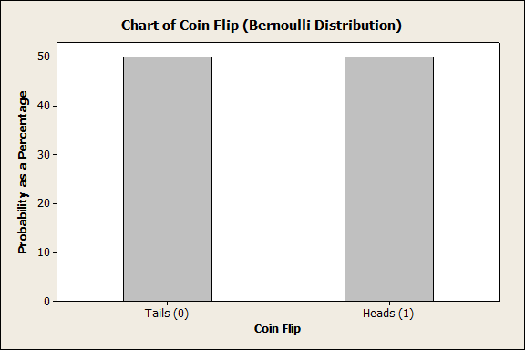

Slide 3
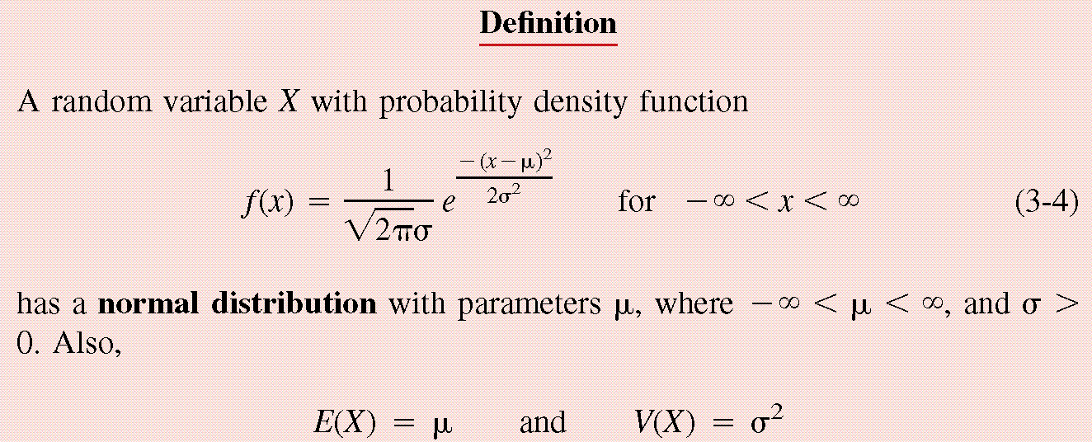
Normal Distribution
0.

Slide 4
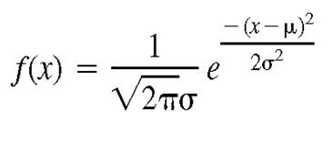
For a Normal Distribution
68% of the data values fall between
95% of the data values fall between
99.7% of the data values fall between
Normal Distribution
6σ
μ
99.7% of distribution within a six sigma range.

Slide 5
Height Exercise

Slide 6
Summary Measures for Numerical Data
Measures of Location
A statistic that represents a central or typical value in the data.
Measures of Dispersion
A statistic that represents a (spread) around the central or typical value in the data.

Slide 7
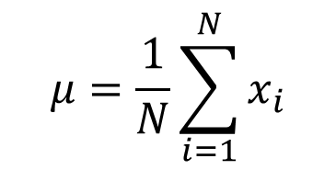
Measures of Location for the Population
Population mean (True mean): μ for a finite population of size N:

Slide 8
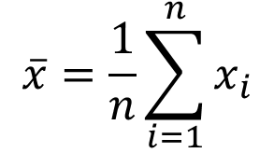
Measures of Location for the Sample
Sample mean (average)
Most commonly used
sensitive to extreme values

Slide 9
Measures of Location for the Sample
Mode: value that occurs most often
Median:
Arrange data from small to large (x₍₁₎, x₍₂₎, ... x_{(n)})
for n is odd: median =
for n is even: median =
not sensitive to extreme values (robust)

Slide 10
Example
Age of faculties in a department (made up)
25, 27, 41, 43, 46, 46, 47, 48, 49, 49, 51, 52, 52, 52,
55, 61, 70.
Mean: (25 + 27 + 41 + …+ 70) / 17 = 47.88
Mode: 52
Median: 49

Slide 11
Shape of a Distribution
Symmetrical
Skewed to the right
Skewed to the left
mean = mode = median
mean > median > mode
mode > median > mean

Slide 12



Measure of Dispersion for the Population
Population Variance:
Population Standard Deviation is the square root of the population variance
$$σ^{2}=\frac{1}{N}\sum_{i=1}^{N}{{(x_{i}−μ)}^{2}}$$
$$σ=\sqrt{\frac{1}{N}\sum_{i=1}^{N}{{(x_{i}−μ)}^{2}}}$$

Slide 13
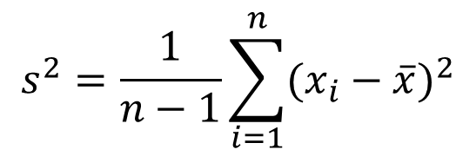

Measure of Dispersion for the Sample
Sample Variance:
Sample Standard Deviation is the square root of the sample variance
$$s^{2}=\frac{1}{n−1}\sum_{i=1}^{n}{{(x_{i}−\overline{x})}^{2}}$$
$$s=\sqrt{\frac{1}{n−1}\sum_{i=1}^{n}{{(x_{i}−\overline{x})}^{2}}}$$

Slide 14
Measure of Dispersion
Quartiles: Division points where data is divided into 4 equal parts
first (lower) quartile has 25% data points below and 75% above it
second quartile (median) has 50% below and above it
third (upper) quartile has 75% below and 25% above it
Percentiles and Quantiles
pth percentile has p percent of the data points below it and (100-p%) above it.
Quantile = Percentile/100

Slide 15
Measure of Dispersion
Inter quartile Range (IQR):
IQR = Q₃ - Q₁
Range: Maximum – Minimum
Coefficient of Variation

Slide 16
Notation

