Slide 1
Probability I
Textbook sections 2.1, 2.2, and 2.4

Slide 2
Sample Spaces and Events
An experiment will mean an action or process that produces a result subject to uncertainty
An outcome is the result of an experiment
The sample space of an experiment, denoted by , is the set of all possible outcomes

Slide 3
Events
In our study of probability, we will be interested not only in the individual outcomes of but also in various collections of outcomes from .
Definition
An event is any collection (subset) of outcomes contained in the sample space .
An event is simple if it consists of exactly one outcome and compound if it consists of more than one outcome.

Slide 4
Events
When an experiment is performed, a particular event A is said to occur if the resulting experimental outcome is contained in A.
In general, exactly one simple event will occur, but many compound events will occur simultaneously.

Slide 5
Example
Consider an experiment in which each of three vehicles taking a particular freeway exit turns left (L) or right (R) at the end of the exit ramp.
The eight possible outcomes that comprise the sample space are LLL, RLL, LRL, LLR, LRR, RLR, RRL, and RRR.
Thus there are eight simple events, among which are E₁ = {LLL} and E₅ = {LRR}.

Slide 6
Example
cont’d
Some compound events include
A = {RLL, LRL, LLR} = the event that exactly one of the three vehicles turns right
B = {LLL, RLL, LRL, LLR} = the event that at most one of the vehicles turns right
C = {LLL, RRR} = the event that all three vehicles turn in the same direction
Suppose the outcome is LLL.
Then the simple event E₁ has occurred and so also have the events B and C (but not A).

Slide 7
Calculating Probability
For many experiments, we can define the sample space so that each outcome is equally likely
In this case, calculating the probability of an event reduces to counting the number of outcomes in the event set and dividing by the number of outcomes in the sample space
Example: For a 2-dice experiment:
What is the probability of rolling doubles?

Slide 8
Sample Space for 2 dice
{die 1, die 2}
{1,1} | {1,2} | {1,3} | {1,4} | {1,5} | {1,6}
{2,1} | {2,2} | {2,3} | {2,4} | {2,5} | {2,6}
{3,1} | {3,2} | {3,3} | {3,4} | {3,5} | {3,6}
{4,1} | {4,2} | {4,3} | {4,4} | {4,5} | {4,6}
{5,1} | {5,2} | {5,3} | {5,4} | {5,5} | {5,6}
{6,1} | {6,2} | {6,3} | {6,4} | {6,5} | {6,6}
{die 1, die 2}
{1,1} | {1,2} | {1,3} | {1,4} | {1,5} | {1,6}
{2,1} | {2,2} | {2,3} | {2,4} | {2,5} | {2,6}
{3,1} | {3,2} | {3,3} | {3,4} | {3,5} | {3,6}
{4,1} | {4,2} | {4,3} | {4,4} | {4,5} | {4,6}
{5,1} | {5,2} | {5,3} | {5,4} | {5,5} | {5,6}
{6,1} | {6,2} | {6,3} | {6,4} | {6,5} | {6,6}
36 equally likely outcomes
What is the probability of rolling doubles?
6/36 =0.16667

Slide 9

Sample Space for 3 cars
{car 1, car 2, car 3}
{L,L,L} | {R,L,L} | {L,R,L} | {L,L,R}
{L,R,R} | {R,L,R} | {R,R,L} | {R,R,R}
What is the probability of exactly one car turning left? A) 1/2 B) 3/8 C) 0
It is sometimes easy to think that events are equally likely when they are not?

Slide 10
Some Concepts from Set Theory
Given two events (A and B), we are often interested in calculating probabilities of other events such as: A and B both occurring, either A or B occurring, etc. . .
Because an event is a set (a subset of the sample space), relations from set theory are useful:
The complement of A (denoted by A') is the set of all outcomes in S that are not in A
The union of A and B (denoted by A∪B and read "A or B") is the set of all outcomes in that are in either A or B or both
The intersection of A and B (denoted by A∩B and read "A and B") is the set of all outcomes in that are in both A and B
A and B are disjoint or mutually exclusive if their intersection is empty

Slide 11
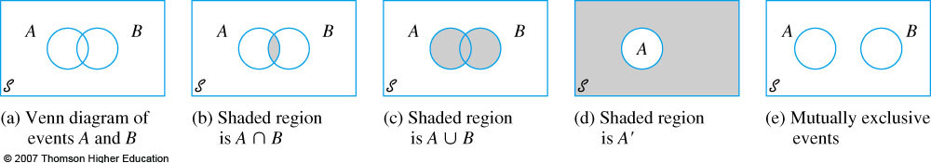
Venn Diagrams showing Set Relations

Slide 12
Example
For the experiment in which the number of pumps in use at a single six-pump gas station is observed, let A = {0, 1, 2, 3, 4}, B = {3, 4, 5, 6}, and C = {1, 3, 5}.
Then
A′ = {5, 6}, A ∪ B = {0, 1, 2, 3, 4, 5, 6} , A ∪ C = {0, 1, 2, 3, 4, 5},
A ∩ B = {3, 4},
A ∩ C = {1, 3},
(A ∩ C)′ = {0, 2, 4, 5, 6}

Slide 13
Axioms of Probability
All probability measures must satisfy the following axioms:
For any event A, P(A) ≥ 0
P( ) = 1
If A₁, A₂, A₃, . . . is a collection of disjoint events, then P(A₁∪A₂∪A₃∪ . . .) =

Slide 14
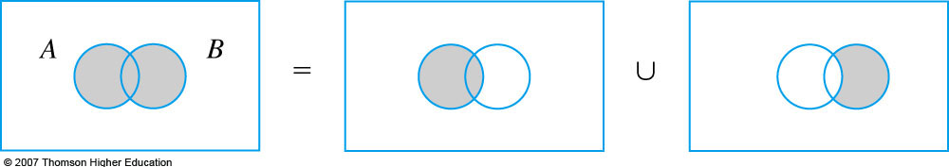
Relations that Follow the Axioms
The following are important relations that can all be derived from the three axioms (and that seem intuitively reasonable):
For any event A, P(A) + P(A') = 1
For any event A, P(A) ≤ 1
For any two events A and B,
P(A∪B) = P(A) + P(B) − P(A∩B)

Slide 15
Sample Space for 2 dice
{die 1, die 2}
{1,1} | {1,2} | {1,3} | {1,4} | {1,5} | {1,6}
{2,1} | {2,2} | {2,3} | {2,4} | {2,5} | {2,6}
{3,1} | {3,2} | {3,3} | {3,4} | {3,5} | {3,6}
{4,1} | {4,2} | {4,3} | {4,4} | {4,5} | {4,6}
{5,1} | {5,2} | {5,3} | {5,4} | {5,5} | {5,6}
{6,1} | {6,2} | {6,3} | {6,4} | {6,5} | {6,6}
{die 1, die 2}
{1,1} | {1,2} | {1,3} | {1,4} | {1,5} | {1,6}
{2,1} | {2,2} | {2,3} | {2,4} | {2,5} | {2,6}
{3,1} | {3,2} | {3,3} | {3,4} | {3,5} | {3,6}
{4,1} | {4,2} | {4,3} | {4,4} | {4,5} | {4,6}
{5,1} | {5,2} | {5,3} | {5,4} | {5,5} | {5,6}
{6,1} | {6,2} | {6,3} | {6,4} | {6,5} | {6,6}
What is the probability of rolling doubles? 6/36
What is the probability of rolling a six? 5/36
What is the probability of rolling doubles or a six?
6/36+5/36-1/36=10/36=0.27778

Slide 16
Frequentist Interpretation of Probability
We are used to statements like "the probability of rolling doubles is 0.16667", but what does this really mean?
Try to define "probability" in formal terms using no other undefined term like "chance", "likelihood", etc.
The following relative frequency interpretation has come to be accepted as the "meaning" of probability:
Suppose an event A for some experiment has probability P(A) of occurring
Then, if we hypothetically repeat the experiment an infinite number of times, independently, P(A) should equal the proportion of times that event A occurs

Slide 17
Door Game

Slide 18
Door Game – Switch Strategy
You choose 1
Lose
Door 1 Wins
You choose 2
Win
You choose 3
Win
0.33
0.33
You choose 1
Win
Door 2 Wins
You choose 2
Lose
You choose 3
Win
0.33
You choose 1
Win
Door 3 Wins
You choose 2
Win
You choose 3
Lose
You win 2/3 of the time.

Slide 19
Door Game – Stay Strategy
You choose 1
Win
Door 1 Wins
You choose 2
Lose
You choose 3
Lose
0.33
0.33
You choose 1
Lose
Door 2 Wins
You choose 2
Win
You choose 3
Lose
0.33
You choose 1
Lose
Door 3 Wins
You choose 2
Lose
You choose 3
Win
You win 1/3 of the time.

Slide 20
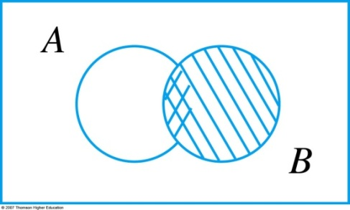
Conditional Probability
Consider two different events (call them A and B) from the same experiment
The notation P(A | B) is read "the conditional probability of A, given that event B has occurred"
The formal definition of conditional probability is:
A useful way to view conditional probability is via the relationship: P(A∩B) = P(A | B)P(B) = P(B | A)P(A)

Slide 21
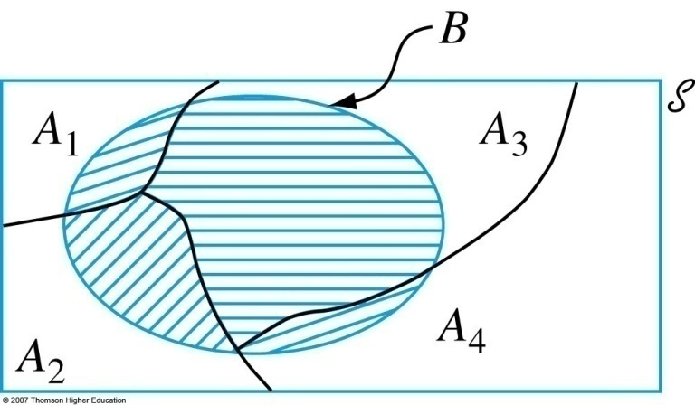
Some Uses of Conditional Probability
For any two events A and B,
If A₁, A₂, . . ., A_{k} are mutually exclusive and exhaustive events, and B is any other event, then:
Law of Total Probability:
Bayes Theorem: For each j = 1, 2, . . ., k:

Slide 22
Examples –Disease Testing
Disease Testing. Suppose 1 in 1000 adults in the population has a particular disease. A test for this disease returns a positive result 99% of the time if the person really has the disease and a "false positive" result 2% of the time if the person does not have the disease.
If a person tests positive, what is the probability that they really have the disease?

Slide 23
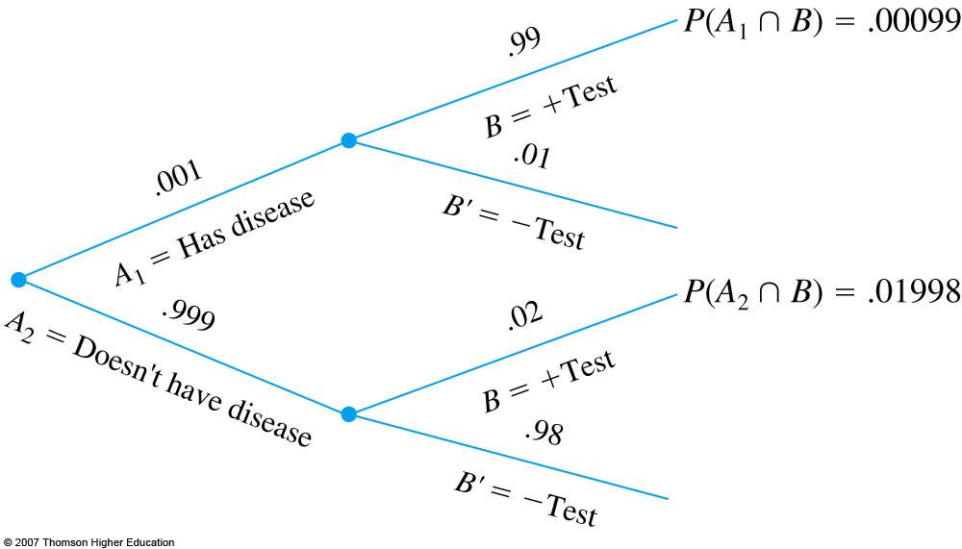
Examples –Disease Testing

Slide 24
Examples –Disease Testing
99 people
100 people
1 person
100,000 people
1998 people
99,900 people
97,902 people

Slide 25
Examples –Disease Testing
Tested Positive
99 people
100 people
1 person
1998 people
99,900 people
97,902 people

Slide 26
Conclusion
Only a 5% chance of having the disease when you test positive.
When you test positive for a rare disease, it is still very likely that you don’t have the disease even if the test is pretty good.
This is why there are always follow up tests for confirmation before treatment is ordered.

