Slide 1
Properties of Estimators
Parameter is (example: μ for Pop. Mean.)
Characteristic of the Population (unknown)
Estimator is (example: for Sample Mean.)
Function of the data in the sample, it is a random variable since the data is random.

Slide 2
Properties of Estimators
On target?
Unbiased:
How much variability around its expected value?
Overall Goodness of Estimator:

Slide 3
Sample Mean Study
The individuals are Normally distributed, so
is Normally distributed.
With expected value μ.
With variance σ²/n
For example: if

Slide 4
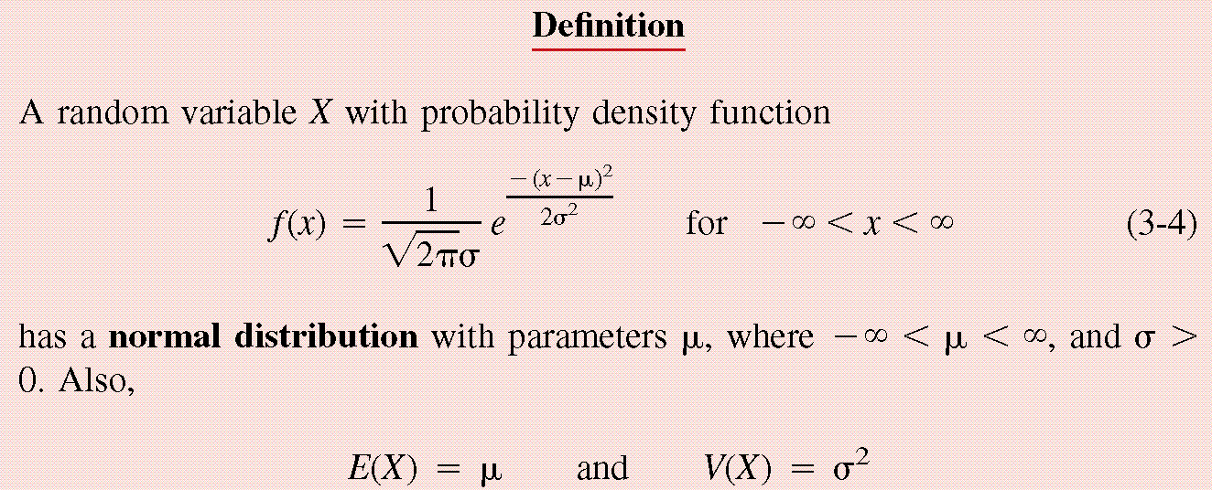
Normal Distribution
0.

Slide 5
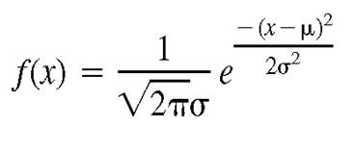
For a Normal Distribution
68% of the data values fall between
95% of the data values fall between
99.7% of the data values fall between
Normal Distribution
6σ
μ
99.7% of distribution within a six sigma range.

Slide 6
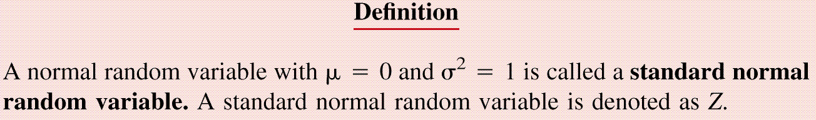
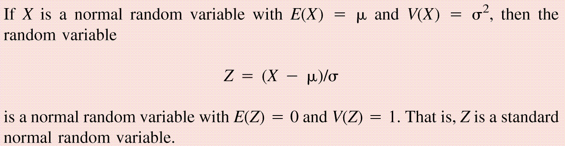
Standard Normal Distribution

Slide 7
Cumulative Distribution Functions (cdf)
The cdf Φ(z) of a Standard Normal random variable, Z, is defined as:

Slide 8
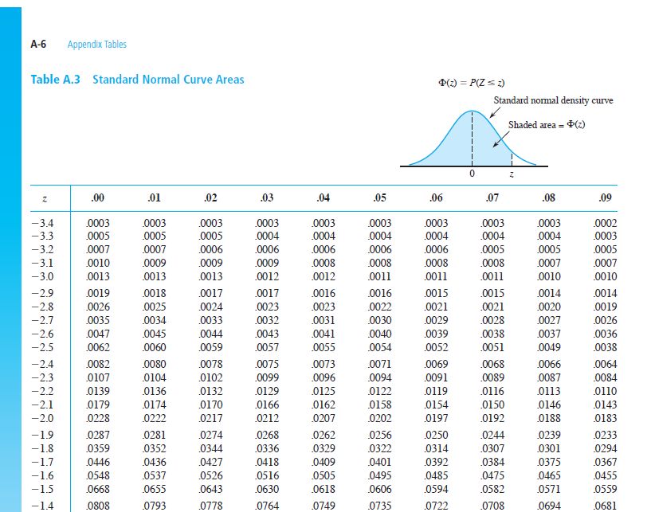

Slide 9
Example
Let X denote the resistance of a random selected resistor. Suppose that X ~N(μ= 4.3, σ = 0.6557).
If the specification limits are 3 to 8 ohms, what fraction of the resistors conform to the specifications?

Slide 10
Percentage Out of Specification
Z_{L}=How many σ’s?
2.39%
0%
LSL=3
USL=8
Z_{U}=How many σ’s?
Normal Distribution

Slide 11
Using the z-Table
z
0
z | 0.00 | 0.01 | 0.02 | 0.03 | 0.04 | 0.05 | 0.06 | 0.07 | 0.08 | 0.09
-1.90 |  |  |  |  |  |  |  | φ(-1.97) | φ(-1.98)

Slide 12
Example
Assume that test scores follow a normal distribution with mean 500 and standard deviation 100. That is, if we use X to denote the test score of an individual, X ~N(μ= 500, σ = 100).
What has to be your score to be sure that you are among the top 10%?
Above 628 is in the top 10%
How well have you done compared to the others if your score is 750?
750 is in the top 1%.
1.28 σ’s
10%

Slide 13
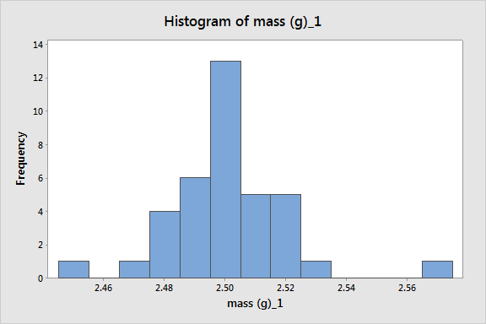
Histogram to Test Normal Assumptions and Outliers

Slide 14
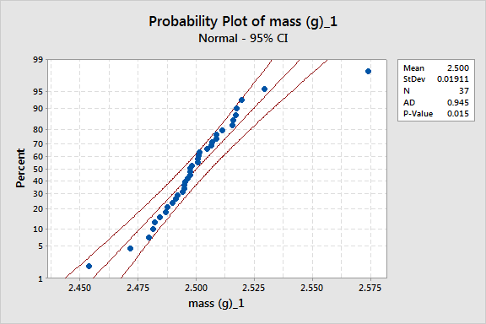
Probability Plot to Test Normal Assumptions and Outliers

Slide 15
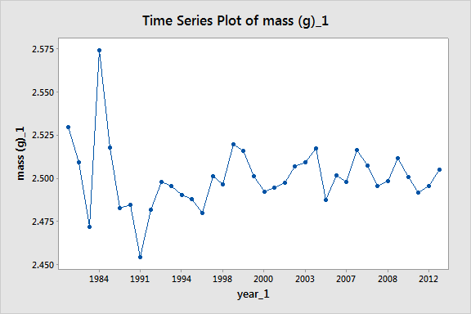
Time Series or Run Chart to Test for I.I.D. Assumption

Slide 16
Example
A manufacturer of potato chips claims that the average contents of bags sold weighs 12 ounces. The distribution is known to be normal with standard deviation σ=0.4 ounces. A random sample of 16 bags produced a sample mean weight of 11.84 ounces. Is it reasonable to say that the average is 12?

Slide 17
Linear Combinations of Random Variables
Suppose X and Y are independent r.v.’s with means μ_{x} and μ_{y} and variances σ_{x}² and σ_{y}² (a, b,c,and d are scalars), then
W=(aX+b) +( cY +d)
V(W) = a² σ_{x}²⁺ c² σ_{y}²
E(W) = aμ_{x} +b+ cμ_{y}+d
If X and Y are Normal then W is Normal.

Slide 18
Example (Sample Mean)
The individuals are Normally distributed, so
is Normally distributed.
With expected value μ.
With variance σ²/n

Slide 19
Example (Sample Mean)
Since
has the standard Normal distribution.
95%
-1.96
1.96

Slide 20
If we keep taking samples of 16 and calculating the sample mean:
95% of the time the interval will contain the true value:
“The probability is 0.95 that the random interval will include μ.”

Slide 21
Confidence Interval Estimation
A 100(1-α)% confidence interval (CI) for an unknown parameter θ is a random interval [L,U] computed from sample data that will contain the true θ with probability 1-α. This probability is called the confidence level.

Slide 22
Two-Sided Confidence Interval for the population mean
The 100(1-α)% two-sided CI’s on μ is given by

Slide 23
The confidence interval gives us all probable values for the population mean.
Use 95% confidence
So it is reasonable to think that the mean is 12, but it could be as low as 11.64.

Slide 24
Interpreting Confidence Intervals
There is a big difference between Statistically Significant and Practically Important.

Slide 25
Always look at both sides of the confidence interval and think about how each value would affect your decision.
Average time saved by driving by the “Shortcut” (-.5,1) minutes.
Average amount of money saved by buying from Amazon.com (5,7) dollars.
Average weight of gold in a pound of Lake Michigan Sand (0,5) grams.
Average error on yard markers on a football field (.02, .04) inches.

