Slide 1
Central Limit Theorem

Slide 2
How do we find out about the properties of an estimator?
We need to know about
SAMPLING DISTRIBUTION: the actual probability distribution that you would get if you collected a similar sample an infinite number of times from the same population and calculated the statistic for each of the samples.
We have methods to find the mean and the variance, but what about the form of the distribution?

Slide 3
Normal Assumption
If we assume that each X_{i} is i.i.d and normally distributed, then the sample mean is a linear combination of Normally distributed random variables and thus it has a Normal distribution.
If this is a good assumption, we have a complete description of the sampling distribution for the sample mean. N(μ,σ²/n)
What if that is a bad assumption?

Slide 4
Central Limit Theorem (C.L.T)
If X₁, X₂, …, X_{n} is an i.i.d. random sample of size n taken from population with mean μ and variance σ², and if is the sample mean, then the limiting form of the distribution of
is the standard normal distribution.
“For sufficiently large n, the sample mean has an approximately normal distribution as long as the population has a finite mean and variance.”

Slide 5
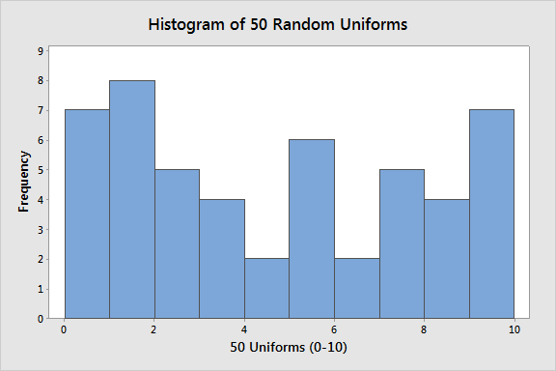
50 Random Draws from a Uniform(0-10)
Uniform (0-10)

Slide 6
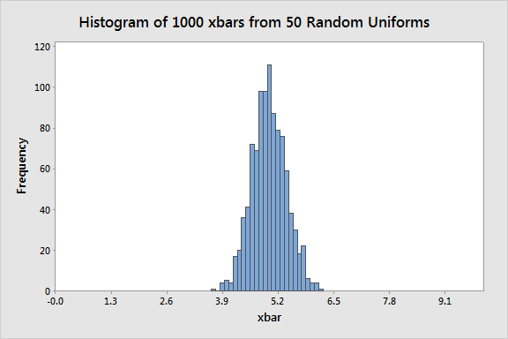
100 Means of 50 Random samples from a Uniform (0-10)
Mean of 50 random sample from (0-10)

Slide 7
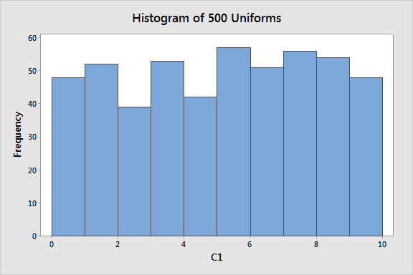
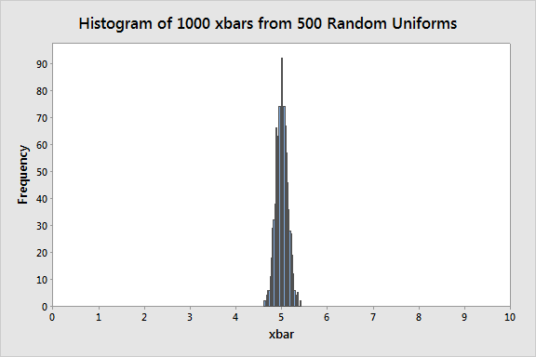
500 Random Draws from a Uniform(0-10)
With n=500, the individual values are not Normal, they are Uniform.
1000 with n=500, the sample means are Normal, even though the individuals are not.

Slide 8
Summary
If n is large
OR
The individuals are Normally distributed then
and
has a standard Normal distribution.

Slide 9
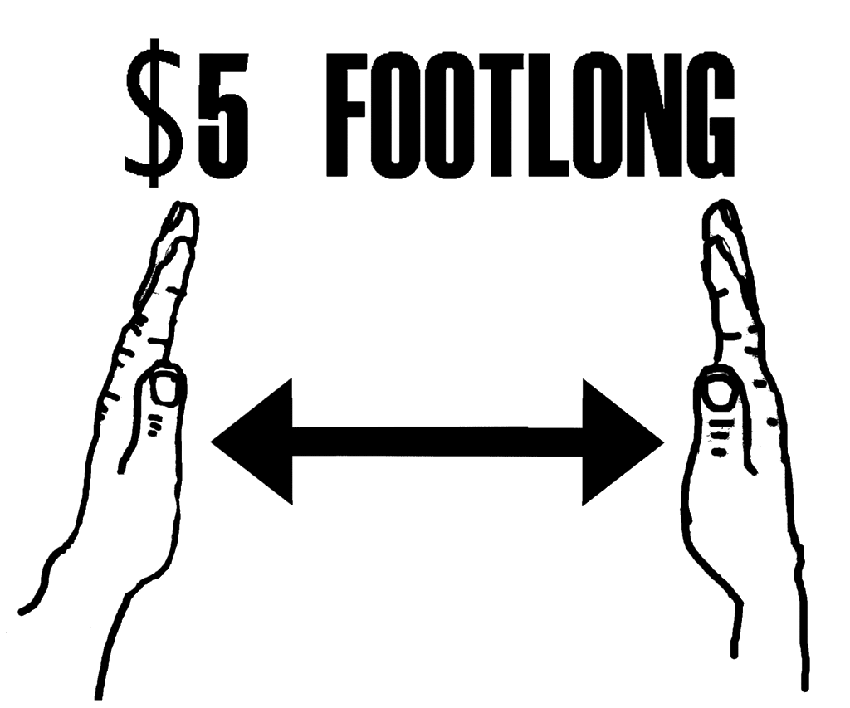


Slide 10
Confidence Intervals

Slide 11
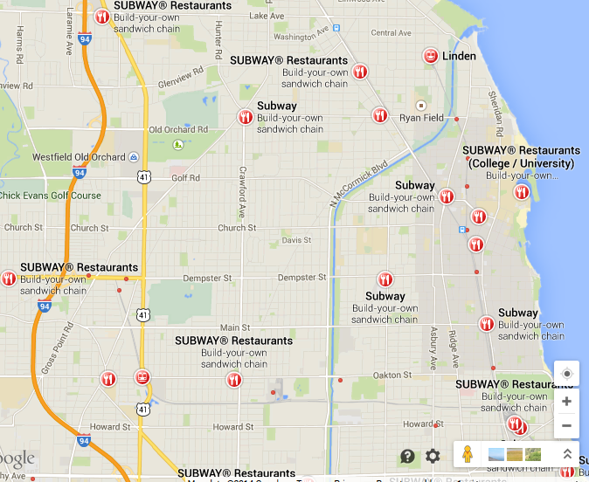
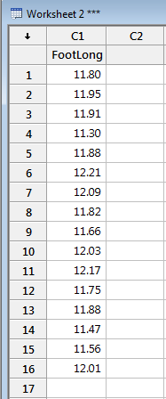
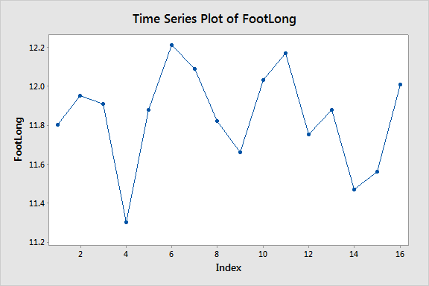
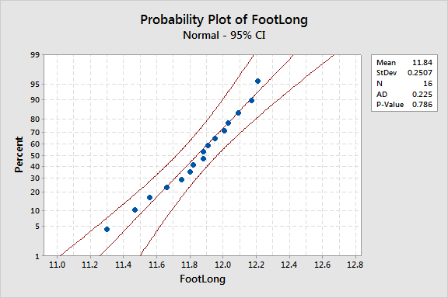
16 Subways

Slide 12
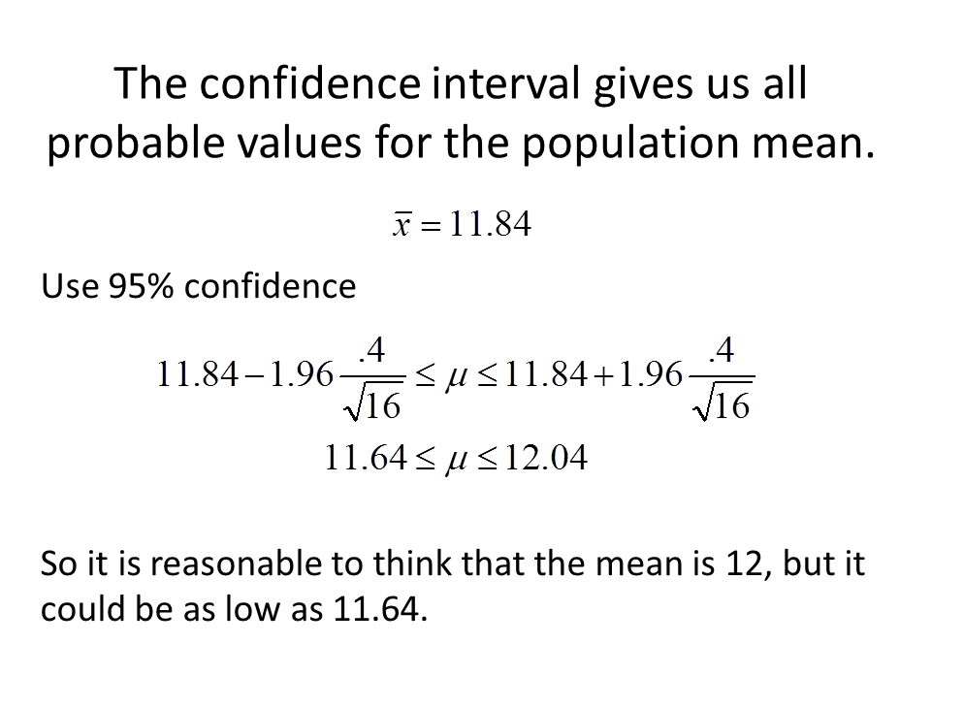

Potato Chips . . .
U

Slide 13
The confidence interval gives us all probable values for the population mean.
Use 95% confidence
So it is reasonable to think that the mean is 12, but it could be as low as 11.64.
Soooo . . . . . .any issues?

Slide 14
When n is large
The assumptions that the sample is drawn from a normal population and that the variance is known can be relaxed.
CLT allows us to regard the distribution of the sample mean as N(μ,σ²/n).
The sample variance s² can be regarded as an accurate estimator of σ².

Slide 15
When n is small
If we are able to assume that the data comes from a Normal distribution, then we can still make a confidence interval, but we have to adjust for the fact that the sample variance s² may be a poor estimate of σ².

Slide 16
Properties of t-distribution
Let t_{v} denote the density function curve for v degrees of freedom
Each t_{v} curve is bell-shaped and centered at 0.
Each t_{v} curve is more spread out than the standard normal (z) curve.
As v increases, the spread of the corresponding t_{v} curve decreases.
As v goes to infinity, the sequence of t_{v} curves approaches the standard normal curve

Slide 17
t critical value
t_{α,v}: the number on the measurement axis for which the area to the right of t_{α,v} under the t curve with v degrees of freedom is α.
Using t-table:
“To obtain t_{.025,15} go to the α=.025 column, look down to the v=15 row, and read t_{.025,15}=2.131. Similarly t_{.025,20}=2.086 (.05 column, v =20 row) and t_{.01,20}=2.528.”

Slide 18
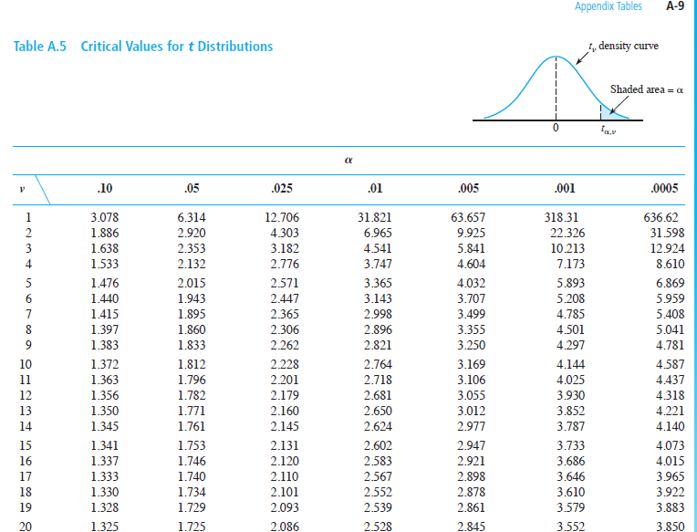

Slide 19
CI on population mean (when s used to estimate σ)
The individuals must be normal and i.i.d (at least approximately) to use t.

Slide 20
One-Sided Confidence Intervals
Sometimes only 1 confidence bound is needed.
Lower confidence bound
e.g., to ensure that the minimum design specification is met.
Upper confidence bound
e.g., to ensure that the maximum allowed level is not exceeded.

Slide 21
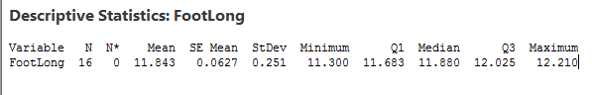
The confidence interval gives us all probable values for the population mean.
Use 95% confidence

Slide 22
What about my Sandwich?

Slide 23
Prediction Intervals (for a single future value, )

Slide 24
Prediction Interval Estimation
A 100(1-α)% prediction interval (PI) for a single independent random draw from the same distribution as x₍₁₎, x₍₂₎, ... x_{(n)} is a random interval [L,U] computed from sample data that will contain the x_{(n+1)} with probability 1-α. This probability is called the confidence level.

Slide 25
PI’s on single future value (s used to estimate σ)
If not normal and i.i.d., you could use the computer to create a prediction interval.

Slide 26
The prediction interval gives us all probable values for the next observation.
Use 95% confidence

Slide 27

But I am the manager at Subway.

Slide 28
Tolerance Intervals (for a selected proportion of all future values)

Slide 29
Tolerance Interval Estimation
A 100(1-α)% tolerance interval (TI) for capturing 100(1-γ)% of the distribution from which x₍₁₎, x₍₂₎, ... x_{(n)} were drawn is a random interval [L,U] computed from sample data that will contain 100(1-γ)% of the distribution with probability 1-α. This probability is called the confidence level.

Slide 30
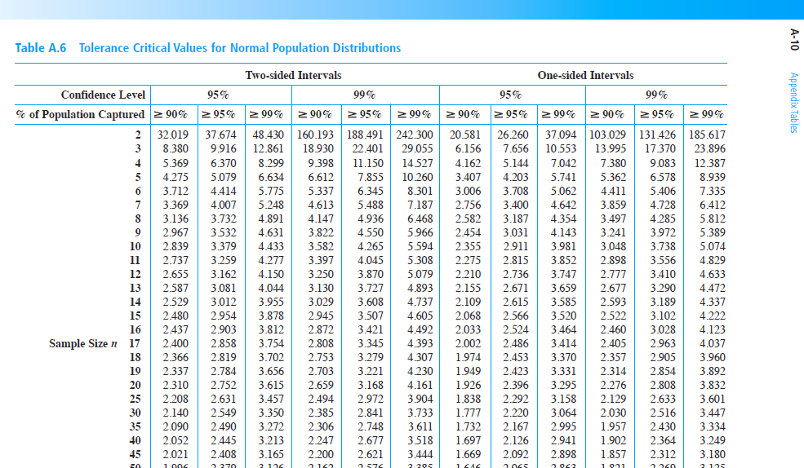
For Two-sided, 95% confidence for 90% of distribution.

Slide 31
TI’s for 100(1-γ)% of the distribution (s used to estimate σ)
If not normal and i.i.d., you could use the computer to create a tolerance interval.

Slide 32
The tolerance interval gives us all probable values for the individuals.
Use Two-sided, 95% confidence for 90% of distribution.
This is the most useful interval when thinking about a product or any other context where the individuals each matter.

Slide 33
The Confidence Interval
The Prediction Interval
The Tolerance Interval

