Slide 1
Confidence Interval for a Proportion

Slide 2
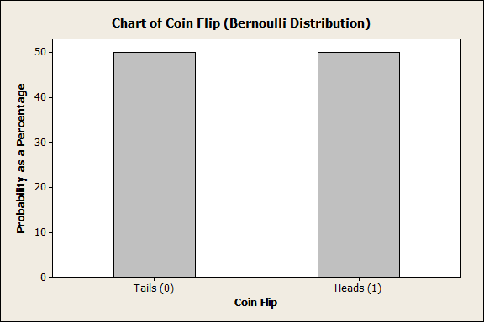
How would we find a “rigged coin”?
Our Theory: p=P(Heads)=0.5.

Slide 3
The Scientific Process of Learning
Data
Deduction
Induction
Deduction
Induction
Deduction
Hypothesis (p=0.5)
Need a CI to decide whether we have enough data to reject our Theory.

Slide 4
A Proportion
A sample proportion is a sample mean of Bernoulli random variables, X_{i}, with some value p=P(X =1).

Slide 5
Central Limit Theorem (C.L.T)
If X₁, X₂, …, X_{n} is an i.i.d. random sample of size n taken from population with mean μ and variance σ², and if is the sample mean, then the limiting form of the distribution of
is the standard normal distribution.
“For sufficiently large n, the sample mean has an approximately normal distribution as long as the population has a finite mean and variance.”

Slide 6
Sampling distribution of .
If n is large,

Slide 7
Sampling distribution of .
If n is large,
An approximate 100(1-α)% CI for p:

Slide 8
Sampling distribution of .
If n is large,
An approximate 100(1-α)% CI for p:

Slide 9
How would we find a “rigged coin”?

Slide 10
A Better Confidence Interval for p
Works for any n but is harder to compute by hand.

Slide 11
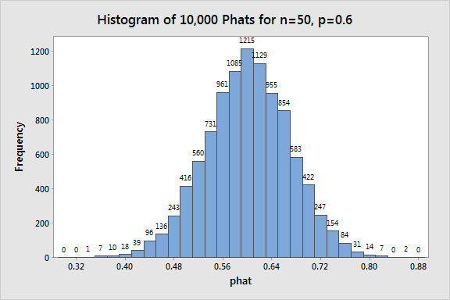
We can also create a CI using Simulation
250 phats
250 phats
95% of distribution (0.46, 0.73)

Slide 12
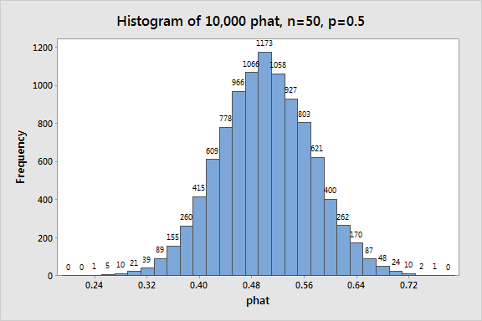
Another way to think about it.
250 phats
250 phats
95% of distribution

Slide 13
How Many?
To get an estimate of μ within 10 lbs?
You must have an estimate of variability!!
Usually use s from an initial sample.
Width of CI for estimate is 20 lbs.

Slide 14
How Many?
Want this to be 10 lbs.

Slide 15
How Many?
Need 34 more.

Slide 16
How Many?
To get an estimate of p within 3 percentage points?
You must have an estimate of variability!!
p=0.5 is worst case
Width of CI for estimate is 6 percentage points.

Slide 17
How Many?
Want this to be 3 percentage points.

Slide 18
How Many?
Notice it doesn’t depend on N.

