Slide 1
Hypothesis Testing

Slide 2
General steps for Hypothesis testing
From the problem context, identify the parameter of interest.
State the null hypothesis, H₀ involving an equality for the parameter of interest.
Specify an appropriate alternative hypothesis, H_{A}. (Must be mutually exclusive and collectively exhaustive with H₀.)
Choose a significance level α.
Compute a 100(1-α)% confidence interval for the parameter of interest.
H₀ should be rejected based if the confidence interval does not contain the hypothesized value in H₀. (This is statistical significance)
Decisions (like do we need more data?) should be made based on the practical importance not just the statistical significance.

Slide 3
Hypothesis testing on the mean - σ² known
Aircrew escape systems are powered by a solid propellant. Specifications require that the mean burning rate must be 50 cm/s. We know the standard deviation of burning rate is σ = 2.0 cm/s. The experimenter decides to specify the significance level at α = 0.05. He selects a random sample of n = 7 and obtains a sample average burning rate 51.3 cm/s. What conclusion should be drawn?

Slide 4
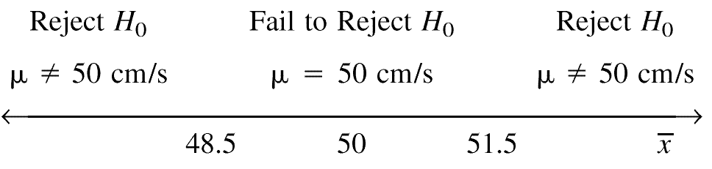
Testing Statistical Hypotheses with confidence intervals
H₀: μ = 50 cm/s
H₁: μ ≠ 50 cm/s
A 100(1-α)% confidence interval

Slide 5
Testing Statistical Hypotheses with confidence intervals
A 100(1-α)% confidence interval
H₀: μ = 50 cm/s
H₁: μ ≠ 50 cm/s
Acceptance Region
Critical values
critical region

Slide 6
Type I Error
Type I error - reject H₀ when it is actually true.
= P(Type I error) = P(reject H₀ when it is true)=P( is in the rejection region when )
- α: significance level of the test.
- 1 - α : confidence level of the test
To decrease α, we can increase the acceptance region or increase sample size.
Sampling Distribution of , when H₀ is true.
Accept H₀
Reject H₀ with probability α/2.
Reject H₀ with probability α/2.

Slide 7
Type II error
Type II error - fail to reject H₀ when it is false.
β = P(Type II error)
= P( fail to reject H₀ when it is false)
= P( is in the acceptance region when )
We need to have a particular alternative to find β.
Distribution of if

Slide 8
Type II error
Type II error - fail to reject H₀ when it is false.
β = P(Type II error)
= P( fail to reject H₀ when it is false)
= P( is in the acceptance region when )
We need to have a particular alternative to find β.
Distribution of if

Slide 9
Type II error
Type II error - fail to reject H₀ when it is false.
β = P(Type II error)
= P( fail to reject H₀ when it is false)
= P( is in the acceptance region when )
We need to have a particular alternative to find β.
Distribution of if

Slide 10
Power of a test
Power of a test
Probability of correctly rejecting a false null hypotheses
A measure of the sensitivity of the test
Power of a test = 1 - P(Type II error) = 1 - β
In general, if you decrease α, Type I error, then β, Type II error will increase unless you increase sample size.
P(Type II error if μ is 52) = 0.254
Power of the test if μ is 52 = 1-0.254 = 0.746

Slide 11
p - value
p-value – Can be used with any statistical test (even if you don’t know how the test works).
The smallest level of significance, α, that would lead to rejection of the H₀.
The observed significance level
If p-value ≤ α, reject H₀.
If p-value > α, do not reject H₀.
p-value: “The probability of your data or more extreme data yours being observed if the null hypothesis is true.”
How likely is data like mine if my theory (the null hypothesis) is correct?

Slide 12
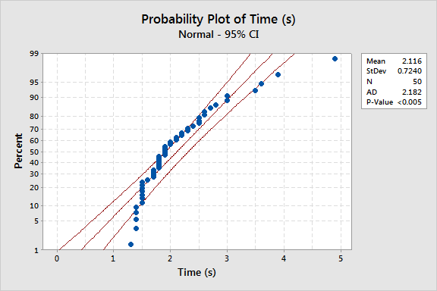
Null Hypothesis: Observations come from a Normal distribution.
An Anderson Darling Test for Normality
If p-value ≤ α, reject H₀.
If p-value > α, do not reject H₀.

Slide 13
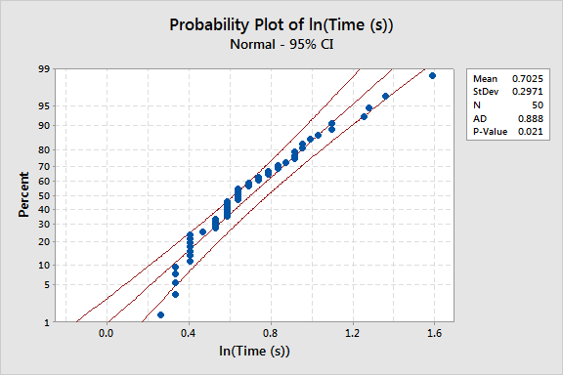
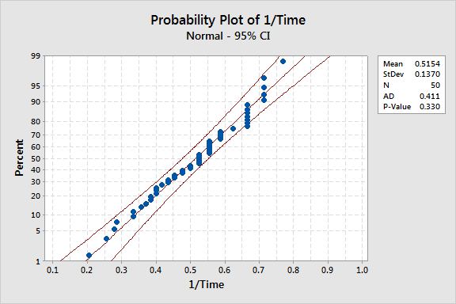
Null Hypothesis: Observations come from a Normal distribution.
An Anderson Darling Test for Normality
If p-value ≤ α, reject H₀.
If p-value > α, do not reject H₀.

Slide 14
Understanding p-values with confidence intervals
A 100(1-p)% confidence interval
H₀: μ = 50 cm/s
H₁: μ ≠ 50 cm/s
A 100(1-α)% confidence interval

Slide 15
Understanding p-values with confidence intervals
A 100(1-p)% confidence interval
Any CI greater with than 100(1-p)%= 91.46% confidence will not reject H₀, since we want 95% confidence.
Do not reject H₀.

