Slide 1


Masters Thesis Defense: Computation of Second Order Control Barrier Functions
Daniel Pietz
@

Slide 2
Formal methods in CS
A historical perspective
Wikipedia: “In computer science, specifically software engineering and hardware engineering, formal methods are a particular kind of mathematically based techniques for the specification, development and verification of software and hardware systems.”

Slide 3
What is a System?

Slide 4
What is a System?

Slide 5

What is a System?
Nonlinear Control Affine
$$\dot{x}=f\left(x\right)+g\left(x\right)u$$
where
$x ≔$ System state
$\dot{x} ≔$ System state rate of change
$f\left(x\right) ≔$ Natural Response
$g\left(x\right) ≔$ Control input map
$u≔$ Control Input

Slide 6

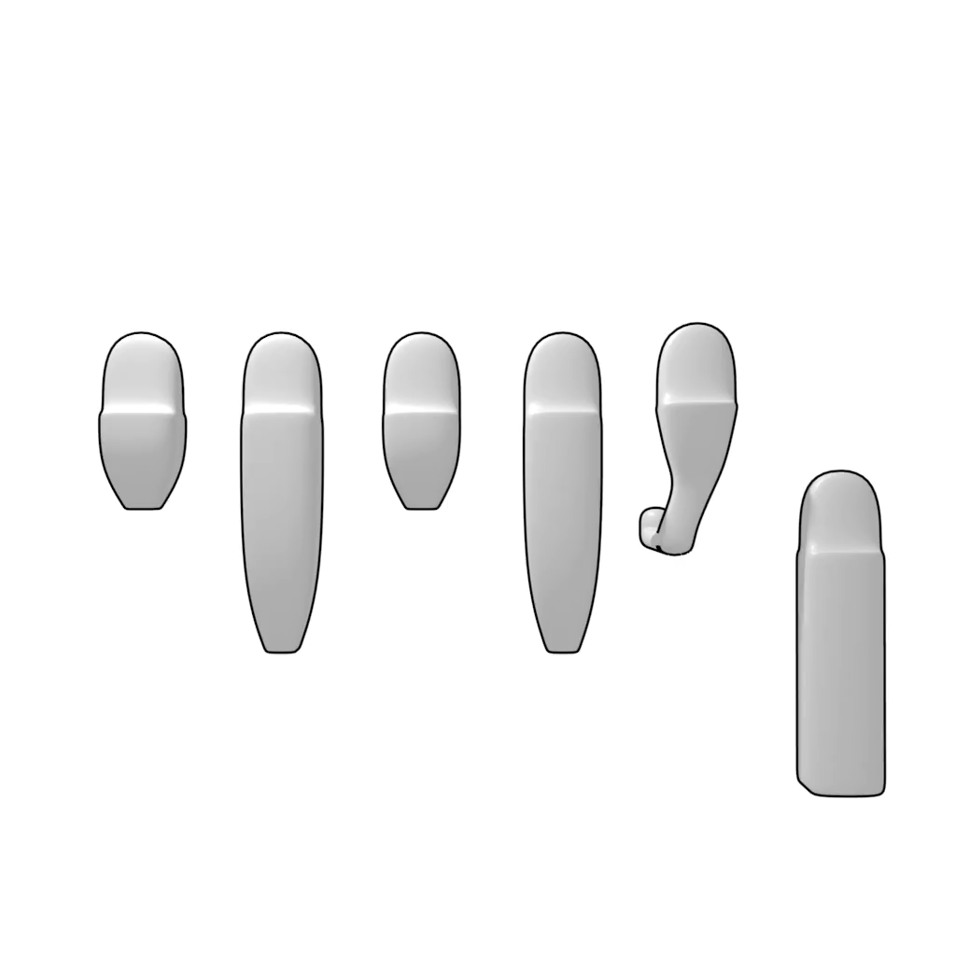
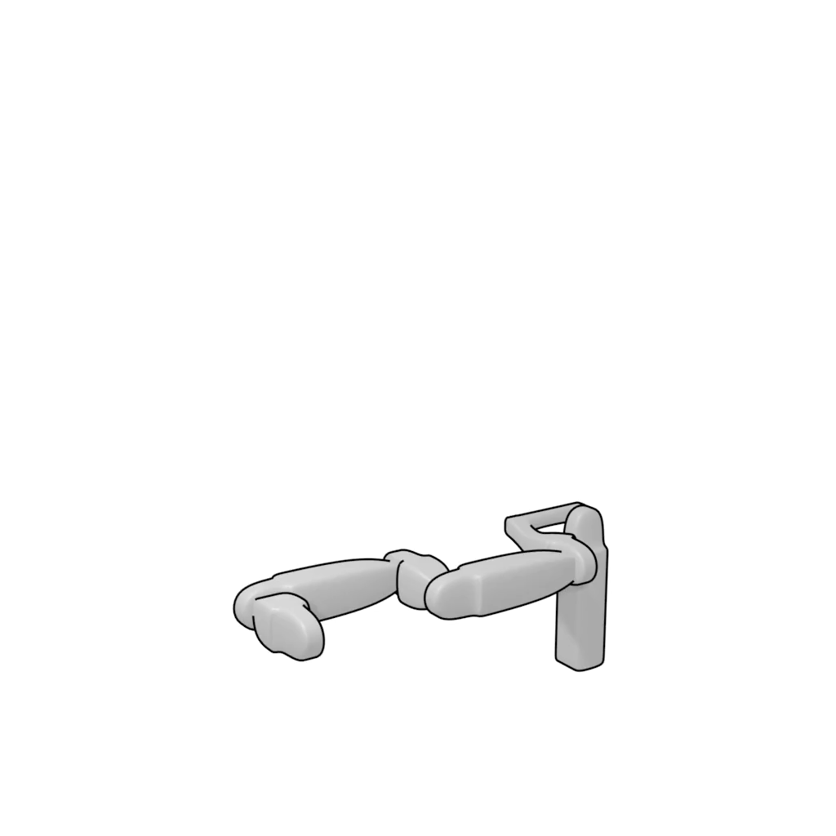
What is a System?
Rigid Open Kinematic Chain
Set of rigid bodies
Joined Together
Rotational and Translational Joints

Slide 7
What is a System?
Rigid Open Kinematic Chain

Slide 8
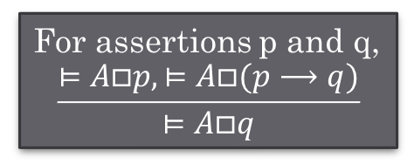
Logic & Deductive Reasoning
In two sentences: Use logic to model the system and the properties about the system. Use an axiomatic system for proving the properties.
Main benefit: Powerful
Main drawback: In general, cannot be fully automated, experts needed
Properties:
For all paths and for all time the system does not enter the deadlock state.
Whenever access is requested, then eventually it is granted.
For assertions p and q,
$$\frac{⊨A□p, ⊨A□(p⟶q)}{⊨A□q}$$
EMP (Entailment modus ponens)
Notes:
Notation from Pnueli & Kesten, Algorithmic and Deductive Verification Methods for CTL*, Models, Algebras and Logic of Engineering Software, IOS Press

Slide 9
Automata and Language theory
In two sentences: Model both the properties and the system as finite state machines. Use graph algorithms to prove properties or compute counter-examples (alternatively, compute plans or solve games)
Main benefit: Fully automated; used in practice e.g. NASA.
Main drawback: Primarily limited to systems with finite states
Environment/ Actions
Discrete Abstraction
∅, w₁₃
∅, w₁₄
∅,w₁
P₅,w₅
∅, w₁₂
“Product” Automaton
∅ w₆
P₄ w₄
∅ w₈
∅ w₁₁
∅
w₁₇
P₁₆ w₁₆
P₃ w₃
∅ w₉
Temporal Logic
Specification
Buechi Automaton
∅
w₂
∅, w₁₅
∅, w₇
∅, w₁₀

Slide 10

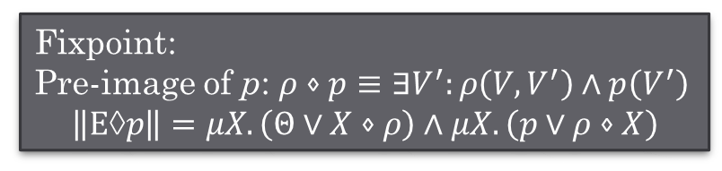
Logic & Symbolic Representation
In two sentences: Use logic to model the system and the properties about the system. Use fixpoint computations for proving the properties or synthesis.
Main benefit: Scales extremely well both in verification and synthesis
Main drawback: Applies only to finite state systems
Fixpoint:
Pre-image of p: $ρ⋄p≡∃V^{′}:ρ\left(V,V^{′}\right)∧p\left(V^{′}\right)$
$$\left\|E→p\right\|=μX.\left(Θ∨X⋄ρ\right)∧μX.\left(p∨ρ⋄X\right)$$
Assumptions about the environment
Desired robot behavior

Slide 11
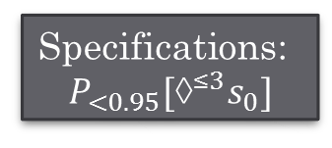
Probabilistic Model Checking
In two sentences: Model the system as a Markov Decision Process (or Chain). Use a combination of matrix multiplications, linear system solutions, and linear optimization to verify probabilistic properties.
Main benefit: Fully automated
Main drawback: Limited properties; Limited to systems with finite states and actions
a, 1
a, 1
Specifications:
$$P_{<0.95}[→^{≤3}s_{0}]$$
s₀
s₁
s₂
a, 0.7
a, 0.3

Slide 12
Academic Tools (Sample)
Model Checking:
NuSMV, SPIN
Theorem Proving:
PVS, HOL
Probabilistic:
PRISM
Synthesis:
?
? The jury is still out: keep track of the synthesis competition: http://www.syntcomp.org/

Slide 13
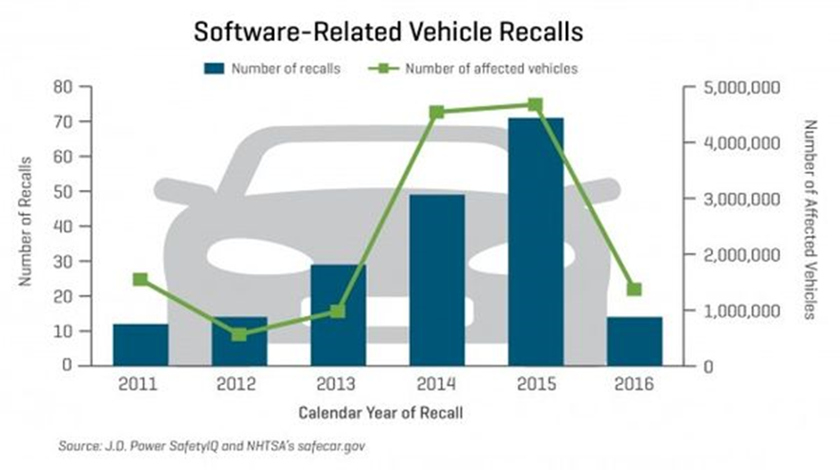
Correctness in CPS: How serious is this problem?
The same holds for the medical device industry!

Slide 14
Moving from finite to hybrid systems
Main problem of concern: Proving that a system is safe (Reachability analysis)

Slide 15
Success story: Extending Automata with Time
Introduce clock variables
Interesting observation: Many problems can use algorithmic solutions for finite state systems
Prove real-time properties of timed systems
Solve timed games
Tools: UPPAAL (www.uppaal.org/)
active
ξ₁:=0
ξ₂:=0
ξ₁=3/ awake
ξ₁:=0
ξ₁=2/expired
sleep
0ξ₁<2
/starting
ξ₂:=0
error
execute
ξ₁=2/expired
0<ξ₂<1/ finished

Slide 16
Beyond timed systems: Linear hybrid systems
Hybrid systems with affine dynamics in each mode of operation
Solve the bounded-time reachability problem
Depending on the structure of the discrete space the tools can handle very large continuous state spaces (continuous variables)
Tools: SpaceEx (http://spaceex.imag.fr/) Hylaa (http://stanleybak.com/hylaa)
Zonotope based reachability analysis

Slide 17
Hybrid System Reachability Analysis: Connections with computational geometry
G
X₀
X₁
X₂
 | Polyhedra |  | Ellipsoids | Zonotopes | Support Fun.
Operation | m constraints | k vertices | n x n matrix | k generators
Convex Hull | exp | 2k | approximate | approximate | O(1)
Minkowski Sum | exp | k² | approximate | 2k | O(1)
Linear Map | m / exp | k | O(n³) | k | O(n²)
Intersection | 2m | exp | approximate | approximate | approximate

Slide 18
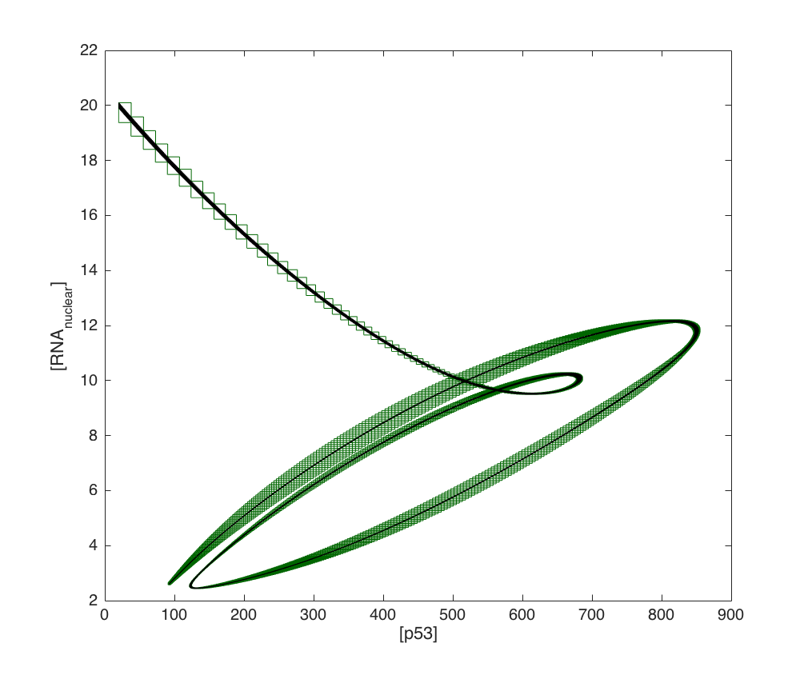
Beyond linear hybrid systems: non-linear
Hybrid systems with non-linear dynamics in each location
Solve the bounded-time reachability problem
Depending on the structure of the discrete space the tools can handle very large continuous state spaces (continuous variables)
Tools (each based on different theory): Flow* (https://flowstar.org/) C2E2 (https://publish.illinois.edu/c2e2-tool/) dReach (http://dreal.github.io/dReach/)
Image from Flow* example

Slide 19
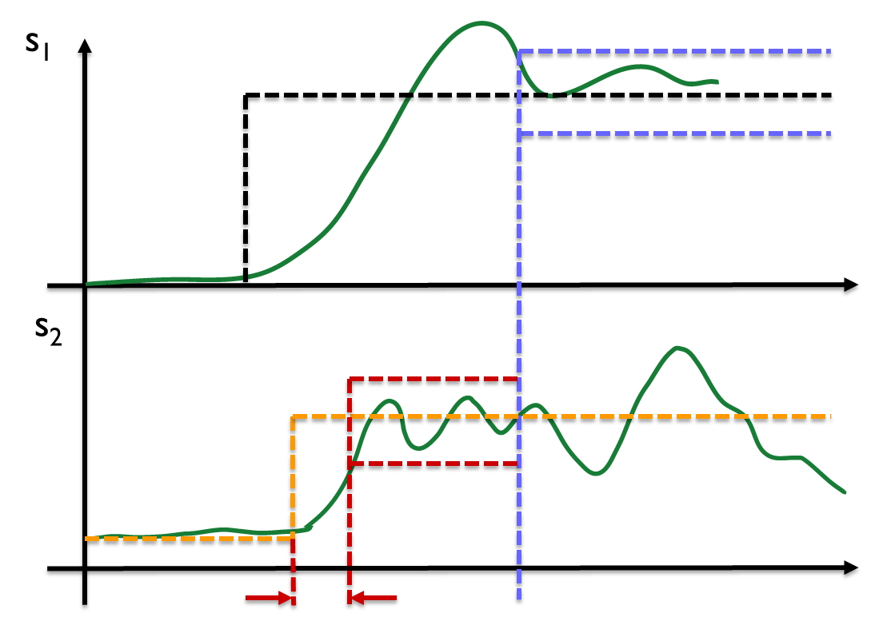
Formal specifications, but best effort methods
Many industrial size models have complex structure not handled by current tools for both theoretical and technical reasons
Current reachability methods cannot handle complex real-time space-time requirements
Specification guided methods provide a viable alternative
Tools S-TaLiRo (https://sites.google.com/a/asu.edu/s-taliro/home) BREACH (http://people.eecs.berkeley.edu/~donze/breach_page.html)
Specification*: When ORANGE event happens after the BLACK EVENT, signal s₂ should stabilize in the RED region within x time units. Signal s₂ should only stay in the RED region only until signal s1 has stabilized in the BLUE region.
* Adopted from Bosch requirements: Roehm et al: Industrial Examples of Formal Specifications for Test Case Generation, ARCH 2015

Slide 20
Academic Tools (Sample)
Reachability analysis:
SpaceEx, Hylaa, C2E2, Flow*, dReach
Theorem Proving:
KeYmaera
Probabilistic & Best Effort:
PRISM, UPPAAL, S-TaLiRo, BREACH
Synthesis:
TuLiP, Pessoa, LTLMoP

Slide 21
Summary

Slide 22
Spectrum of Analysis Techniques
Can apply to real designs? (scalability)
Software Testing
Control Theory Techniques
Program Analysis
Formal Verification
Simulation
Ideal technique
Specification Guided Test Generation
Linear Analysis (numerical)
Test Vector Generation for Model Coverage
Unexplored Frontier
Concolic
Testing
Linear Analysis (symbolic)
(Bounded) Model Checking
Stability
Proofs
Theorem
Proving
Reachability
Analysis
How formal/exhaustive?
[Slide adapted from slides by Kapinski, MBD, Toyota]

Slide 23
Review – Questions by organizers
How hybrid systems are interpreted in your field?
Through a formal model and a formal correctness requirement: either verify the requirement against the model, or synthesize a correct model from the requirement
What are key problems your field thinks about?
Computational geometry; Scalability issues; Modeling issues; Black- or Gray-box models
What are some problems that you view as solved?
Problems related to timed automata and low dimension general hybrid systems
What are some problems that you view as not solved but important?
Automatically proving complex real-time properties of large scale hybrid non-linear systems (possibly stochastic or non-deterministic); easy to use tools by non-expert users
What is a technical idea that might be powerful and general enough that it might be of use by others?
Reachability analysis tools as a tool of choice replacing simulation based analysis
High level specification formalisms for time domain properties: There can be applications to both hybrid system analysis and synthesis

