Slide 1
Predicting Monthly Game Releases on Steam
Daniel Son

Slide 2

Why a Steam Dataset?
I have always loved video games, and Steam is considered the golden standard of game launchers.
Understanding trends overtime on the platform can provide insights into industry growth as a whole.
In particular, this dataset was fairly large, with over 27,000 games and it was fairly well preprocessed.

Slide 3
Why Time Series?
I have an understanding of basic statistical models like linear regression, logistic regression, decision trees.
I wanted wanted to expand my knowledge by learning time series modeling.

Slide 4
Goal: Use time series forecasting to predict how many games would be released between 2019 to 2024, and compare to actual data from that time period.

Slide 5
Key Questions:
How have game releases on Steam changed over time?
Can we predict future trends in game releases?
Which forecasting model works best for this type of data?

Slide 6
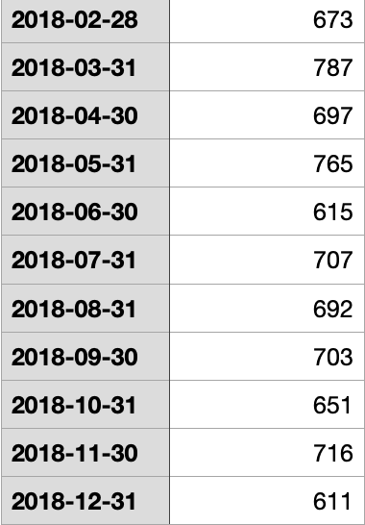
Preprocessing Data
Updated csv example:
I ended up using only two out of the 18 columns of the dataset: release_date and appid.
release_date: used to aggregate monthly game releases.
appid: used to count the number of unique games released per month.
I converted all dates to the proper datetime format.
The dataset was created May 2019, so I filtered to only include games released before 2019-01-01.
This was so yearly data would not be skewed for 2019, which would only have four months worth of data.

Slide 7
01
First Approach: Yearly

Slide 8
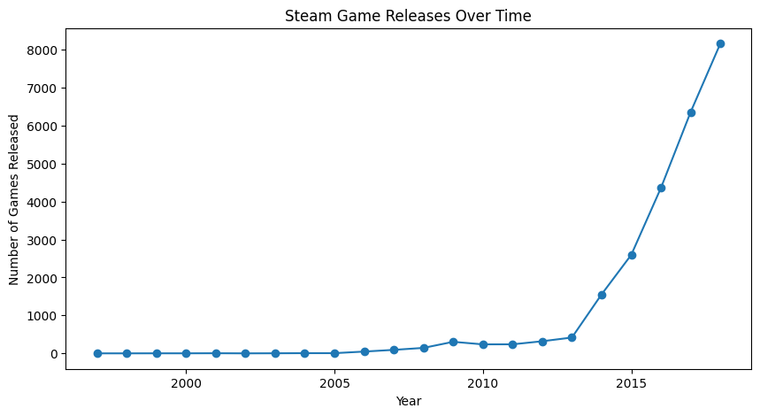
Steam Game Releases by Year (1997-2018)

Slide 9

Initial Thoughts:
The graph exhibits a clear upwards trend.
I initially thought that this may be exponential growth, as there is a massive spike from 2013 onwards.

Slide 10
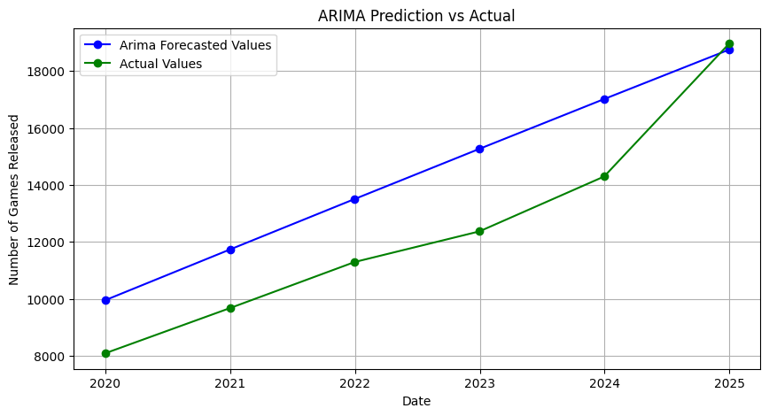
First Model: ARIMA

Slide 11
ARIMA
ARIMA stands for:
AutoRegression (AR): Predicts future values based on a linear combination of past values.
Integration (I): Differencing is applied to make the data “stationary”, removing trends and stabilizing the mean over time.
Moving Average (MA): Corrects predictions by modeling the relationship between past forecast errors and future values.

Slide 12
The Issue:
ARIMA assumes that the data is stationary, meaning that there is not a consistent trend in the data.
ARIMA requires the data's mean and variance to remain constant over time.
The yearly Steam game releases clearly show consistent growth over time, so the data is not stationary.

Slide 13
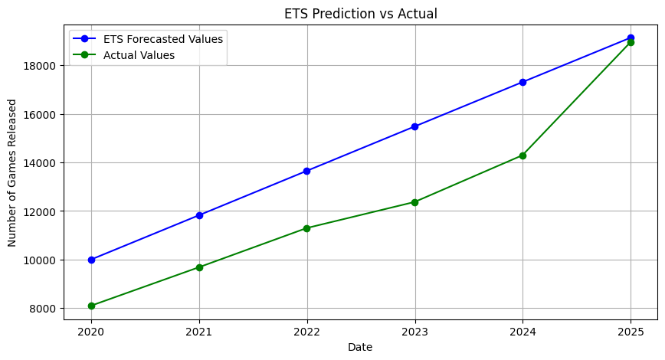
Second Model: ETS

Slide 14
ETS
ETS stands for Error, Trend, Seasonality
It predicts future values by breaking down a time series those three parts.
Error (E): This represents the random variation or noise in the data that can’t be predicted.
Trend (T): This captures the overall direction of the data over time, whether it’s going up, down, or staying flat.
Seasonality (S): This identifies repeating patterns or cycles, such as increases during certain months or seasons.

Slide 15
The Issue:
ETS assumes that trends are either additive or multiplicative.
Because of the sudden surge of game releases between 2010 and 2013, it either underestimated the growth, or way overshot it (not depicted)
Yearly data provides very few observations, making it harder for ETS to detect subtle changes in trends or seasonality.

Slide 16
Overarching Problems
Measuring yearly releases does not provide enough data.
Time series models rely on patterns over many periods, so they were not very effective at forecasting future years.
Time series models use seasonal patterns to recognize trends; the lack of data makes this difficult.
The almost exponential growth from 2012-2013 onwards is difficult to capture with such little data points.
Because of these factors, both time series models we tested ended up predicting linear growth, which is not what we want.

Slide 17
TLDR: There was not enough data to create an accurate prediction/forecast.

Slide 18
01
Second Approach: Monthly

Slide 19
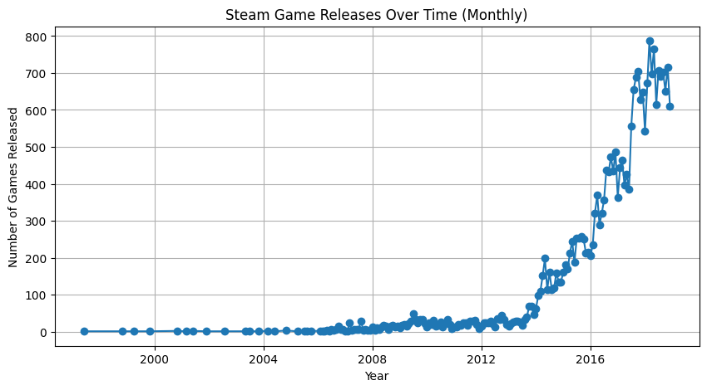
Steam Game Releases by Month (1997-2018)

Slide 20
The Solution: Monthly Data
Using monthly data as data points provided numerous benefits:
There were almost 12x more data points compared to the yearly data, fixing our biggest issue.
Monthly data highlights short-term fluctuations, like spikes in game releases during holidays or specific months, or seasonality.
Seasonality is a very important factor for the models we are using.

Slide 21
Changes
Actual Release Numbers
Models
Switching to monthly data allowed for better trend analysis and improved model accuracy, but I had to adjust the data I was comparing the prediction to accordingly. This data was much harder to find than expected, and I ended up having to hard code the values into an array.
With a greater understanding of which factors are important for which models, I adjusted the models I would use for prediction accordingly, utilizing variations of the first two models and a completely new model for the third.

Slide 22
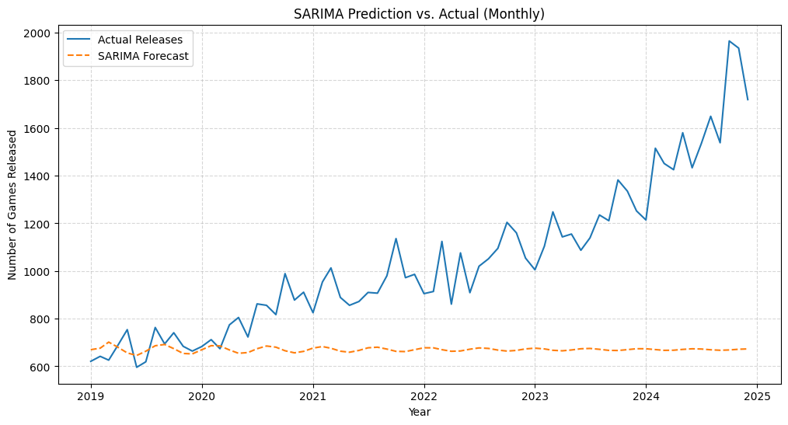
First Model: SARIMA

Slide 23
SARIMA
Very similar to ARIMA, but now takes into account seasonal patterns (e.g., annual or monthly cycles).
This pairs well with our monthly data, where there is clearly a recurring pattern of ups and downs.

Slide 24
The Issue:
Exponential Growth: Similarly to the original ARIMA, it struggled with accounting for the rapid, nonlinear increase in game releases over time.
Parameter Fine Tuning: Out of all the models, SARIMA requires the most overhead in regards to fine-tuning; this is very time consuming, and I did not have enough time or expertise regarding the inner workings of the model to achieve a desired level of performance.

Slide 25
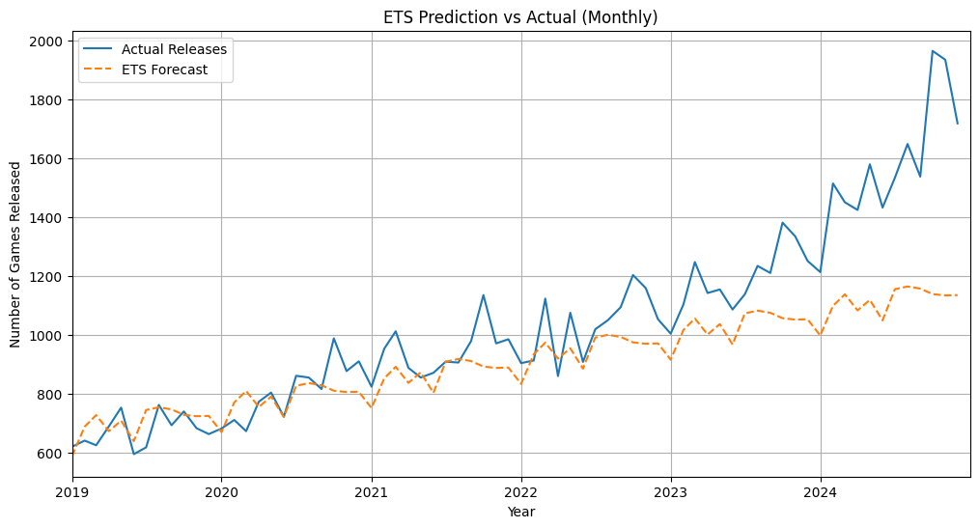
Second Model: ETS

Slide 26
ETS
I used this model before on our yearly data; however, I was able to achieve much better performance using the monthly data.
Here, I used an additive trend and seasonality
Because of the increased number of data points, ETS did a very good job at predicting the trend in releases from 2019 to 2022.
However, due to the additive trend, the number of releases increased at a slightly higher rate and began outscaling the predictions.
The further the model forecasts into the future, the further the gap.

Slide 27
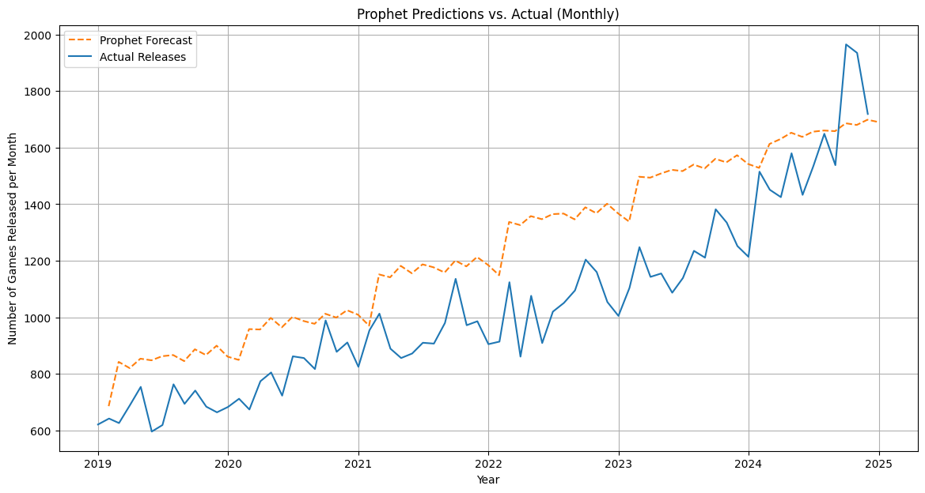
Third Model: Prophet

Slide 28
Prophet
Similarly to ETS, Prophet achieved high performance using the monthly data; however, it overestimated the growth as opposed to underestimating it.
Prophet is designed to handle data with trends, as opposed to models like ARIMA.
This complemented our dataset very well, which exhibited consistent growth.
Similarly to ETS and SARIMA, Prophet automatically identifies and adjusts for seasonal patterns.

Slide 29
Conclusion:
ETS
SARIMA
Prophet
Accurately modeled stable growth and seasonality but underestimated sharp increases.
Overall good performance.
Captured very short-term trends well but struggled with non-linear growth.
Overall poor performance.
Handled long-term trends and seasonal patterns while adapting to irregularities.
Overall best performance.

Slide 30
Struggles
I did this entire project in a short period of time; I set out to challenge myself and learn something new, but I had to cut corners so I could have some sort of insight by the deadline.
I had to constantly reference external tools and resources constantly because working with time-series models was a new domain of interest.
While I was able to get the models running, my actual code was very messy because I was constantly experimenting and debugging my code; I had to clean up my workspace after I finished everything.

Slide 31
Future Directions
Test Different Models
Fine Tune Parameters
There are many other time series models out there that may perform better at predicting game releases.
Models like ARIMA and SARIMA overall did not perform as well as their counterparts, but part of that was due to my lack of time to fine-tune.
Genre Trends
Test Different Timeframes
I wanted to initially explore trends for released games overall, and then released games by genre, to see which genres grew the most. However, just exploring the overall trends was much harder than I expected.
Using data regarding Steam game releases from a smaller time frame, for example, 2012 onwards, may help the models predict; earlier data is very sparse, and may make be skewing the data.

Slide 32
Thanks!
Do you have any questions?
danieljson15@gmail.com
+1 571 666 2464
Please keep this slide for attribution

