Slide 1
Hierarchical Bayesian Parameter Estimation

Slide 2
Memory Retention

Slide 3
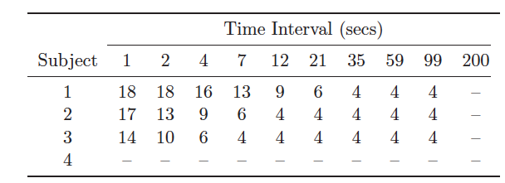
Memory Retention
Typical task:
study a list of items
Recall as many items as you can (tested at different times)
Data from Rubin et al. (1999)
Tested on 18 items at 10 time intervals
Missing data

Slide 4
Exponential Decay Model
The probability that an item will be remembered after a period of time t has elapsed is
Rate of decay of information
Baseline level of remembering

Slide 5
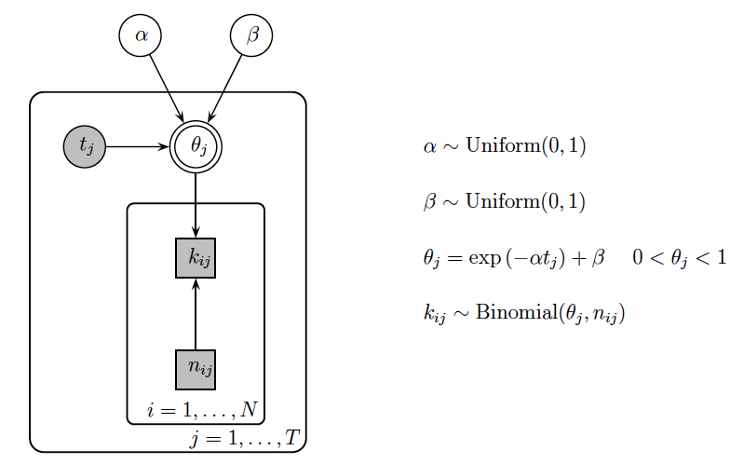
Graphical Model (No Individual Differences)
Same decay rate and baseline for all people
Different rate for each time interval, but same for all people
Time interval
Number of items recalled
Number of items (i.e., 18)

Slide 6
Code
model{
# Observed and Predicted Data
for (i in 1:ns){
for (j in 1:nt){
k[i,j] ~ dbin(theta[i,j],n)
predk[i,j] ~ dbin(theta[i,j],n)
}
}
# Retention Rate At Each Lag For Each Subject Decays Exponentially
for (i in 1:ns){
for (j in 1:nt){
theta[i,j] <- min(1,exp(-alpha*t[j])+beta)
}
}
# Priors
alpha ~ dbeta(1,1)
beta ~ dbeta(1,1)
}
Fits to observations
Posterior predictive

Slide 7
Exercise
Draw the graphical model assuming full individual differences

Slide 8
Solution: Full Individual Differences

Slide 9
Exercise
Implement the full individual differences model

Slide 10
Solution: Side by Side Comparison of Code

Slide 11
What about Participant 4?
The weakness of the full individual differences model is evident in its predictions for Subject 4
Because each subject is assumed to have their own parameters, the only information the model has about the new subject are the priors for alpha and beta
Intuitively, we might predict that Subject 4 will have parameters represented by some sort of average of Subjects 1-3

Slide 12
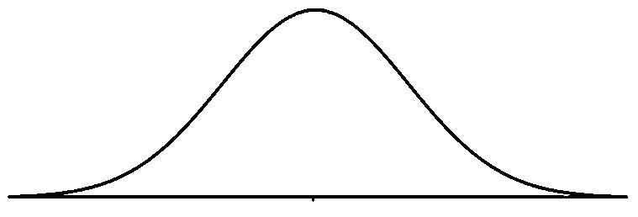

Hierarchical Modeling
Prior
Prior

Slide 13
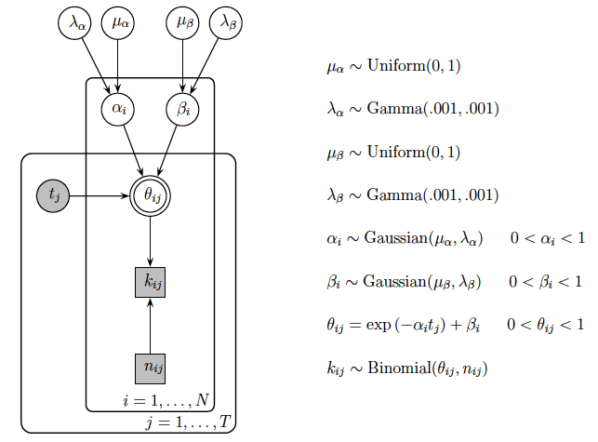
Graphical Model (Structured Individual Differences)
Group level rates and baselines
Different decay rate and baseline for each person

Slide 14
Priors on Standard Deviations
JAGS parameterizes the Gaussian distribution in terms of the mean and precision, not the mean and variance
Precision: λ = 1/σ²
Setting priors on standard deviations is tricky
Two ways:
Set a uniform prior on σ and then calculate λ
Set the prior directly on λ

Slide 15
Comments on the Gamma Distribution
Gamma: dgamma(r, lambda)
r = shape, lambda = rate
Variance is dependent on change of scale
Gamma(0.001, 0.001) prior on precision parameters is motivated by scale invariance arguments (i.e., changing the measurement scale of the data does not affect inference)
Notes:
Blue: r = lambda = .1
Red: r = lambda = .001

Slide 16
Side by Side Comparison of Code
Full Differences
Structured Individual Differences
model{
# Observed and Predicted Data
for (i in 1:ns){
for (j in 1:nt){
k[i,j] ~ dbin(theta[i,j],n)
predk[i,j] ~ dbin(theta[i,j],n)
}
}
# Retention Rate At Each Lag For Each Subject Decays Exponentially
for (i in 1:ns){
for (j in 1:nt){
theta[i,j] <- min(1,exp(-alpha[i]*t[j])+beta[i])
}
}
# Priors For Each Subject
for (i in 1:ns){
alpha[i] ~ dbeta(1,1)
beta[i] ~ dbeta(1,1)
}
}
model{
# Observed and Predicted Data
for (i in 1:ns){
for (j in 1:nt){
k[i,j] ~ dbin(theta[i,j],n)
predk[i,j] ~ dbin(theta[i,j],n)
}
}
# Retention Rate At Each Lag For Each Subject Decays Exponentially
for (i in 1:ns){
for (j in 1:nt){
theta[i,j] <- min(1,exp(-alpha[i]*t[j])+beta[i])
}
}
# Parameters For Each Subject Drawn From Gaussian Group Distributions
for (i in 1:ns){
alpha[i] ~ dnorm(alphamu,alphalambda)T(0,)
beta[i] ~ dnorm(betamu,betalambda)T(0,)
}
# Priors For Group Distributions
alphamu ~ dbeta(1,1)
alphalambda ~ dgamma(.001,.001)T(.001,)
alphasigma <- 1/sqrt(alphalambda)
betamu ~ dbeta(1,1)
betalambda ~ dgamma(.001,.001)T(.001,)
betasigma <- 1/sqrt(betalambda)
}

Slide 17
Revisiting Signal Detection Theory

Slide 18
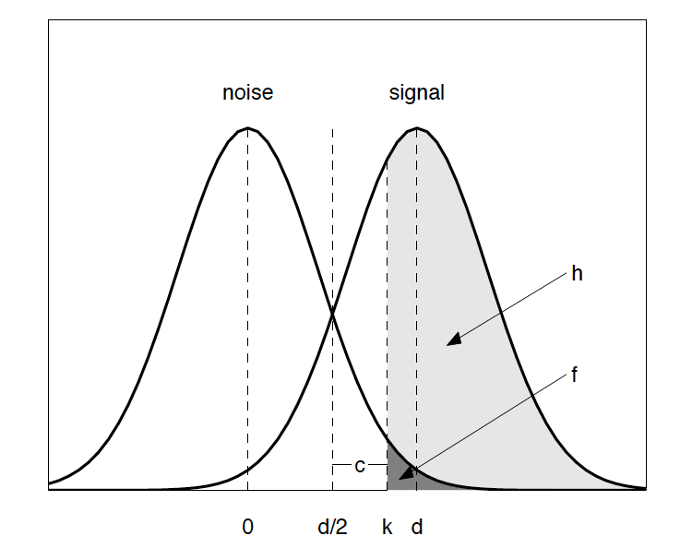
Equal-variance Gaussian Signal Detection Theory Framework
mean of noise = 0
d = discriminability (the distance between the means of the signal and noise distributions)
d/2 = criterion value at which both signal and noise distributions are equally likely
k = actual criterion used for responding
c = distance between k and d/2
Hit rate
FA rate

Slide 19
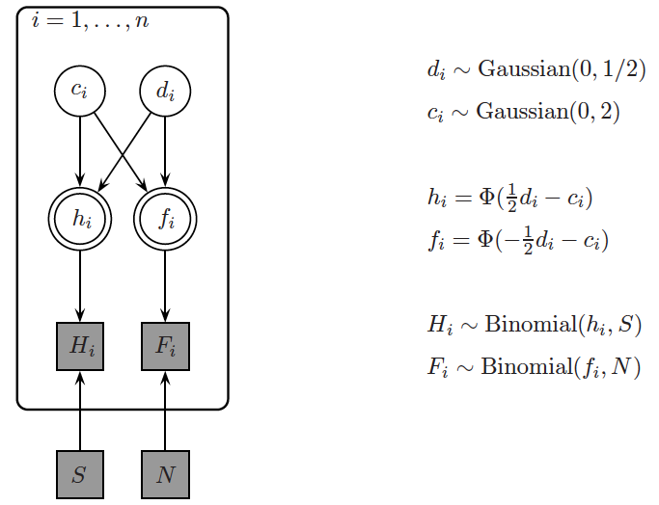
Graphical Model
Number of datasets (e.g., different groups of people)
SDT bias parameter
SDT discriminability parameter
False alarm rate
Hit rate
Number of hits
Number of false alarms
Number of signal trials
Number of noise trials
Notes:
f_i: the area from d/2+c to inf. Because of symmetry around 0, this is the same as the area from –inf to -(d/2+c), which is given by the CDF
h_i: first shift the distribution to have mean 0 by subtracting d. Then, h_i is the area from (d/2+c) –d to inf (i.e., -d/2+c). Because of symmetry around 0, this is the same as the area from –inf to –(-d/2+c), which is –inf to d/2-c

Slide 20
Hierarchical SDT
Previously we modeled group data
A hierarchical extension of the basic STD model will allow us to model individual differences
The idea is that different subjects have different discriminabilities and biases that are drawn from group-level Gaussian distributions

Slide 21
Exercise
Draw the graphical model for the hierarchical extension of SDT

Slide 22
Solution: Graphical Model

