Slide 1
Choice Response Time Models

Slide 2
Overview
Preliminaries
Brief History of Response Time
Uses of Choice Response Time Models
Theoretical Models of Decision Making
Decision Component of Other Theoretical Models
Measurement

Slide 3
Preliminaries

Slide 4
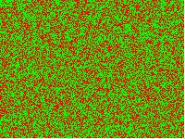


Speeded Choice Tasks
Every trial, we observe a choice and a response time

Slide 5
Data
Want to model every response time and every choice
Care about
Distribution of response times
Proportion of correct and incorrect responses

Slide 6
Plotting Data

Slide 7
History of Diffusion Models

Slide 8
Early Work
Stone (1960) proposed random walk model
Produces positively-skewed distribution of response time
Laming (1968) and Link & Heath (1975) proposed that start-point of evidence changes from trial-to-trial
Produces fast incorrect responses (relative to correct responses)

Slide 9
The Beginning of an Empire
Ratcliff (1978) proposed that accumulation rate varies from trial-to-trial
Captures incorrect responses that are slower than correct responses
Ratcliff (1998) combined both start-point and drift-rate variability

Slide 10
The “Full” Diffusion Model
Ratcliff & Tuerlinckx (2002) proposed variability in non-decision time
Allows the model to predict that the fastest responses can differ

Slide 11
Revisit code for choice response time models
Open diff.r
Familiarize yourself with this code
Find the differences between rw.r and diff.r
Implement between-trial variability in
Start-point
Drift-rate
Non-decision time

Slide 12
Theoretical Models of Decision Making

Slide 13
Full Diffusion

Slide 14
Leaky Competing Accumulator
Usher & McClelland (2001)
Accumulator for each response
Decay in accumulation
Inhibition between accumulators

Slide 15
Collapsing Bounds
Threshold for responding decreases over time
Adapt diff.r to implement collapsing bounds (linear)

Slide 16
Time-Varying Drift Rates
Threshold for responding decreases over time
Adapt diff.r to implement non-stationary drift rates (one switch point)

Slide 17
Lots of these

Slide 18
Decisions in Other Models

Slide 19
Predicted Probability of Response
Most models of cognitive tasks predict the probability of responses
Often model the observed proportion of correct responses as Binomial or Bernoulli
Can think of diffusion models as providing an alternative method for generating a response
Also allows us to model response time!

Slide 20
GCM

Slide 21
GCM + Random Walk (EBRW)

Slide 22
Lots of These
E.g.,
Brown, Marley, Donkin & Heathcote (2008)
Donkin, Nosofsky, Gold & Shiffrin (2013)
Kent & Lamberts (2005)
Fific, Little & Nosofsky (2010)
Hockley & Murdock (1987)

Slide 23
Measurement

Slide 24
Models as measurement tools
Bob
correctly detects signal on 75% of trials (h=0.75)
Incorrectly detects signal on 30% of trials (f=0.3)
Joe
h = 0.65, f = 0.2
Signal Detection Model
Bob d’ of 1.199
Joe d’ of 1.227
Notes:
Joe is better…
Our measurements are a way of getting at a latent ‘thing’ that we care about….we make that link through a model

Slide 25
Choice RT Models as measurement tools
Group 1 takes 1,000 ms to do a task (on average)
Group 2 takes 500 ms to do a task (on average)
Group 1 makes errors on 5% of trials
Group 2 makes errors on 15% of trials
Which group is better?

Slide 26
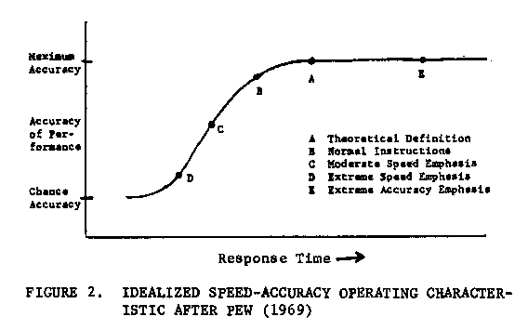
Speed-Accuracy Trade-off
Accuracy and RT both measures of ‘latent’ ability
But they trade-off
Need some way of measuring ability, taking into account caution (and bias)

Slide 27
Diffusion Models as Measurement
Drift rate
Performance
Threshold
Caution
Start-point
Bias
Non-Decision Time
Other Stuff

Slide 28
Ratcliff, Thapar & McKoon (2004)
Observe general slowing in RT with age
Is this because older people are ‘worse’? (Salthouse general slowing)
Have younger and older participants do the same task
e.g., Recognition memory
Fit RT distributions with diffusion model
What parameters differ between older and younger participants?

Slide 29
Ratcliff, Thapar & McKoon (2004)

Slide 30
Ratcliff, Thapar & McKoon (2004)

Slide 31
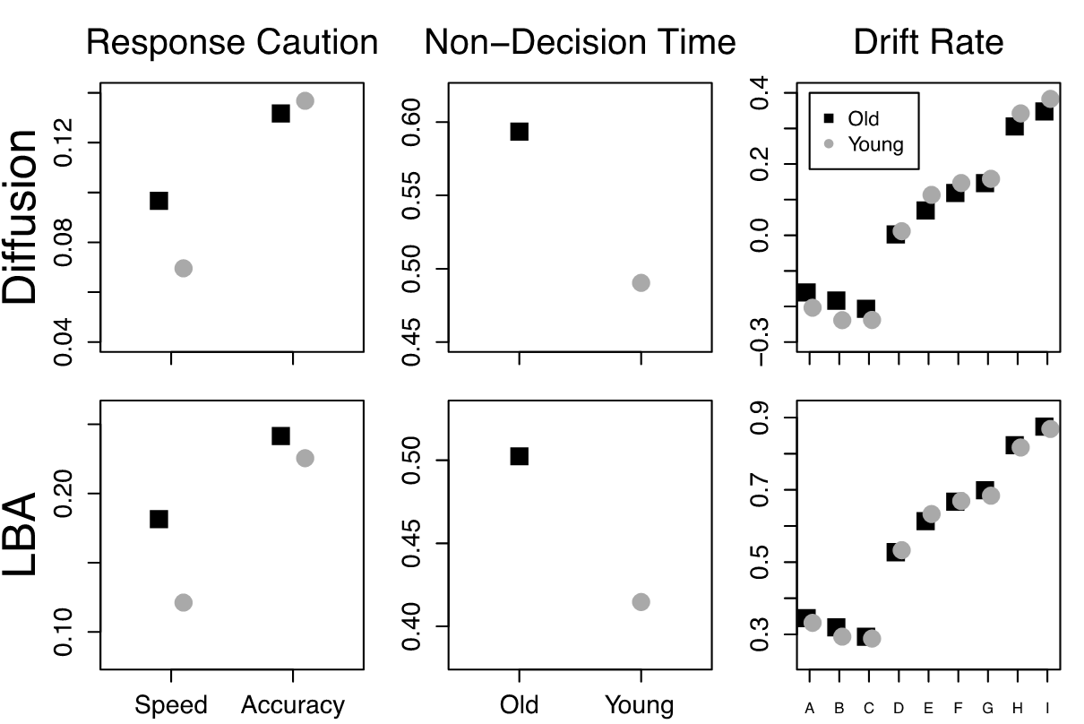
Ratcliff, Thapar & McKoon (2004)

Slide 32
Diffusion Models as Measurement
Lexical Decision task
Effects of fatigue and practice
Effects of alcohol
IQ
Anxiety/Depression
Parameters can be correlated with brain signals
e.g., locate area of brain associated with setting response caution

Slide 33
Other Measurement Models
LBA
EZ diffusion

Slide 34
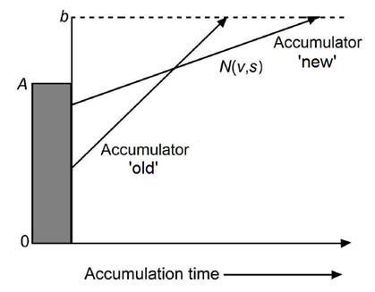
Linear Ballistic Accumulator

Slide 35
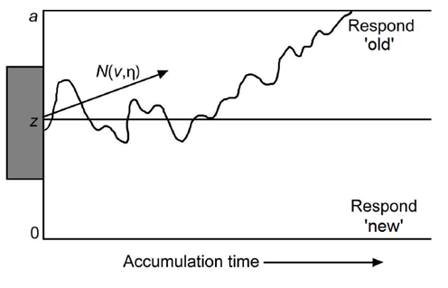
Primary Parameters
Both models have
Rate of information accumulation
Response Caution
Non-Decision Time
Diffusion
v
a
T_{er}
LBA
v
b-A/2
T_{er}

Slide 36
Cross Fitting Study
Simulate data from one model and fit with the other model.
Choose one model.
Set all parameters at default values.
Choose one parameter and
Identify 250 values which span observed range.
Simulate a data set for each value.
Fit each of those 250 data sets with the other model.
Repeat for all parameters and for both models.

Slide 37
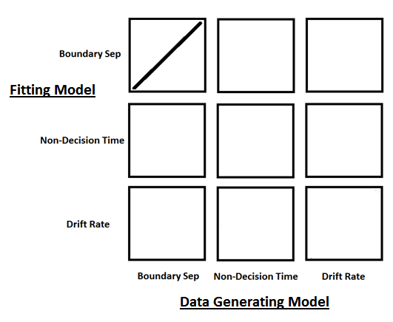
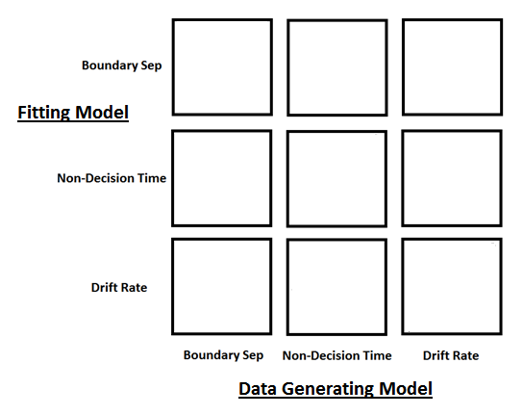
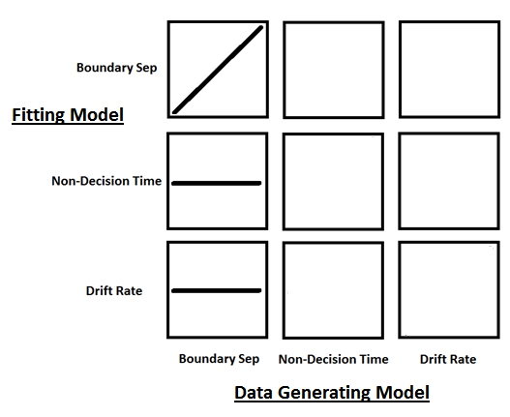
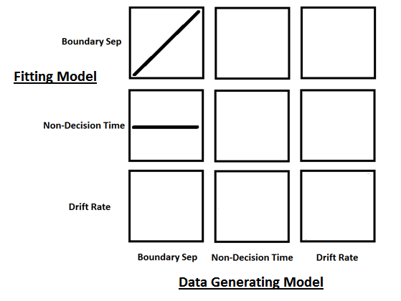
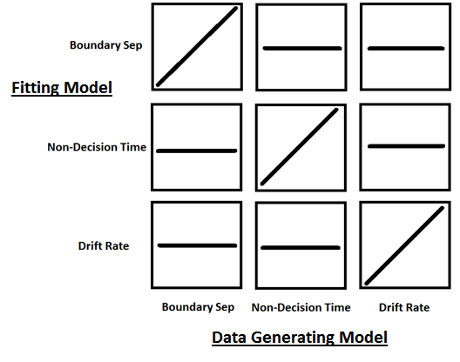
Selective Influence
If parameters in our models map appropriately to each other then changing a parameter in one model will cause a comparable change in only the same parameter of the other model.

Slide 38
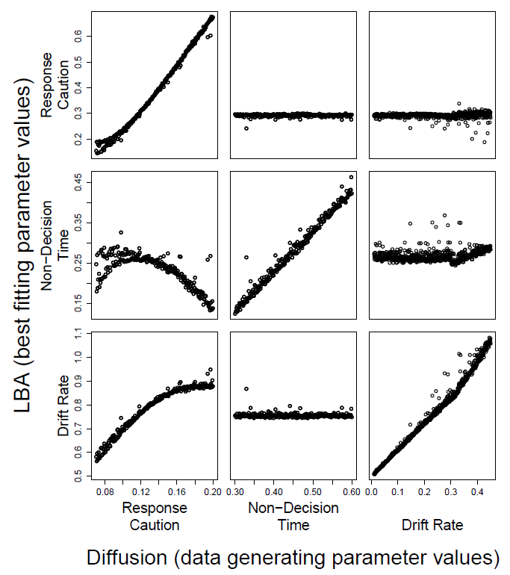
LBA fits to Diffusion data

Slide 39
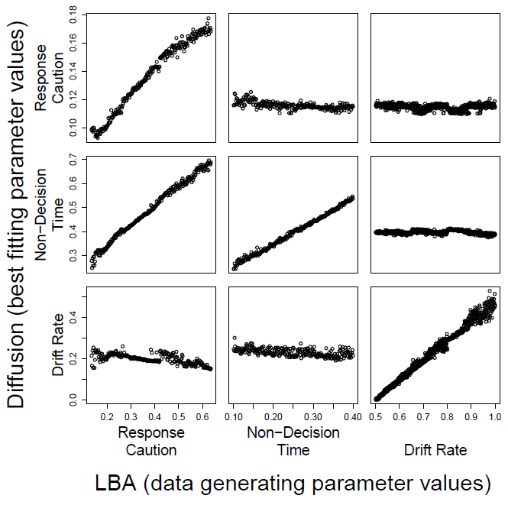
Diffusion fits to LBA data

Slide 40
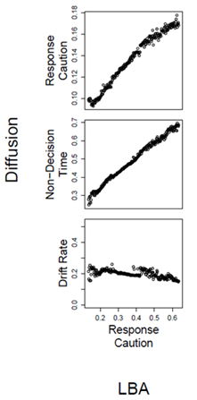
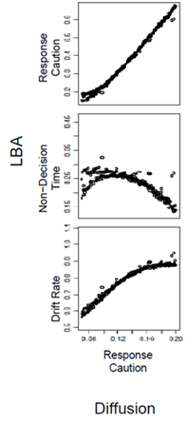
Response Caution Mis-map
Increasing response caution in LBA causes increase in non-decision time in diffusion.
Increasing response caution in diffusion model causes increase in drift rate in LBA.
Might be because of differences in assumptions about within-trial variability in evidence accumulation.

Slide 41
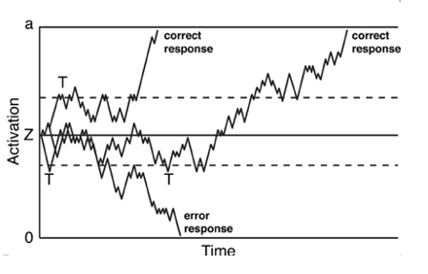
EZ Diffusion
Just a fitting method for simple diffusion
Simple diffusion model
No between-trial variability in non-decision time
No between-trial variability in start-point
No between-trial variability in drift rate
No bias
Method of Moments for fitting
Mean RT, Var RT, Proportion Correct

Slide 42
EZ Diffusion

Slide 43
Why Use LBA or EZ?!?
Clearly worse theoretical models of decision-making
Exclude very realistic and sensible assumptions

Slide 44
Power Analysis
Simulate data from full diffusion model
Two conditions – between subjects
Vary drift rates between conditions
Three effect sizes (0.5, 0.8, or 1.2 times sigma)
Also vary
Number of participants: 10, 20, 30, 40, 50
Number of trials per participant: 50, 100, 200

Slide 45
Power Analysis
Simulate data from full diffusion model
Two conditions – between subjects
Drift rate differs between two conditions
Fit both Full and EZ diffusion models
Ask both models whether drift rate differs
Perform t-test on drift rates for each model
Count up correct rejections of H₀

Slide 46
Power Analysis

Slide 48
EZ is powerful
Why?

Slide 49
EZ is powerful
Bias/Variance trade-off
Parameters in EZ
biased when estimating data from Full diffusion
Estimated with less variance
Parameters in Full diffusion
No bias
More variance
Should we worry about bias?

Slide 50
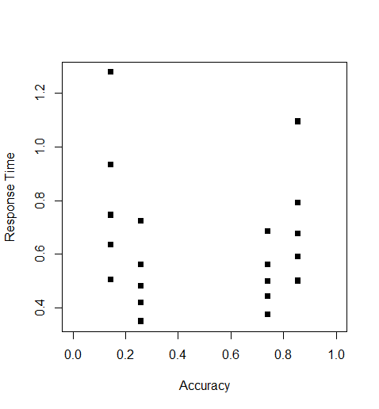
Real Data
Data with two conditions
What changes across these conditions?
Drift rate
Threshold
Non-decision time

Slide 51
Exercise 1: Use EZ
Let’s use the EZ diffusion model to compare the two conditions
Get v, a, and Ter parameters for each participants in each condition
Are there differences in the parameters across conditions?

Slide 52
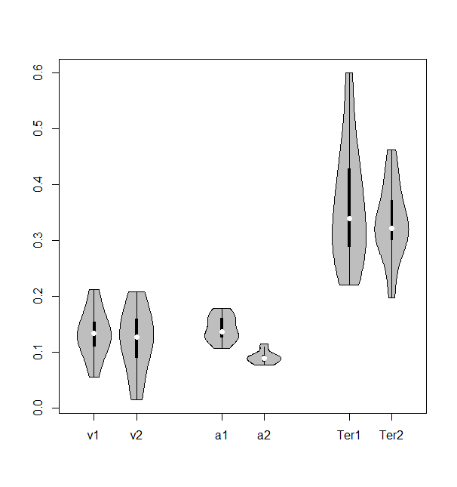
EZ

Slide 53
Exercise 2 : Use JAGS
Now let’s implement some Bayesian versions of the Simple Diffusion Model
dwiener(alpha,tau,beta,drift)
alpha = boundary separation
tau = non-decision time
beta = bias
delta = drift rate
response times for one response are positive
response times for other response are negative

Slide 54
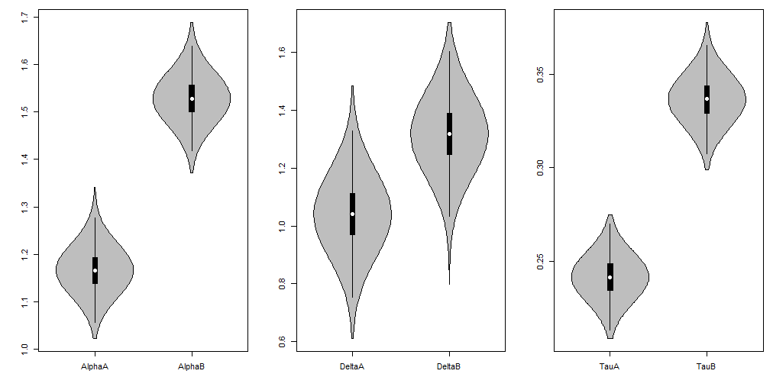
JAGS

Slide 55
EZ is also better with real data
True across a lot of data sets (validation study)
Use EZ2 if you suspect bias
May not hold for more complex experiments.

Slide 56
MANY-LABS STUDY
17 TEAMS OF RESEARCHERS
GIVEN 14 DATA SETS
ALWAYS TWO GROUPS
BLIND
INFER WHICH DIFFER
EASE, CAUTION, BIAS, NON-DECISION TIME

Slide 57
PSEUDO EXPERIMENTS

Slide 58
REAL EXPERIMENT
20 PARTICIPANTS
DOT MOTION TASK
2 (DIFFICULTY) x 2 (EMPHASIS) x 2 (BIAS)
400 TRIALS OF PRACTICE

Slide 59
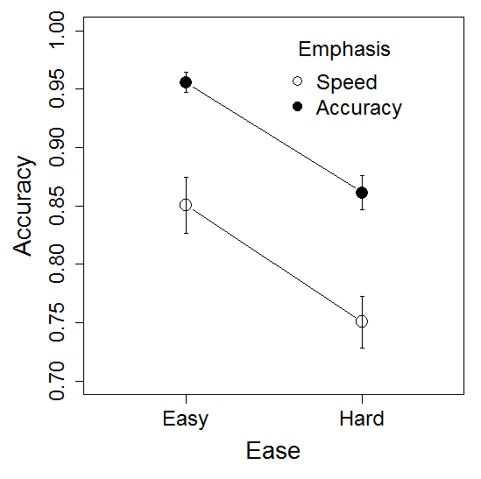
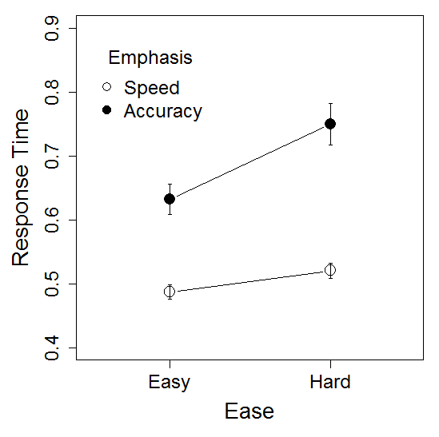
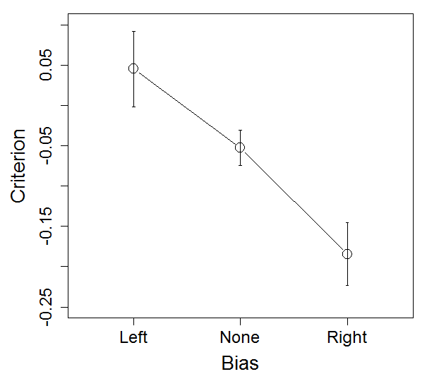
REAL EXPERIMENT

Slide 60
PSEUDO EXPERIMENTS

Slide 61
SIMPLE DIFFUSION
FULL DIFFUSION
LBA
NO MODEL
HIERARCHICAL BAYES
MAXIMUM LIKELIHOOD CHI-SQUARE
KOLMOGOROV-SMIRNOV
MOMENTS
ESTIMATES
NHST
POSTERIORS
MODEL SELECTION
AIC OR BIC
BAYES FACTORS

Slide 63
DIFFUSION

Slide 64
LBA

Slide 65
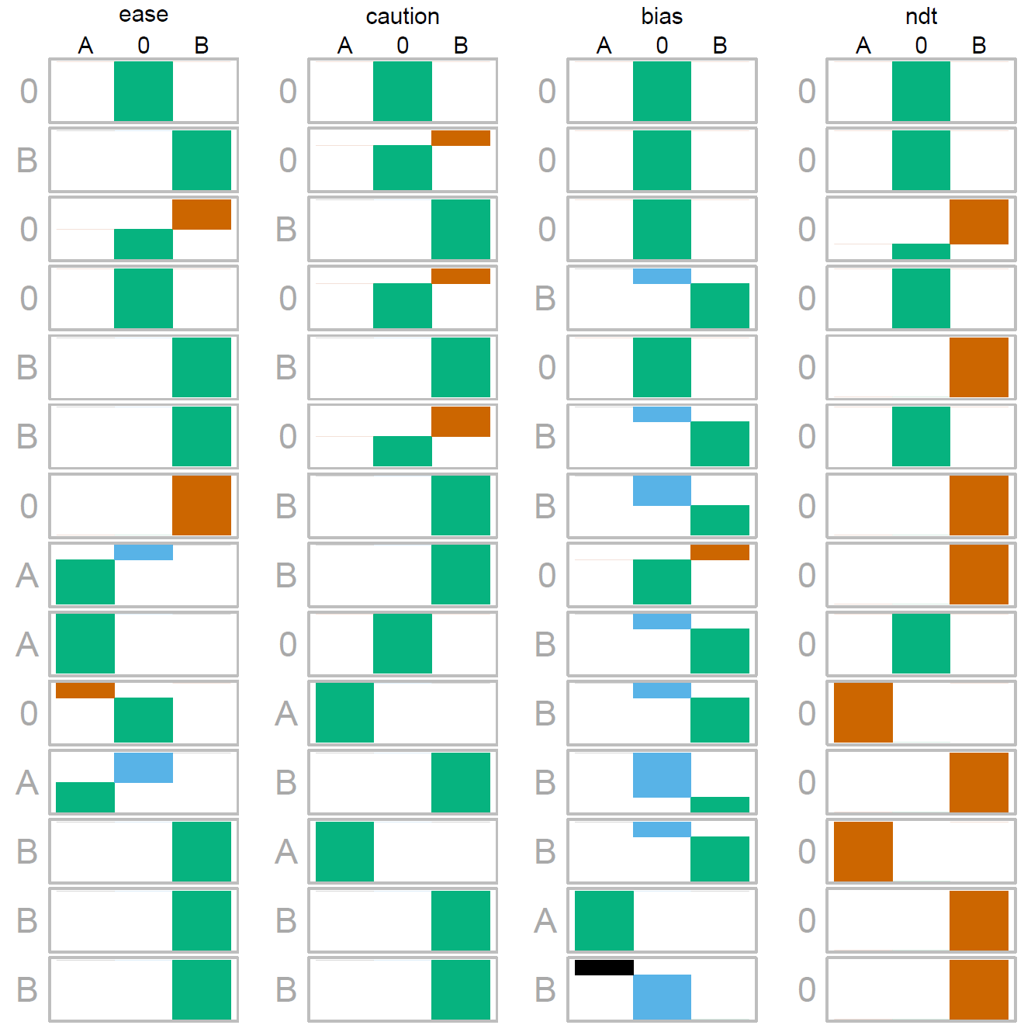
HIERARCHICAL BAYES

Slide 66
INDIVIDUAL ESTIMATES

Slide 67
ESTIMATION

Slide 68
MODEL-SELECTION

Slide 69
rtdists
See Steve and Simon’s book for details and instructions
I’m not too keen on maximum likelihood, because it has all the bad bits of Bayes, with none of the good stuff
Are other fitting methods that are more robust to ‘outliers’, such as KS and QMP estimation methods
If you need to fit the full diffusion model, then rtdists can be useful
Also try fastDM code
However, it does generate random data from the models, which can be useful.

