Slide 1
Background: Conflicting views on effects of regulation
Hare et al. (2011) suggest that vmPFC value signals can be deliberated to modulated representations of taste, and correlate with choice regardless of regulation instruction
Hutcherson et al. (2012) find little evidence of ability to down-regulate value signals in vmPFC, and find evidence that vmPFC value signals no longer correlate with behavior.

Slide 2
A comparison
Hare et al. (2011) ask participants to focus explicitly on healthy eating
Hutcherson et al. (2012) ask participants to “decrease their cravings and distance themselves from the foods”
Perhaps these are different regulatory strategies with different effects and time-courses?

Slide 3


Study design
(N = 56 Group 1, N = 61 Group 2)
Self-Control Task
Attribute Rating Task
Yes
No
How much ?
Health
Taste
Health Eval Time
Taste Eval Time
Natural Focus
×100 trials
Health Focus
×100 trials
Or Decrease Desire
Notes:
To study these questions, I’ve been developing computer mouse-tracking methods that yield a continuous indicator of value and choice over time. These methods have significantly better temporal resolution than fMRI, and have a clearer relationship to choice behavior than EEG signals.
7 female participants

Slide 4
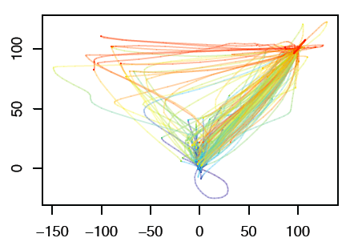
Dynamic movements reveal dynamic computation
Sample Subject
Unchosen
Food
Chosen
Food
3500 ms
Time
0 ms

Slide 5
Tracking influence with per-time-point regressions
Angle_{i}(t) =
α(t)*Taste_{i} + β(t)*Health_{i}
Heading at time t = 200
Prediction 1:
Later health → later influence on instantaneous angle
Prediction 2:
Later health → Less healthy choices
Heading at time t = 100
Heading at time t = 1
Notes:
Now, one difficulty here is that different participants and different trials take different amounts of time. So what we’ve done is normalize time so that each mouse trace consists of 101 time points – this allows us to compare timing on a common scale.

Slide 6
Reaction time
P = .08
Decrease Desire
Focus on Health

Slide 7
Changes of mind
P = .16
Decrease Desire
Focus on Health

Slide 8
Changes in taste and health influence
*
**
**
**
**
Decrease Desire
Focus on Health

Slide 9
Dynamics: Taste
DECREASE DESIRE
FOCUS ON HEALTH

Slide 10
Dynamics: Health
DECREASE DESIRE
FOCUS ON HEALTH

Slide 11
Dynamics: Health
DECREASE DESIRE
FOCUS ON HEALTH

Slide 12
Dynamics: Regulatory Success
TASTE
HEALTH
Decrease Desire
Focus on Health

Slide 13
Real-life correlates: Natural
Less taste influence → Fiber, veg consumption
More health influence → Fiber, veg consumption
No correlates during regulation

Slide 14
Personality correlates: Natural
Emotional eating → less health influence
Cognitive restraint → more health influence
Cognitive restraint → less taste influence (.06)
No correlates during regulation

