Slide 1
Welcome! In this experiment, we are interested in understanding how people decide what they want to eat.
This experiment should take about 1.5 hours total. For your participation today, you will earn 1.5 participation credits.
Press to continue.

Slide 2
Before we begin the experimental tasks, we would like to know how hungry you feel RIGHT NOW.
Please indicate how hungry you are at this moment by pressing a key from 1 (stuffed) to 9 (starving).
1
2
3
4
5
6
7
8
9
Stuffed
Very
Full
Moderately
Full
Slightly
Full
Neither hungry nor full
Slightly
hungry
Moderately
hungry
Very
hungry
Starving

Slide 3
In this portion of this experiment, we are interested in getting some more detail about your perceptions of different foods.
Press to continue.

Slide 4
Right now, we are interested in how much you would like to eat different foods. You will see several different pictures of foods, and for each one we would like you to rate it for how much you personally would like to eat the food. Regardless of any other considerations, please rate how much you would like to eat each food RIGHT NOW.
To make the rating, use the indicated keys, which will appear below each food. There is no time limit for your response.

Slide 5
Right now, we are interested in how TASTY each food seems to you. You will see several different foods, and for each one we would like you to rate it for how tasty you personally find the food. Regardless of other considerations like health or price, please rate how TASTY this food seems to you.
To make the rating, use the indicated keys, which will appear below each food. There is no time limit for your response.
Press to continue.

Slide 6
Right now, we are interested in how HEALTHY each food seems to you. You will see several different foods, and we would like you to rate it for how healthy you personally think the food is. Regardless of other considerations like tastiness or price, please rate how HEALTHY this food seems to you.
To make the rating, use the indicated keys, which will appear below each food. There is no time limit for your response.
Press to continue.

Slide 7
You have now finished with this portion of the task.
Please press the right arrow key to receive instructions for the next portion of the experiment.
Press to continue.

Slide 8
Now, we are interested in understanding how people make choices about different foods.
On every trial, you will be given a choice about whether or not to eat a food presented on that trial.
At the end of the experimental tasks, you will wait in the lab for an additional 30 minutes. During this time, you will be allowed to eat a snack, which will be determined by one of the choices you make in the experiment.

Slide 9
On each trial, you will see a picture of food on a plate, in a bowl, or in a glass. You might also see food displayed behind the plate, or next to the bowl or glass, but this food is simply there to help you identify the food on that trial. You will only be asked to eat what is on a plate, in a bowl, or in a glass.
For every trial, you should consider eating the food EXACTLY as it is displayed on a plate, in a bowl, or in a glass, and make your decision about whether you would like to eat that food, in the amount shown.

Slide 10
Here’s how we will determine what you eat. At the end of the experiment we will select ONE of the choice trials that you saw, and this trial will count for real. If you said yes, you will be asked to eat the food EXACTLY AS IT IS SHOWN ON THE PLATE. If you said no, you will not eat any food. Only one trial will be selected, so you should treat every trial as if it could be the one that counts.
Note: You will NOT be allowed to eat any other food during the experiment or the 30-minute eating period, and you will be required to eat any food you say yes to, so think about each choice carefully.

Slide 11
Here’s how you choose a food.
On each trial during the choice task, you will see a START button. To reveal the food on that trial, you must first click on the START button, and then begin moving your mouse upwards.
IMPORTANT: The food will appear only when you begin moving your mouse upwards, and not before.

Slide 12
Once the food appears, you can choose whether you would prefer to eat it or not. To choose yes, click the ‘YES’ button. To choose no, click on the ‘NO’ button.
IMPORTANT: You won’t be able to see the food until your cursor moves beyond the top of the START box. Your response will be entered and the trial will end as soon as you use the mouse to click on either the ‘YES’ or the ‘NO’ button.

Slide 13
While you are choosing, please respond as quickly and accurately as possible. If you haven’t responded within 10 seconds, whatever button you are closest to at the end of the 10 second period will be selected.
Also: You should use the mouse to indicate exactly how you feel at each moment in a trial. This may mean that you sometimes move the mouse back and forth if your feelings change during a trial. But please do not “play” with the mouse by moving it in spirals, etc. Please just use the mouse to indicate whether you feel like eating the food or not.

Slide 14
You will now have a few practice trials in which you can get a feel for how to use the mouse to make a choice.
These trials will not count for anything, and will not determine what you eat at the end of the experiment. They are here just to give you a feel for the choice task you will be doing.

Slide 15
If you have any questions about how to use the mouse to make choices, please ask the experimenter now. Otherwise, press the right arrow key to continue.
Press to continue.

Slide 16
Before you begin the choice trials, there is one other aspect of the task to tell you about.
In this study, we are interested in understanding people’s ability to modulate their food cravings. There will be two types of trials, where we will ask you to respond in one of the following ways:
Consider the HEALTHINESS of the food
RESPOND NATURALLY, and allow yourself to want the food as much or as little as feels natural

Slide 17
Before you begin the choice trials, there is one other aspect of the task to tell you about.
In this study, we are interested in understanding people’s ability to modulate their food cravings. There will be two types of trials, where we will ask you to respond in one of the following ways:
DECREASE your desire for the food
RESPOND NATURALLY, and allow yourself to want the food as much or as little as feels natural

Slide 18
When you see the cue RESPOND NATURALLY, you should choose as naturally as possible. Allow whatever thoughts or feelings arise, and simply make your choice.
When you see the cue FOCUS ON HEALTH, you should try to think about whether eating the food, in the amount shown, is consistent with a healthy lifestyle (i.e., is it nutritious/good for you). You should continue to look at the food the whole time, and focus on the healthiness of the food as you decide whether or not you would like to eat the food.

Slide 19
When you see the cue RESPOND NATURALLY, you should choose as naturally as possible. Allow whatever thoughts or feelings arise, and simply make your choice.
When you see the cue DECREASE DESIRE, you should do whatever you need to to decrease your desire for the food. You should continue to look at the food the whole time, and try to distance yourself from any craving or emotional response to the food as you decide whether or not you would like to eat the food.

Slide 20
During the choice task, trials will be divided into blocks of 10. Before each block of 10 trials, we will display an instructional cue describing which task you should do for that block of trials.
The cue will also be shown before each trial at the bottom of the screen as a reminder.

Slide 21
After the instructional cue telling you what to do at the beginning of the trial, the first trial in the block will begin.
It is very important that you respond accurately and consider the instructional cue for each trial in the block. You should try to keep the instructed consideration in mind as strongly as possible when making your choices.

Slide 22
You should also keep in mind that no matter what type of block you are in, you are ALWAYS FREE TO DECIDE AS YOU PLEASE whether or not to eat a food item. For example, you are free to choose to eat an unhealthy food item during a health block if you wish to do so. Similarly, you are free to choose not to eat a tasty food item during a natural block if you prefer not to.

Slide 23
You should also keep in mind that no matter what type of block you are in, you are ALWAYS FREE TO DECIDE AS YOU PLEASE whether or not to eat a food item. For example, you are free to choose to eat a food item during a decrease block if you wish to do so. Similarly, you are free to choose not to eat a food item during a natural block if you prefer not to.

Slide 24
You may notice that some choices seem very similar. You should always consider your preference for the exact food shown, in the exact amount, on that trial. However, only one trial will be selected to determine what you eat at the end of the study. Whatever you chose on that trial, regardless of the instruction, will be exactly what you receive.
Therefore your decisions on other trials should not affect what you do on the current trial. On every trial, just choose what you prefer after focusing on the instructions for that trial.

Slide 25
We will now ask you a few short questions to make sure that you understand the task.
Please press the right arrow key to continue to the quiz questions.

Slide 26
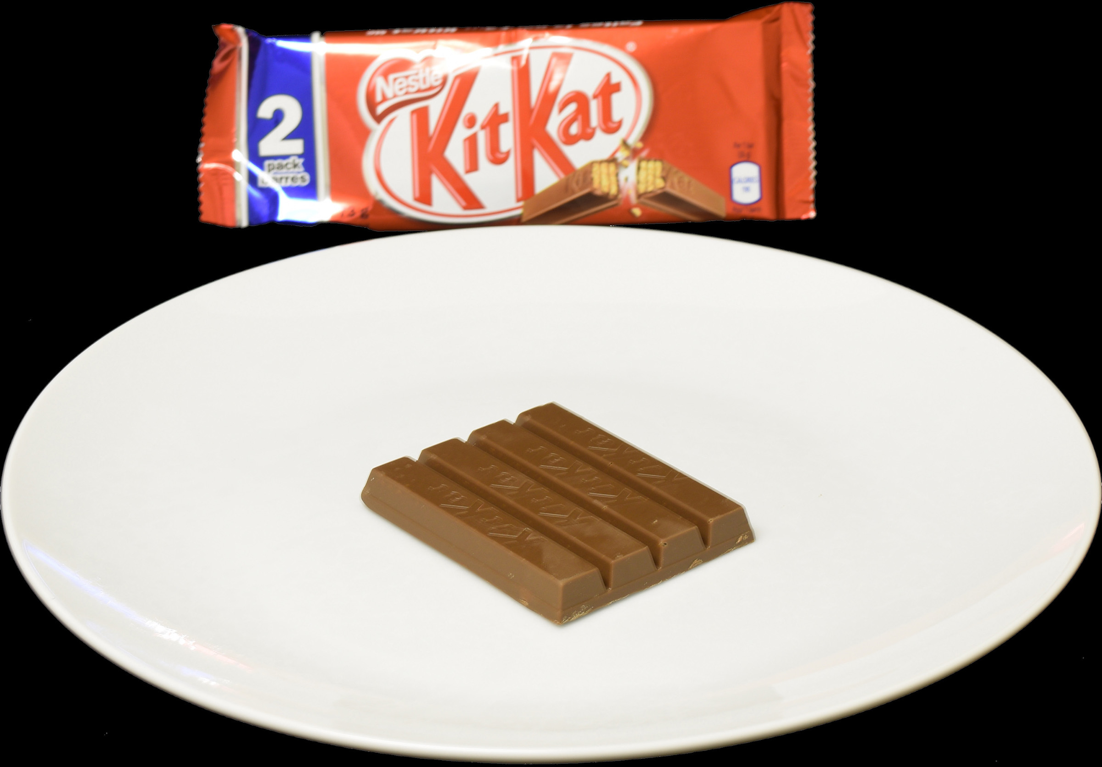
Question 1: If you say NO to the food below, what would you eat at the end of the study if that trial is drawn to count?
SELF
$30 $100
I would eat 4 bars of KitKats.
I would eat nothing.
I would eat 1 bar of KitKats.

Slide 27
CORRECT!
When you choose to reject a particular option, you will NOT eat anything at the end of the study.
Press to continue.

Slide 28
INCORRECT!
When you choose to reject a particular option, you will NOT eat anything at the end of the study.
Press to continue.

Slide 29
Question 2: If you say YES to the food below, what would you eat at the end of the study if that trial is drawn to count?
SELF
$30 $100
I would eat 1 bar of KitKats.
I would eat nothing.
I would eat 4 bars of KitKats.

Slide 30
CORRECT!
When you say yes to a food, you will be required to eat EXACTLY that food, in EXACTLY the amount shown on the plate.
Press to continue.

Slide 31
INCORRECT!
When you say yes to a food, you will be required to eat EXACTLY that food, in EXACTLY the amount shown on the plate.
Press to continue.

Slide 32
Question 3: If we ask you to control your responses, and you say YES to a food that you do not like, will you still have to eat it at the end of the experiment if that trial is drawn?
Yes. Any trial could be the one that determines what I eat at the end of the experiment.
No. Only “Respond Naturally” trials count for real.
Maybe. If I want to eat it at the end of the study, I will eat it, otherwise I won’t.

Slide 33
CORRECT!
All trials, regardless of the instruction we give you, count equally. Any one could determine what you eat at the end of the experiment. If that trial is drawn, you will be bound by your response on that trial.
Press to continue.

Slide 34
INCORRECT!
All trials, regardless of the instruction we give you, count equally. Any one could determine what you eat at the end of the experiment. If that trial is drawn, you will be bound by your response on that trial.
Press to continue.

Slide 35
Question 4: If we ask you to control your responses, and you don’t manage to change how you feel about the food, how should you make your choice?
I should choose based on what the instructions tell me to do on that trial.
I should reject the food.
I should choose based on my true preferences in the moment.

Slide 36
CORRECT!
Although we would like you to do your best to follow the instructions for how to think about the food on each trial, you should always just choose according to your preference, regardless of whether your preferences match the instruction or not.
Press to continue.

Slide 37
INCORRECT!
Although we would like you to do your best to follow the instructions for how to think about the food on each trial, you should always just choose according to your preference, regardless of whether your preferences match the instruction or not.
Press to continue.

Slide 38
If you have any questions now, please ask the experimenter.
Otherwise, press the right arrow key and the task will begin on the next screen.
Press to continue.

Slide 39
You have now finished with this portion of the task.
Before we continue, we would like to know how hungry you feel RIGHT NOW.
Please indicate how hungry you are at this moment by pressing a key from 1 (stuffed) to 9 (starving).
1
2
3
4
5
6
7
8
9
Stuffed
Very
Full
Moderately
Full
Slightly
Full
Neither hungry nor full
Slightly
hungry
Moderately
hungry
Very
hungry
Starving

Slide 40
We will now determine which trial will be used to determine what you eat.
Once the outcome has been revealed, please inform the experimenter that you have finished with this portion of the experiment.
Press to continue.

Slide 41
RESPOND NATURALLY
For the next set of trials, we would like you to RESPOND NATURALLY. Do whatever you need to let any feelings or thoughts you have come naturally and make whatever choice you most prefer.

Slide 42
FOCUS ON HEALTH
For the next set of trials, we would like you to FOCUS ON THE HEALTH OF THE FOODS. Do whatever you need to think about the health implications of your choice before deciding what you prefer to do. Then make whatever choice you most prefer.

Slide 43
FOCUS ON DECREASING DESIRE
For the next set of trials, we would like you to DECREASE YOUR DESIRE FOR THE FOODS. Do whatever you need to to try to decrease your craving for the food before deciding what you prefer to do. Then make whatever choice you most prefer.

Slide 44
1
2
3
4
5
6
Strongly
dislike
Moderately
dislike
Slightly
dislike
Slightly
like
Moderately
like
Strongly
like

Slide 45
1
2
3
4
5
6
Strongly
like
Moderately
like
Slightly
like
Slightly
dislike
Moderately
dislike
Strongly
dislike

Slide 46
1
2
3
4
5
6
Very
Untasty
Moderately
Untasty
Slightly
Untasty
Slightly
Tasty
Somewhat
Tasty
Very
Tasty

Slide 47
1
2
3
4
5
6
Very
Unhealthy
Moderately
Unhealthy
Slightly
Unhealthy
Slightly
Healthy
Somewhat
Healthy
Very
Healthy

Slide 48
1
2
3
4
5
6
Very
Tasty
Moderately
Tasty
Slightly
Tasty
Slightly
Untasty
Somewhat
Untasty
Very
Untasty

Slide 49
1
2
3
4
5
6
Very
Healthy
Moderately
Healthy
Slightly
Healthy
Slightly
Unhealthy
Somewhat
Unhealthy
Very
Unhealthy

