Slide 1
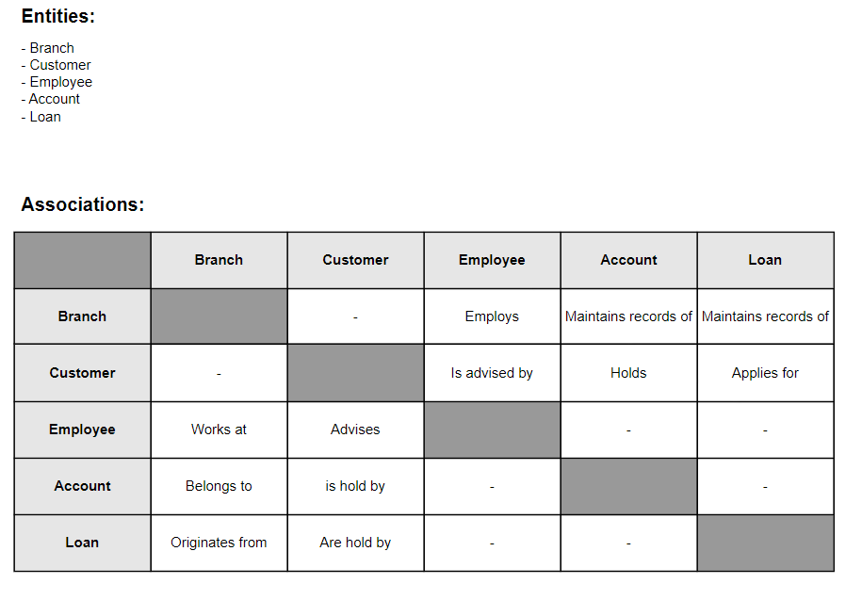
Step 1

Slide 2
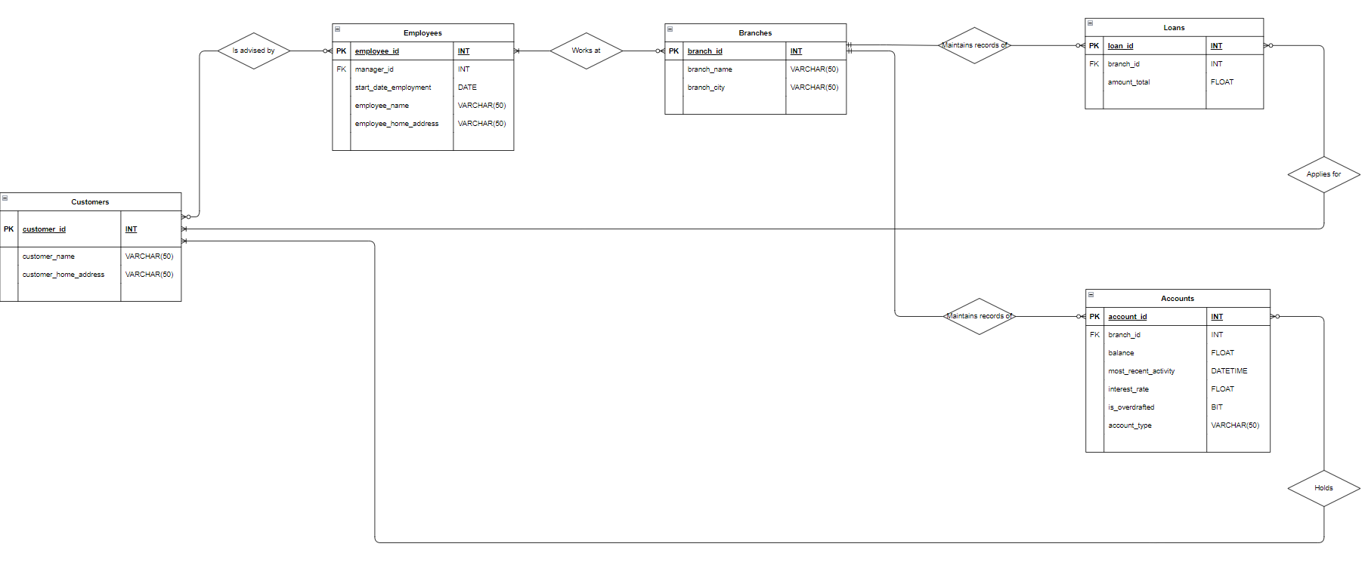
Step 2

Slide 3
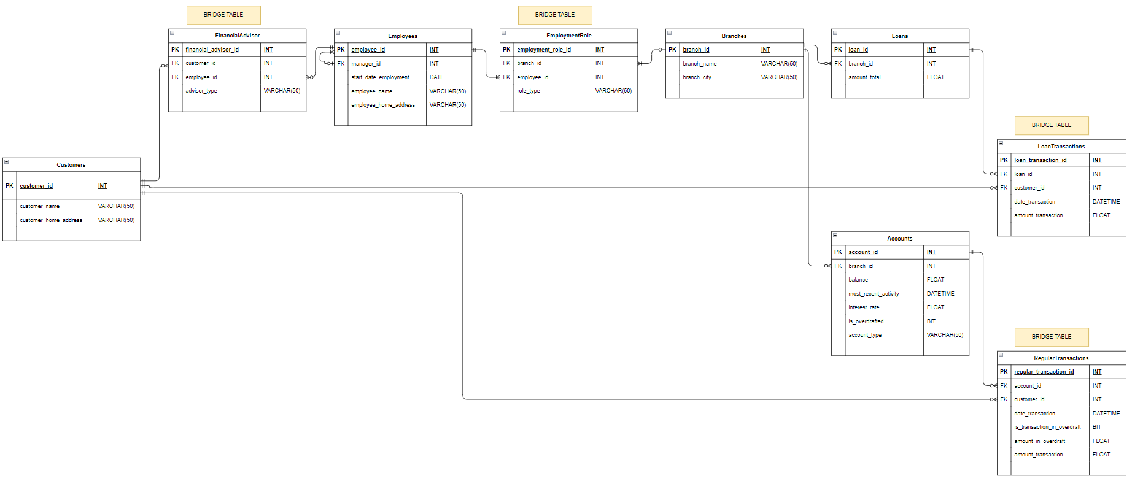
Step 3
- Atomic (Pass NF1) - No Partial Dependencies (Pass NF2) - No Transitive Dependencies (Pass NF3)

