Slide 1
Kinda League
Babylonjs, typescript, colyseusS,Nodejs, amazon vc2, vs-code, github

Slide 2
Before we start
“I want to slap your titties like a wine bag and drink the milk from them” - Brody

Slide 3
What is the game?
Third person, birds eye view
Right click to move
Browser Game
Team Death math (TBD)

Slide 4
Lets get down to business
Let’s go over the things we will be using to make the game and how they tie in

Slide 5

Our ide (integrated development environment) Visual studio code
This Photo by Unknown Author is licensed under CC BY-SA

Slide 6
Babylonjs
Native java script physics engine
Handles vectors, collisions, cameras, the whole world
Very quick
Is a library that can work with any IDE that handles javascript

Slide 7
Colyseuss
Handles communication between server and client
Has class called Schema which lets any custom class you write be communicated and updated through the server.

Slide 8
Typescript: the superhero of javascript
Converts directly to JavaScript
Allows for intellisense and easier programming
.ts file extension

Slide 9
Node js
Host our client and server
Handles connections and transferring information
npm start

Slide 10
Github
Our source control
Create a github account and provide Daniel your email or username.
To get started open a terminal and type “git clone https://github.com/danielkboyer/KindaLeague”
Generates a folder with your server and client
cd to the servers download location and type “npm install” (if npm is not installed download it here)
Then type npm start. Should see your terminal waiting for request
Open a new terminal and do the same thing with client.
Once finished visit localhost:8080 and play the game! (very boring)

Slide 11
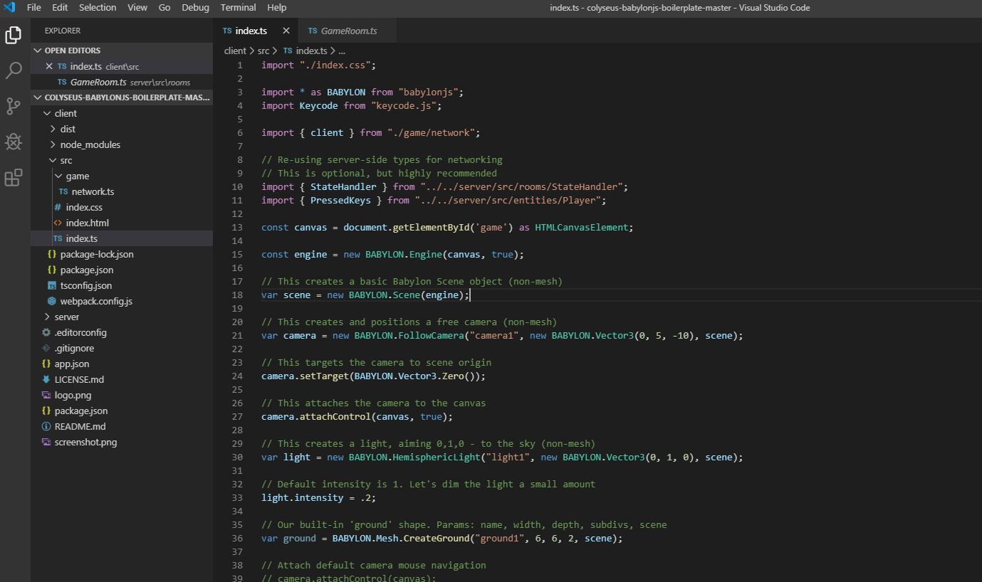
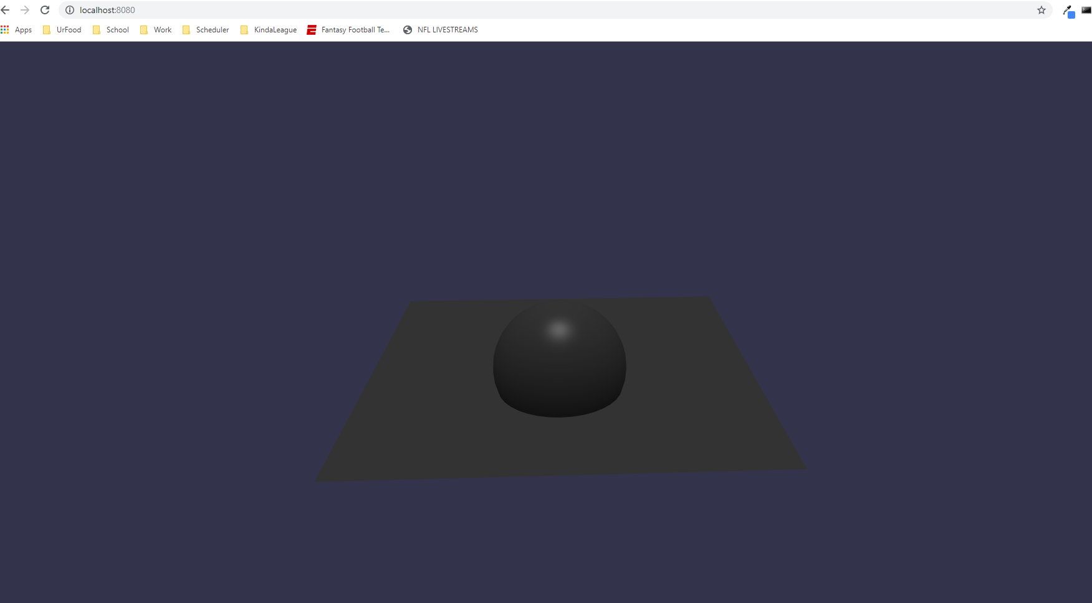
Let’s get dirty
You have the code, now let’s learn it.
Take a look at the game first

Slide 15
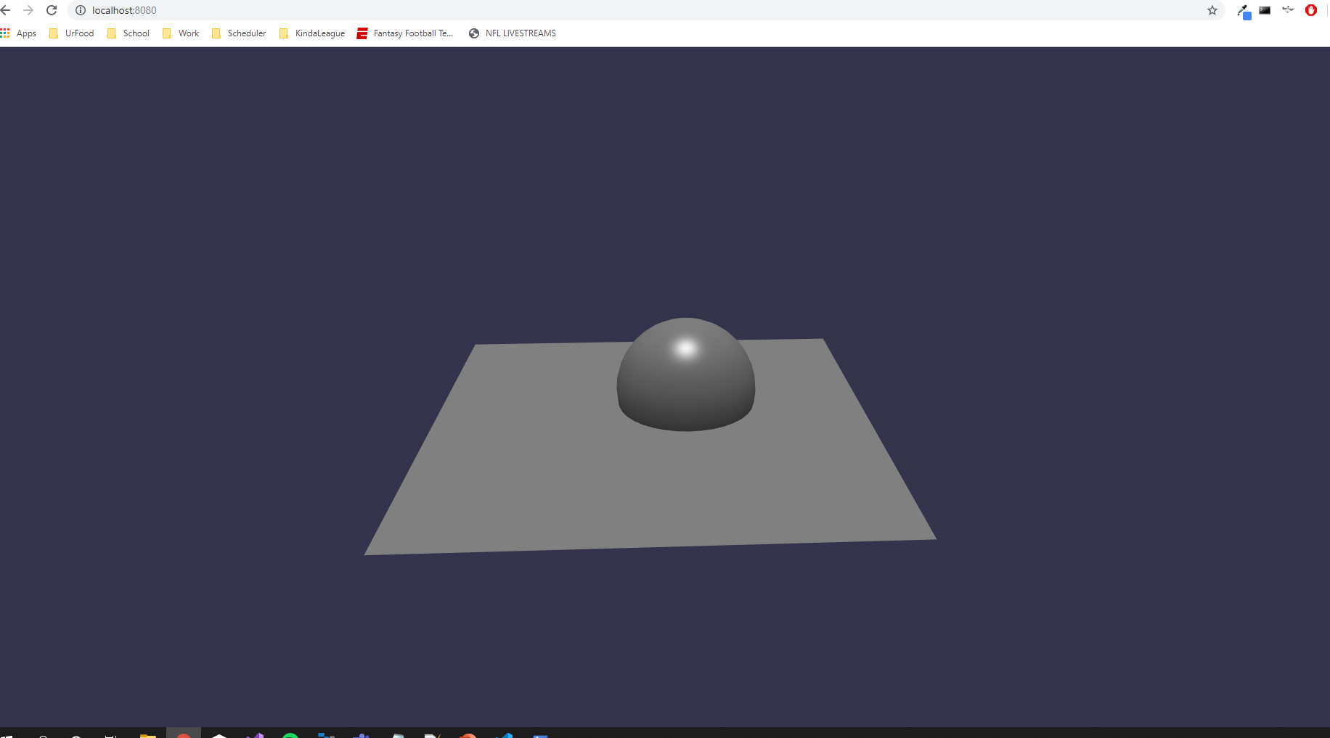

Slide 16
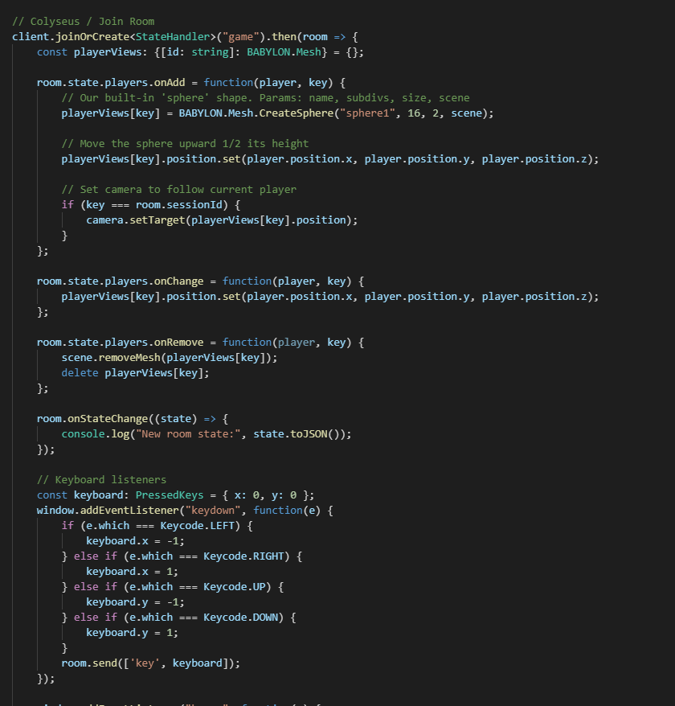
Client to server: this is still client code!

Slide 17
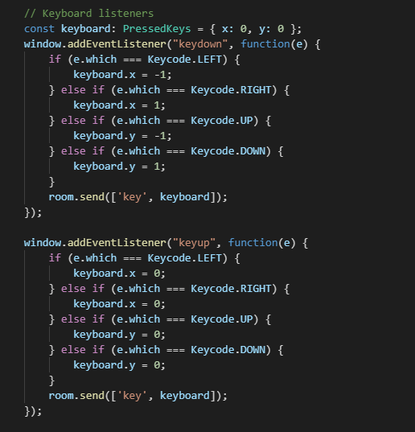
Client keyboard movement

Slide 18
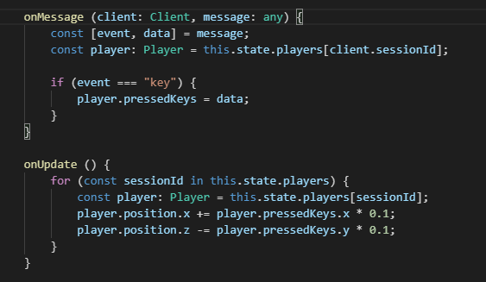
Server receives movement command
onUpdate being called every second
onMessage is called when client sends data.

Slide 19
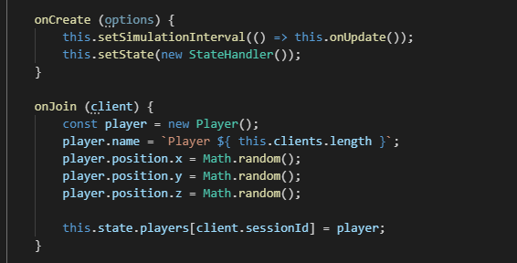
Where do the players come from? On join

Slide 20
What now?
Mess around with the code! You cannot break anything live and can always restart
Try messing with the numbers in the code to see if you can make the player move faster or slower
Watch some tutorials on typescript…. Here is one

