Slide 1

Face Recognition Emotion Based Music Recommendation System

Slide 2
Introduction
A Face Recognition Emotion Based Music Recommendation System is a system that uses facial recognition technology to recommend music based on the emotion detected from an individual's facial expressions
It is capable of detecting different emotions such as Happy(happy), Angry(anger_chill), Sadness(cheerful), Love(love), Surprise(surprise) and Neutral(neutral) can make informed recommendations based on those emotions.
This system has been implemented by various companies on YouTube videos to help users find the music that suits their current mood.

Slide 3
Motivation..
Detect emotions from facial expressions and then recommend music tailored to each person's emotional state.
This system would allow users to match their current mood with the appropriate type of music, increasing the effectiveness of therapeutic treatments, as well as general wellbeing.

Slide 4
Problem statement
In old style music players a user had to manually browse through the playlist and select songs that would soothe his mood.
Music listeners have tough time creating and segregating the play-list manually when they have hundreds of songs
It is also diﬃcult to keep track of all the songs. Sometimes songs that are added and never used, wasting a lot of device memory and forcing the user to ﬁnd and delete songs manually.

Slide 5
Objectives
General objectives
Face recognition emotion based music recommendation system is a machine learning technique that uses facial expressions from live videos to detect and recognize the emotions of users in order to recommend songs based on the emotion.
Specific objectives
Accurately identify a user’s emotions using facial recognition and make song selections that best suit their current emotional state.

Slide 6
Methodology
We are using agile methodology because integrates the emotional response of a person through facial recognition and then recommends music according to their emotional state.
The agile methodology adopted by this approach facilitates rapid development cycles and quicker deployment of features to ensure maximum satisfaction of users

Slide 7
Algorithms Used
Convolutional Neural Networks
Classification Based on the CNN
The emotions recorded in the training phase are the labels on which the incoming data will be classified.
Happy(happy)
Angry(anger_chill)
Sadness(cheerful)
Love(love)
Surprise(surprise)
Neutral(neutral)

Slide 8
Data source and preprocessing
Live video from the Webcam
Pre-trained python frameworks pre-process and manipulate the incoming data.
Frameworks and Libraries Used;
Mediapipe
Opencv
Tensorflow
Numpy
Keras
Streamlit

Slide 9

Implementation
Face recognition emotion based music recommendation system is a computer vision-based technology for analyzing facial expressions and extracting meaningful information that can be used to generate personalized music recommendations.
The system can identify positive emotions happiness, negative emotions such as fear, angry and sadness.
The most important part of implementing this type of system is collecting accurate facial expression data from users’ real-time performances in order to determine which song or genre best matches their current state of emotion.
Accuracy : 97%
Loss: 3%

Slide 10
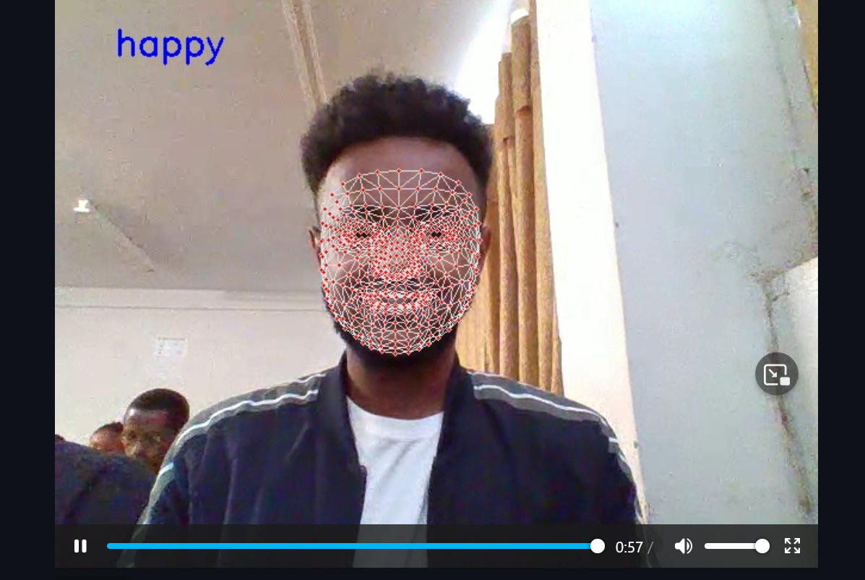

Slide 11
Recommendation and conclusion
The face recognition emotion based music recommendation system has proven to be a very beneficial tool for detecting the emotional state of users and recommending the most appropriate music accordingly.
The system is based on machine learning algorithms and efficiently highlights individual preferences.
This technology can bring numerous advantages to its implementations, such as increasing customization, making customers happier with better music recommendations, improving the customer experience of online platforms and helping marketers understand their target audience better.

Slide 12
Thank you

