Slide 1
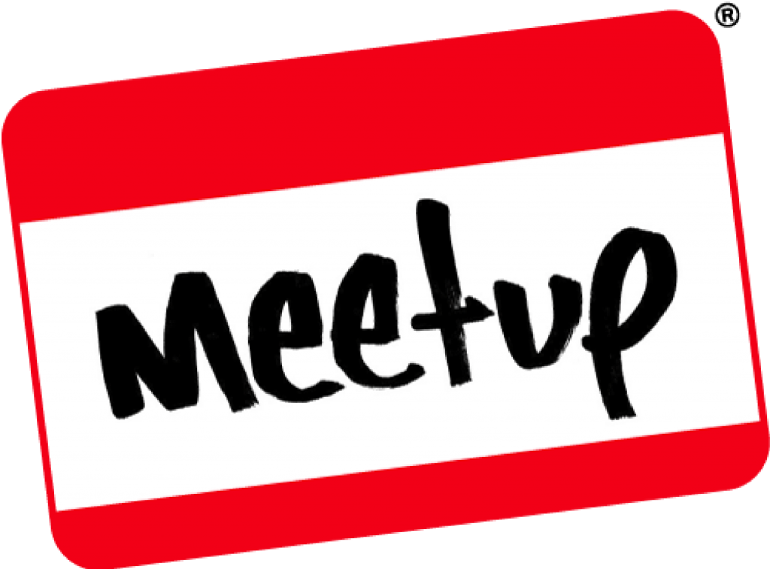
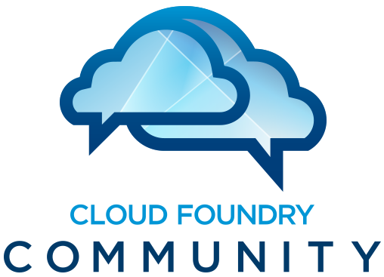
St. Louis Cloud Foundry Meetup
September 16, 2014 - CF + Docker

Slide 2


Thanks to our hosts!

Slide 3
Agenda
Introduction + Food
Services Overview
Service Broker Architecture
Docker Service Broker Demo
Next Steps
Why are we here?

Slide 4
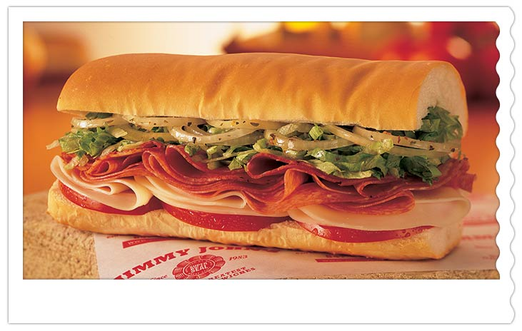
Introductions
WIFI: wwtvisitor
Meet your neighbor

Slide 5
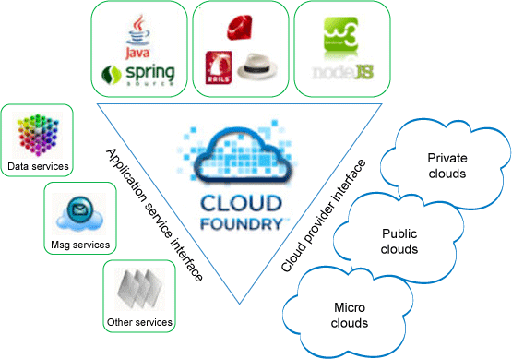
CF Services Overview
Apps vs. Services

Slide 6
CF Services Overview
Services
Not managed by (or hosted within) Elastic Runtime
May or may not be managed via bosh
Available to any application in same space
Typical use case is persistence or middleware
Heavily underutilized in monolithic architectures
Can be brokered or user-provided

Slide 7
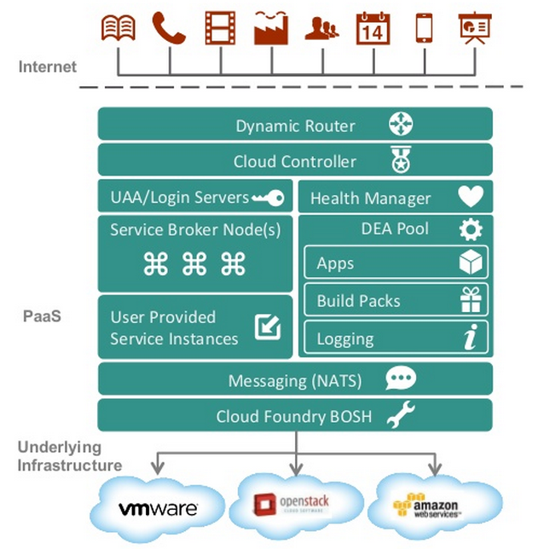
CF Services Overview
Not managed by Elastic Runtime

Slide 8
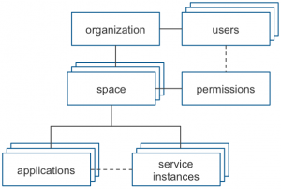
CF Services Overview
Available to any app in same space

Slide 9
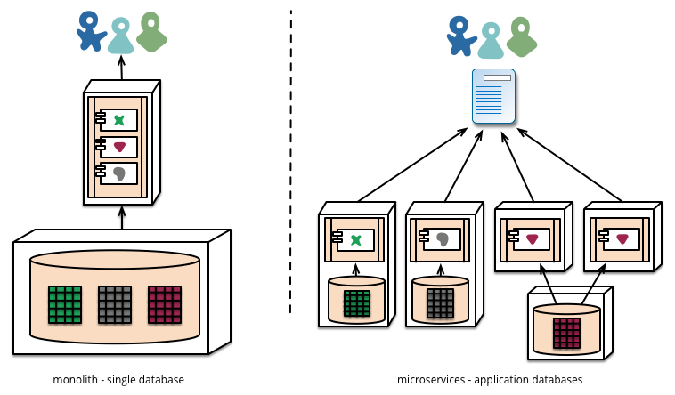
CF Services Overview
Great for Microservices Architecture
Loosely coupled, scalable, distributed
Discoverable in environment
Backdrop/Fabric for complex applications

Slide 10
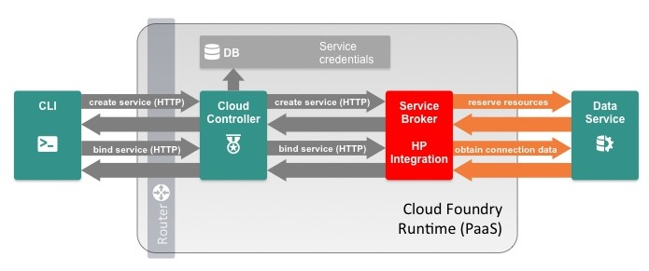
CF Services Overview
Brokered vs. User-provided
$ cf cups test-pubsub-01 -p "host, port, url, user, password" host> pubsub01.example.com
port> 1234
url> pubsub-example.com
user> pubsubuser
password> p@$$w0rd
Creating user provided service test-pubsub-01 in org \
my-org / space development as me@my-org.com ... OK

Slide 11
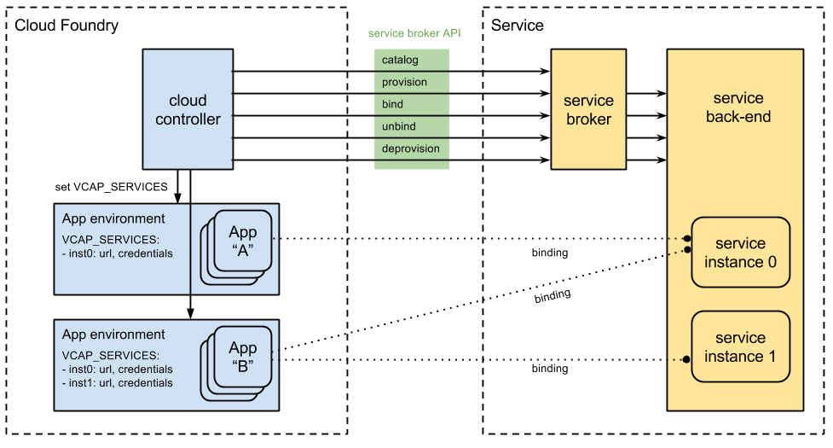
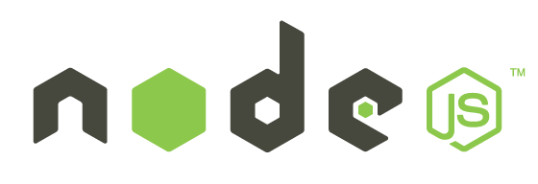
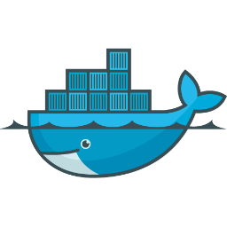

Service Broker Architecture
Service Broker Architecture
Methods: marketplace, create, bind, unbind, delete

Slide 12

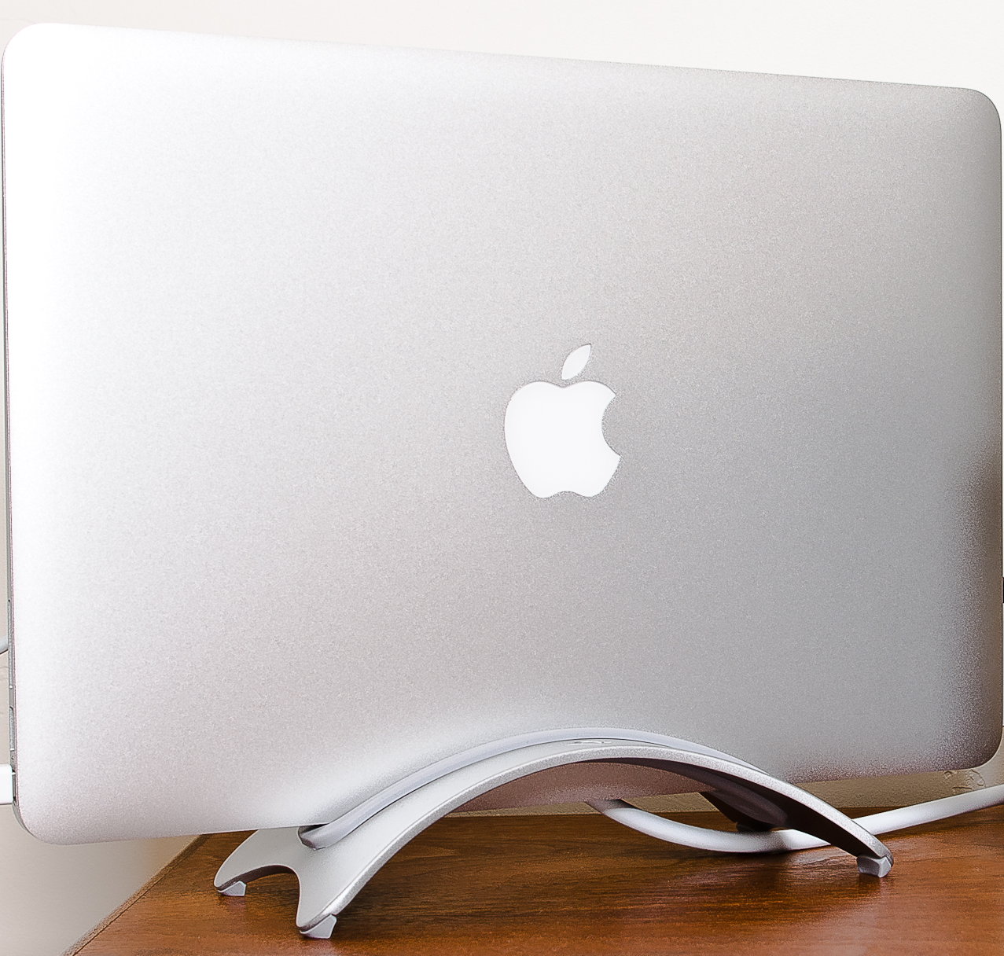
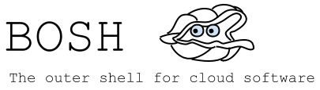
Docker Service Broker
Service Broker
https://github.com/danielkennedy/cf-broker-demo

Slide 13
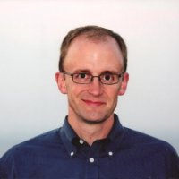
Next Steps
Jason Hunt
Continuous Delivery with CF
October 21, 2014

Slide 14
Thanks for joining us!
Next Meetup: October 21, 2014
https://github.com/danielkennedy/cf-broker-demo

