Slide 1
Educational YouTube Video Recommender
For Aspiring
Data
Professional

Slide 2
Have you ever use YouTube as an Educational Platform?

Slide 3
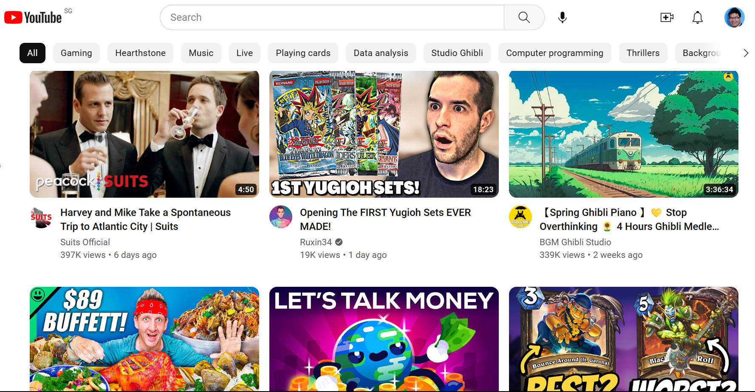
Problem 1 - Distraction

Slide 4
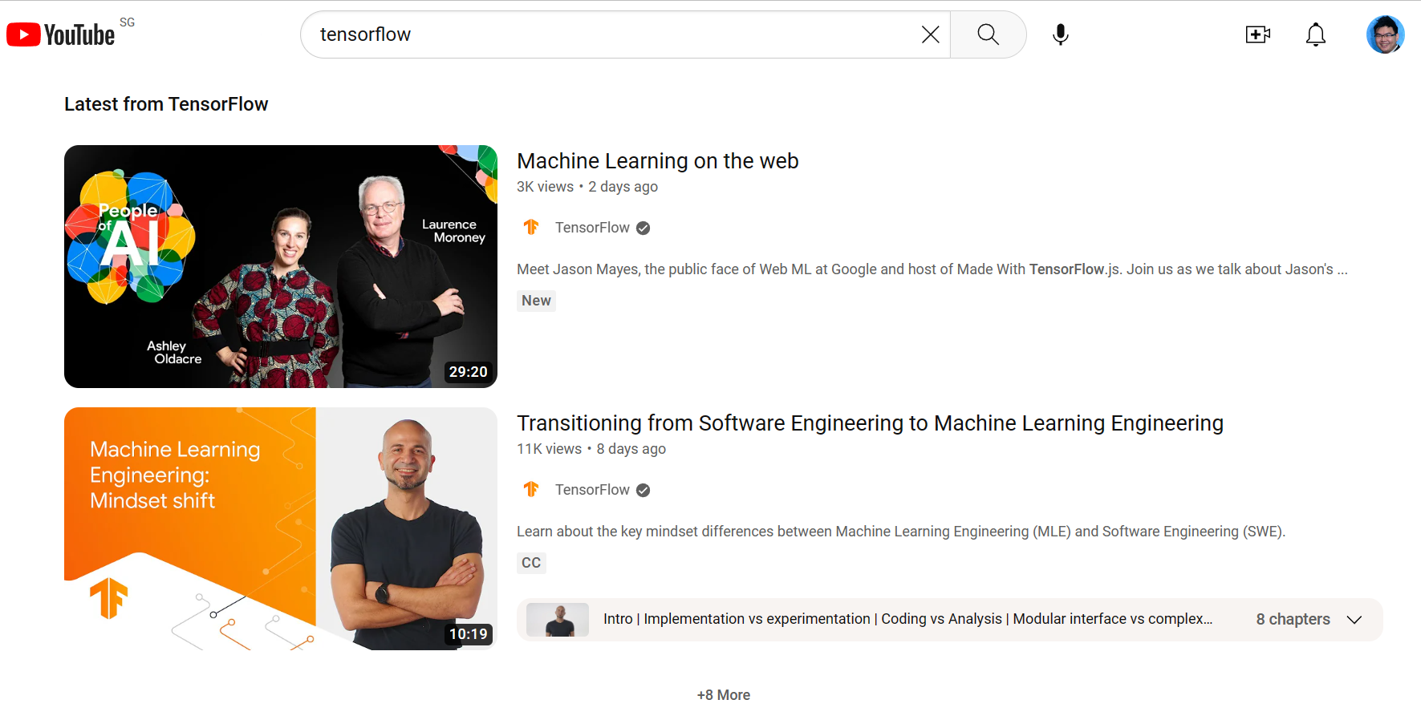

Problem 2 – Vast Choices

Slide 5
Objective
Create a library of videos published by YouTuber who are Data Professional.
Scoring system other than view count to rank the video.

Slide 6
Overview of Approach
Second Step
Fouth Step
Categorise video into Topics
Creating a Dashboard
First Step
Third Step
Curate a Library of Video
Determine the Quality of videos

Slide 7
First Step – Curating a Library
Second Step
Fouth Step
Categorise video into Topics
Creating a Dashboard
First Step
Third Step
Curate a Library of Video
Determine the Quality of videos

Slide 8
Curating a YouTube Video Library
30 YouTube Channels
Who works in various Data-related
profession
3713 Videos
Title, Publish Date, Views, Likes, Length, Description and Types
3,478 Captions
Full video content

Slide 9
Second Step – Topic Modelling
Second Step
Fouth Step
Categorise video into Topics
Creating a Dashboard
First Step
Third Step
Curate a Library of Video
Determine the Quality of videos

Slide 10
Categorise Videos into Topics
BERTopic is used to group similar YouTube together based on their Title and Caption.
It uses the BERT model, a powerful pre-trained language model developed by Google.
It works by first extracting meaningful information from the title/caption using the BERT language model.
Then applies a clustering algorithm to group the title/caption based on their semantic similarity.

Slide 11

Word Cloud For Title

Slide 12
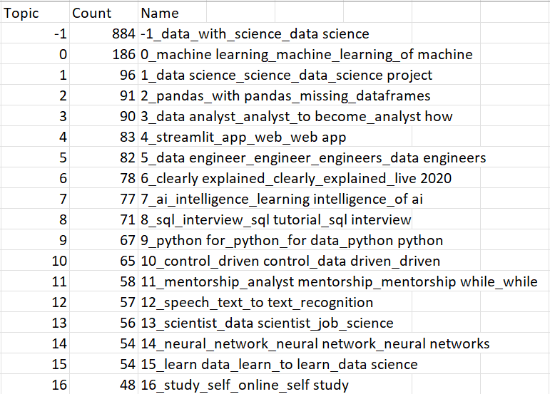
Top Topics Generated for Title using Base model

Slide 13
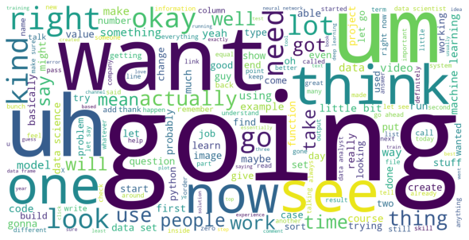
Word Cloud For Caption

Slide 14
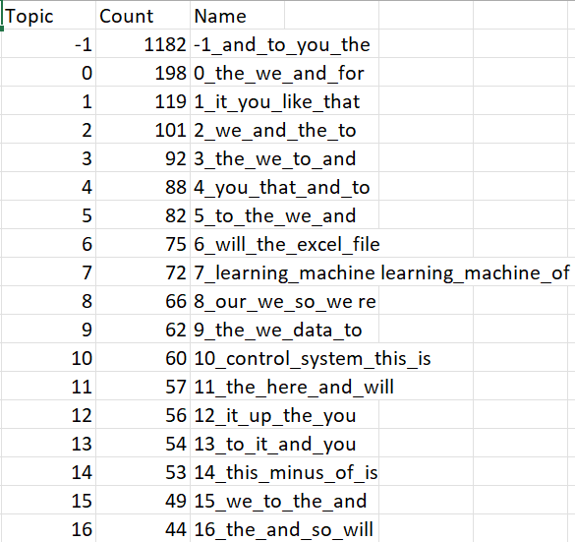
Top Topics Generated for Caption using Base model

Slide 15
Adding extra model to base BERTopic
Count Vectorizer model is included to remove stop words. Examples of stop words in English are “a,” “the,” “is,” “are,” etc
Class TFIDF model is to reduce the impact of frequent words

Slide 16
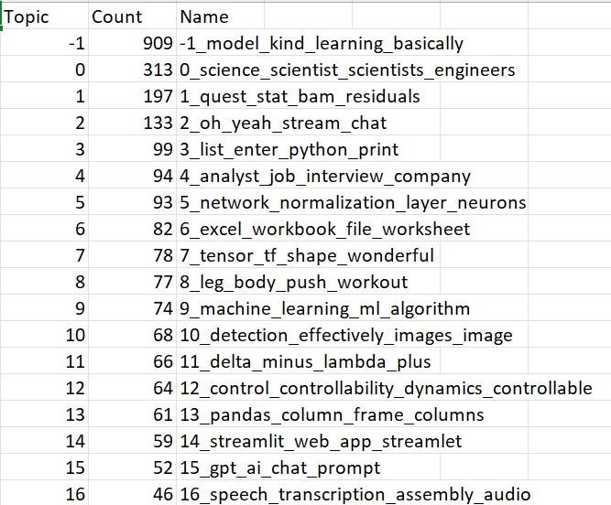
Top Topics Generated after adding extra model

Slide 17
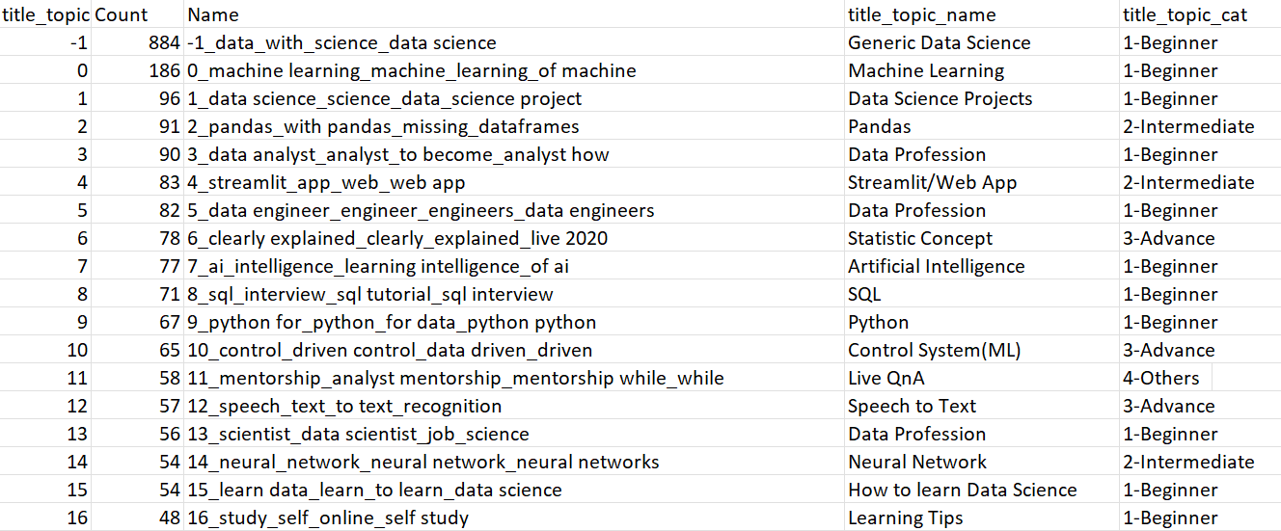
Improving Topic Interpretability by Renaming

Slide 18
Third Step – Qualifying videos
Second Step
Fouth Step
Categorise video into Topics
Creating a Dashboard
First Step
Third Step
Curate a Library of Video
Determine the Quality of videos

Slide 19
Determine the Quality of videos
Hypothesis: Higher Quality videos have a higher likes count proportional to its views
For instance, if it took 3 videos before a quality video
First 2 videos would have only gotten my view count
However, the last video would have both my view and like
Hence, videos that have actual likes higher than it predicted like will be classified as a Quality videos

Slide 20
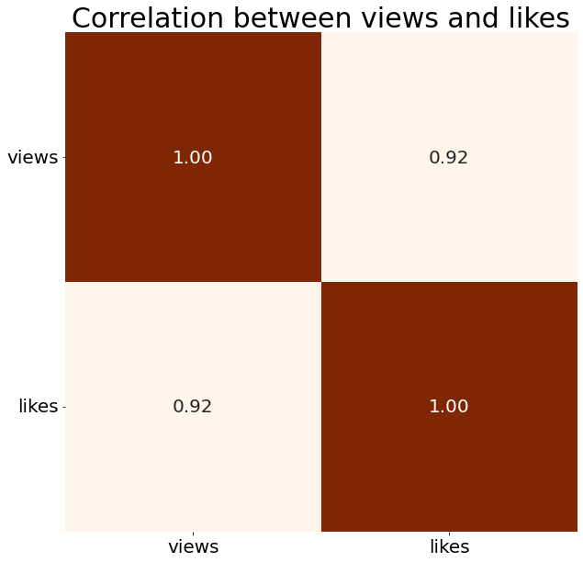
Establish the correlation between Likes and Views
Likes and Views are strongly correlated with correlation coefficient of 0.92
Hence, Views could be used to predict Likes

Slide 21
Determining the best model to predict Likes
Model | Mean Absolute Error | R-Square
Linear Regressor | 395.61 | 0.87
K-nearest neighbours | 480.69 | 0.74
Gradient Boosting Regressor | 519.96 | 0.60
Random Forest Regressor | 577.63 | 0.58
Decision Tree Regressor | 673.84 | 0.39

Slide 22
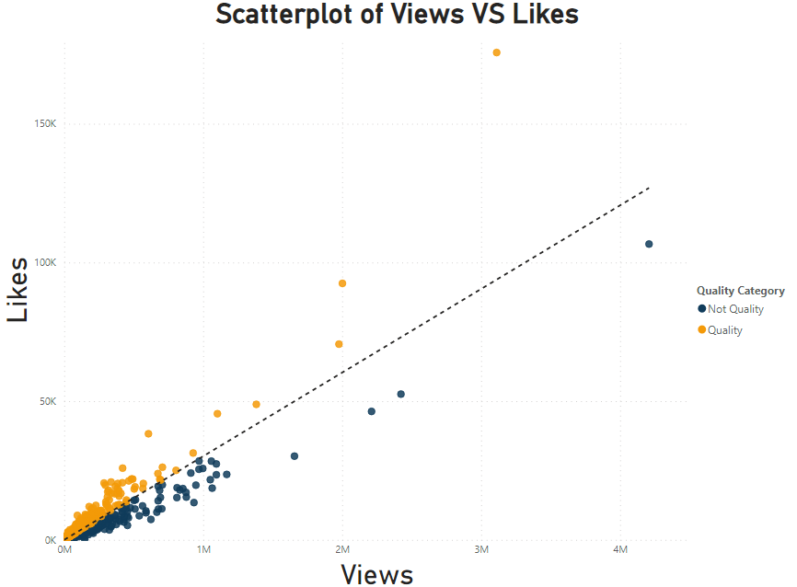
Likes = 13.17 + 0.03Views (3% of view counts
So if video have 100 views, it is predicted to have 16 likes

Slide 23
Fourth Step - Dashboard
Second Step
Fourth Step
Categorise video into Topics
Creating a Dashboard
First Step
Third Step
Curate a Library of Video
Determine the Quality of videos

Slide 24
1
Sentiment analysis
Comments of viewer are important metric determining quality
4
Channels
Future works
To increase from 30 to 80 channels
2
Improve Dashboard
Include word search function instead of drop down selection
5
Genre
Replicate for other genre E.g Cooking
3
Better Topic Model
Research and improve the Topics generated by BERTopic

Slide 25
Thank You
Credit to slidesgo for the slides design

