Slide 1
Deutsche Telekom Use Case: Unexpected Incidents with Multi-Agent Collaboration
IETF 125 Shenzhen, March 2026

Slide 2

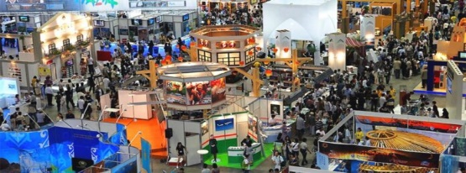
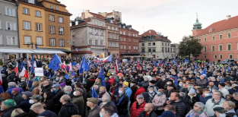
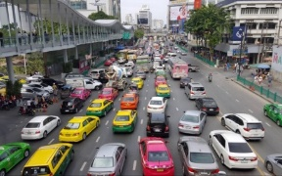
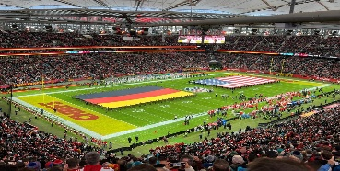

Unexpected Incidents Scenarios and Challenges
Scenarios
Challenges
Challenge 1: Perception and Prediction of Traffic Burst
Traffic Burst and Performance Degradation caused by Large number of User Access
Marathons
Traffic Jams
Sport Events
Load traffic statistics
Burst traffic
9:00
10:00
11:00
12:00
Hour
Hour-level traffic monitoring cannot capture the traffic burst occur at minute-level
Scenario1
Un-planned Events
Scenario2
Planned Events
Challenge 2: Manual Optimization is Low-efficiency for Experience Assurance/Compliant Handling
Typical Event | Accidents/Traffic Jams/... | Concerts/Sporting/…
Characteristics | unfixed time & location | Fixed time & location
Suggestion | Focus on Downlink throughput optimization | Focus on Uplink throughput optimization
Offline Tools
Data collection
Issue analysis
Solution formulation
Review and delivery
Automatic processing
Manual handling
Hours / Days

Slide 3
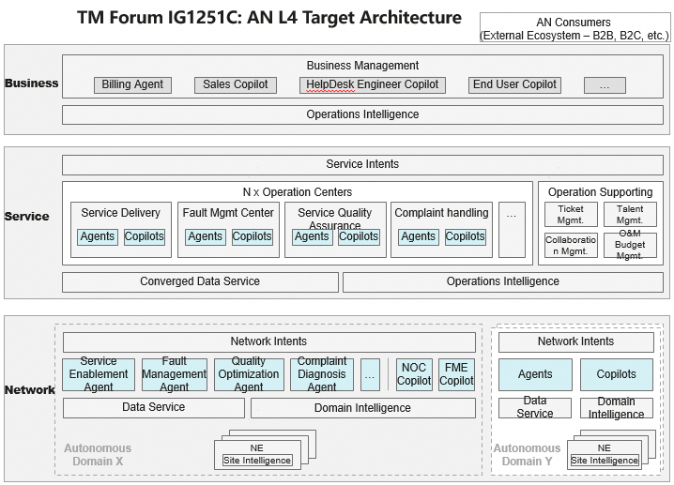
DT Agentic Architecture
Introducing agents at both service layer and network layer: Multi-vendor and multi-domain autonomy enabled by single domain autonomy
DT Agentic Architecture
Principal Agent
Service
Layer
Service Task Agent 1
(e.g. RAN Guardian)
Service Task Agent 2
…
Collaborate with multi-vendor and multi-domain agents
Domain 1
Task Agent
Domain 2
Task Agent
…
Network
Layer
Achieve single domain autonomy

Slide 4

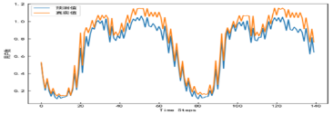
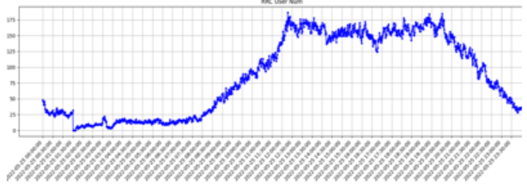

Service Experience Promotion enabled by Collaboration of Multi-layer agents
Internet data
Operation Team
Complaint
User Experience
Scenarios
DT Guardian Agent
Planned Events: 1500+ Events in Germany per year. for example, Beer Exchange, Concerts, Sports in the venue.
Un-planned Events : traffic-jam, cell out-of-service.
Event Scan
Service
Layer
Guardian Policy Decision
Opt. Policy
Decision & execution
Effect Evaluation
Guardian Target
Agent-to-Agent Communication
Values
Before Event
During Event
After Event
↓ Intent Generation
↑ Monitor and Predict
↓ Policy & Conflict decision
↑ Opt. Policy Suggestion
↓ Business Eva.
↑ Network Eva.
Realtime Perception
Realtime Optimization
Download Speed<5Mbps
Percentage*
Planned Events
Hours
foresight
Network Optimization Agent
NEM
DTRC
1-2 Hours
3 -4 Hours
Traffic Prediction
Traffic Burst Detection
Traffic Burst Optimization
Un-planned Events
~6%
Network
Layer
RF,MLB,HO,…
Minutes detection
Intra-frequency
Inter-frequency
Minutes
AS-IS
TO-BE
AS-IS
TO-BE
AS-IS
TO-BE
NE

Slide 5
Discussion

