Slide 1
AI based Network Management Agent (NMA): Concepts & Architecture
AI based Network Management Agent: Industry Direction and Standards Opportunities
Presenters:
Daniele Ceccarelli (Cisco)
Xing James Jiang (Cisco)

Slide 2
draft-zhao-nmop-network-management-agent/
Draft authors:
Xing Zhao (CAICT)
Minxue Wang (CMCC)
Bo Wu (Huawei)
Daniele Ceccarelli (Cisco)
Haomian Zheng (Huawei)
Jin Zhou (ZTE)
Background
Draft linked and presented many times in NMOP working group
Scope
This draft establishes a standardized architecture for AI Agents in Network Management (Network Management Agents - NMAs).
Goals
Define the foundational framework of the NMA.
Clarify the relationship between the NMA and existing network controllers.
Specify functional requirements for NMAs across various network scenarios, including their required interfaces.
Not Goals
Specific agent implementation details are out of scope.

Slide 3
NMA definition
NMA = AI Agents for network management = A network management entity built on ML/AI and equipped with the processing capabilities to create autonomous closed-loop.
It interacts with other components of the NM tools to: carry out network perception, do task intent interpretation, task planning, decision-making and task execution operations based on user task intentions or preset goals, so as to achieve closed-loop operations
Decisions
NMA
Insight
Action
Not replacing existing tools!!!

Slide 4
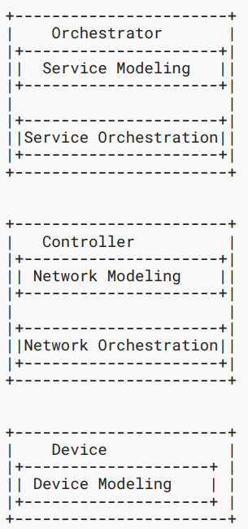
Relationship with RFC8969
RFC 8969 A Framework for Automating Service and Network Management with YANG
Relation: this draft enhances RFC 8969 with AI/ML “intelligent” capabilities
Hierarchy NMA interaction
Orchestrator
NMAs
NMAs
NMAs
NMAs
NMA can exist at both the Controller and Orchestrator levels.
Service Modeling
Service Orchestration
Inter-layer
A2A interface
Controller
NMAs
NMAs
NMAs
NMAs
Network Modeling
Network Orchestration
NMA1
NMA2
Intra-layer A2A interface
Device
End-side AI
Device Modeling
Layering and Representation withing a network operator
Enhanced intelligent network management and control framework based on NMA

Slide 5
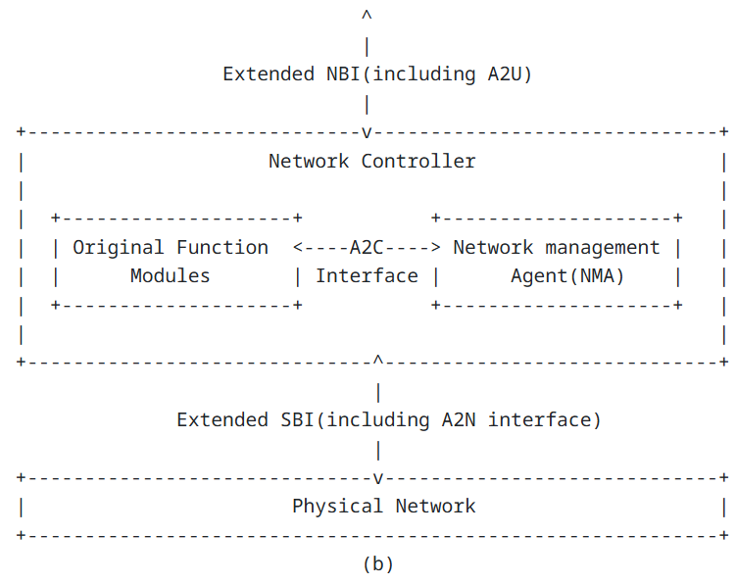
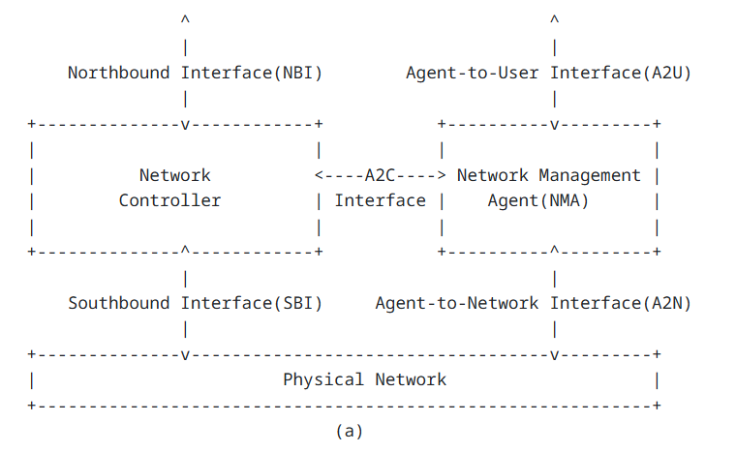
NMA interfaces – impacts of deployment models
Integrated model
Extended model

Slide 6
NMA interfaces – CHALLENGES AND OPPORTUNITIES
+ Building trust !!!!!
NBI
NMA Agentic Framework
Agent operations
Multi agent support
LLM
External NMA
LLM proxy&routing
Inter agent comm.
Data retrieval
Knowledge Graph
Knowledge Graph
Network
Controllers
Data Lakes

Slide 7
CHALLENGES AND OPPORTUNITIES
Standardization opportunities
Interfaces:
NBI (including NMA operations and NMA usage)
Agent to Agent (specific for NMA?)
Data collection (MCP? MCP for NMA?)
Are the industry protocols good enough? E.g. MCP, A2A vs A2A-T ?
Knowledge graph internal or external? Need for a standard way to feed it (NMOP)
Trust: a standardized way of measuring agent reliability/trustworthiness

Slide 8
THANK YOU

Slide 9
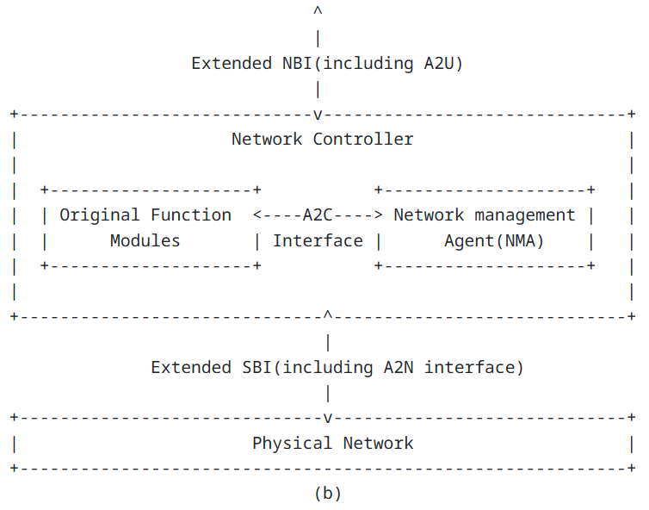
HOW the deployment mode impacts NMA interfaces
Mode a): Independent Mode
Mode b): Integrated Mode
NMA is independent from the original controllers.
A new east-west interface (A2C) needs to be added between NMA and controller to achieve capability calling and result feedback.
An intelligent southbound interface ( “A2N”) needs to be added between NMA and the physical network.
NMA interacts with users (human or other agents) through a new A2U interface (A2A interface belongs to the scope of this interface)
NMA is integrated and serves as a function of the controller.
NMA interacts with original function modules through internal A2C interface.
NMA interacts with users through extended NBI (including A2U)
The enhanced MCS interacts with underlay physical network through extended SBI (including A2N)

