Slide 1
Perceptive/Adaptive Routing A Side Meeting IETF-121 Monday 4th November 17.00 – 18.00
Xuesong Geng (gengxuesong@huawei.com)
Adrian Farrel (adrian@olddog.co.uk)

Slide 2
IETF Rules Apply
This is a side meeting, but IETF rules apply
IETF Note Well
You are contributing to IETF work
Policies on patents and code of conduct apply
Disclose relevant IPR or do not make contributions
Be respectful and courteous even/especially when you disagree
This meeting will be recorded!

Slide 3
Administrivia
Remote access via side meeting Webex
https://ietf.webex.com/meet/ietfsidemeeting2
Please stay on mute unless you are addressing the meeting
Please you the “hand raise” function to queue to speak
We are recording and will post a link when it is available
Meeting materials
Agenda and slides at https://github.com/danielkinguk/adaptive-perceptive-routing/blob/main/ietf-121-agenda.md
Minutes
We are taking notes and will post to the github after the meeting

Slide 4
Objectives of This Meeting
We want to investigate the problem space
Highly redundant networks with varying traffic demands
What are the use cases?
What are the desired behaviors?
What thought has been given to this before, and what is new?
Is there work for the IETF?
We Do Not want to spend time on detailed discussions of solutions!
We do want to work on solutions…
Later
If there is a problem to be solved
If it is in scope for the IETF
The primary purpose of the meeting is for open discussion

Slide 5
Agenda
Introduction (Xuesong and Adrian) : 5 minutes
Administrivia
Objectives of this meeting
Background (Xuesong and Adrian) : 15 minutes
Discussion of what the IETF might do (everyone) : 40 minutes
Next steps

Slide 6
Adaptive/Perceptive Routing Background

Slide 7
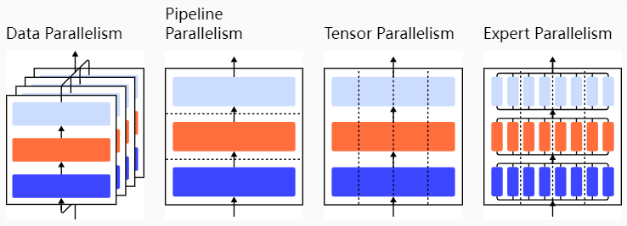
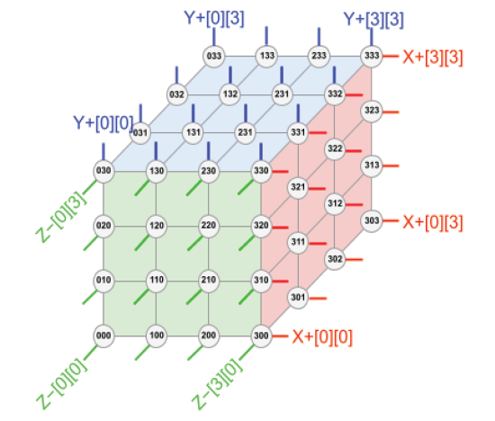
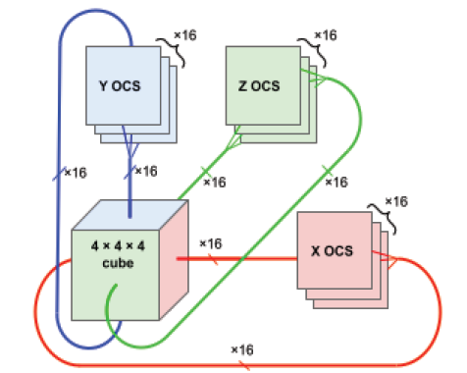
Background
Advances in DC topologies being made all the time
Enable greater resiliency and robustness
Facilitates more parallelism in complex processing tasks
Various New Network Topologies to are Introduced to the DC that could enable new applications such as AI Training
Dragonfly+
Multi-rail fat tree
3D Torus
Changes to Traffic Models (for example, for AI training)
Large Packets: Some workloads may involve the transmission of large data packets (4KB), unlike ordinary data center traffic which may consist of smaller, more frequent packets.
High Volume Traffic: Some applications (such as AI training) generates significant amounts of data (X GB data), resulting in high traffic volumes.
Fewer Flows: Specialist data centers (e.g., those built for AI) handle fewer but larger data flows, reflecting the intensive and concentrated data transfer needs of the applications.
Parallelism and Collective Communication are Powerful Tools
It also could be applicable beyond data center to inter-data center collaboration scenarios.

Slide 8
Requirements
Taking the AI Data Center Network as an example, the key challenges are:
High-Performance Interconnect
Node Interconnect: Training large AI models requires substantial data transfer. The interconnect network must support data and pipeline parallelism with bandwidth demands of 200Gbps to 400Gbps, providing high bandwidth and scale-out capability for thousands of GPUs.
High Availability
Load Balancing and Congestion: Irregular communication patterns and large single-flow traffic in AI training can lead to network congestion due to hash collision. Optimized load balancing and lossless transmission are essential.
Operations and Maintenance
Monitoring and Troubleshooting: Enhanced usability through refined monitoring, one-click fault localization, and self-healing mechanisms is crucial.
Security
Protection Measures: AI models are targets for network attacks. Ensuring data confidentiality, integrity, and protection from leaks and misuse, especially in multi-tenant environments, is vital.

Slide 9
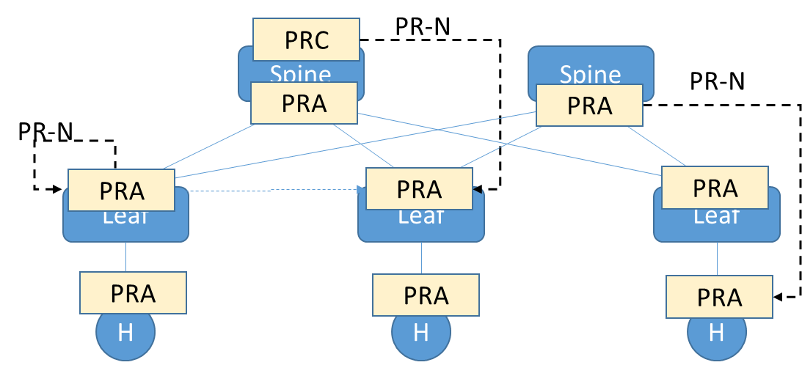
Problem Statement：A Generalized Proposal for Perceptive/Adaptive Routing for DC and also DCI
PR Sensing Node: percept local and network information for routing decisions.
PR Routing Node：use multi-dimensional sensory information to make routing decisions, including reroute, adjust speed, load balance, etc.
PR Notification：the message from PR-SN to PR-RN.
Port failure
Congestion states
Queue depth
Link SLA
…
PR-RN
Local sensing
Route
PR-SN：
Remote sensing
On path info
Bottle neck info
Topology info
…
Sense
Notify
Reroute
Congestion control
ECMP mode
Hierarchical routing
Service routing
…
PR-RN：
PR-SN
PR-N

Slide 10
Existing IETF Work
IETF drafts | Summary | Classification
draft-cheng-rtgwg-ai-network-reliability-problem | Existing route convergence methods: BFD, ECMP, FRR, BGP PIC Remote link fault response) Gap Analysis: fault detection speed, notification speed, fault switchover speed. | Gap analysis
draft-liu-rtgwg-path-aware-remote-protection | Path-aware remote protection. | Routing decision
draft-wh-rtgwg-adaptive-routing-arn | ARN (adaptive routing notification) | Notification
draft-lyu-rtgwg-coordinated-cm | Coordinated congestion mechanism: coordinate congestion control and adaptive routing | Detection + notification + Routing decision
draft-xu-idr-fare | Fully Adaptive Routing Ethernet using BGP (BGP for congestion notification) | Notification + Routing decision
draft-xu-lsr-fare | Fully Adaptive Routing Ethernet using LSR (TLV for congestion notification) | Notification + Routing decision
draft-wang-rtgwg-dragonfly-routing-problem | Gap analysis for dragonfly routing: 1. adaptive routing or valiant load-balancing may affect performance; 2. ARNs need to be standardized and routinized. | Gap analysis: notification + routing decision
draft-agt-rtgwg-dragonfly-routing | DF+ routing
draft-cheng-rtgwg-adaptive-routing-framework | Adaptive routing framework: flow and packet based solutions | Routing decision
draft-liu-rtgwg-adaptive-routing-notification | Detailed discussion of info carried by ARN. | Notification
draft-lou-rtgwg-sinc | Signaling In-Network Computing operations (SINC) | Notification + Routing decision
draft-liu-nfsv4-rocev2 | ROCEv2-based Collective Communication Offloading | Detection + notification + Routing decision
draft-przygienda-rift-adrift | Extends RIFT to carry additional link and node information | Notification + Routing Decision

Slide 11
Use Case 1：Failure Awareness for Fast Reroute
UC：Distributed training tasks require frequent, high-volume, and efficient communication. Failure-aware nodes must quickly notify and converge routes to minimize impact of network failures and prevent application performance degradation due to packet loss. BFD needs a large number of sessions for ECMP, which is not efficient.
Procedure:
Continuously Sense state changes, such as link or port failures (down)
When state changes exceed thresholds, devices send immediate Notifications to upstream devices.
Utilize failure-specific information to dynamically adjust routing decisions (switching flows to healthy paths).
2. Notify
sender
receiver
3. Route
1. Sense
p0
q0
w0
q1
q2
q3
leaf
spine
leaf

Slide 12
Use Case 2: Congestion Awareness for Load Balancing
UC：The high volume and simultaneous point-to-point communications can easily cause congestion. While network devices can quickly detect congestion using various existing technologies (e.g., CSIG/INT/IOAM), there is a lack of standardized methods to notify the ingress/source, allowing subsequent traffic to avoid congested points and leverage the multipath capability of networks to alleviate congestion.
Procedure：
1. Sense congestion information: Continuously gather congestion data (e.g., IOAM, CSIG)
2. Immediate notification right after sensing congestion: Quickly notify upstream network devices or source nodes to react to the congestion.
3. Upstream devices or source nodes promptly reroute (switch the flows to alternate paths to avoid congested points or apply proactive rate limiting).
sender
1. Sense
1. Sense
1. Sense
receiver
p0
q0
w0
q1
3. Route
q2
q3
leaf
spine
leaf
2. Notificaiton
Notes:
大量、同时的、点对点的通信容易使网络造成拥塞。网络设备利用现有诸多技术可以快速感知拥塞，但缺乏标准方法来通告ingress使得后续流量避开拥塞点，通过CLOS组网里的多路径能力来缓解拥塞。
强调快速、及时的通告，由上游网络设备/源端第一时间进行路径的切换，避免流量经过拥塞点，甚至可以主动进行速率限制。

Slide 13
Use Case 3: Service Awareness for In-Network Computing
UC: Switches naturally sit at the center of a network, and thus can aggregate information with less data transmission. Offloading collective communication operations such as AllReduce to the network can significantly improve the efficiency of AI training.
Current in-network computing method:
xPUs that need to perform a communication operation send request to switches or controller;
Switches or controller build an aggregation tree based on the request(s) and allocate resources;
Root switch or controller notify the xPUs to send data;
INC switches aggregate data from child nodes and send to parent node.
Root switch distribute the aggregated result to all relevant xPUs.
3. Routing
Analysis：
Sense: xPUs sense job information and resource requirement.
Notification: xPUs send aggregation requests to switches or controller.
Route: INC switches build aggregation trees based on the request, and then aggregate and route the data packets based on the structure of the aggregation tree.
2. Notification
1. sense

Slide 14
Use Case 4：Service Awareness for Routing method differentiation
UC: A network could use multiple strategies to send a flow. For example, the network could use packet spraying to achieve better load balance at the cost of reordering; Or the network could send all packets of a flow on the same path to preserve packet order. For different types of flows, the optimal strategy may be different. However, network clusters usually could only employ one routing strategy at a time, as the strategy need to be configured on each device.
Proposal:
Packets carry info of preferred routing strategy
Network devices employ corresponding strategy
1. Sense
2. Notification
3. Route
sender
receiver
leaf
spines
leaf
QP
s1
QP
Procedure：
Sense: Sender or TOR senses the characteristics of a flow and decide the best routing strategy.
Notification: Routing strategy info is carried in data packets throughout the network path.
Route: Network devices then route packets based on the routing strategy information, allowing the network to employ different strategies for different types of flows.
spray
payload
s2
s3
s4
sender
receiver
No-spray
payload
leaf
spines
leaf
QP
s1
QP

Slide 15
Open Discussion

Slide 16
Questions to Think About
Do we agree on the problem space?
Is there IETF work to be done?
Why/how is this different from RFC 3286 (https://datatracker.ietf.org/doc/rfc2386/)?
Do implementations in the data centre care about interop or is this secret sauce?
What might be the deliverables?
Is it "just" tweaking existing protocols?
Does it need a new place (working group) to do the work?
Who else should be involved in these discussions?

Slide 17
Next Steps?

Slide 18
Possible Next Steps
Post some notes from this meeting
Post the link to the recording
If there is enough interest to discuss this further…
Ask for a mailing list
If the document authors have shared ideas…
Consolidate and advance the drafts
Multiple and overlapping drafts are not very helpful
If there is potential work to do and we can find focus
Plan for a BoF in Bangkok

